Slide 1

AI EXPLAINED, PLAIN AND SIMPLE — LESSON 4
What Is a
"Skill"?
An agent already has a goal, tools, and memory. A skill is how it gets a brand-new, reusable capability bolted on — without rebuilding the agent from scratch.
Notes:
HOOK (0:00-0:20). You've met Agent, Model, and Memory. But how does an agent actually learn to do something new — summarize meeting notes, format a report a specific way, follow a house style? It doesn't get smarter on its own. Someone packages that capability once, as a Skill, and clips it on. Let's unpack what a Skill actually is.

Slide 2
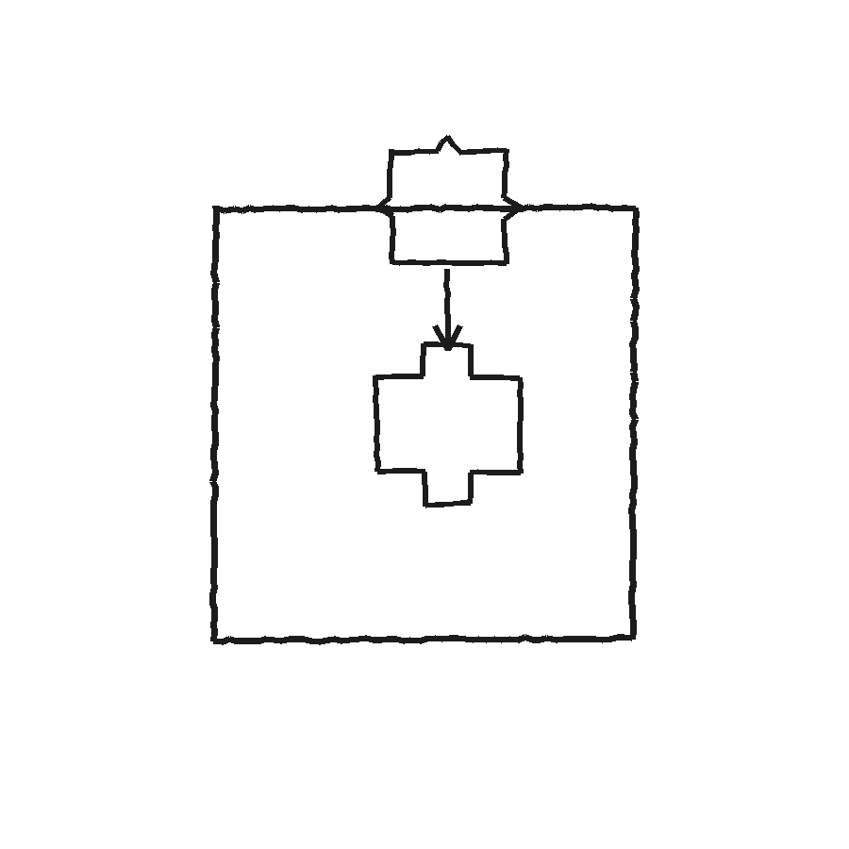
THE EVERYDAY DEFINITION
A packaged capability that snaps in
A Skill is a reusable set of instructions for one job. You don't retrain the agent — you attach the Skill, like a puzzle piece into a matching slot.
Built once, reused on many tasks
Snaps onto an existing agent, doesn't replace it
The agent still has its own goal, tools, and memory underneath
Notes:
(0:20-0:55) A Skill is a packaged, reusable capability — written once, then attached to an agent instead of retraining it. Think of a puzzle piece with exactly the right shape for one job, snapping into a slot the agent already has. The agent's core goal, tools, and memory don't change; it just gained one more specific thing it knows how to do well.

Slide 3
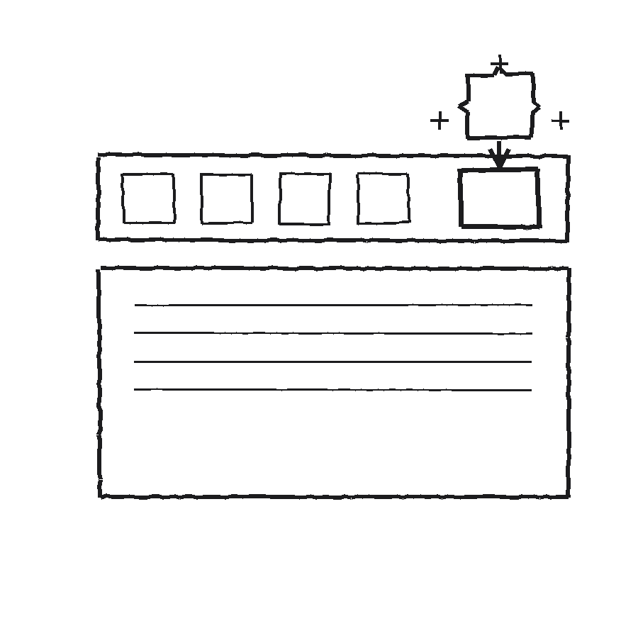
ANALOGY 1 — OFFICE SUITE
Like installing a Word add-in
Word doesn't ship knowing how to format a legal citation a specific way. You install a citation add-in once, and a new button appears on the ribbon — in every document, from then on.
Add-in: one new button, works everywhere in the app
Skill: one new capability, works on every task the agent gets
Neither one required rewriting the core app
Notes:
(0:55-1:30) You already know this pattern from Word or Excel add-ins. Word doesn't come knowing how to format a legal citation a particular way — you install a citation add-in once, and a new button shows up on the ribbon, available in every document after that. A Skill works the same way for an agent: install it once, and the capability is just there from now on, without anyone rewriting the agent's core.

Slide 4
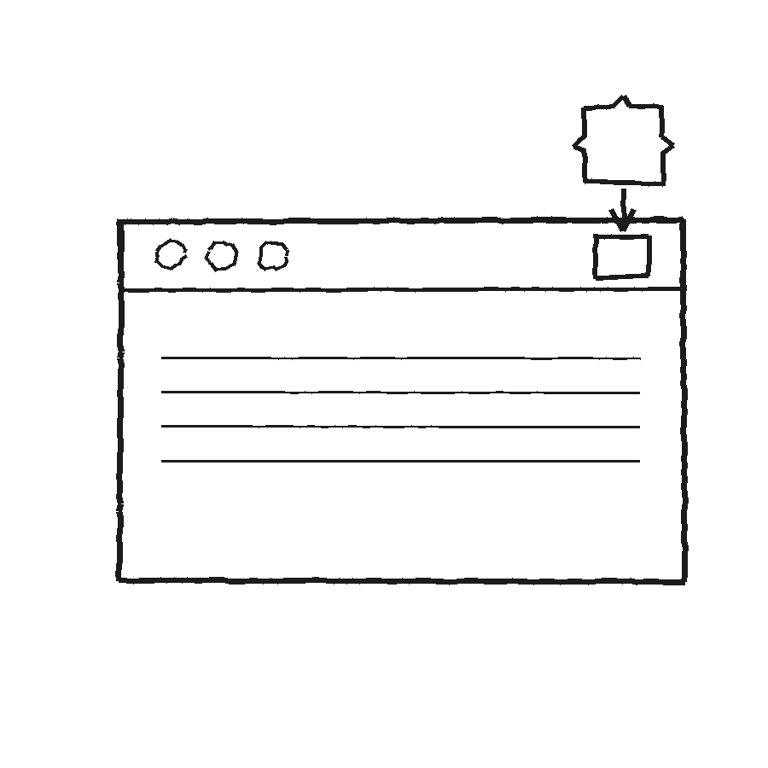
ANALOGY 2 — WEB BROWSER
Like adding a browser extension
A grammar-checker extension doesn't rebuild the browser. Install it once, and it quietly works on every site you visit from then on — a new capability layered on top.
Extension: install once, works across every tab
Skill: attach once, works across every relevant task
Notes:
(1:30-1:55) Same idea with a browser extension. A grammar-checker extension doesn't touch the browser's underlying code — you install it once, and now it quietly checks your spelling on every site, forever, without you doing anything else. A Skill sits on an agent the same way: install once, benefit every time the task calls for it.

Slide 5
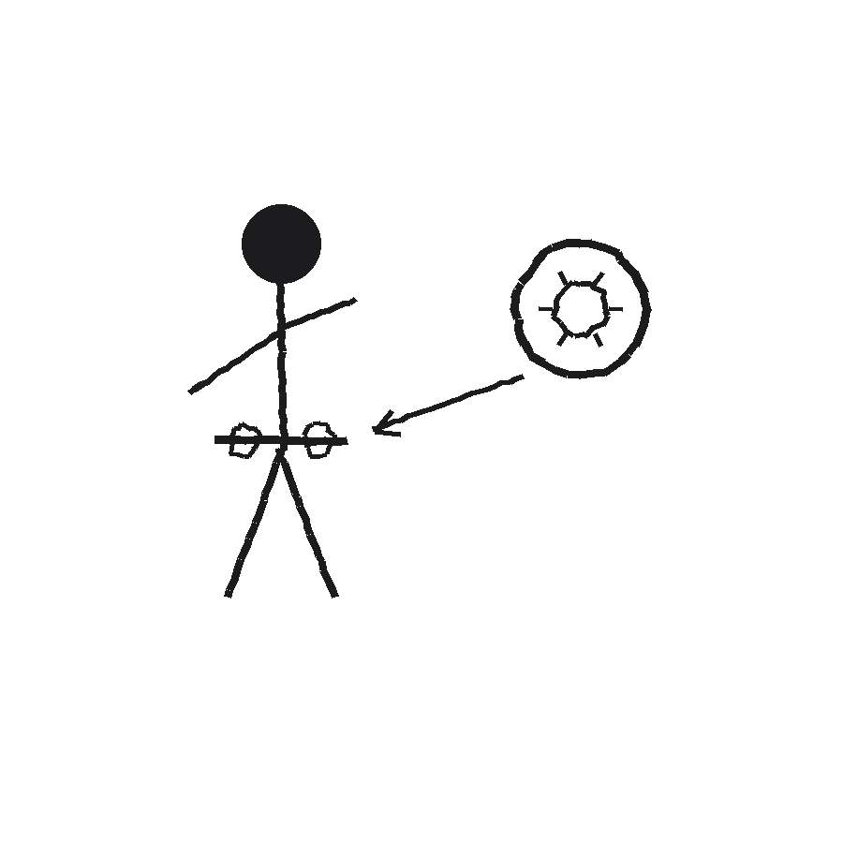
ANALOGY 3 — EVERYDAY TASK
Like learning to change a tire
You don't retrain as a driver to learn this. You add one specific, reusable skill to your toolkit — and pull it out only when the situation actually calls for it.
You stay the same driver you were before
The skill sits ready, used only when relevant
Notes:
(1:55-2:15) Or think about learning how to change a tire. You don't retrain as a driver from scratch — you're the same driver, plus one specific, reusable capability now sitting in your toolkit, ready for the one situation where it actually applies. That's exactly the shape of a Skill: narrow, reusable, bolted on.

Slide 6
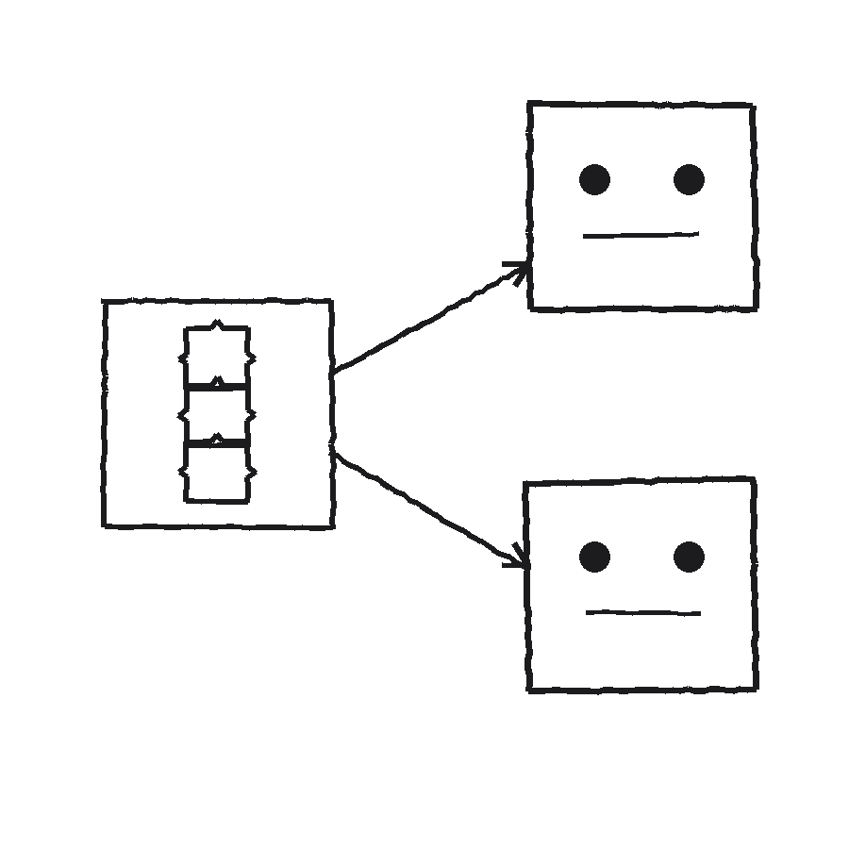
SEE IT IN A REAL TOOL
Mistral Studio's Skills catalog
Mistral Studio lets you build a Skill once — say, 'turn meeting notes into action items' — and attach that exact same Skill to several different agents, instead of re-writing the instructions inside each one.
Build the Skill once, in its own definition
Attach it to Agent A and Agent B, unchanged
Update the Skill once — every agent using it benefits
Notes:
(2:15-2:50) Here's what this looks like in a real product: Mistral Studio has an actual Skills catalog alongside its Models and Agents. You build a Skill once — for example, 'turn raw meeting notes into a clean action-item list' — and you can attach that same Skill to more than one agent. Update the Skill later, and every agent using it picks up the improvement, without you touching each agent individually.

Slide 7
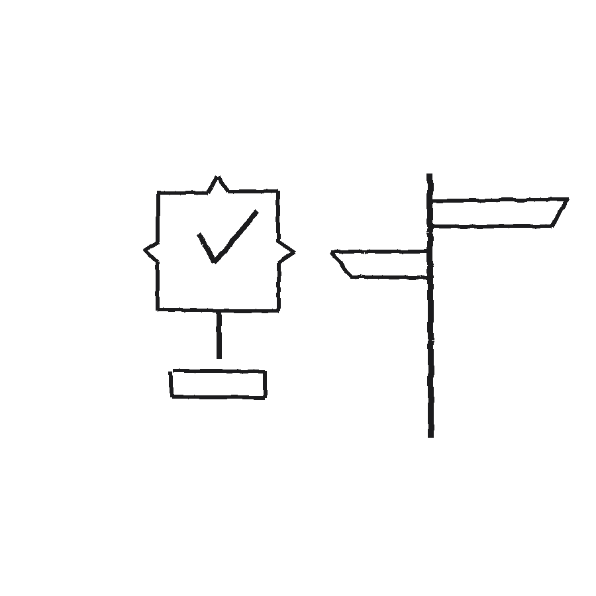
RECAP
Skill = one
reusable capability,
bolted on
Covered so far: Agent, Model, Memory, Skill (Lessons 1-4). Next up: Hook — the trigger that runs something automatically. Also queued: Workflow, JSON, Python.
Notes:
(2:50-3:15) Recap: a Skill is a packaged, reusable capability you attach to an agent, the way an add-in bolts a new button onto Word's ribbon or an extension adds a capability to every browser tab. The agent's own goal, tools, and memory stay the same underneath. Covered so far: Agent, Model, Memory, Skill. Next up: Hook — what actually triggers an agent or a skill to run in the first place. Also queued: Workflow, JSON, Python.

