Slide 1
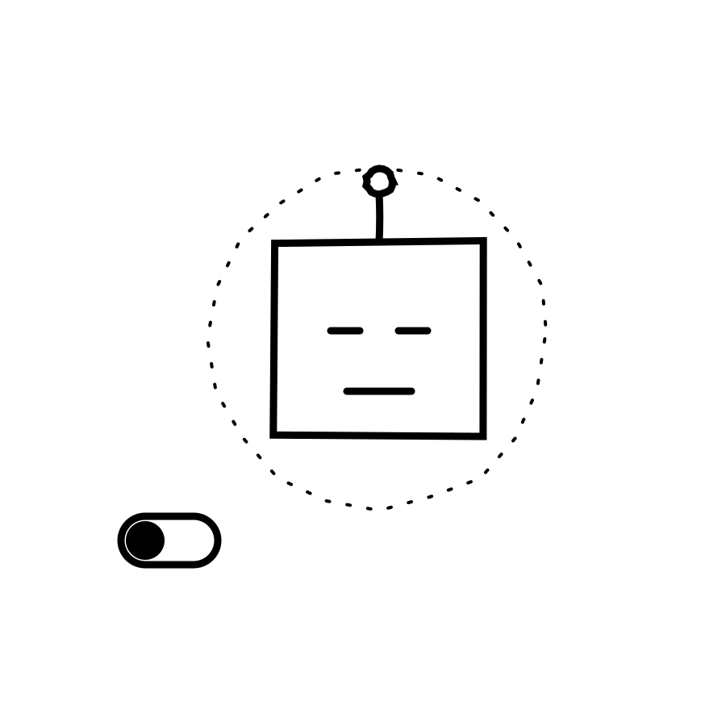
AI EXPLAINED, PLAIN AND SIMPLE — LESSON 5
What Is a
"Hook"?
None of Agent, Model, Memory, or Skill do anything until something flips the switch. A Hook is what tells them to start — automatically.
Notes:
HOOK (0:00-0:20). You've met Agent, Model, Memory, and Skill. But none of them do anything until something tells them to start. So what actually flips the switch? That's called a Hook — and it's simpler than it sounds.

Slide 2
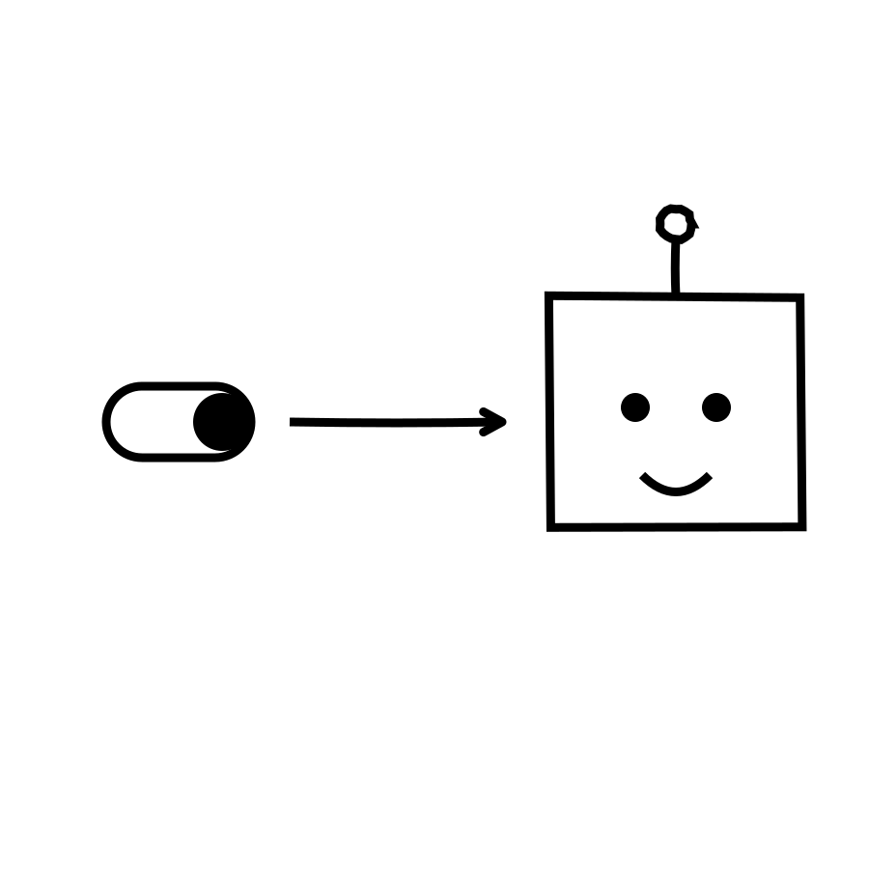
THE EVERYDAY DEFINITION
A standing rule that fires itself
A Hook is a rule: when a specific thing happens, automatically run this — no person needs to be watching or clicking “go.”
Wired to an event, not to a person remembering
Fires the instant the condition is true
Decides WHEN an agent runs, not what it does
Notes:
(0:20-0:55) A Hook is a standing rule: when a specific thing happens, automatically run this — no person needs to be watching or clicking 'go.' Think of a light switch wired to a motion sensor instead of a hand: the light doesn't wait to be asked, it just reacts the instant the condition is met.

Slide 3
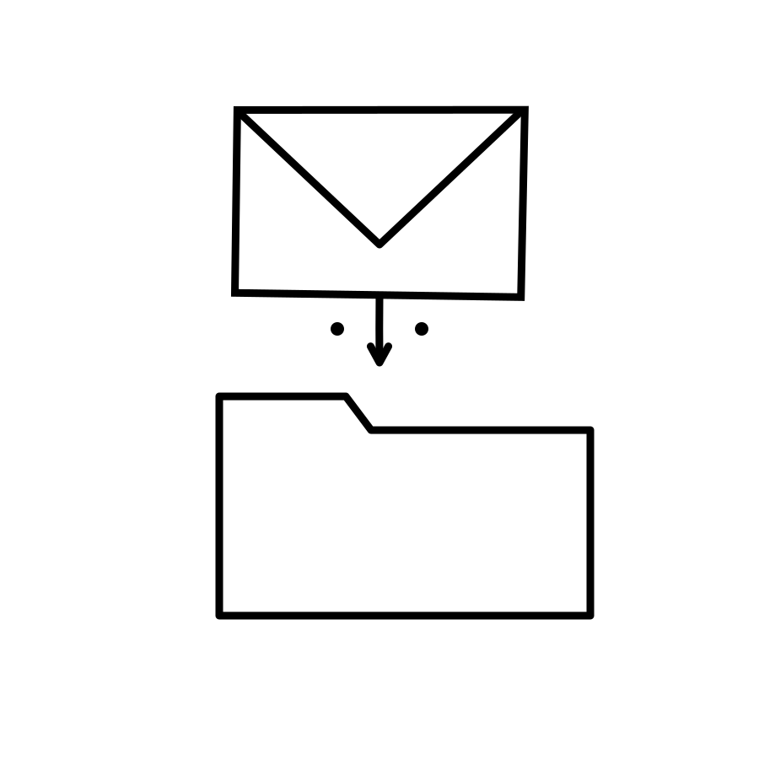
ANALOGY 1 — OFFICE SUITE
Like an inbox rule
Gmail or Outlook doesn't decide in the moment. You set a rule once — “if sender is X, file it here” — and it fires silently, every time, forever.
Rule: set once, works on every future email
Hook: set once, works on every future trigger
Neither needs a person re-deciding each time
Notes:
(0:55-1:30) You already use this pattern in your inbox. Gmail or Outlook rules: 'if the sender is my accountant, move it to the Finance folder' — you set that once, and it silently fires every single time, forever, with nobody re-deciding it. A Hook is that same standing rule, just pointed at an agent instead of a folder.

Slide 4
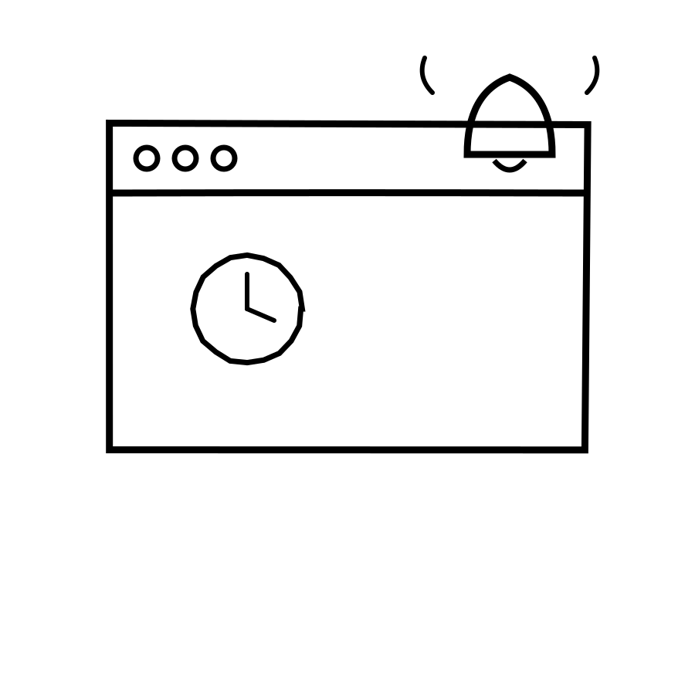
ANALOGY 2 — WEB BROWSER
Like a calendar reminder
A calendar app doesn't wait for you to check it. It's wired to a clock, and the reminder pops up automatically at the moment you set — nobody has to be watching.
Reminder: wired to a clock, fires on its own
Hook: wired to an event, fires on its own
Notes:
(1:30-1:55) Same idea with a calendar reminder or a browser notification. You don't sit there watching the clock — you set the time once, and the reminder pops up by itself the moment it's due. The trigger is wired to an event, not to you remembering to check.

Slide 5
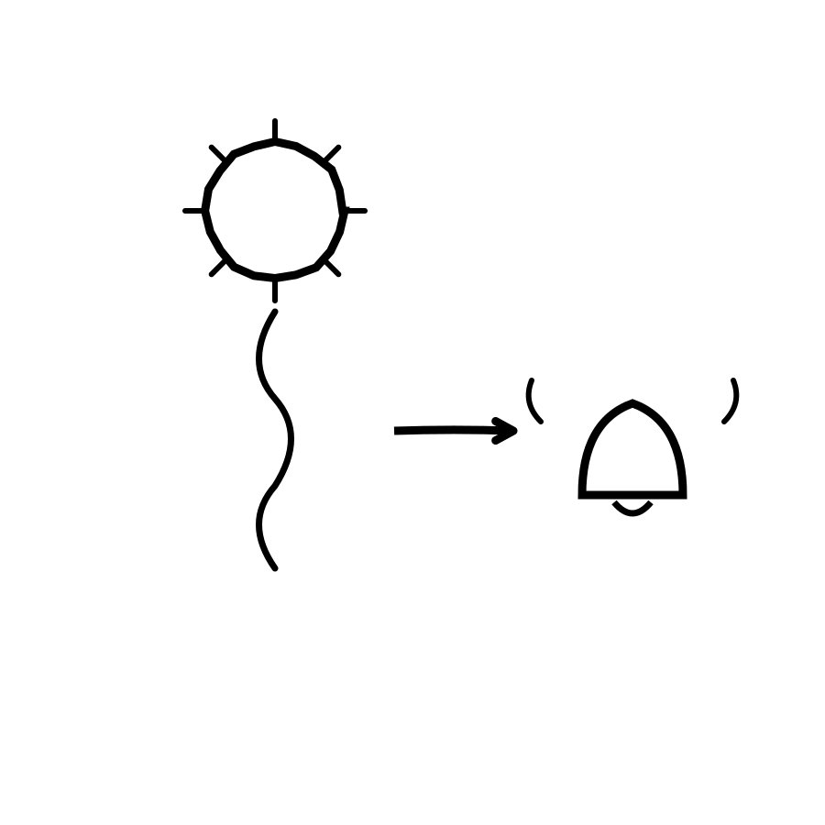
ANALOGY 3 — EVERYDAY TASK
Like a smoke detector
It does nothing for months — until smoke actually reaches it, and then it rings immediately, with zero human deciding to sound the alarm.
Silent until the real condition is met
Instant the moment it is — no delay, no asking
Notes:
(1:55-2:20) Or the clearest version: a smoke detector. It does nothing for months — until smoke actually reaches it, and then it rings immediately, with zero human in the loop deciding to sound the alarm. That's a Hook in its purest form: silent until the trigger condition is true, instant once it is.

Slide 6
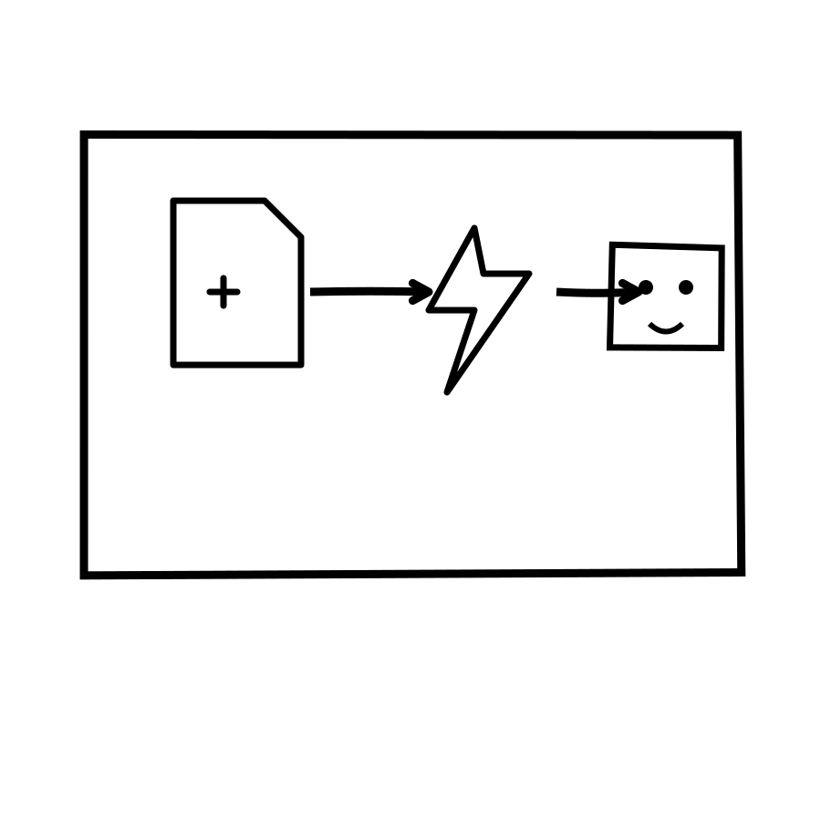
SEE IT IN A REAL TOOL
Mistral Studio's automatic triggers
There's a real difference between typing into a chat to start an agent, and wiring that same agent to run on its own — say, whenever a new file lands in a connected library, or on a fixed schedule.
Event happens — a file arrives, a time is reached
The Hook fires, no person involved
The agent runs automatically, goal and tools unchanged
Notes:
(2:20-2:50) Here's what this looks like in a real product: the difference between an agent you manually start by typing into a chat, versus one wired to run automatically — whenever a new file lands in a connected document library, or on a fixed schedule. That automatic wiring, the 'when this happens, run the agent' setting, is the Hook. You configure it once; after that, it just runs.

Slide 7
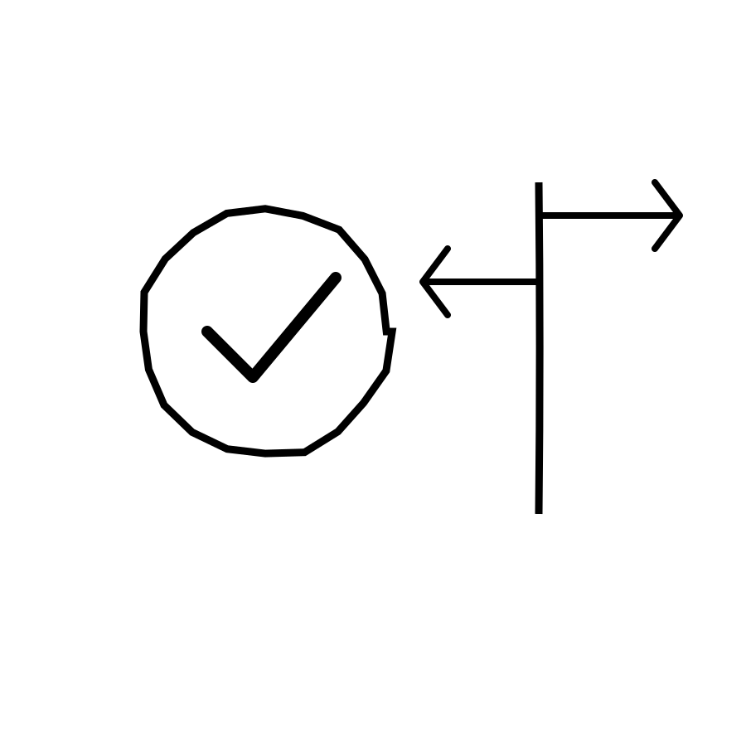
RECAP
Hook = a standing
trigger rule
Covered so far: Agent, Model, Memory, Skill, Hook (Lessons 1-5). Next up: Workflow — chaining several triggers and steps into one automatic sequence. Also queued: JSON, Python.
Notes:
(2:50-3:15) Recap: a Hook is a standing 'when this happens, do that' rule — an inbox filter, a calendar reminder, and a smoke detector are all the same idea. It's what turns an agent from something you have to ask, into something that's already watching. Covered so far: Agent, Model, Memory, Skill, Hook. Next up: Workflow — how several of these steps get strung together into one automatic sequence. Also queued: JSON, Python.

