Slide 1
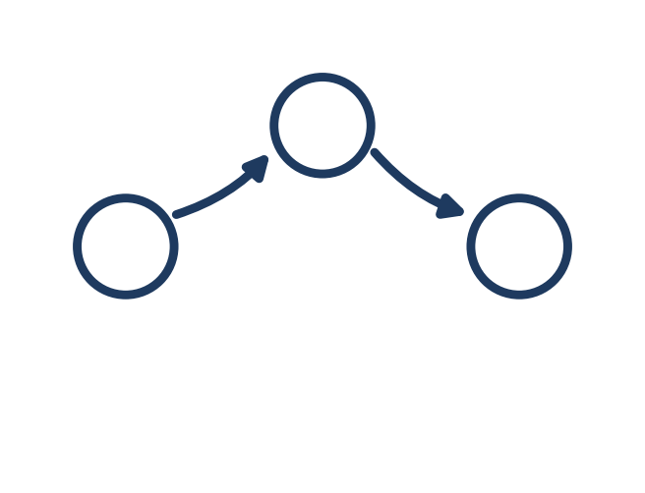
AI EXPLAINED, PLAIN AND SIMPLE — LESSON 6
What Is a
"Workflow"?
Agent, Model, Memory, Skill, and Hook have all been one piece acting alone. A Workflow is what strings several of them together — automatically.
Notes:
You've met Agent, Model, Memory, Skill, and Hook. Every one of those, so far, has been one piece acting alone. But what happens when a trigger needs to set off several pieces, in order, without you babysitting each handoff? That's a Workflow.

Slide 2
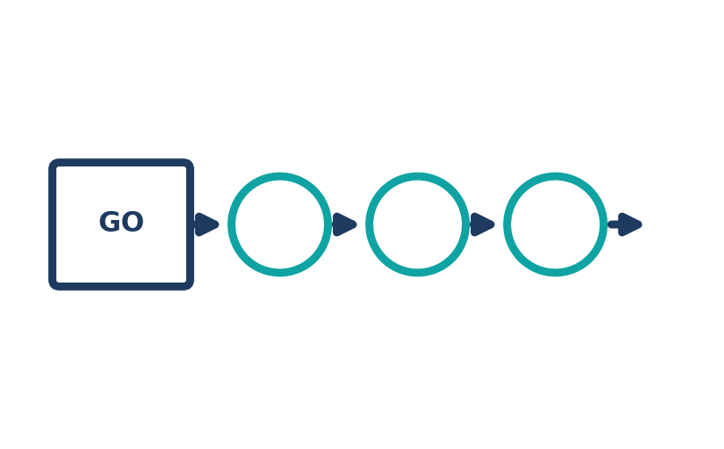
THE EVERYDAY DEFINITION
A saved chain that runs itself
A Workflow is a sequence: step one finishes, its result feeds step two, from one starting trigger — no person re-clicking "go" in between.
Chains Hooks, Agents, and Skills together
One trigger runs the whole sequence
Decides WHAT RUNS NEXT AFTER WHAT, not what any single piece does
Notes:
A Workflow is a saved sequence: step one finishes, its result feeds step two, step two finishes, its result feeds step three, all from one starting trigger, with no person re-clicking 'go' in between. It's not a new kind of building block; it's the wiring between the blocks you already know.

Slide 3
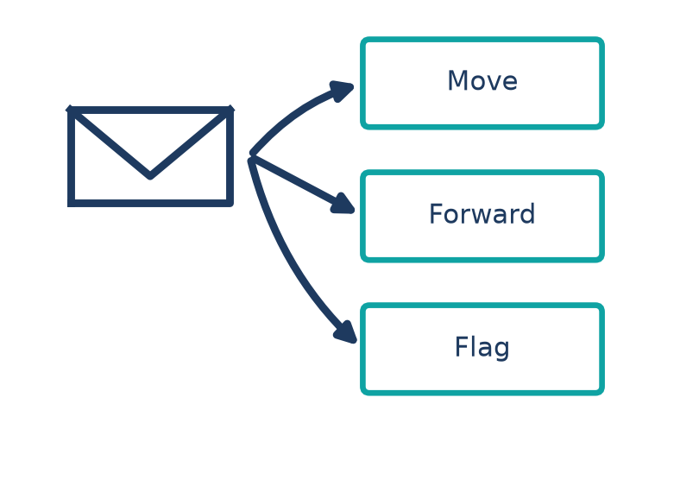
ANALOGY 1 — OFFICE SUITE
Like a chained inbox rule
Outlook doesn't stop at one action per rule. Set it once: move it, AND forward it, AND flag it, AND create a follow-up task.
A basic rule: one trigger, one action
A Workflow: one trigger, several chained actions
Same order, every time, no re-clicking between them
Notes:
You've probably seen the seed of this in Outlook. A basic rule does one thing, move a message. But you can chain actions onto a single rule: if the sender is my accountant, move it to Finance, AND forward it to my bookkeeper, AND flag it, AND create a follow-up task. Four actions, one trigger, always the same order. That's a Workflow in miniature, already sitting in your inbox settings.

Slide 4
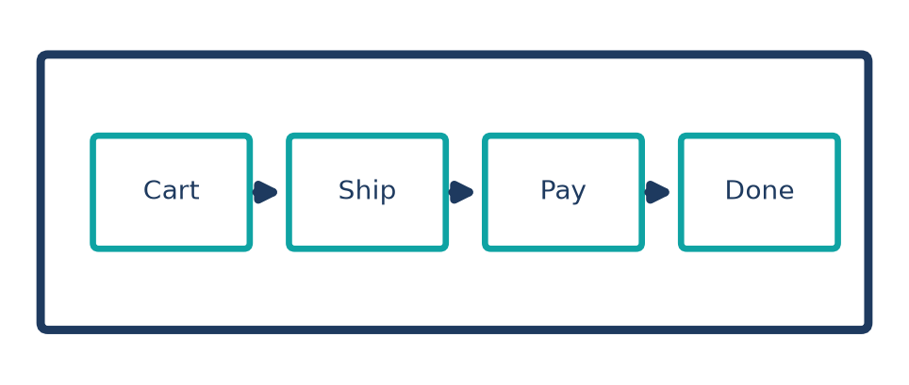
ANALOGY 2 — WEB BROWSER
Like an online checkout
Cart hands off to shipping, shipping hands off to payment, payment hands off to confirmation — nothing re-entered.
Each step's output feeds directly into the next step
No manual restart between pages
Workflow: the same handoff, between Agents and Skills
Notes:
Think about any online checkout. Cart hands off to shipping. Shipping hands off to payment. Payment hands off to confirmation. You never re-enter your address on the payment page, each step's output is already sitting there, waiting, because the pages are chained. A Workflow chains Agents and Skills the exact same way.

Slide 5
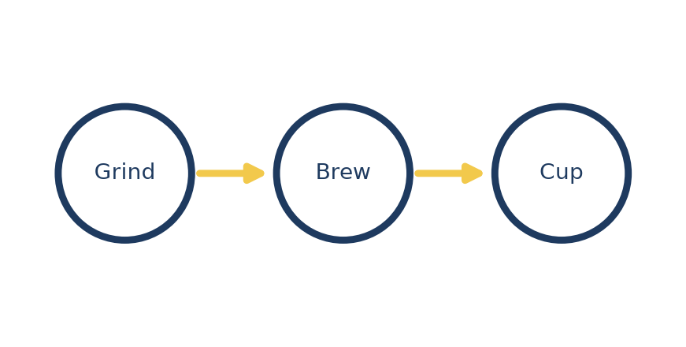
ANALOGY 3 — EVERYDAY TASK
Like a coffee maker's brew button
Press once, and grind, brew, and keep-warm happen in order — nobody operates three separate machines.
One press, several ordered stages
Each stage starts only when the last one finishes
That's a workflow, already in your kitchen
Notes:
Simplest of all: a coffee maker with one 'brew' button. Press it once, and grind, brew, and keep-warm happen in order, each starting only when the last one finishes. You don't operate three machines, you press one button and walk away.

Slide 6
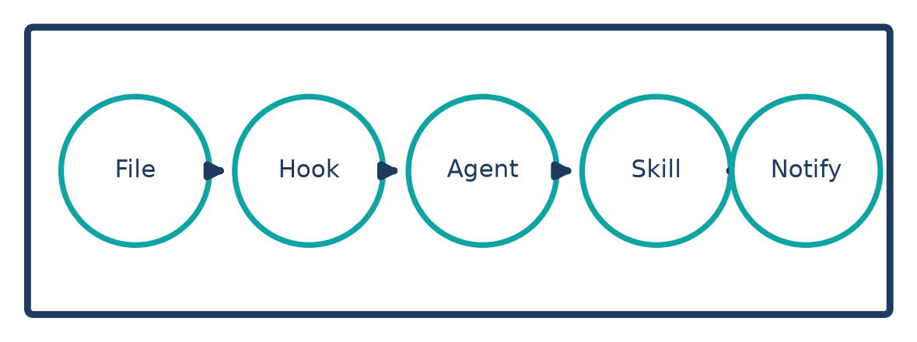
SEE IT IN A REAL TOOL
Mistral Studio's chained pipelines
A new file triggers a Hook, which starts an Agent, which calls a Skill to format it, then notifies you — all from one trigger.
File arrives → the whole chain runs itself
Configured once, in order
Agent, Skill, and Hook stay unchanged — just wired together
Notes:
In Mistral Studio, this is what turns a single automation into a real pipeline: a Hook notices a new file lands in a connected library, that triggers an Agent to draft a summary, the Agent calls on a Skill to format it correctly, and a final step notifies you it's ready, all chained from that one file arriving. You configure the chain once, in order; after that, one trigger runs the whole thing.

Slide 7
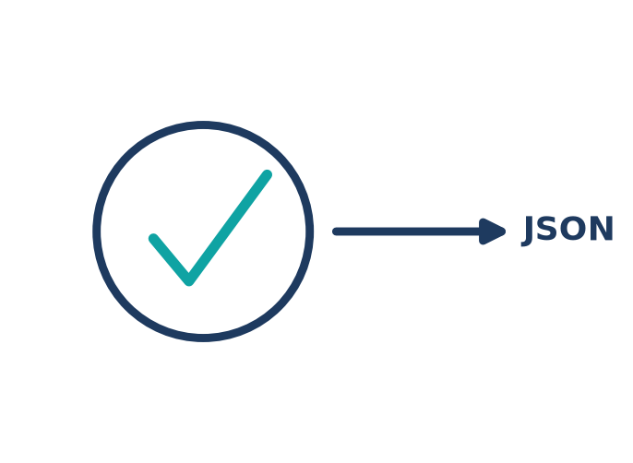
RECAP
Workflow = the wiring
between the blocks
Covered so far: Agent, Model, Memory, Skill, Hook, Workflow (Lessons 1-6). Next up: JSON — the format the steps actually pass to each other. Also queued: Python.
Notes:
So: a Workflow is a saved chain of steps, Hooks, Agents, Skills, where one trigger sets off the whole sequence, each step handing its result to the next. Next time: JSON, the plain-text format almost every one of these tools uses to actually pass that data between steps.

