Slide 1

BITE-SIZED PHOTOGRAPHY TUTORIALS
Photography Fundamentals
Seven core ideas — gamma, contrast, brightness, sharpness, the tone curve,
exposure, and automation — explained in plain language.
Hands-on examples in DxO PhotoLab • Adobe Lightroom • Adobe Photoshop
Includes hand-drawn doodled diagrams and speaker notes for self-study or teaching.
Notes:
User notes: This deck is designed to be taught or self-studied one concept per slide. Each slide follows the same rhythm — definition, visual, then a practical tip — so it can be presented in any order. DxO PhotoLab is used as the running example tool alongside Lightroom and Photoshop because its Smart Lighting / ClearView Plus / DeepPRIME features map directly onto these concepts.

Slide 2
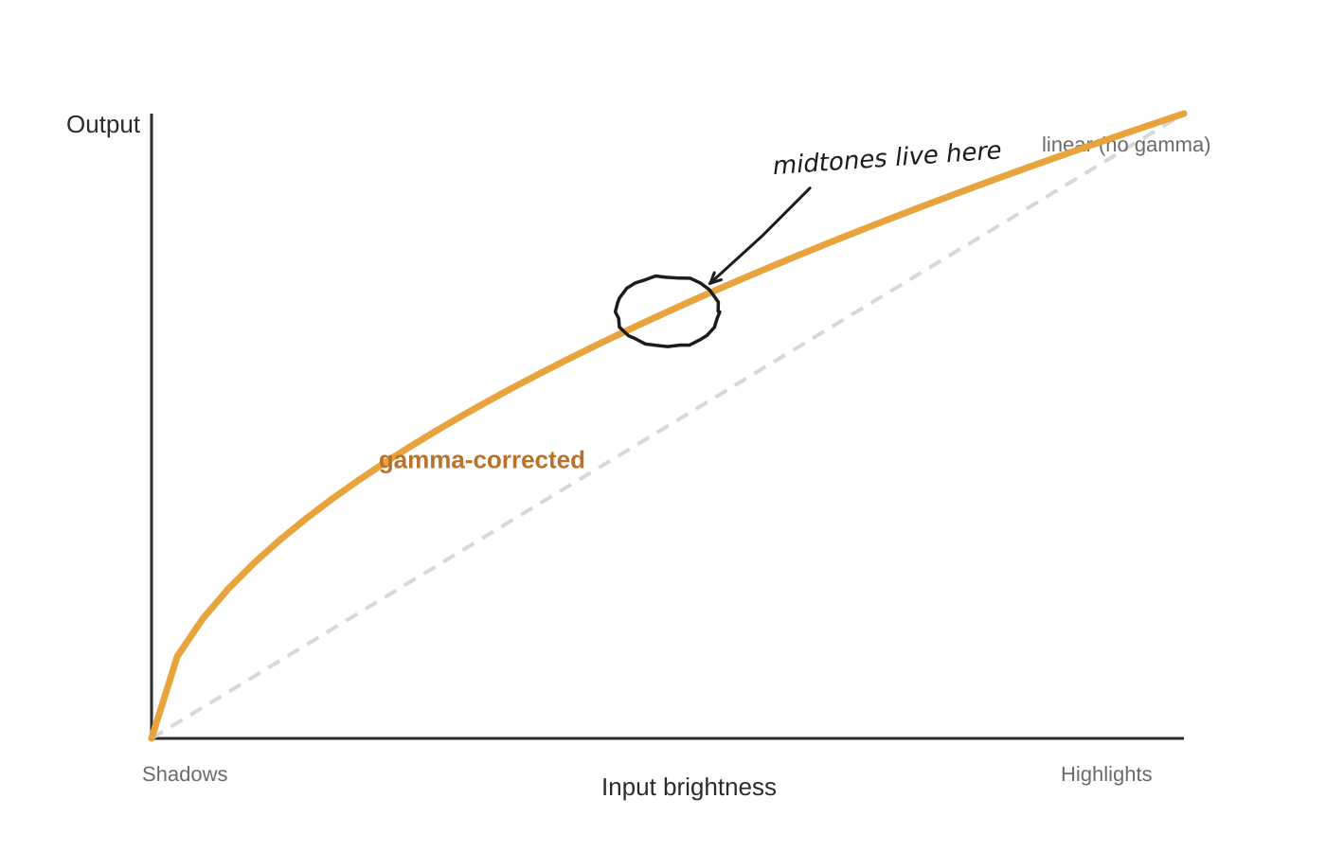
1
CONCEPT 1 OF 7
Gamma
WHAT IT MEANS
Gamma is the curve that translates the light your camera's sensor records into the brightness values you actually see on screen. Because sensors capture light in a straight line but our eyes don't perceive brightness that way, gamma correction bends that line so midtones look natural instead of murky or washed out. You'll rarely set a “gamma number” yourself — it's baked into how every camera and screen renders an image.
Try it now
TIP
DxO PhotoLab: gamma is part of each camera's built-in color rendering — fine-tune how midtones feel with the Selective Tone sliders instead. Lightroom / Photoshop (Camera Raw): nudge the Midtones region of the Tone Curve panel if photos look flat or too harsh straight out of camera.
1 / 7
Notes:
Gamma — speaker / user notes: • Definition: Gamma is the curve that translates the light your camera's sensor records into the brightness values you actually see on screen. Because sensors capture light in a straight line but our eyes don't perceive brightness that way, gamma correction bends that line so midtones look natural instead of murky or washed out. You'll rarely set a “gamma number” yourself — it's baked into how every camera and screen renders an image. • Practical tip: DxO PhotoLab: gamma is part of each camera's built-in color rendering — fine-tune how midtones feel with the Selective Tone sliders instead. Lightroom / Photoshop (Camera Raw): nudge the Midtones region of the Tone Curve panel if photos look flat or too harsh straight out of camera. • Reminder: demo this live in DxO PhotoLab (or Lightroom/Photoshop) before moving on — let learners drag the slider themselves. • Common beginner mistake: adjusting this in isolation without checking the histogram/zoomed view first.

Slide 3
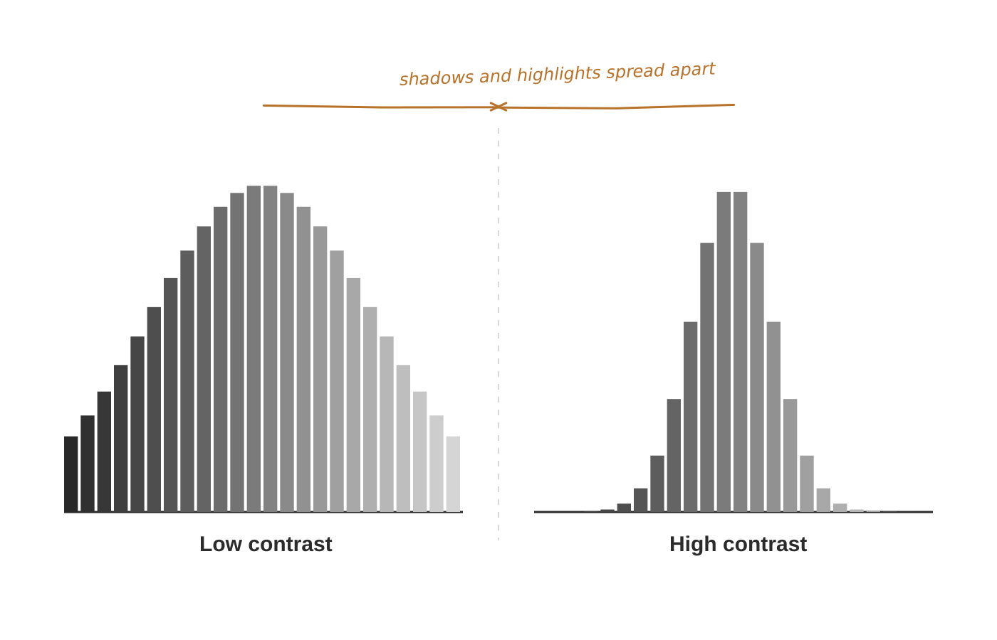
2
CONCEPT 2 OF 7
Contrast
WHAT IT MEANS
Contrast is the gap between the darkest and lightest tones in a photo. Push it up and shadows go deeper while highlights get brighter, giving a punchy, graphic look; pull it down and everything sits closer to the middle for a soft, hazy look.
Try it now
TIP
DxO PhotoLab: the Contrast slider (under Smart Lighting) adjusts this globally, while ClearView Plus removes haze-related low contrast in landscapes. Lightroom / Photoshop: drag the Contrast slider, or for finer control, bend the Tone Curve into a gentle “S” shape.
2 / 7
Notes:
Contrast — speaker / user notes: • Definition: Contrast is the gap between the darkest and lightest tones in a photo. Push it up and shadows go deeper while highlights get brighter, giving a punchy, graphic look; pull it down and everything sits closer to the middle for a soft, hazy look. • Practical tip: DxO PhotoLab: the Contrast slider (under Smart Lighting) adjusts this globally, while ClearView Plus removes haze-related low contrast in landscapes. Lightroom / Photoshop: drag the Contrast slider, or for finer control, bend the Tone Curve into a gentle “S” shape. • Reminder: demo this live in DxO PhotoLab (or Lightroom/Photoshop) before moving on — let learners drag the slider themselves. • Common beginner mistake: adjusting this in isolation without checking the histogram/zoomed view first.

Slide 4
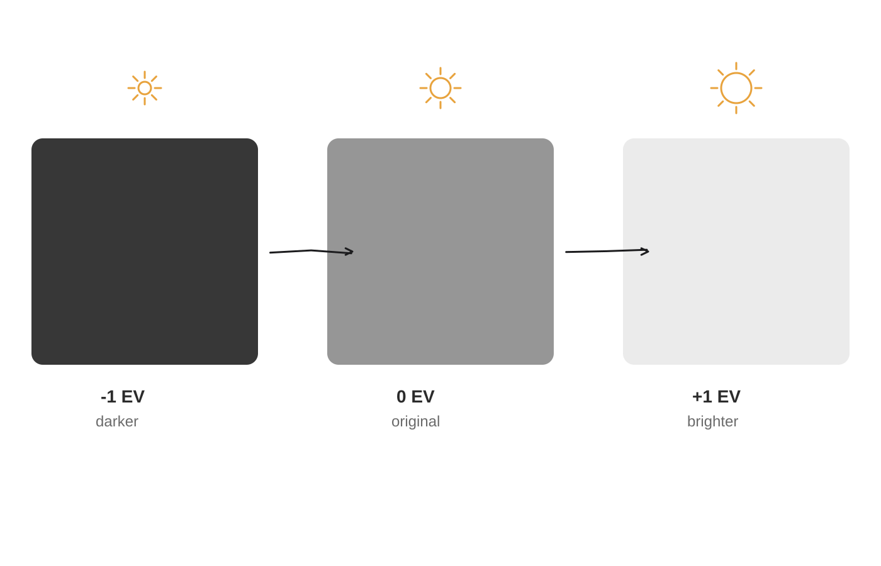
3
CONCEPT 3 OF 7
Brightness
WHAT IT MEANS
Brightness is how light or dark the whole photo looks, top to bottom. Raising it lifts every tone together — shadows, midtones and highlights all move up at once, like turning up a dimmer switch on a room. It's the simplest adjustment, but pushing too far washes out highlights and flattens detail.
Try it now
TIP
DxO PhotoLab: the Smart Lighting slider lifts brightness while protecting highlights automatically. Lightroom / Photoshop: start with Exposure for an overall lift, then use Brightness in small steps (about 0.1–0.3) since it moves the whole image at once.
3 / 7
Notes:
Brightness — speaker / user notes: • Definition: Brightness is how light or dark the whole photo looks, top to bottom. Raising it lifts every tone together — shadows, midtones and highlights all move up at once, like turning up a dimmer switch on a room. It's the simplest adjustment, but pushing too far washes out highlights and flattens detail. • Practical tip: DxO PhotoLab: the Smart Lighting slider lifts brightness while protecting highlights automatically. Lightroom / Photoshop: start with Exposure for an overall lift, then use Brightness in small steps (about 0.1–0.3) since it moves the whole image at once. • Reminder: demo this live in DxO PhotoLab (or Lightroom/Photoshop) before moving on — let learners drag the slider themselves. • Common beginner mistake: adjusting this in isolation without checking the histogram/zoomed view first.

Slide 5
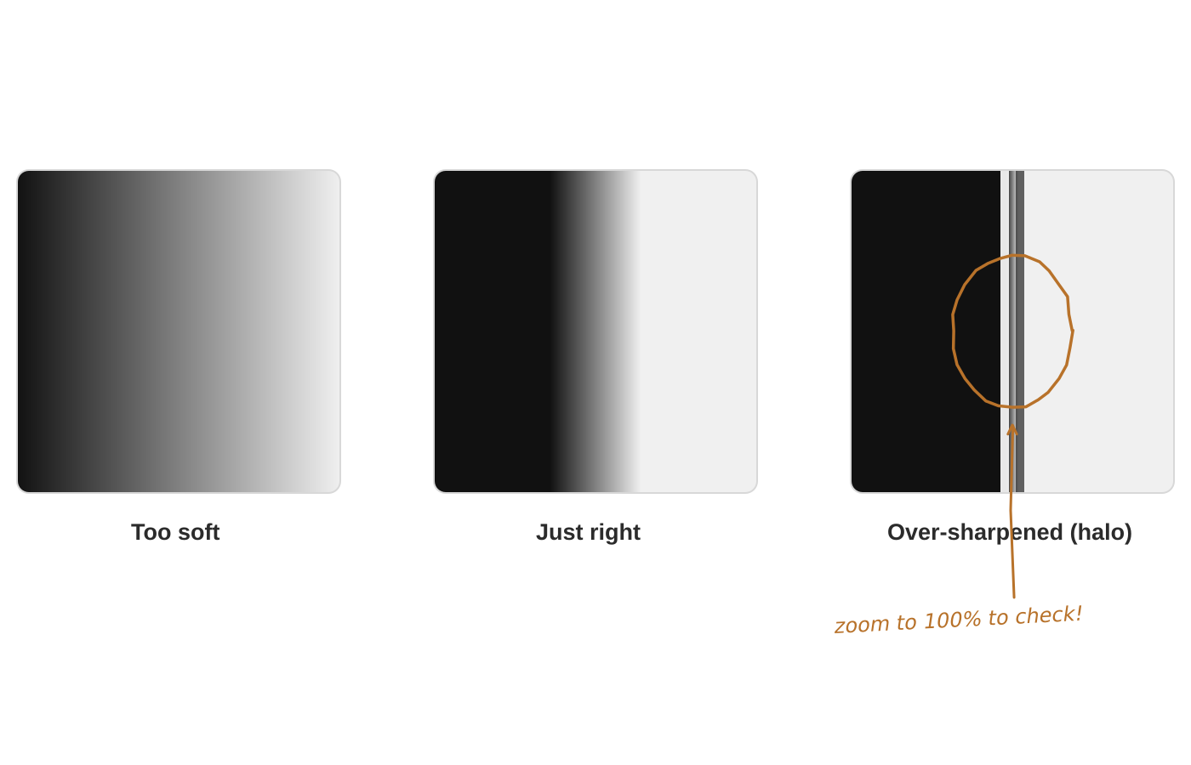
4
CONCEPT 4 OF 7
Sharpness
WHAT IT MEANS
Sharpness is how crisply fine details and edges appear — hair strands, text, leaf veins. Too little looks soft and out of focus; too much creates harsh outlines with a bright/dark fringe around edges, an effect called “haloing.”
Try it now
TIP
DxO PhotoLab: DeepPRIME (or the Lens Sharpness module) corrects lens softness automatically per lens profile — add Unsharp Mask on top only if needed. Lightroom / Photoshop: use the Detail panel or Smart Sharpen with a small radius (~1px), and always check at 100% zoom before judging it.
4 / 7
Notes:
Sharpness — speaker / user notes: • Definition: Sharpness is how crisply fine details and edges appear — hair strands, text, leaf veins. Too little looks soft and out of focus; too much creates harsh outlines with a bright/dark fringe around edges, an effect called “haloing.” • Practical tip: DxO PhotoLab: DeepPRIME (or the Lens Sharpness module) corrects lens softness automatically per lens profile — add Unsharp Mask on top only if needed. Lightroom / Photoshop: use the Detail panel or Smart Sharpen with a small radius (~1px), and always check at 100% zoom before judging it. • Reminder: demo this live in DxO PhotoLab (or Lightroom/Photoshop) before moving on — let learners drag the slider themselves. • Common beginner mistake: adjusting this in isolation without checking the histogram/zoomed view first.

Slide 6
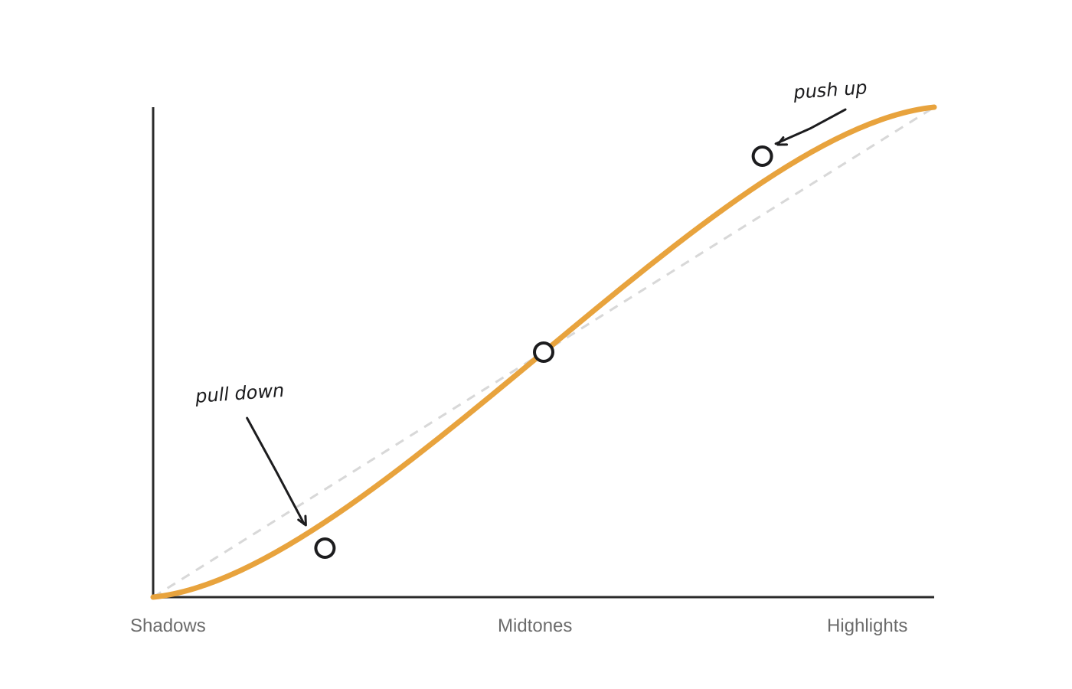
5
CONCEPT 5 OF 7
The Tone Curve
WHAT IT MEANS
The tone curve is a graph that lets you reshape brightness at every level individually — shadows, midtones, and highlights each get their own adjustment point, instead of one slider moving everything equally. Pulling the shadow end down and pushing the highlight end up (an “S” shape) is the classic way to add rich, natural contrast.
Try it now
TIP
DxO PhotoLab: the Tone Curve palette works exactly like this — click and drag points directly on the graph. Lightroom's Tone Curve panel and Photoshop's Curves adjustment layer work the same way; try a gentle S-curve as your very first move on any photo.
5 / 7
Notes:
The Tone Curve — speaker / user notes: • Definition: The tone curve is a graph that lets you reshape brightness at every level individually — shadows, midtones, and highlights each get their own adjustment point, instead of one slider moving everything equally. Pulling the shadow end down and pushing the highlight end up (an “S” shape) is the classic way to add rich, natural contrast. • Practical tip: DxO PhotoLab: the Tone Curve palette works exactly like this — click and drag points directly on the graph. Lightroom's Tone Curve panel and Photoshop's Curves adjustment layer work the same way; try a gentle S-curve as your very first move on any photo. • Reminder: demo this live in DxO PhotoLab (or Lightroom/Photoshop) before moving on — let learners drag the slider themselves. • Common beginner mistake: adjusting this in isolation without checking the histogram/zoomed view first.

Slide 7
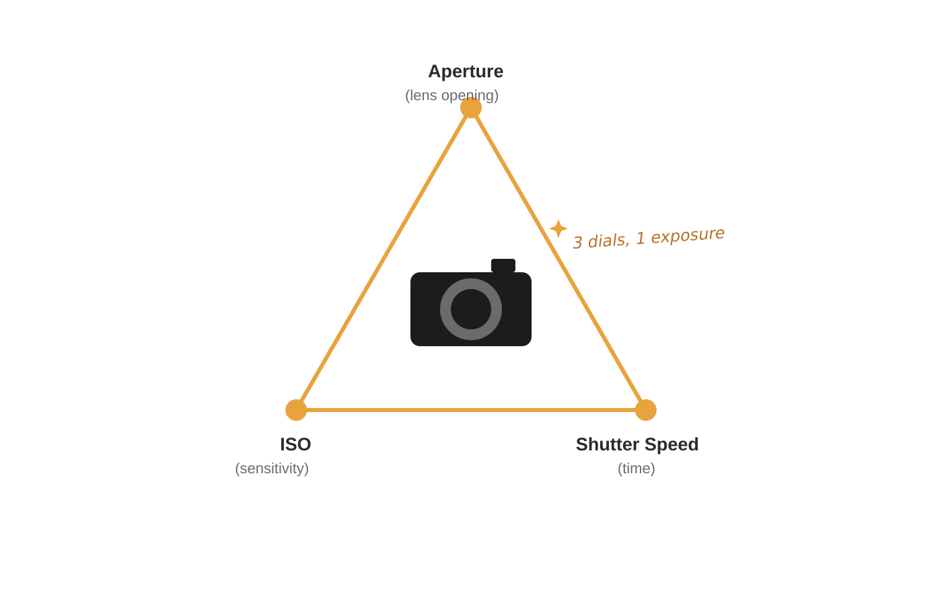
6
CONCEPT 6 OF 7
Exposure
WHAT IT MEANS
Exposure is the total amount of light that reaches your camera's sensor, controlled by three settings working together: aperture (how wide the lens opens), shutter speed (how long light hits the sensor), and ISO (how sensitive the sensor is). Balance them well and detail survives in both shadows and highlights; get it wrong and detail is lost to solid black or pure white.
Try it now
TIP
DxO PhotoLab: Smart Lighting (HSP technology) recovers shadow and highlight detail from RAW files after the fact. Lightroom / Photoshop (Camera Raw): use Exposure for overall level, then Highlights/Shadows to rescue clipped detail — trust the histogram over your screen, which can mislead in a bright room.
6 / 7
Notes:
Exposure — speaker / user notes: • Definition: Exposure is the total amount of light that reaches your camera's sensor, controlled by three settings working together: aperture (how wide the lens opens), shutter speed (how long light hits the sensor), and ISO (how sensitive the sensor is). Balance them well and detail survives in both shadows and highlights; get it wrong and detail is lost to solid black or pure white. • Practical tip: DxO PhotoLab: Smart Lighting (HSP technology) recovers shadow and highlight detail from RAW files after the fact. Lightroom / Photoshop (Camera Raw): use Exposure for overall level, then Highlights/Shadows to rescue clipped detail — trust the histogram over your screen, which can mislead in a bright room. • Reminder: demo this live in DxO PhotoLab (or Lightroom/Photoshop) before moving on — let learners drag the slider themselves. • Common beginner mistake: adjusting this in isolation without checking the histogram/zoomed view first.

Slide 8
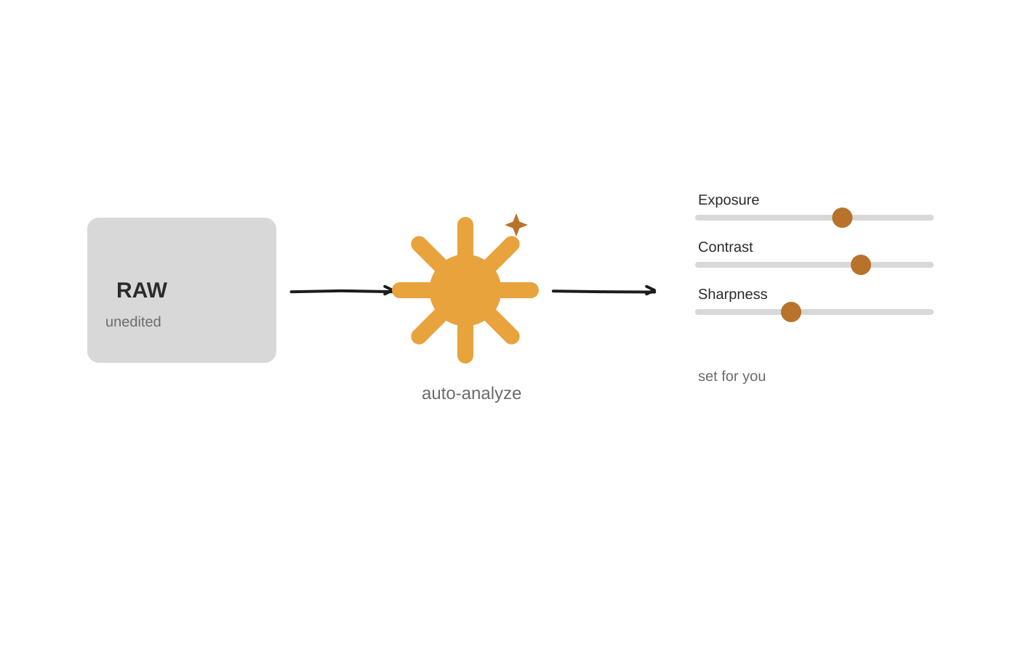
7
CONCEPT 7 OF 7
Automation
WHAT IT MEANS
Automation means letting editing software analyze a photo and automatically set gamma, contrast, brightness, sharpness and exposure for you, using built-in algorithms instead of moving every slider by hand. It's a fast, one-click starting point — you can always fine-tune the result afterward.
Try it now
TIP
DxO PhotoLab: Smart Lighting and ClearView Plus auto-analyze each photo's histogram to balance light and haze in a single click. Lightroom's “Auto” button and Photoshop's Auto Tone/Contrast/Color do the same job — a great first pass, not necessarily the final word.
7 / 7
Notes:
Automation — speaker / user notes: • Definition: Automation means letting editing software analyze a photo and automatically set gamma, contrast, brightness, sharpness and exposure for you, using built-in algorithms instead of moving every slider by hand. It's a fast, one-click starting point — you can always fine-tune the result afterward. • Practical tip: DxO PhotoLab: Smart Lighting and ClearView Plus auto-analyze each photo's histogram to balance light and haze in a single click. Lightroom's “Auto” button and Photoshop's Auto Tone/Contrast/Color do the same job — a great first pass, not necessarily the final word. • Reminder: demo this live in DxO PhotoLab (or Lightroom/Photoshop) before moving on — let learners drag the slider themselves. • Common beginner mistake: adjusting this in isolation without checking the histogram/zoomed view first.

Slide 9

BRINGING IT TOGETHER
Automating Your Edits
How auto-adjustments handle gamma, contrast, brightness, sharpness and exposure in three popular tools.
1
2
3
DxO PhotoLab
Adobe Lightroom
Adobe Photoshop
Smart Lighting — auto-balances exposure & contrast using HSP tech
ClearView Plus — one-click haze & local-contrast removal
DeepPRIME — auto denoise + sharpening straight from RAW
“Auto” button (Basic panel) sets exposure, contrast, highlights, shadows, whites & blacks together
Auto White Balance for a neutral starting color
Auto Mask/Select Subject to speed up local edits
Image > Auto Tone / Auto Contrast / Auto Color
Camera Raw filter's Auto button (same engine as Lightroom)
Neural Filters for auto skin-smoothing & portrait light
Auto is a starting point, not a finish line — always check the histogram and zoom to 100% before you export.
Notes:
User notes: use this slide to wrap up the tutorial — run each tool's auto feature live if possible. Emphasize that automation (Smart Lighting, Auto Tone, etc.) is judged against everything taught in this deck: it is quietly setting gamma-aware tone mapping, contrast, brightness, sharpening and exposure recovery all at once. Reminder: auto results vary by scene — a backlit portrait or a high-contrast sunset often needs manual correction afterward.

