Slide 1
AI Lessons, Episode 1
What Is a “Model”?
Series: Core AI Terms in Plain English — by Sourov Deb
AI Lessons — Episode 1: What Is a Model?
Notes:
Cold open: 'You already do this every day and don't call it AI. Let's fix that.' Today's term is MODEL -- the most foundational AI concept, and the right place to start the series.

Slide 2
The everyday version
• Think about your web browser: in Settings you can pick a default search engine — Google, Bing, DuckDuckGo.
• Same question, same browser — but each search engine gives slightly different answers.
• An AI “model” is that same idea, one layer down: it's the engine doing the thinking behind an AI app.
• Swap the model and the same question can come back faster, slower, cheaper, or smarter.
AI Lessons — Episode 1: What Is a Model?
Notes:
Anchor the term in something everyone already does: choosing a search engine in browser settings. That muscle memory is the whole concept.

Slide 3
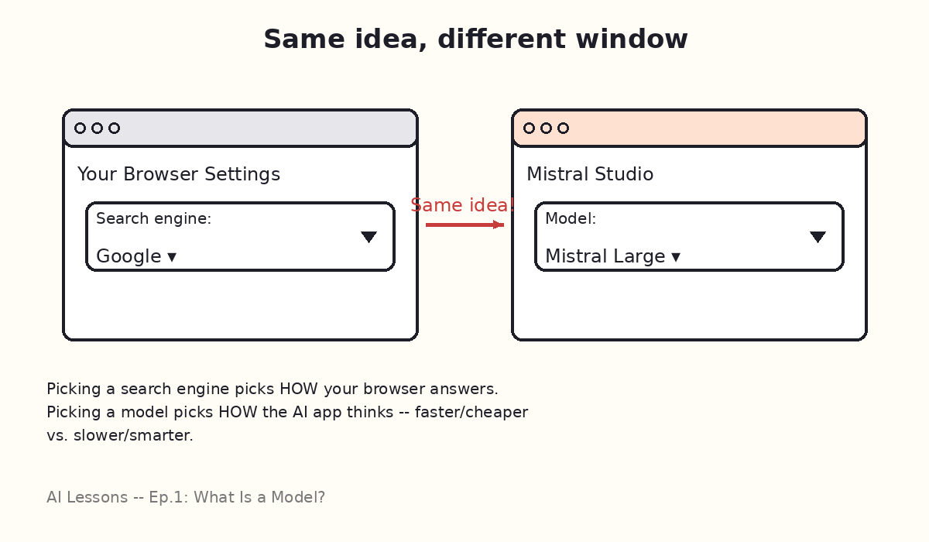
Same idea, different window
AI Lessons — Episode 1: What Is a Model?
Notes:
Show the doodle: a browser's search-engine dropdown next to Mistral Studio's model dropdown. Picking a search engine picks HOW your browser answers; picking a model picks HOW the AI app thinks.

Slide 4
The plain-English definition
A MODEL is the trained “brain” an AI app runs on.
One app can offer several models — small and fast, or large and smart — the way one browser can offer several search engines.
• No extra jargon needed beyond that.
• Everything else in this series (skill, agent, memory, hook) gets ADDED ON TOP of a model — which is why the series starts here.
AI Lessons — Episode 1: What Is a Model?
Notes:
This is the one sentence to remember: a model is the trained brain an AI app runs on. Everything else in the series builds on top of this.

Slide 5
The kitchen analogy
• Picture a recipe card — that's your question, or “prompt.”
• Hand that recipe to the intern (small model): fast, cheap, great for a quick sandwich.
• Hand the same recipe to the head chef (large model): slower and pricier, but nails the complicated dish.
• Same recipe, same kitchen, different chef — different result.
AI Lessons — Episode 1: What Is a Model?
Notes:
This is the memorable hook: small model = fast intern, large model = head chef. Same input, different depth of output.

Slide 6
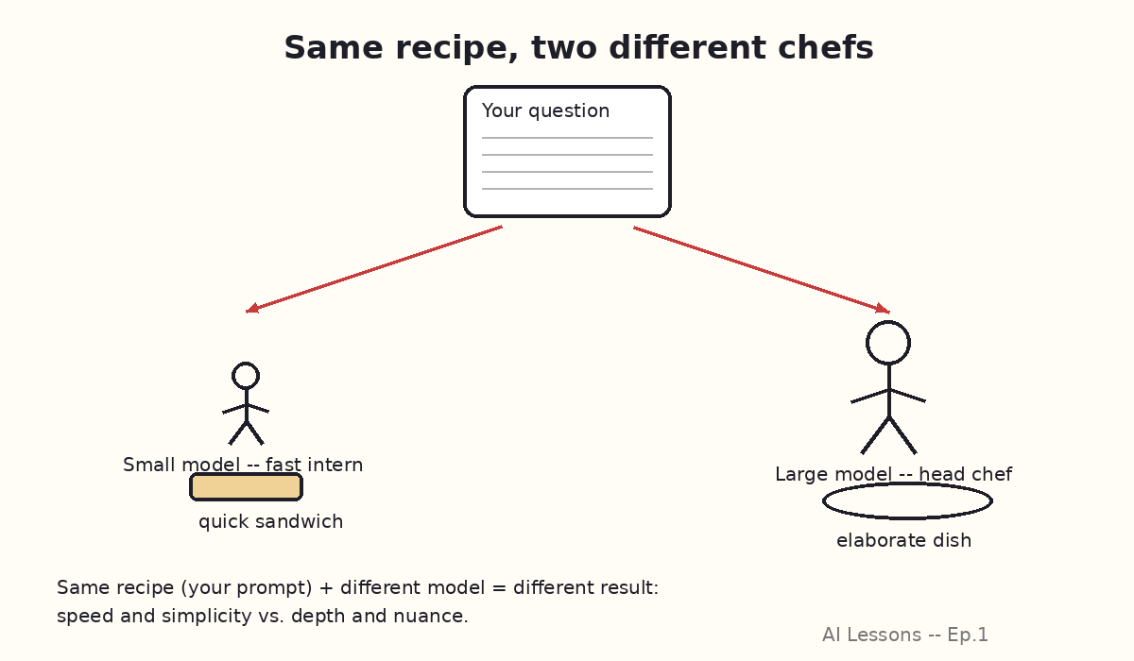
Same recipe, two different chefs
AI Lessons — Episode 1: What Is a Model?
Notes:
Visual reinforcement of the kitchen analogy: one recipe card, two arrows, two chefs, two different dishes.

Slide 7
See it live in Mistral Studio
• Open Mistral Studio and start a new chat or playground session.
• Find the model picker — a dropdown near the top of the screen (e.g. Mistral Small, Mistral Large, Codestral).
• Ask a simple question using Mistral Small — notice the near-instant reply.
• Switch to Mistral Large, ask the SAME question — notice the extra nuance (and the extra beat of wait time).
• That dropdown IS the lesson: you're not changing the app, you're changing the “chef” doing the thinking.
AI Lessons — Episode 1: What Is a Model?
Notes:
Live demo moment -- if presenting in person, actually click the model dropdown in Mistral Studio on screen here. Seeing the label change is more convincing than describing it.

Slide 8
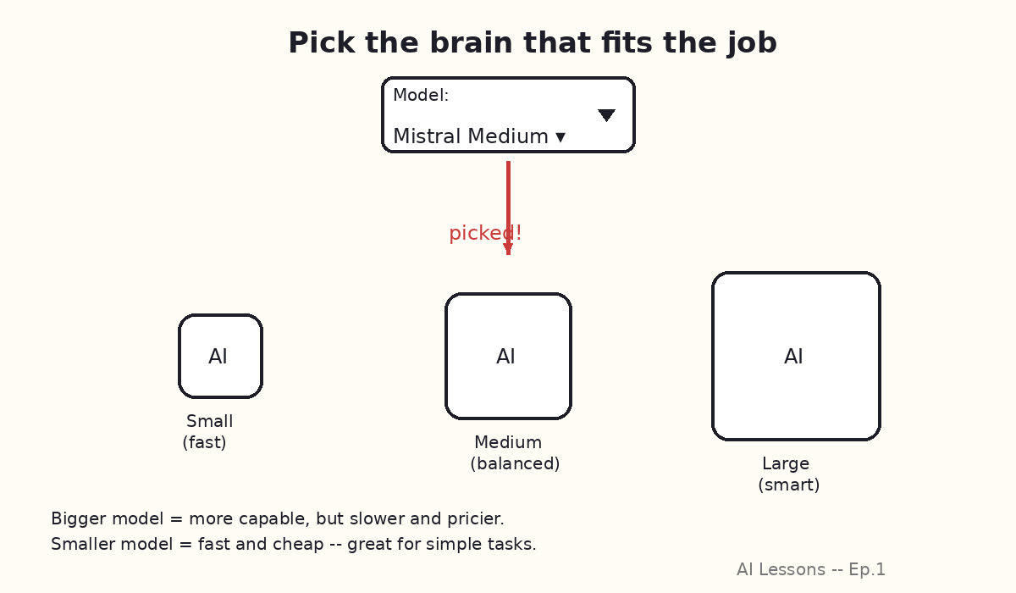
Pick the brain that fits the job
AI Lessons — Episode 1: What Is a Model?
Notes:
Three brain-in-a-box sizes under a dropdown -- reinforces 'bigger = smarter but slower/pricier, smaller = fast and cheap.'

Slide 9
Why this matters — and the recap
• You wouldn't use a sledgehammer to hang a picture frame.
• Match the model size to the job: small models for quick drafts and lookups, large models for complex analysis or nuanced writing.
• RECAP: a model = the engine/chef behind the AI. Same app, different model, different speed and skill.
• Pick the one that fits the job — exactly like picking a search engine in your browser.
AI Lessons — Episode 1: What Is a Model?
Notes:
Land the practical takeaway (match model size to task) before the recap line, which is the one sentence worth remembering.

Slide 10
Series tracker
• ✅ Covered so far: Model (Episode 1)
• ▶ Suggested next topic: Skill — “a recipe you hand the chef”, building directly on today's analogy.
• ⏭ Planned pool remaining after that: Agent → Memory → Hook → JSON → Python
Common mix-up to head off next time: a MODEL is not the same as an APP. Mistral Studio is the app (the kitchen); Mistral Large/Small are the models (the chefs) inside it.
AI Lessons — Episode 1: What Is a Model?
Notes:
Wrap-up slide for the series format the user asked for: state what's covered and what's next, so each episode can stand alone or be watched in order.

