Slide 1
PHOTO EDITING BASICS
7 Concepts in Plain English
A beginner's map to gamma, contrast, brightness, sharpness,
curves, exposure & automation -- with DxO PhotoLab examples.
Episode 1 of the Photography Concepts Made Simple series
Notes:
Series intro. Built for people who've never touched a camera dial -- every definition avoids film-era jargon. Each concept slide follows the same shape: Definition -> Doodle -> DxO PhotoLab tip. Tool used for the practical examples is DxO PhotoLab, with Lightroom/Photoshop equivalents noted so the deck isn't tool-locked. Total runtime if read aloud: about 5 minutes.

Slide 2
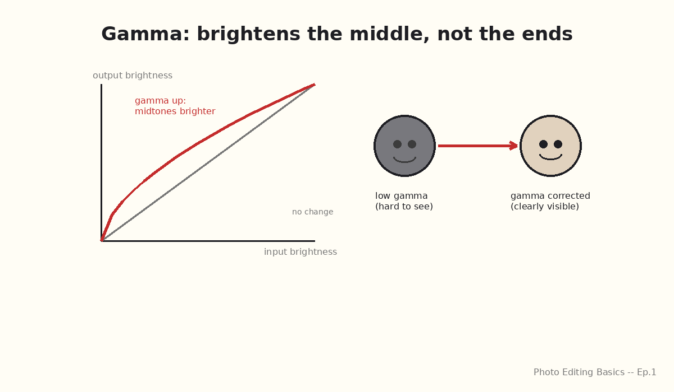
1
Gamma
Gamma controls how bright your midtones -- the in-between grays, not the darkest shadows or brightest highlights -- look in a photo. Two photos can share the same black point and white point but look completely different because their gammas differ: low gamma keeps midtones murky, higher gamma opens them up so detail is visible.
DXO PHOTOLAB TIP
PhotoLab doesn't expose a slider literally named "gamma" -- it's built into the Tone Curve tool and the Smart Lighting engine. Drag the curve's midpoint up, without moving the black/white endpoints, to open up midtones the same way a gamma boost would.
Lightroom / Photoshop: the midtone point on the Curves / Tone Curve panel does the same job.
Photo Editing Basics -- Episode 1
Notes:
Emphasize: gamma is NOT the same as brightness -- it reshapes the middle of the tone range while leaving pure black and pure white anchored. That's the one mix-up worth heading off before Slide 3 (Brightness), which moves everything uniformly.

Slide 3
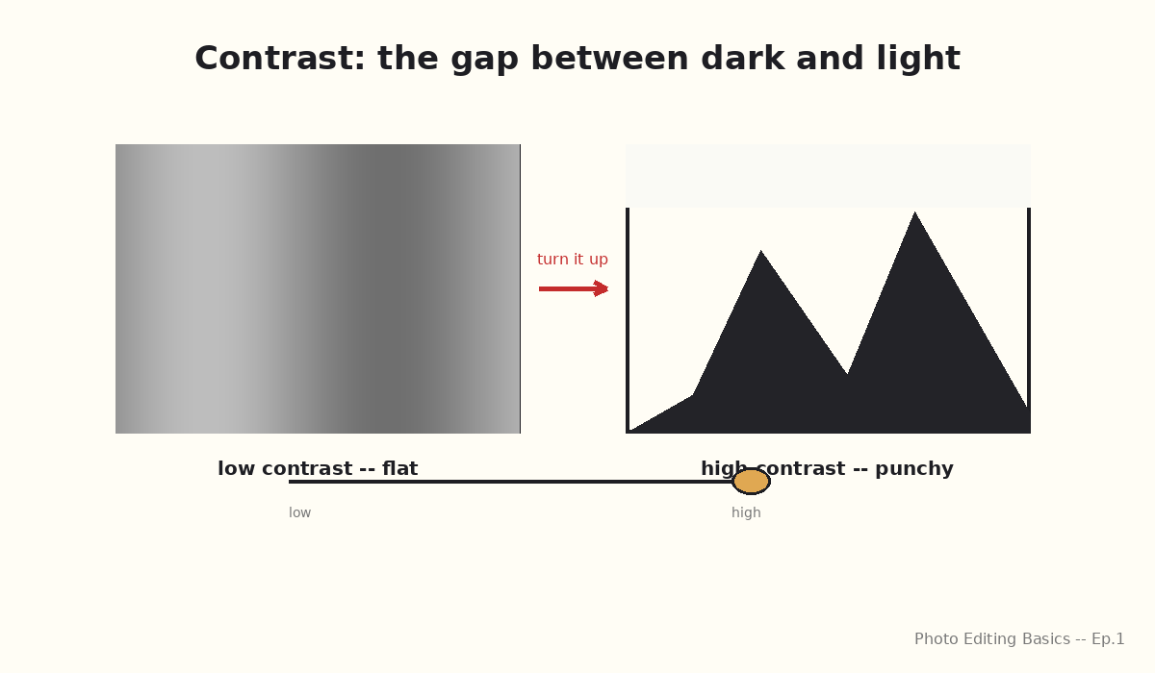
2
Contrast
Contrast is the difference between the darkest and lightest parts of a photo. High contrast makes shadows deeper and highlights brighter, giving a punchy, dramatic look; low contrast keeps everything closer to middle gray, giving a flat, hazy look.
DXO PHOTOLAB TIP
Use the Contrast slider in the Light palette -- click the small circular "A" (auto) icon next to it to let PhotoLab suggest a starting point, then fine-tune by eye.
Lightroom / Photoshop: the Contrast slider in the Basic panel, or the "Auto" button for a first pass.
Photo Editing Basics -- Episode 1
Notes:
Good moment to show the mountain-silhouette doodle live: low contrast = gentle rolling hills (grays blending), high contrast = jagged sharp peaks with real black in the valleys.

Slide 4
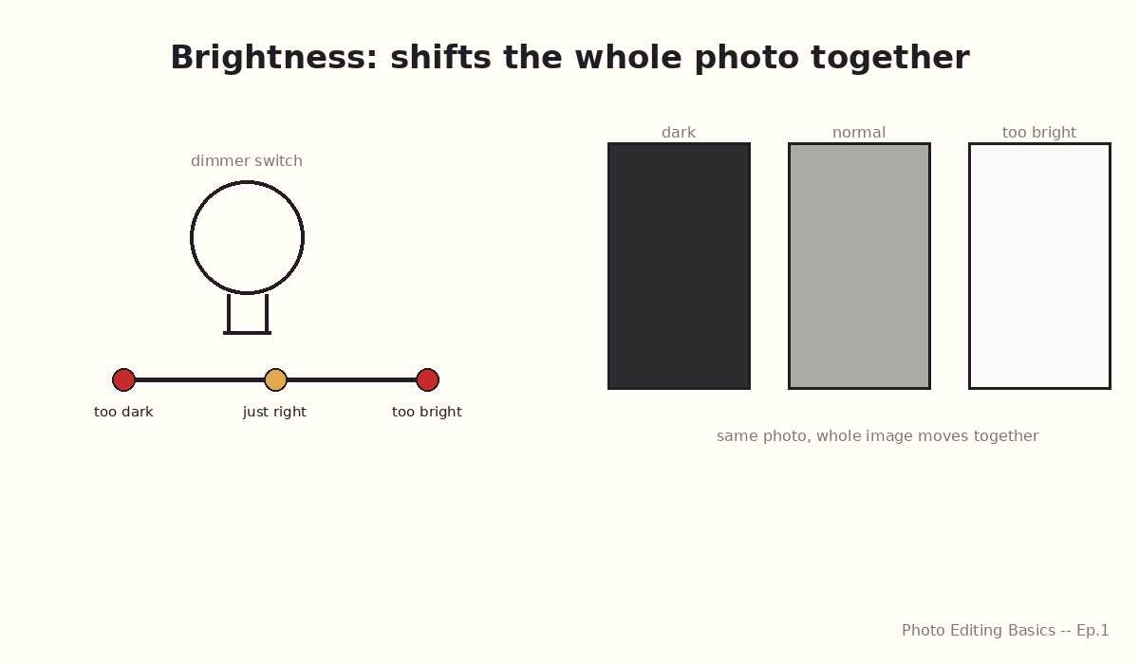
3
Brightness
Brightness shifts the entire photo lighter or darker, all at once and by roughly the same amount -- unlike contrast, which stretches dark and light apart. Turn brightness up and shadows, midtones, and highlights all lift together; turn it down and everything dims together.
DXO PHOTOLAB TIP
PhotoLab's closest control is the Exposure slider in the Light palette, which moves everything uniformly (measured in stops), plus Selective Tone's Highlights/Shadows sliders if you want to protect the extremes while brightening the middle.
Lightroom / Photoshop: the Exposure slider in the Basic panel.
Photo Editing Basics -- Episode 1
Notes:
This is the slide to contrast directly against gamma (Slide 2) and curves (Slide 6): brightness is a single uniform push, those two tools are selective.

Slide 5
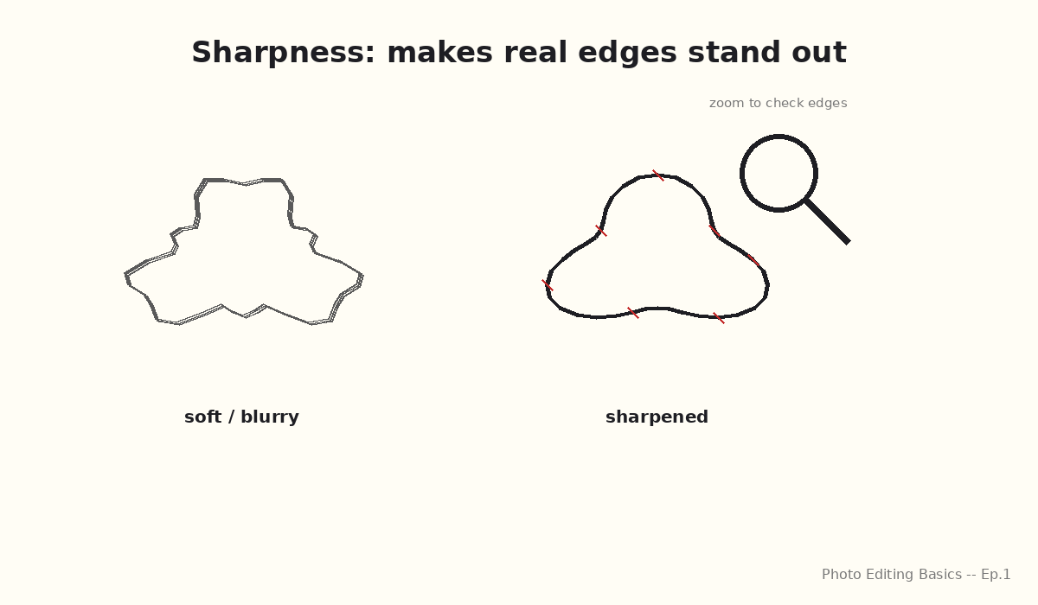
4
Sharpness
Sharpness controls how crisp the edges and fine details in a photo look. Sharpening works by increasing contrast right along edges -- it can't invent detail that was never captured, but it makes the detail that is there stand out more clearly.
DXO PHOTOLAB TIP
Use the Sharpness slider in the Detail palette, and zoom to 100% while adjusting so you see real edges, not screen artifacts. Go easy -- over-sharpening creates halos. If you shot in low light, run DeepPRIME noise reduction first; it and sharpening work best together.
Lightroom: the Detail panel's Sharpening sliders. Photoshop: Filter -> Sharpen -> Smart Sharpen.
Photo Editing Basics -- Episode 1
Notes:
Worth saying out loud: sharpening is not a fix for a genuinely out-of-focus photo -- it only enhances edge contrast that already exists in the file.

Slide 6
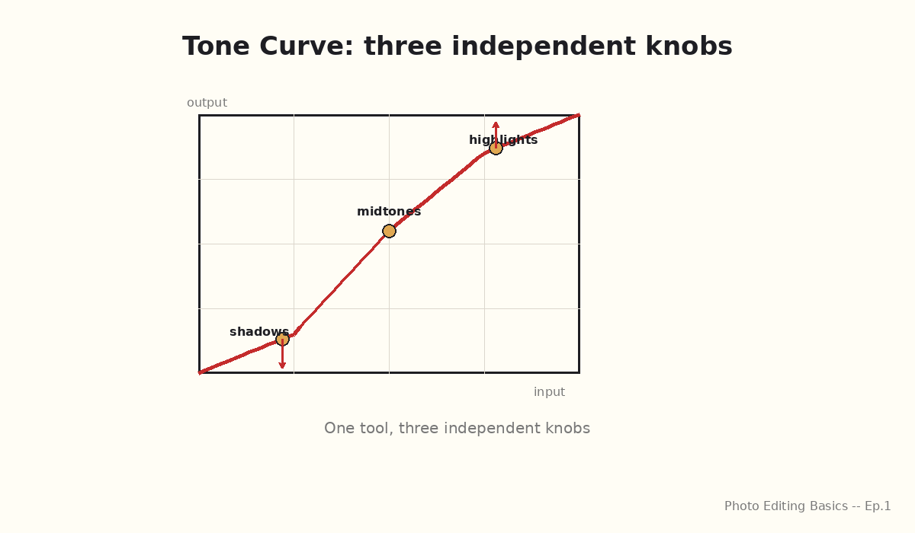
5
Curve (Tone Curve)
A tone curve is a graph that lets you reshape brightness selectively -- pulling shadows down, pushing highlights up, or adjusting midtones -- all independently, instead of moving the whole image at once like brightness does. It's the most flexible tool on this list because you can place as many control points as you need.
DXO PHOTOLAB TIP
Open the Tone Curve tool in the Light palette, click directly on the curve to add a point, then drag. Add one point and lock it in place before dragging a neighboring point, so you don't accidentally flatten the section you just fixed.
Lightroom: the Tone Curve panel. Photoshop: Image -> Adjustments -> Curves (Ctrl/Cmd+M).
Photo Editing Basics -- Episode 1
Notes:
This is the payoff slide after Gamma and Brightness -- "one tool, three independent knobs" is the line to land. Curves subsume both: a curve that only bows the middle IS a gamma adjustment; a curve that's a straight diagonal line shifted up IS a brightness adjustment.

Slide 7
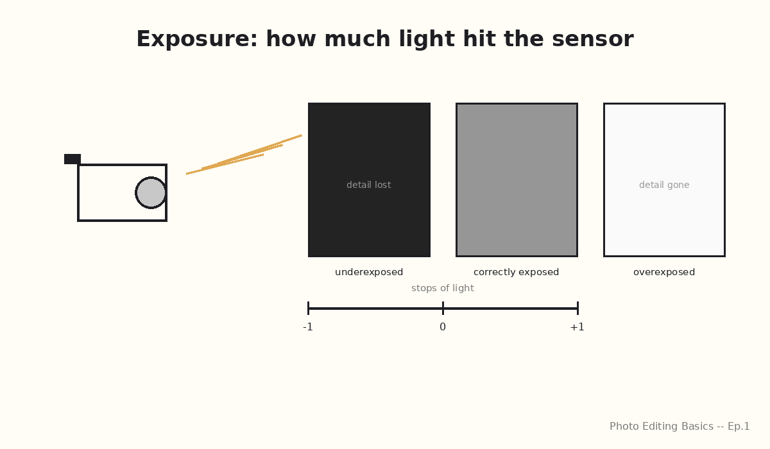
6
Exposure
Exposure is how much light hit the camera's sensor when the photo was taken -- too little light and the photo is dark and murky (underexposed); too much and the brightest areas turn to featureless white (overexposed, or "blown out"). In editing software, an exposure slider simulates adding or removing that light after the fact.
DXO PHOTOLAB TIP
Use the Exposure slider in the Light palette (adjustments are shown in stops, e.g. "+0.5 EV"); turn on Smart Lighting first so PhotoLab recovers shadow/highlight detail automatically before you fine-tune exposure by hand.
Lightroom / Camera Raw: the Exposure slider in the Basic panel.
Photo Editing Basics -- Episode 1
Notes:
Key distinction from Brightness (Slide 3): exposure describes light captured at shooting time (or simulating that), while brightness is purely a post-capture display adjustment -- in practice most software's Exposure slider does both jobs at once, which is worth naming as the reason people conflate the two terms.

Slide 8
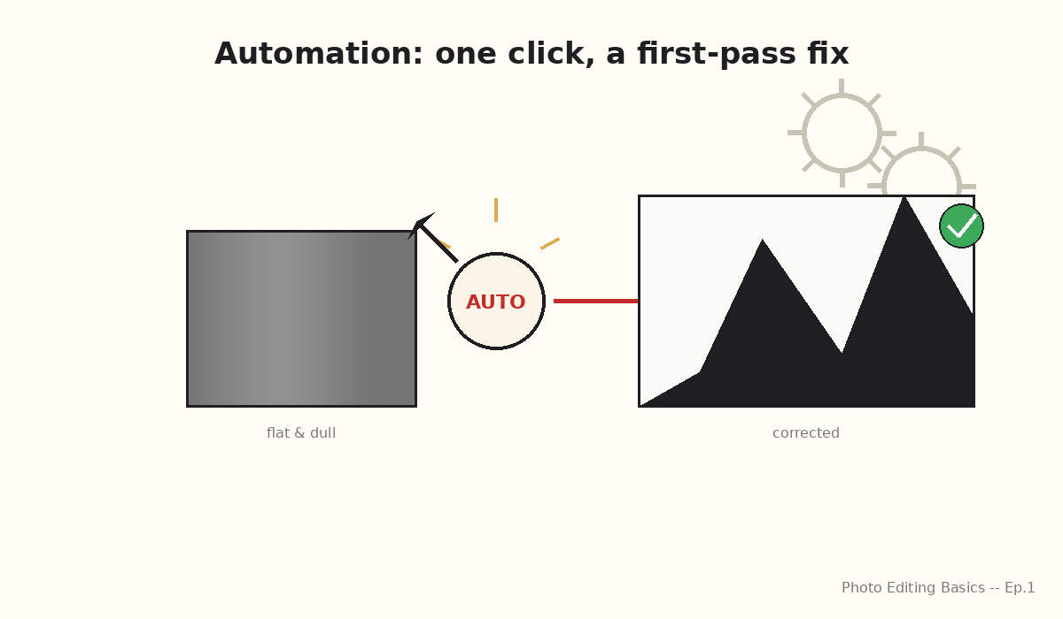
7
Automation
Automation means letting the software look at your photo's histogram -- its map of dark-to-light pixels -- and apply a first-pass version of exposure, contrast, and sharpness adjustments for you. It's a starting point you then fine-tune, not a replacement for your own eye, and it's the fastest way to get a batch of photos from flat and dull to presentable in one click.
DXO PHOTOLAB TIP
Click the small "A" auto icon next to almost any slider (Exposure, Contrast, etc.) for a per-tool auto-correction, or apply Smart Lighting for a whole-image automatic balance of shadows, midtones, and highlights in one step -- then adjust from there.
Lightroom: the "Auto" button in the Basic panel (Adobe's AI-based auto-tone). Photoshop: Image -> Auto Tone / Auto Contrast / Auto Color.
Photo Editing Basics -- Episode 1
Notes:
Bridge to the closing slide: this slide covers automation as a concept; the final slide turns it into a concrete cheat-sheet across all three tools mentioned in this deck.

Slide 9
AUTOMATING THESE ADJUSTMENTS
In Common Tools
Every major editor offers a one-click version of the adjustments in this deck. Use it as a fast starting point, then fine-tune the slider that matters most for your photo.
DxO PhotoLab
Smart Lighting + per-slider "A" auto icon
Exposure, contrast, highlight/shadow recovery
Adobe Lightroom
"Auto" button (Basic panel)
Exposure, contrast, highlights, shadows, whites, blacks
Adobe Photoshop
Image -> Auto Tone / Auto Contrast / Auto Color
Tone levels per channel, contrast stretch, color cast
Closing tip: auto-adjustments are a starting point, not a finish line -- always compare against the original.
Photo Editing Basics -- Episode 1
Notes:
Wrap-up slide -- this is the deliverable's explicit "final slide on automating these adjustments in common tools" requirement. Read the three rows as a literal cheat-sheet: same underlying idea (histogram-driven first-pass correction), different button per tool. End on the closing tip -- automation is a starting point, the presenter's own eye still finishes the job.

