Slide 1
AI TERMS EXPLAINED
What Is an AI Agent?
Lesson 1 of the doodle-illustrated series — plain-language AI concepts,
explained with Office Suite and browser analogies, and a live Mistral Studio example.
~3
MIN
Runtime
Notes:
Cold open framing for the presenter: this is Lesson 1 in an ongoing 'AI Terms Explained' series. Each lesson takes one core AI concept and explains it with everyday Office Suite / browser analogies, then shows it live in Mistral Studio. Today's term: AI AGENT.

Slide 2
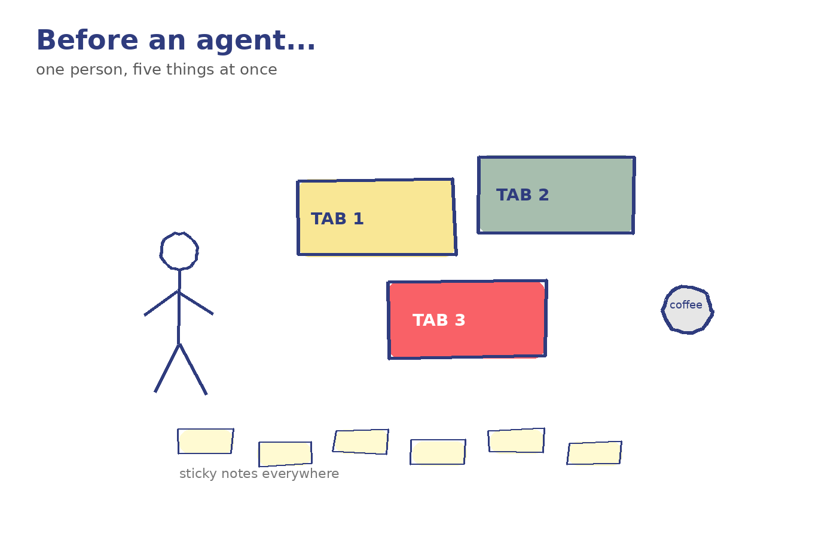
Notes:
Narrator: You know that feeling when a task needs five steps, three apps, and you have to do all of it by hand? That's the gap an 'AI agent' is built to close. On-screen text: Today's term: AI AGENT.

Slide 3
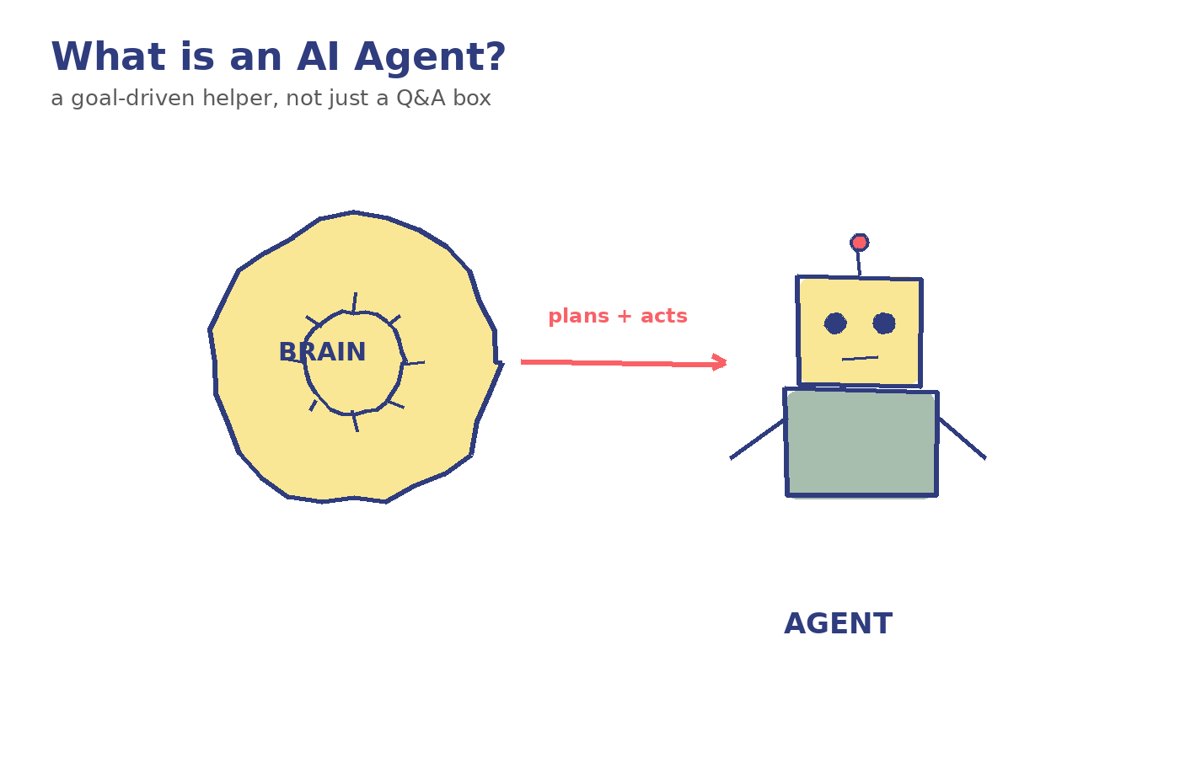
Notes:
Narrator: An AI agent is a program that doesn't just answer one question — it takes a goal, plans the steps, and acts on its own to get there, checking its work as it goes. Plain-language line: Think of the difference between a calculator and an assistant. A calculator waits for you to type the exact numbers. An assistant hears 'handle my expense report' and goes and does it — opens the app, finds the receipts, fills the form, tells you when it's done. USER NOTE — one-line definition to remember: An agent doesn't just respond — it plans, acts, and checks its own work toward a goal.

Slide 4
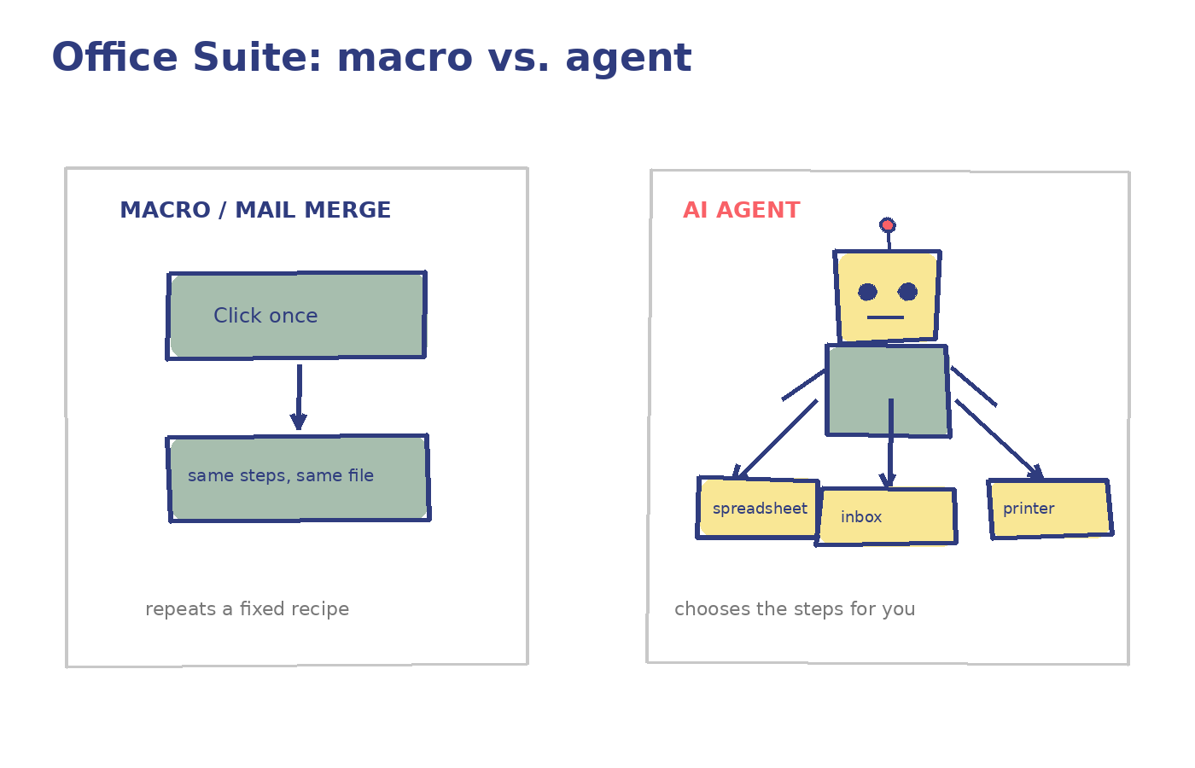
Notes:
Narrator: You already know a cousin of this from Office Suite tools. A macro or Mail Merge is a fixed recipe: click one button, and it repeats the same steps on the same file, every time, no matter what. An AI agent is more like a new hire you hand a goal to: 'Send this month's invoice to everyone who hasn't paid.' It has to figure out which rows qualify, how to word each email, and whether something looks off — and adjust instead of just repeating a fixed script. Key line: A macro follows steps. An agent chooses the steps.

Slide 5
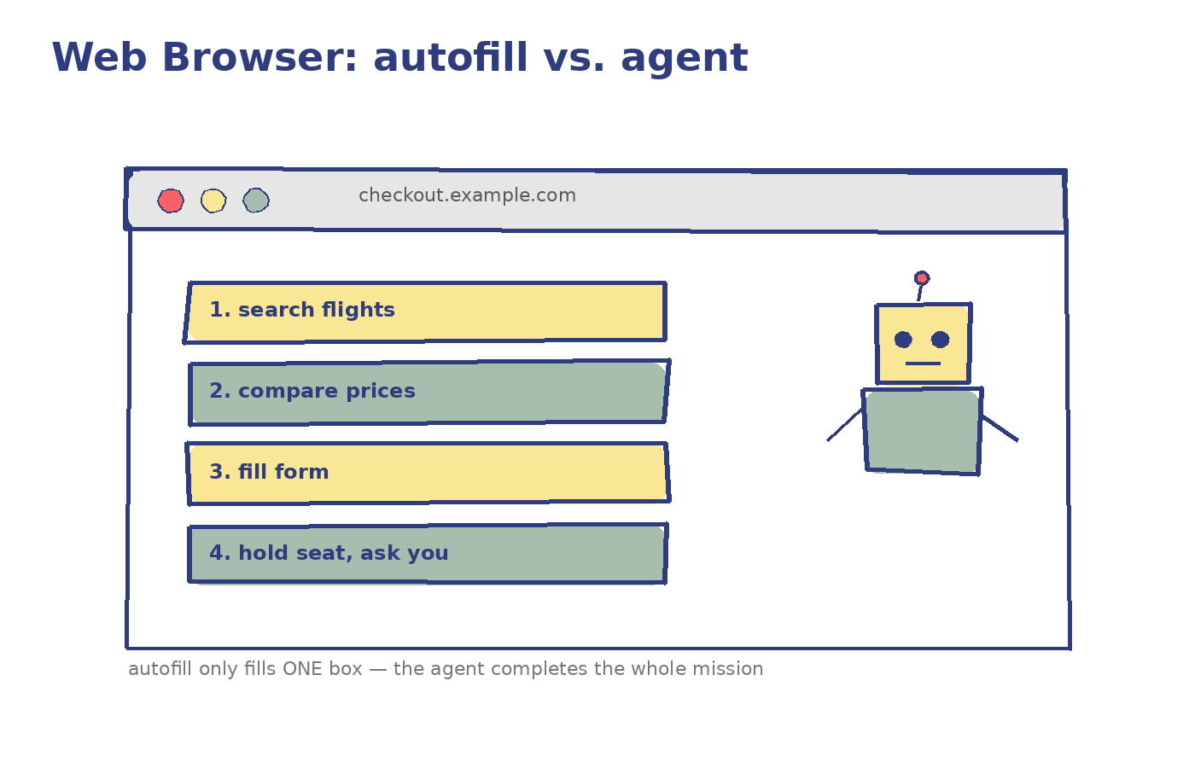
Notes:
Narrator: Same idea in your browser. Autofill just pastes your saved name and address into a form you're already looking at. Useful, but it can't leave the page. An AI agent can be told 'find the cheapest flight to Berlin next Friday and hold a seat,' and it will open tabs, compare prices, fill the form, and stop to ask you before it pays — moving through the whole task, not just one field. Key line: Autofill fills a box. An agent completes a mission.

Slide 6
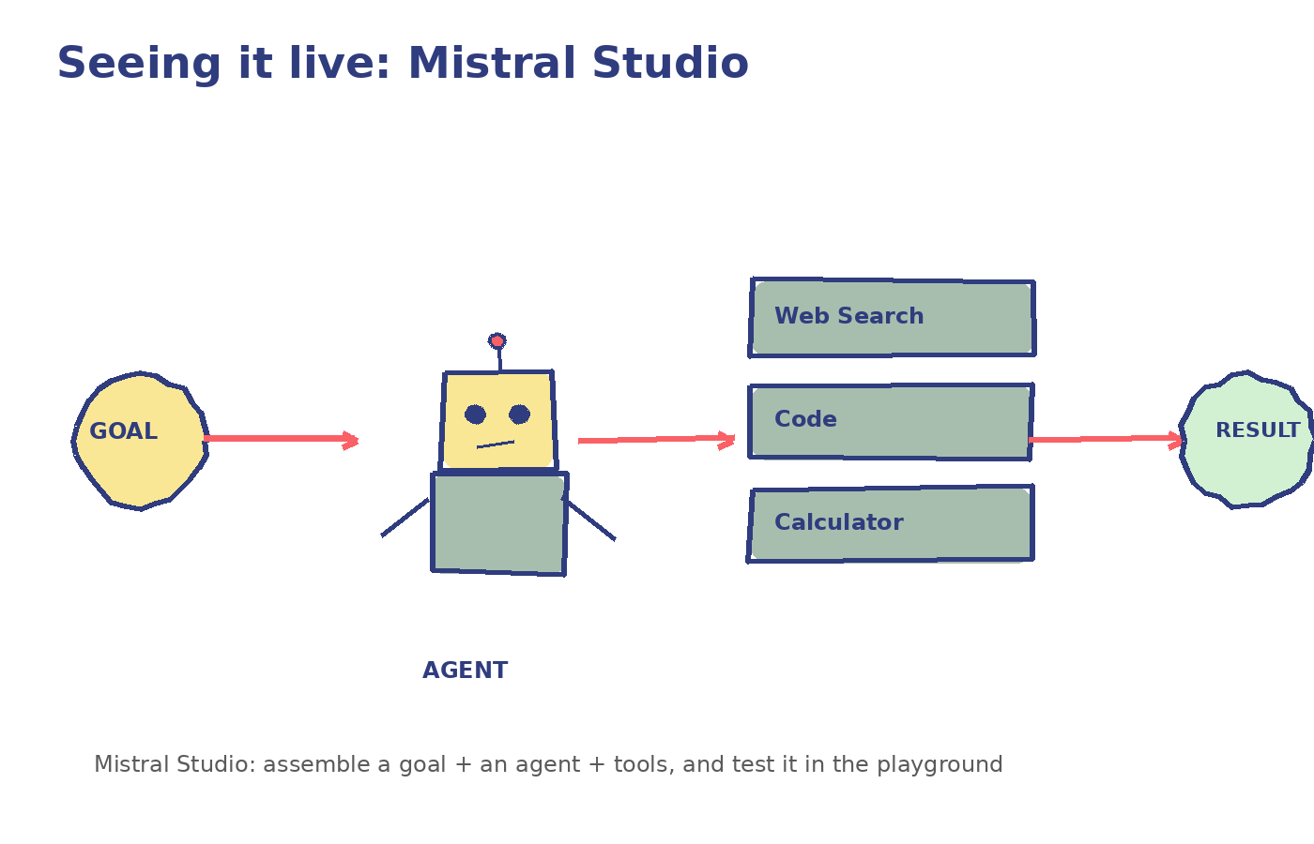
Notes:
Narrator: Here's what this looks like in a real tool: Mistral Studio, Mistral AI's workspace for building and testing AI apps. In Mistral Studio, you don't just chat with a model — you can configure an agent: give it a goal or instructions, hand it tools (like web search, a code interpreter, or a document reader), and watch it work through a task step by step in the playground, the same way you'd test a macro before trusting it on real files. USER NOTE — where to see it live: Mistral Studio → create an agent → attach tools → give it a goal → watch it reason step by step. Try it yourself: create one agent, give it a single tool (e.g., web search), and ask it a task that needs 2-3 steps to complete.

Slide 7
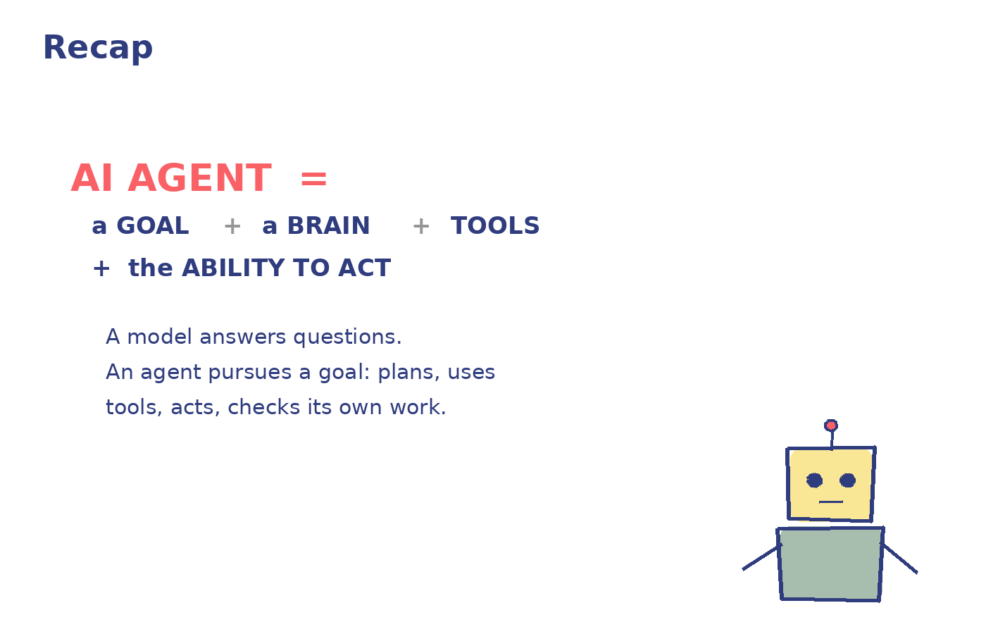
Notes:
Recap: A model answers questions. An agent pursues goals — it plans, uses tools, and acts across multiple steps until the job is done. Office macros and browser autofill hinted at this; agents generalize it. Mistral Studio is one concrete place you can build and test one yourself. USER NOTE — common confusion to avoid: an agent is not just a smarter chatbot — the defining feature is that it takes actions across multiple steps, not just better answers in one reply.

Slide 8
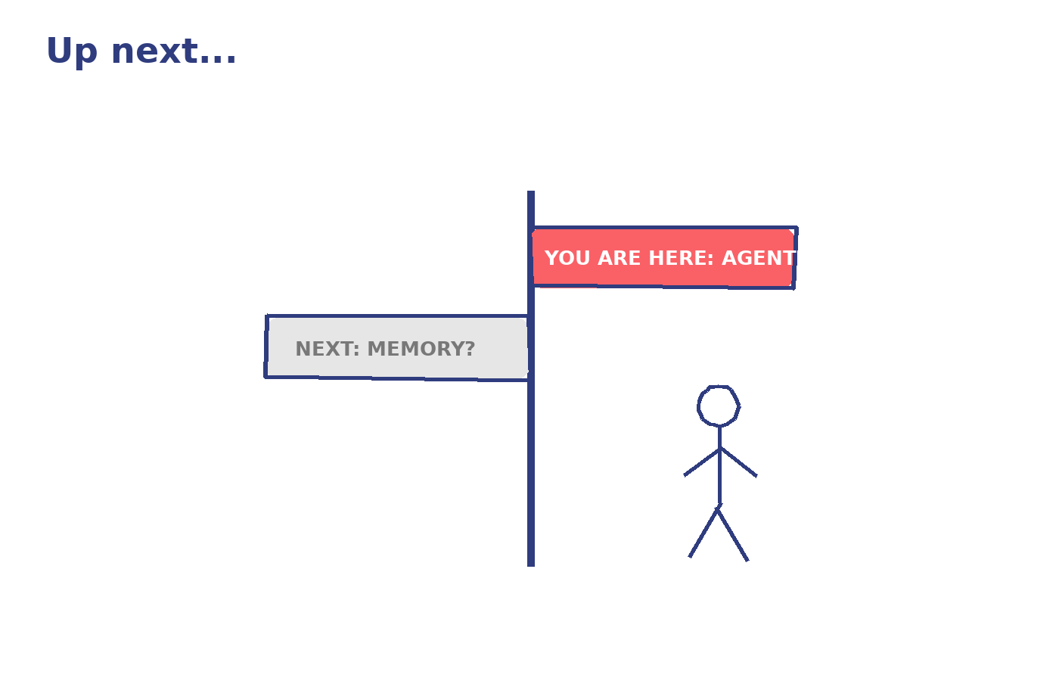
Notes:
Narrator: That's an AI agent. Next time, we'll open the hood on 'memory' — how an AI remembers what you told it five minutes (or five days) ago. Series tracker: Covered so far — Lesson 1: AI Agent. Suggested next topics (via brainstorm-agent diverge/debate pass): Memory → Skill → Hook → Model → Prompt/JSON basics.

