Slide 1
Micro-Credit Defaulter Model
Fliprobo.com

Slide 2
Problem statement and solution
Problem
The problem in the business is the defaulter category(0) which is the main cause of leakage of revenue.
In this data set of 9months the company have incurred a loss of 148956 Indonesian Rupiah.(Assumed Zero’s in feature”amnt_loans90” are customer’s who never paid or might have also left the network)
Solution
We can stop giving credit to such defaulter customers.
or we can offer them some other deal on trial basis if the company wants.
My model can predict the customer will be a defaulter(0) or non defaulter(1) by analyzing the customers past transaction records .Hence we find ways to deal with such customer more effectively and try to retain the customer.
Example-We can increase the interest rate for such customers so as to recover old amount.
-Setting a threshold on number of loan unless cleared previous amount.

Slide 3
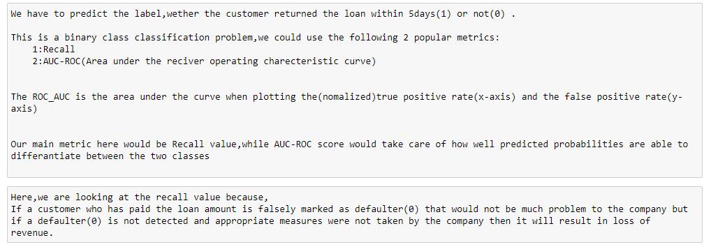
Choosing the evaluation metrics

Slide 4
Data Preprocessing
1) EDA by sweetviz library.
2) Removing unwanted rows for prediction(customers with no credit history past 90days)
3) Feature Engineering/ generation from “pdate” feature.
4) Removing ‘pdate’ feature as we have extracted our required data. 5) Removing 'I' from 'msisdn' column and converting it into integer. Dropping the original feature. 6) Adding 25000 to all numerical feature to cancel out the max -ve value in the dataset (- 24720.580000-rental90), then i will take log1p().This will not affect the distribution of the dataset. 7) Over sampling (RandomOverSampler) as it is faster than SMOTETomek. 8) Removing skewness.
9) Applying StandardScaler.
10) Applying XGBoostClassifier here, And checking scores. 11) Finding best random state for XGBoostClassifier 12) GridsearchCV on XGBoostClassifier 13) Cross validating the model. 14) Saving the final model in joblib-->'Micro-Credit Defaulter.obj' 15) Loading the model 16) Testing the model on test data. 17) Saving final predictions in file.csv format 18) Conclusion

Slide 5
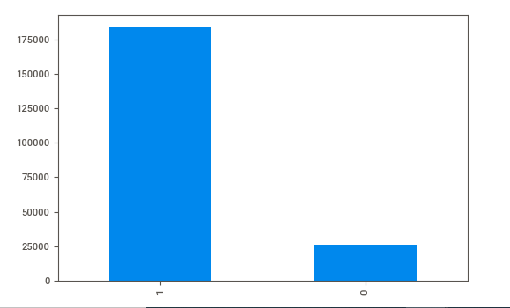
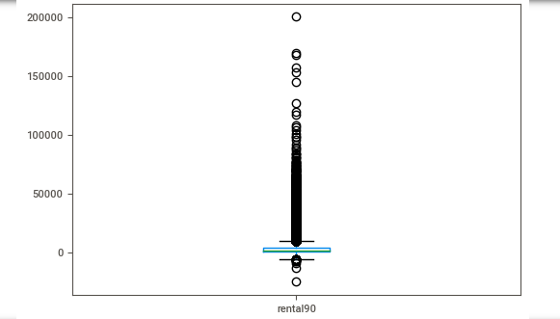
Visualization
Imbalanced dataset
Negative values is dataset
Feature Engineering has been applied on “pdate” feature to get new features like month,day,week,quarter.

Slide 6
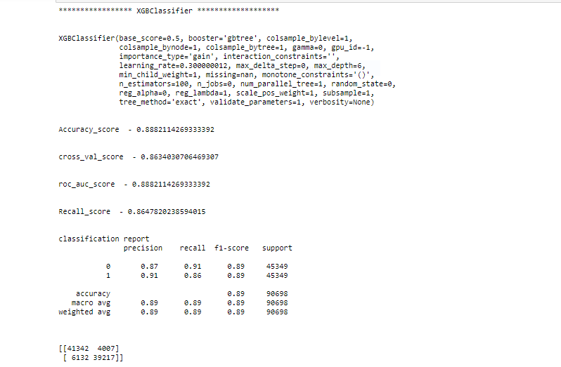
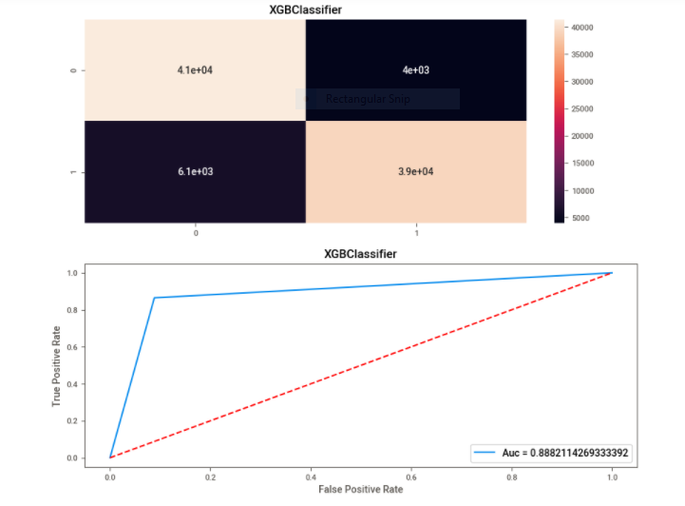
XgboostClassifier modelling

Slide 7




Choosing the final model
Choosing the Xgboost model because the model has the highest recall and auc-roc_score incomparision to other model.

Slide 8
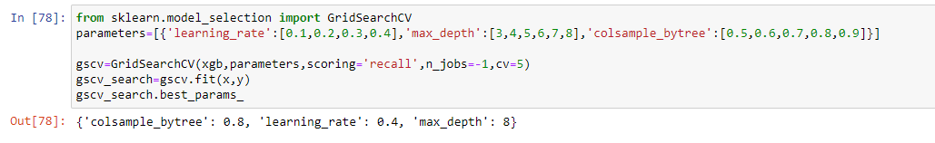
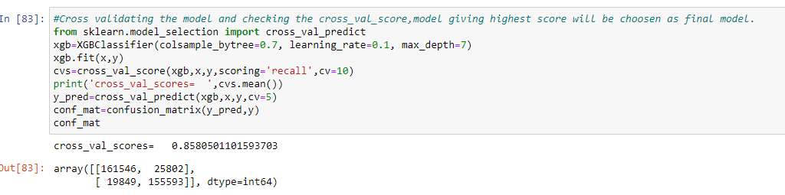
Hypertuned model
Model is cross validated with recall metrics and score is good=85.5%

Slide 9
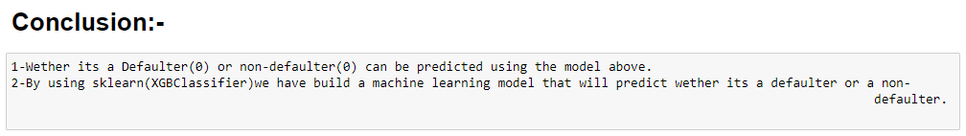
conclusion
Hence This model can surely help to us save some revenue of the company. Later on it can be developed for using the model in different ways to solve different problems .
“Money saved is money earned”.
. Thank You

