Slide 1
Project RoutinE GENERAtion and Modification System

Slide 2
Project Member
Muntasir Ahmed
UG02-32-13-004
Project Supervisor
Md. Masud Tarek
Asst. Professor
Department of CSE

Slide 3
Objective
The Objective is to create a desktop software that will take
input such as
Name/Code of the courses
Id of the students associated with the course
Associated course teacher’s name
and it will give a
Routine with
maintaining all the constraint like
minimum or no conflict, gap between classes

Slide 4
Current Vs New System
Manual
Requires lot of time
Chances of conflict
Difficult to update
Manual way of checking conflict
Person can miss maintaining any constraint
Automated
Requires almost no time
No/ Minimum chance of conflict
Easy to update
Pop up option for checking conflict
Constraint maintaining is done by automated system.

Slide 5
Platform
Backend Platform: JAVA
Persistent Layer: Microsoft Access
Frontend: JAVA GUI

Slide 6
Database Table
Course Info
Student Info
Room Info
Routine
Couse ID | Teacher ID | Slot Per Week | Batch | Type
Course ID | Student ID
RoomID | Day | Slot | Status | Capacity | Type
Room ID | Day | Slot | Course ID

Slide 7
E-R Diagram
Slot
Course ID
Student ID
Course ID
Teacher ID
Batch
Type
Has
Student
Course
Routine
Room
Type
Room ID
Status
Day
Slot

Slide 8
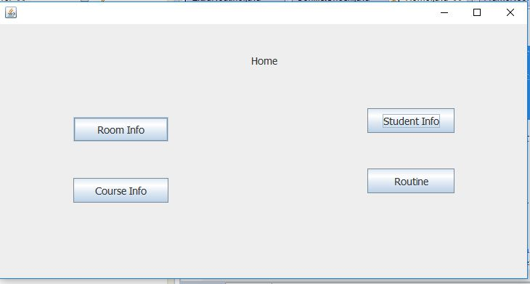

Slide 9
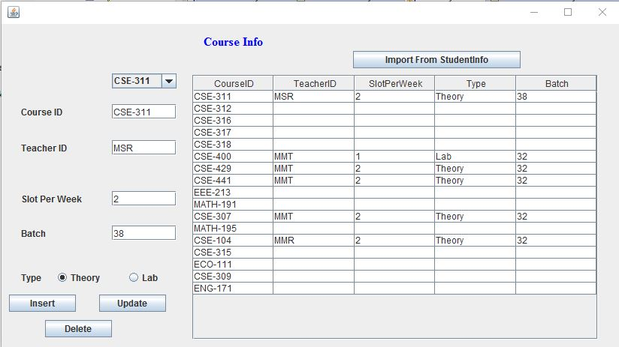

Slide 10
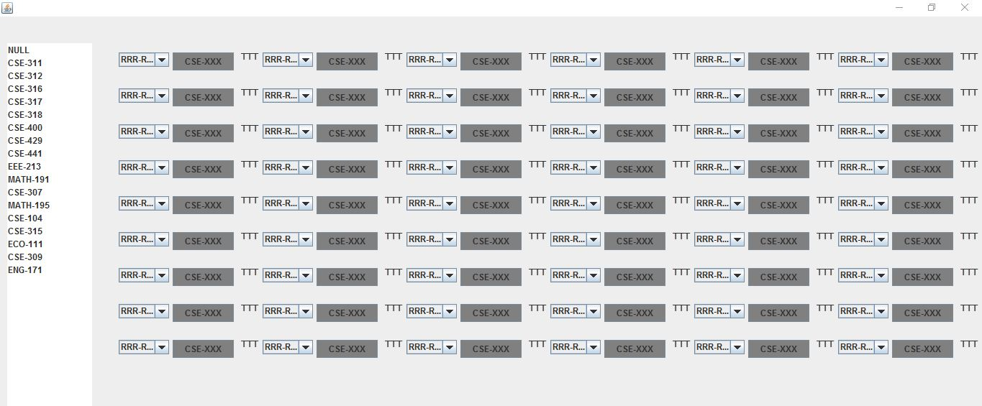

Slide 11
Any Question

Slide 12
Thank You

