Slide 1
Interleaver Design for Deep Neural Networks
Sourya Dey, Peter Beerel, Keith Chugg
Asilomar Conference on Signals, Systems, and Computers
Oct-Nov 2017

Slide 2
Overview of Current DNNs
Key machine learning technologies
Lot of parameters - Memory intensive
Slow to train - Computationally intensive
Training done offline in CPU/GPU
Custom hardware used for inference only

Slide 3

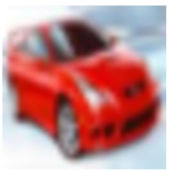

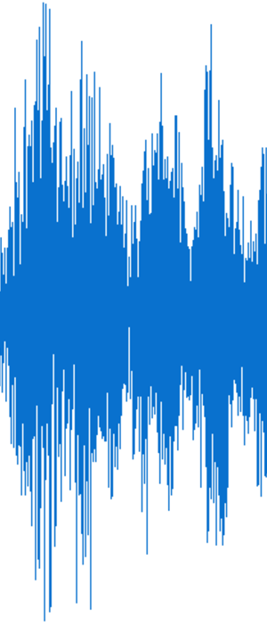
Typical Supervised Network
Convolutional Layers
Pooling and Normalization
Fully Connected Classification Layers (CLs)
Predictions
95% of total network connections
5% of total network connections
Krizhevsky, A., Sutskever, I., Hinton, G.E.: Imagenet classification with deep convolutional neural networks. In: NIPS-2012, pp. 1097–1105 (2012)
Zhang, C., Wu, D., Sun, J., Sun, G., Luo, G., Cong, J.: Energy-efficient CNN implementation on a deeply pipelined FPGA cluster. In: ISLPED-2016. pp. 326– 331. ACM, New York (2016)

Slide 4
Focus of our Approach
Convolutional Layers
Pooling and Normalization
Fully Connected CLs
Predictions
95% of total network connections

Slide 5
Overview of our Research
Predefined sparsity - Memory friendly
2-3x savings on CL only network parameters
2 orders of magnitude savings on CL parameters of CNNs *
Edge-based processing - Computationally flexible
Hardware optimizations - Fast training
FPGA based architecture - Online training and inference
Dey, S., Shao, Y., Chugg, K.M., Beerel, P.A.: Accelerating Training of Deep Neural Networks via Sparse Edge Processing. In: Proc. ICANN-2017, pp. 273-280. LNCS (2017)
* Dey, S., Huang, K.W., Beerel, P.A., Chugg, K.M.: Characterizing Sparse Connectivity Patterns in Neural Networks. In: ICLR-2018 (submitted for publication)

Slide 6
Sparsity
Sparsity – Predefined
Fully connected (FC) network
Sparse network
fo = 1, fi = 2
Connectivity = 25%
Fanout (fo) = 4
Fanin (fi) = 8
Connectivity = 100%

Slide 7
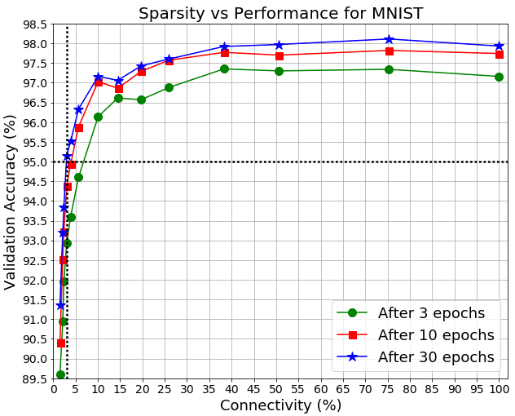
Example of Parameter Savings
No accuracy degradation at <40% connectivity
3% connectivity gives >95% MNIST accuracy, within 3% of FC

Slide 8
Present Work - Interleavers for Sparse Patterns
𝜋_{W}(0)
𝜋_{W}(1)
𝜋_{W}(2)
𝜋_{W}(3)
𝜋_{W}(4)
𝜋_{W}(5)
𝜋_{W}(6)
𝜋_{W}(7)
𝜋_{W}(0)
𝜋_{W}(1)
𝜋_{W}(2)
𝜋_{W}(3)
𝜋_{W}(4)
𝜋_{W}(5)
𝜋_{W}(6)
𝜋_{W}(7)
𝜋_{W}(0)
𝜋_{W}(1)
𝜋_{W}(2)
𝜋_{W}(3)
𝜋_{W}(4)
𝜋_{W}(5)
𝜋_{W}(6)
𝜋_{W}(7)
0
1
2
3
4
5
6
7
𝜋_{W}(0)
𝜋_{W}(1)
𝜋_{W}(2)
𝜋_{W}(3)
𝜋_{W}(4)
𝜋_{W}(5)
𝜋_{W}(6)
𝜋_{W}(7)
0
1
2
3
4
5
6
7
Interleaver algorithm ensures:
Each output connected to a good spatial chunk of different inputs
No neuron unconnected
☹
☹
Weight Interleaver
Weight Interleaver
Weight Interleaver
Weight Interleaver
Junction 1
Junction 2
Notes:
Talk about interleaving being on left

Slide 9
Interleaver Requirements
Optimized for computational efficiency in hardware
Optimized for on-chip storage
High values for metrics which are performance indicators

Slide 10
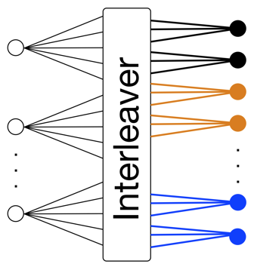
Degree of Parallelism = z
z memories for all parameters of same type
Process z parameters in 1 cycle => 1 from each mem
Process all parameters in a sweep
Mem 0 | Mem 1 |  |  |  | Mem z-1
w₀ | w₁ | w₂ |  |  | w_{z-1}
w_{z}
w_{2z}
w_{3z} |  |  |  |  | w_{W-1}

Slide 11
Clash Freedom
E.g. p activations, so depth of each memory = p/z
Accessed in interleaved (permuted order)
Mem 0 | Mem 1 |  |  |  | Mem z-1
a₀ | a₁ | a₂ |  |  | a_{z-1}
a_{z}
a_{2z}
a_{3z} |  |  |  |  | a_{p-1}
Mem 0 | Mem 1 |  |  |  | Mem z-1
a_{z}
a_{3z}
p/z
Clash-free access ☺
Clash stalls processing ☹
Interleaver must prevent clashes when accessing activations

Slide 12
Ease of Accesses
Mem 0 | Mem 1 |  |  |  | Mem z-1
Mem 0 | Mem 1 |  |  |  | Mem z-1
Mem 0 | Mem 1 |  |  |  | Mem z-1
Mem 0 | Mem 1 |  |  |  | Mem z-1
Row 0
Row 1
p/z
Row 2
Row
(p/z-1) = 3
Cycle 2
Cycle 1
Cycle 3
Cycle 4
Design interleaver to have easy address computation

Slide 13
Interleaver Design Algorithm
Example: p=32, fo=2, z=8 => i∈[0,63]. Say i = 45
Let r be a random permutation of memory row index => Size p/z
Replicate or partition r to form s of z elements => Starting indices of all mems
t = {s, s+1, …, s+p/z-1}%(p/z) => All p indices for all mems in order
$$π_{W}\left(i\right)=\left(t\left[i\%p\right]×z+i\%z\right)×fo+\left\lfloor i/p\right\rfloor$$
Activation Memory Bank Row = 45%32 = 1
Row1 | a₈ | a₉ | a₁₀ | a₁₁ | a₁₂ | a₁₃ | a₁₄ | a₁₅
a₁₃
Left side Neuron = 1x8+45%8 = 13
w₂₆
Left side Neuron’s Weight = 13x2 = 26
a₁₃
w₂₇
Weight Offset = 1
Finally: w₂₇

Slide 14
Meeting Requirements
Easily generated – Proof in paper
All variables involved are powers of 2 (add extra neurons)
Modulo = Bit select
Multiply = Bit shift
Only store r for a new pattern
Create t by accumulating 1s
Clash freedom – Proof in paper

Slide 15
Variations
Start Vector Shuffle (SV)
Sweep Starter Shuffle (SS)
Memory Dither (MD)
Original: s = {2,0,3,1,2,0,3,1} After SV: s = {2,0,3,1,3,0,1,2}
Original: After SS:
1st sweep s = {2,0,3,1,2,0,3,1} 1st sweep s = {2,0,3,1,3,0,1,2}
2nd sweep s = {2,0,3,1,2,0,3,1} 2nd sweep s = {0,3,2,1,0,3,2,1}
$$π_{W}\left(i\right)=\left(t\left[i\%p\right]×z+v[i\%z]\right)×fo+\left\lfloor i/p\right\rfloor$$
v[.] = Permutation of [0,z-1]

Slide 16
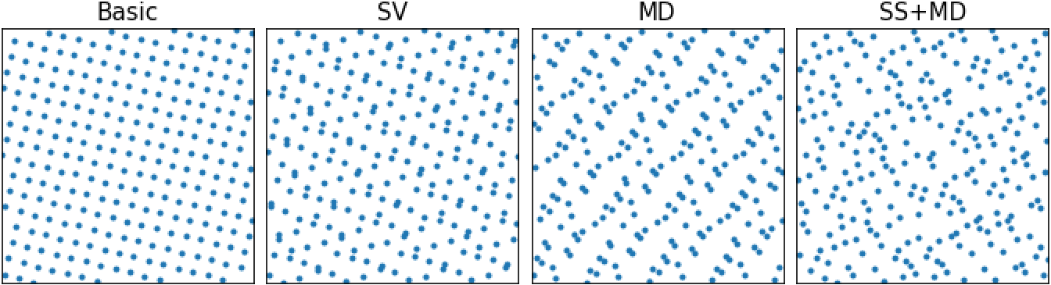
Some Weight Interleaver Patterns
𝜋_{W}(i)
i

Slide 17
Spread and Dispersion
Spread: Connections that are close on 1 side should be far away on other
Dispersion: Connections should be irregular, i.e. no patterns or trends
Interleaver Variant | Spread | Dispersion
Basic | 18.28 | 0.04
MD | 7.48 | 0.22
SS | 9.7 | 0.07
SS + MD | 6.5 | 0.37
SV | 6.6 | 0.08
SV + MD | 7.31 | 0.23
SV + SS | 5.05 | 0.09
SV + SS + MD | 5.7 | 0.39

Slide 18
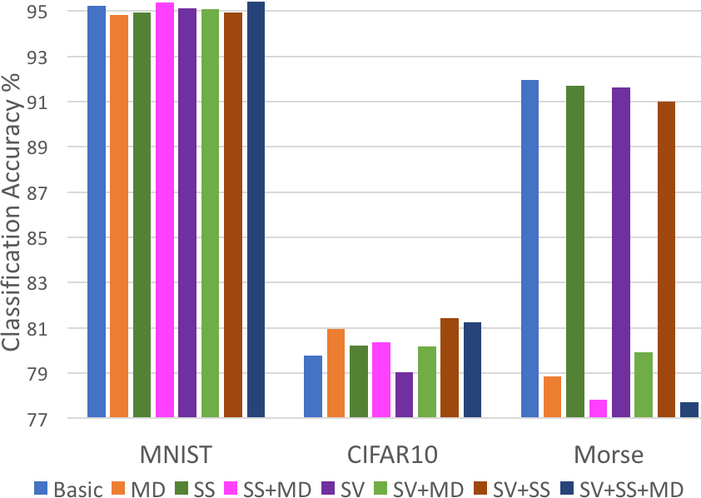
Dataset Results
*
* Sourya Dey: https://cobaltfolly.wordpress.com/2017/10/15/morse-code-dataset-for-artificial-neural-networks/

Slide 19
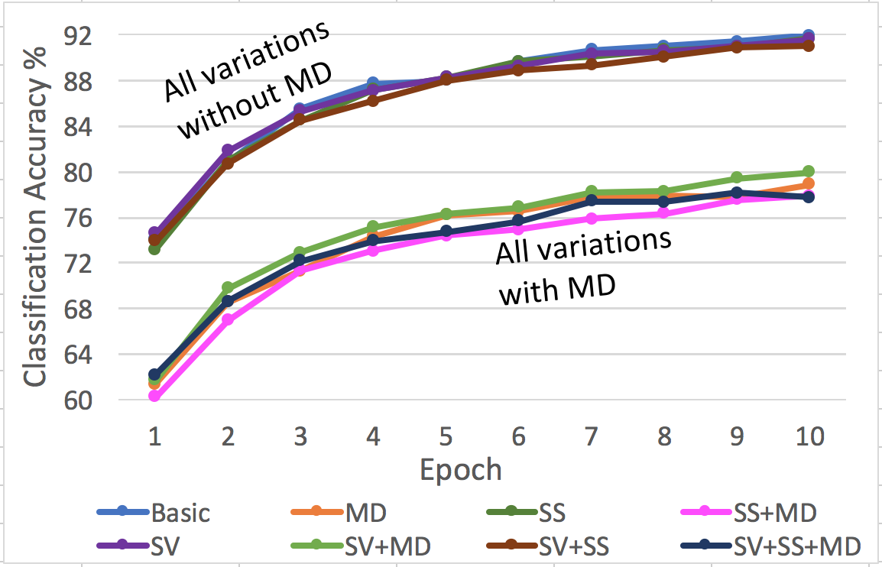
Morse Dataset Trends
Morse has fewer inputs and low redundancy
Spread should be high, dispersion hurts

Slide 20
Summary and Ongoing Work
Pre-defined sparse hardware architecture to lower memory and computational footprint
Interleaver algorithm to guarantee clash freedom and ease of storage
Interleaver variations and effects on performance
Extension to multiple junctions - Adjacency matrices
Measures to characterize network performance
Dey, S., Huang, K.W., Beerel, P.A., Chugg, K.M.: Characterizing Sparse Connectivity Patterns in Neural Networks. In: ICLR-2018 (submitted for publication)

Slide 21
Thank you!
Questions?
Contact: souryade@usc.edu

Slide 22
Ease of Accesses
Mem 0 | Mem 1 |  |  |  | Mem z-1
Mem 0 | Mem 1 |  |  |  | Mem z-1
Cycle 1
Cycle 2
Cycle 3
Cycle 4
Mem 0 | Mem 1 |  |  |  | Mem z-1
Mem 0 | Mem 1 |  |  |  | Mem z-1

Slide 23
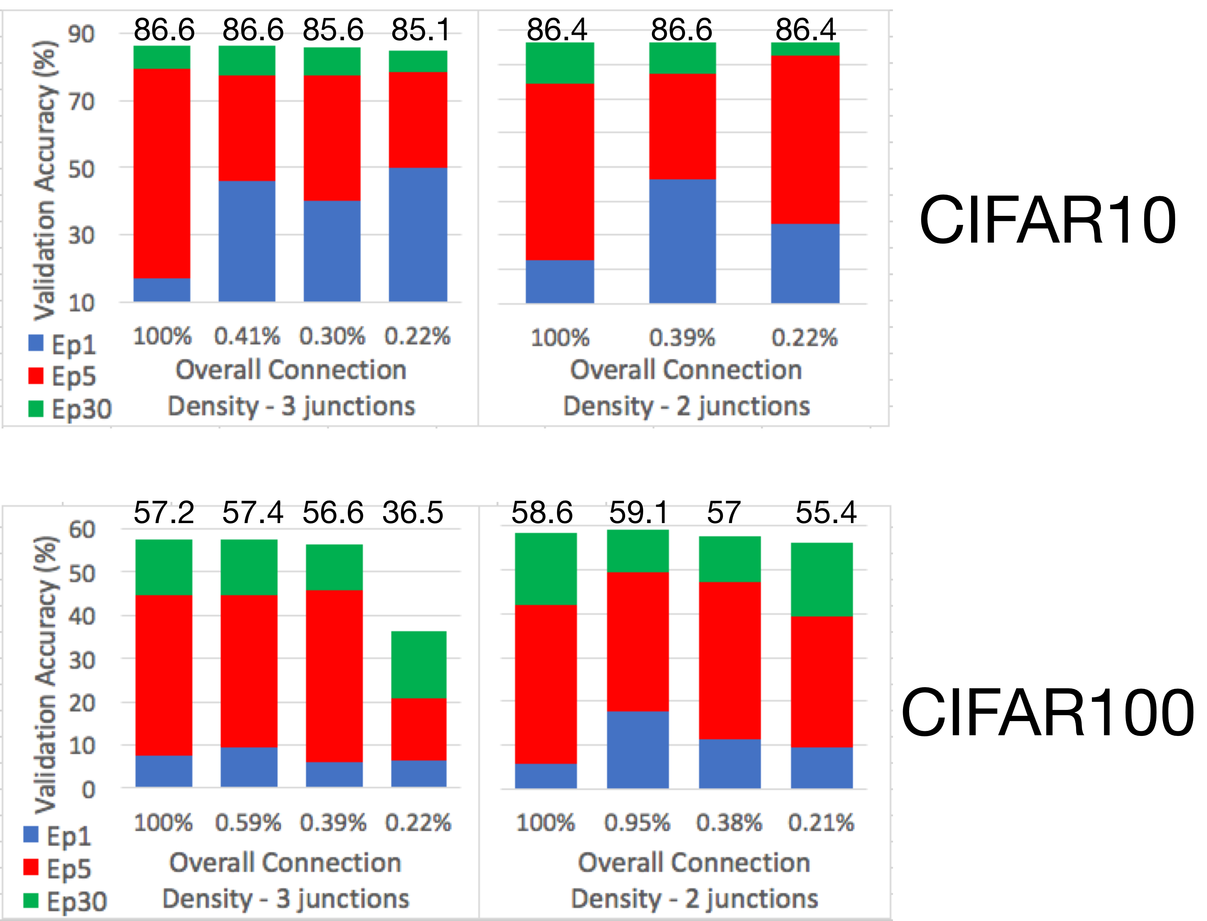
Results of pre-defined sparsity

Slide 24
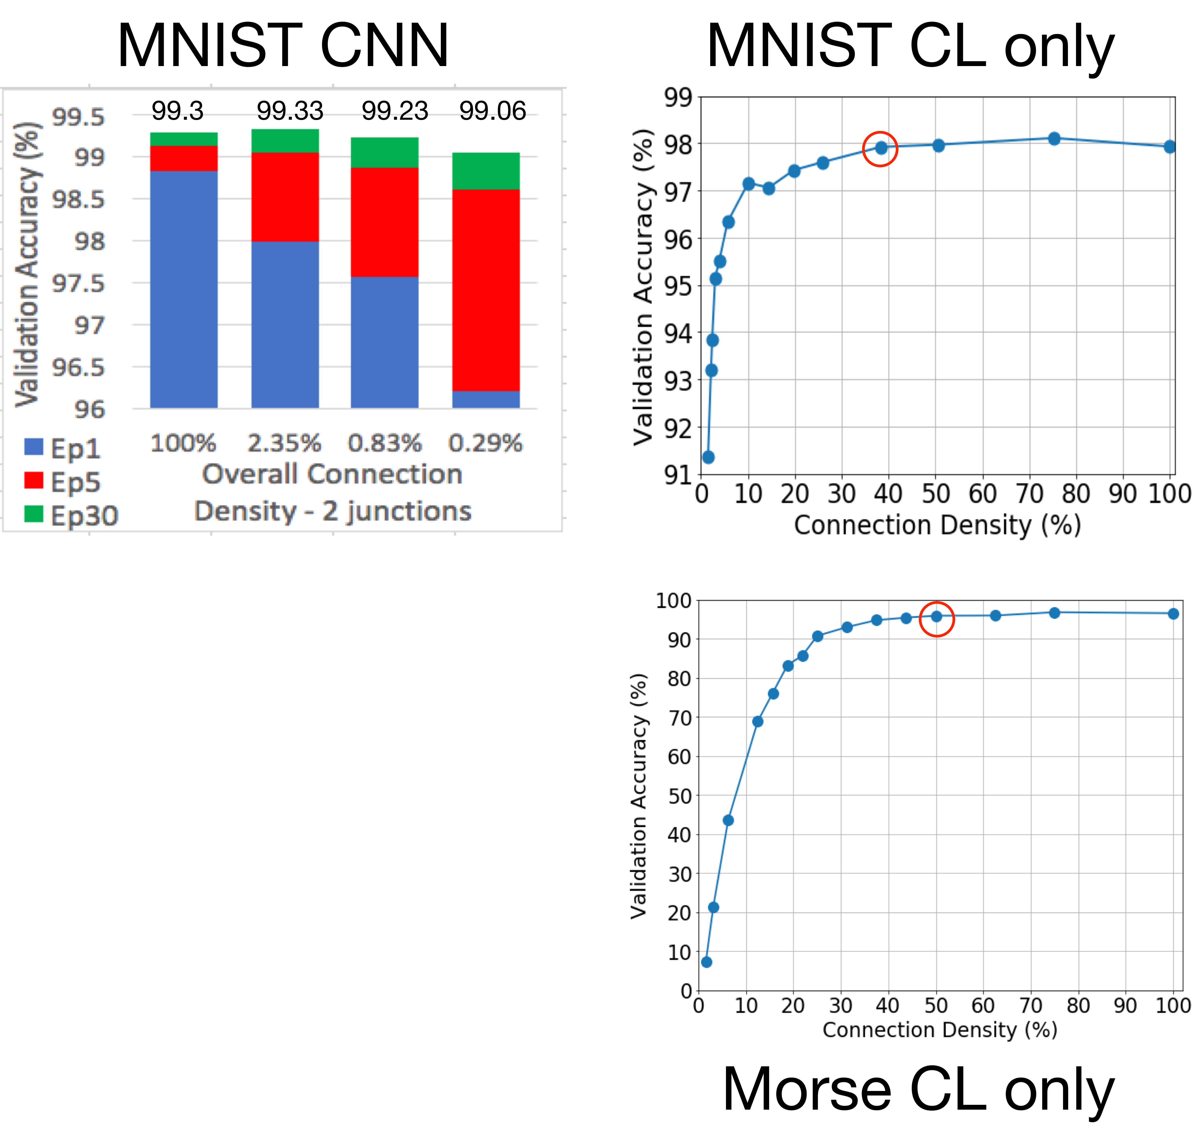
Results of pre-defined sparsity
Negligible accuracy loss!
Parameter savings possible:
2 orders of magnitude on CLs of CNNs
2-3x on CL only networks

Slide 25
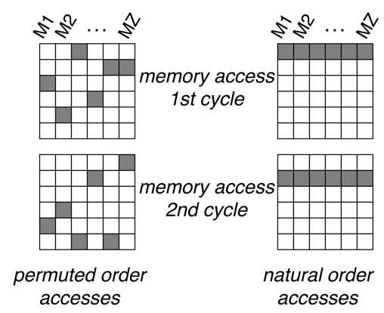

Clash Freedom
Interleaver must prevent clashes when accessing activations
Example: z=6
Permuted order accesses for previous layer parameters
Natural order accesses for junction weights and next layer parameters

Slide 26
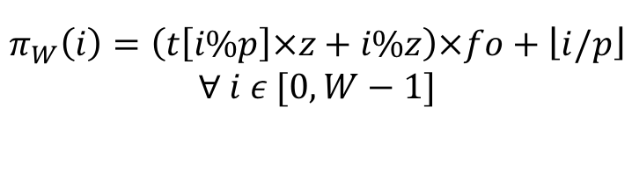


Interleaver Design Algorithm
Example: p=32, fo=2, W=64, z=8. Take i = 45
r = {2,0,3,1}
s = {2,0,3,1,2,0,3,1}
t = {2,0,3,1,2,0,3,1,3,1,0,2,3,1,0,2,0,2,1,3,0,2,1,3,1,3,2,0,1,3,2,0}
Let r be a random permutation of memory row index => Size p/z
Replicate or partition r to form s of z elements => Starting indices of all mems
t = {s, s+1, …, s+p/z-1}%(p/z) => All p indices for all mems in order
Say i = 45:
$$π_{W}\left(i\right)=\left(t\left[i\%p\right]×z+i\%z\right)×fo+\left\lfloor i/p\right\rfloor$$
$$∀ i ε [0,W−1]$$
$$π_{W}\left(45\right)=\left(t\left[45\%32\right]×8+45\%8\right)×2+\left\lfloor 45/32\right\rfloor$$
$$=\left(t\left[13\right]×8+5\right)×2+1$$
W = Total weights in junction
$$=\left(1×8+5\right)×2+1=27$$

