Slide 1
Morse Code Datasets for Machine Learning
Sourya Dey, Keith Chugg, Peter Beerel
9th International Conference on Computing,
Communication and Networking Technologies
July 2018

Slide 2
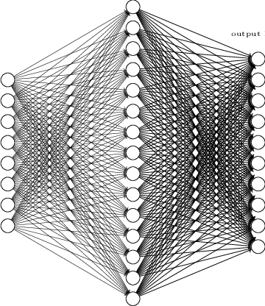
Machine Learning and Neural Networks
An algorithm to learn from data and classify it
Need a lot of data for good performance

Slide 3

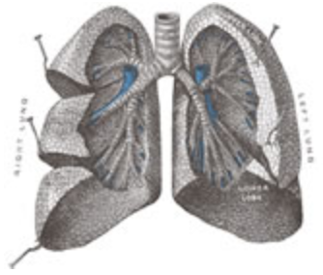
Issues with Natural Data
Most data is naturally collected and labeled by humans
Labeling is time-consuming (e.g. Imagenet¹)
Data can have missing features (e.g. Lung cancer dataset²)
1: http://www.image-net.org/
2: http://archive.ics.uci.edu/ml/datasets/Lung+Cancer

Slide 4
Synthetic data as a Solution
Synthetic data generated and labeled using algorithms
Can be mass-produced cheaply without missing features
Algorithm can be tuned to:
Adjust difficulty
Get any distribution

Slide 5
Overview of our Work
Algorithm to generate Morse code classification datasets of varying difficulty
Metrics to evaluate difficulty of a dataset
Morse code is a system of communication to encode characters as dots and dashes
+ . _ . _ .
64 character classes

Slide 6
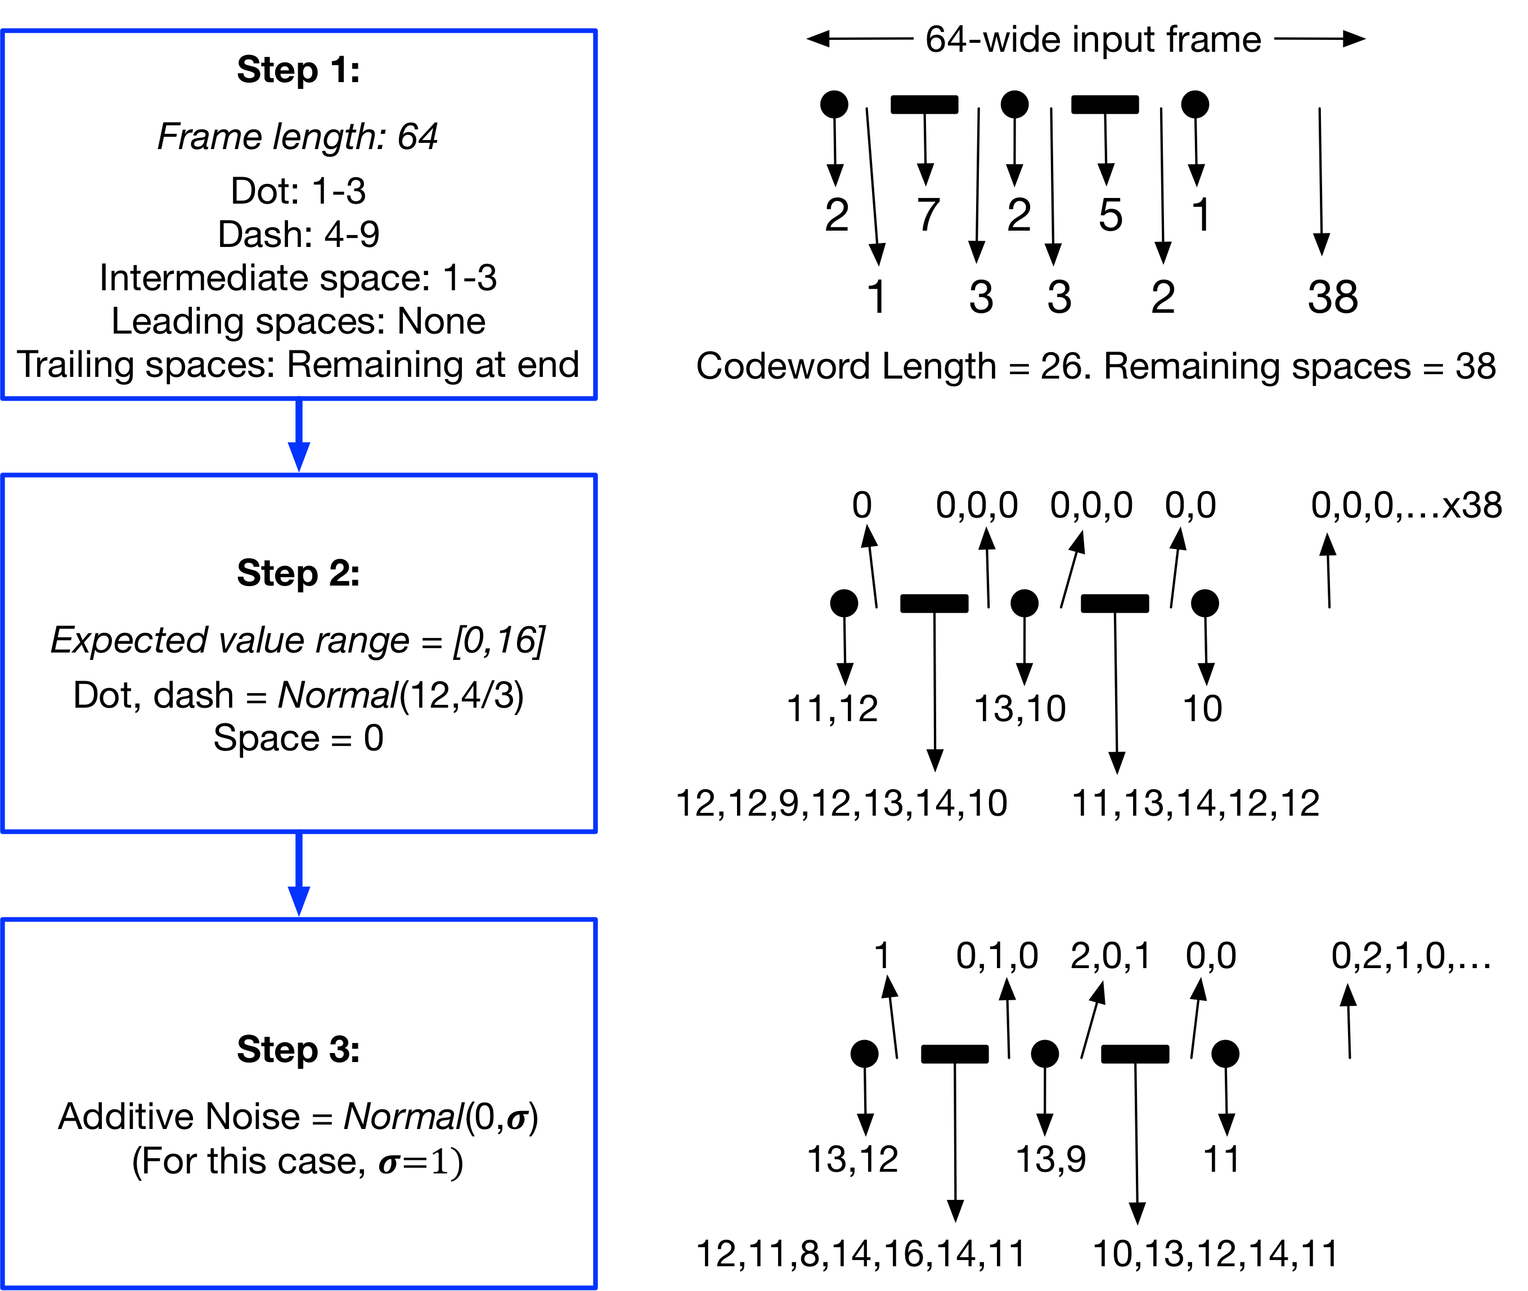
The Algorithm

Slide 7
The Neural Network
64 input neurons = Frame length of each Morse codeword
64 output neurons = Number of character classes
1024 hidden neurons

Slide 8
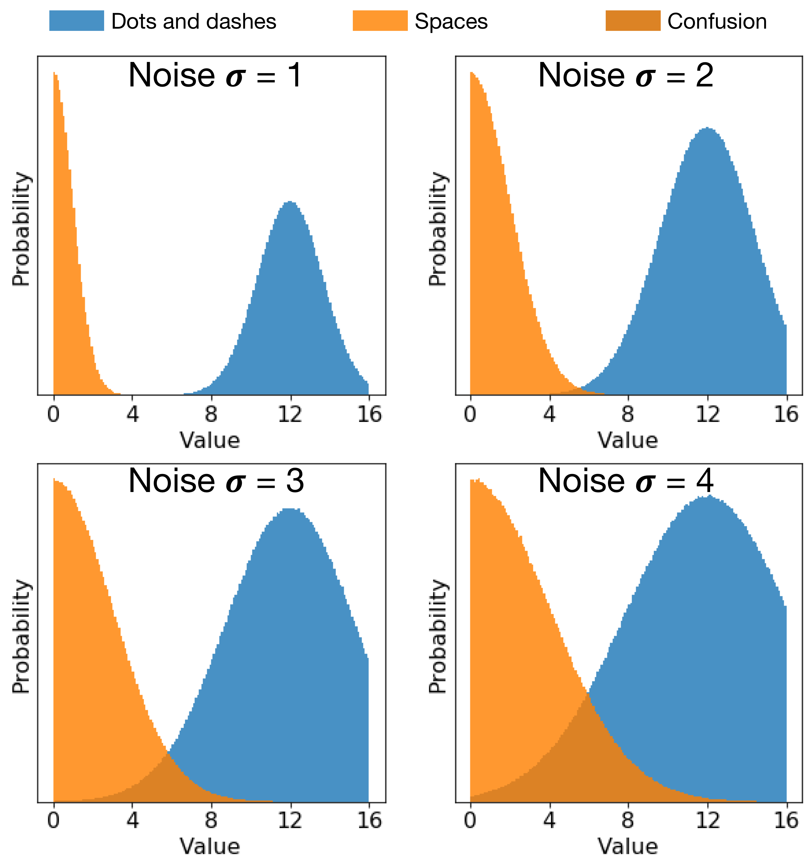
Variations and Difficulty Scaling - 1
Increasing 𝝈 of noise leads to confusion between dots, dashes and spaces

Slide 9
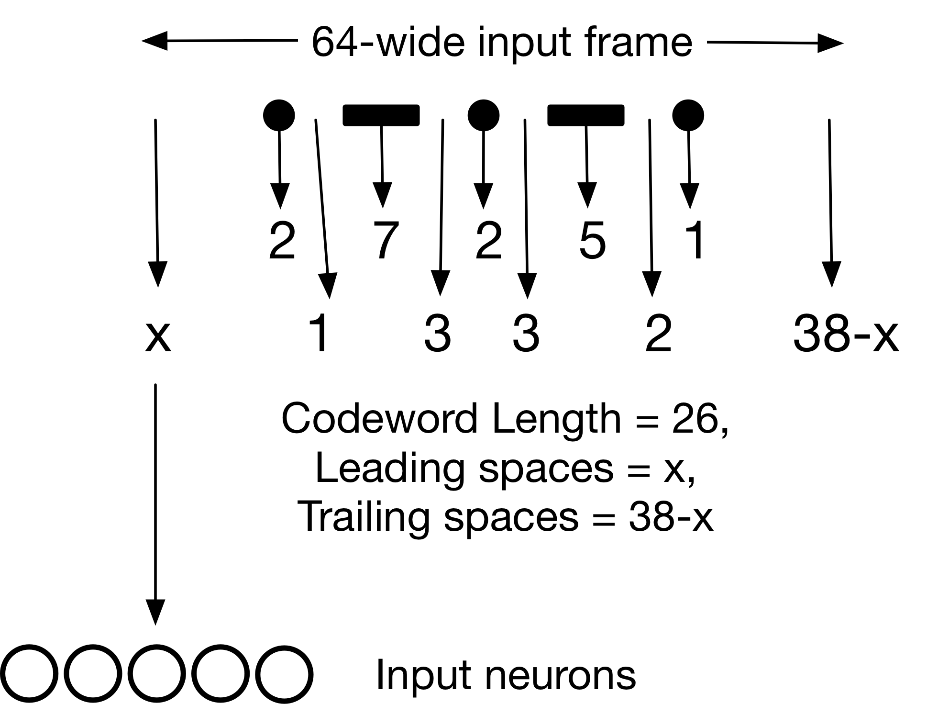
Variations and Difficulty Scaling - 2
Distribute remaining spaces randomly between leading and trailing

Slide 10
Variations and Difficulty Scaling - 3, 4
Dash length is 3-9, can be confused with dots and spaces
Dilate inputs by 4x
Property | Before Dilation | After Dilation
Frame length (= Number of inputs) | 64 | 256
Space | 1-3 | 4-12
Dot | 1-3 | 4-12
Dash | 3-9 | 12-36

Slide 11
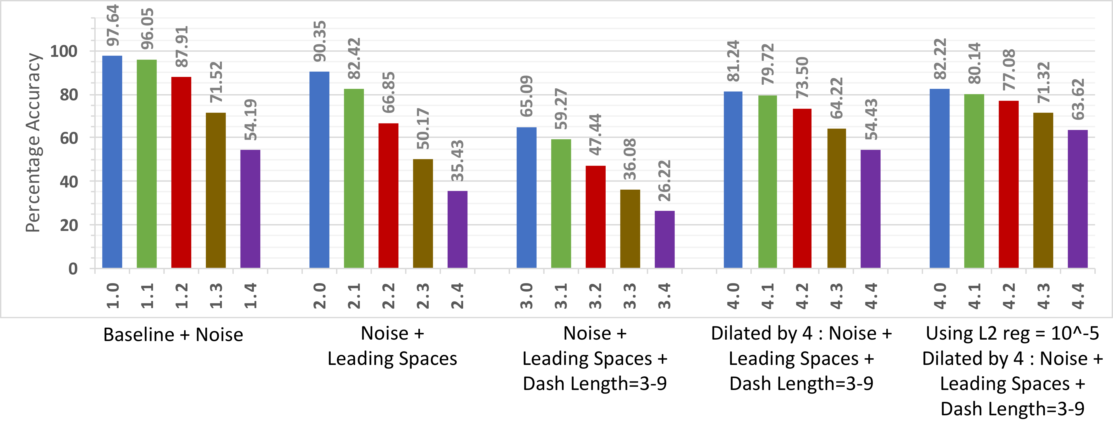
Classification Accuracy on Test Data
Standard deviation 𝜎 of added Gaussian noise

Slide 12
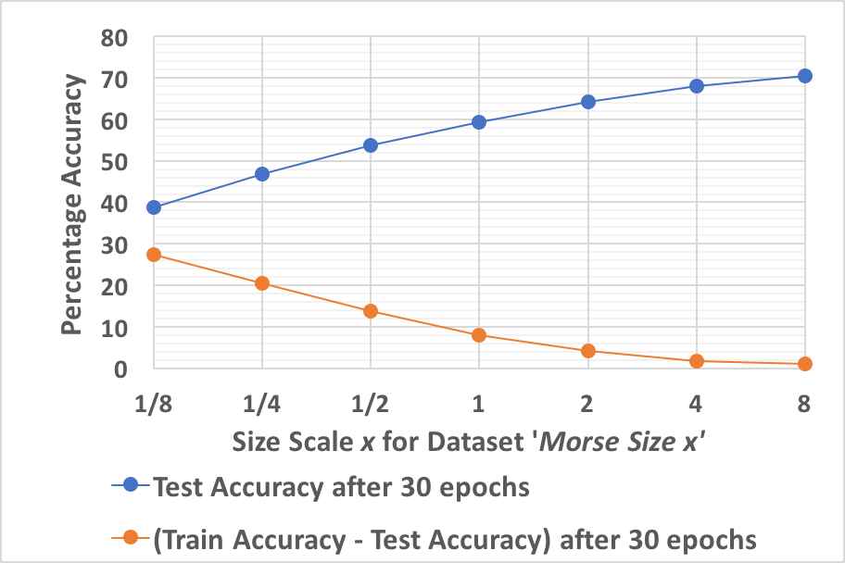
Increasing Dataset Size
Unlimited amounts of data can be easily generated using computer algorithms
~3M training samples
Overfitting region

Slide 13
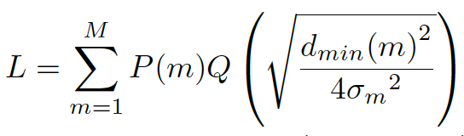
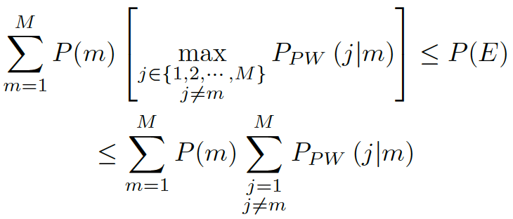
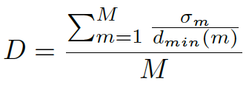
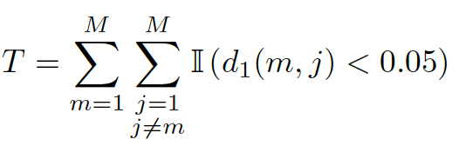
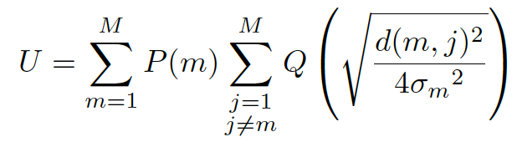
Dataset Evaluating Metrics
Difficult datasets have increased probability of classification errors

Slide 14
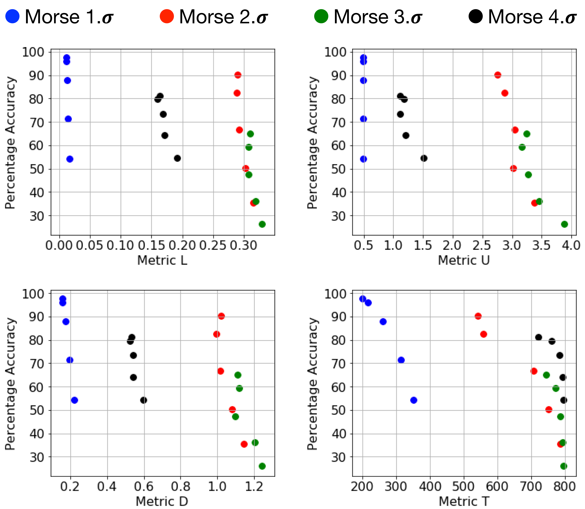
Performance of the Metrics
Harder datasets have lower accuracy and higher metric values
Metric | -𝜌
L | 0.59
U | 0.64
D | 0.63
T | 0.64

Slide 15
Conclusion
Algorithm to generate machine learning datasets of tunable difficulty
Synthetic data to solve challenges associated with natural data
Metrics to evaluate dataset difficulty prior to training

Slide 16
Thank you!
Questions?
Contact: souryade@usc.edu

