Slide 1
Aula Teste
Java + MySQL
Prof. M.Sc. Marcelo Tomio Hama

Slide 2

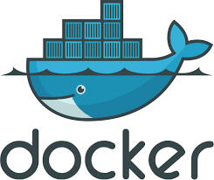

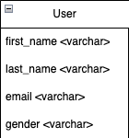


Stack, Modelo de Dados, e Arquitetura
UserController
User
UserService
JpaRepository
UserRepository
UserServiceImpl

Slide 3
Hands-On em Laboratório
https://github.com/marcelohama/docker-java-mysql
MYSQL
$ docker network create --driver bridge javamysql-network
$ docker container run -p 3306:3306 --name docker-mysql --network javamysql-network -e MYSQL_ROOT_PASSWORD=1q2w3e4r5t -e MYSQL_DATABASE=javamysqldb -d mysql:latest
$ docker container exec -it docker-mysql bash
$ mysql -u root -p javamysqldb
$ CREATE TABLE users ( id int NOT NULL,first_name varchar(255) NOT NULL,last_name varchar(255),email varchar(255),gender varchar(255));
$ INSERT INTO users (id, first_name, last_name, gender, email) VALUES (1, 'Teste', 'Teste', 'male', 'teste@gmail.com');
$ SELECT * FROM users;
JAVA BACKEND
$ mvn -Dmaven.test.skip=true package
$ docker build -t javamysql-backend:latest .
$ docker run -p 8080:8080 --name java-backend javamysql-backend:latest
http://localhost:8080/api/users

