Slide 1
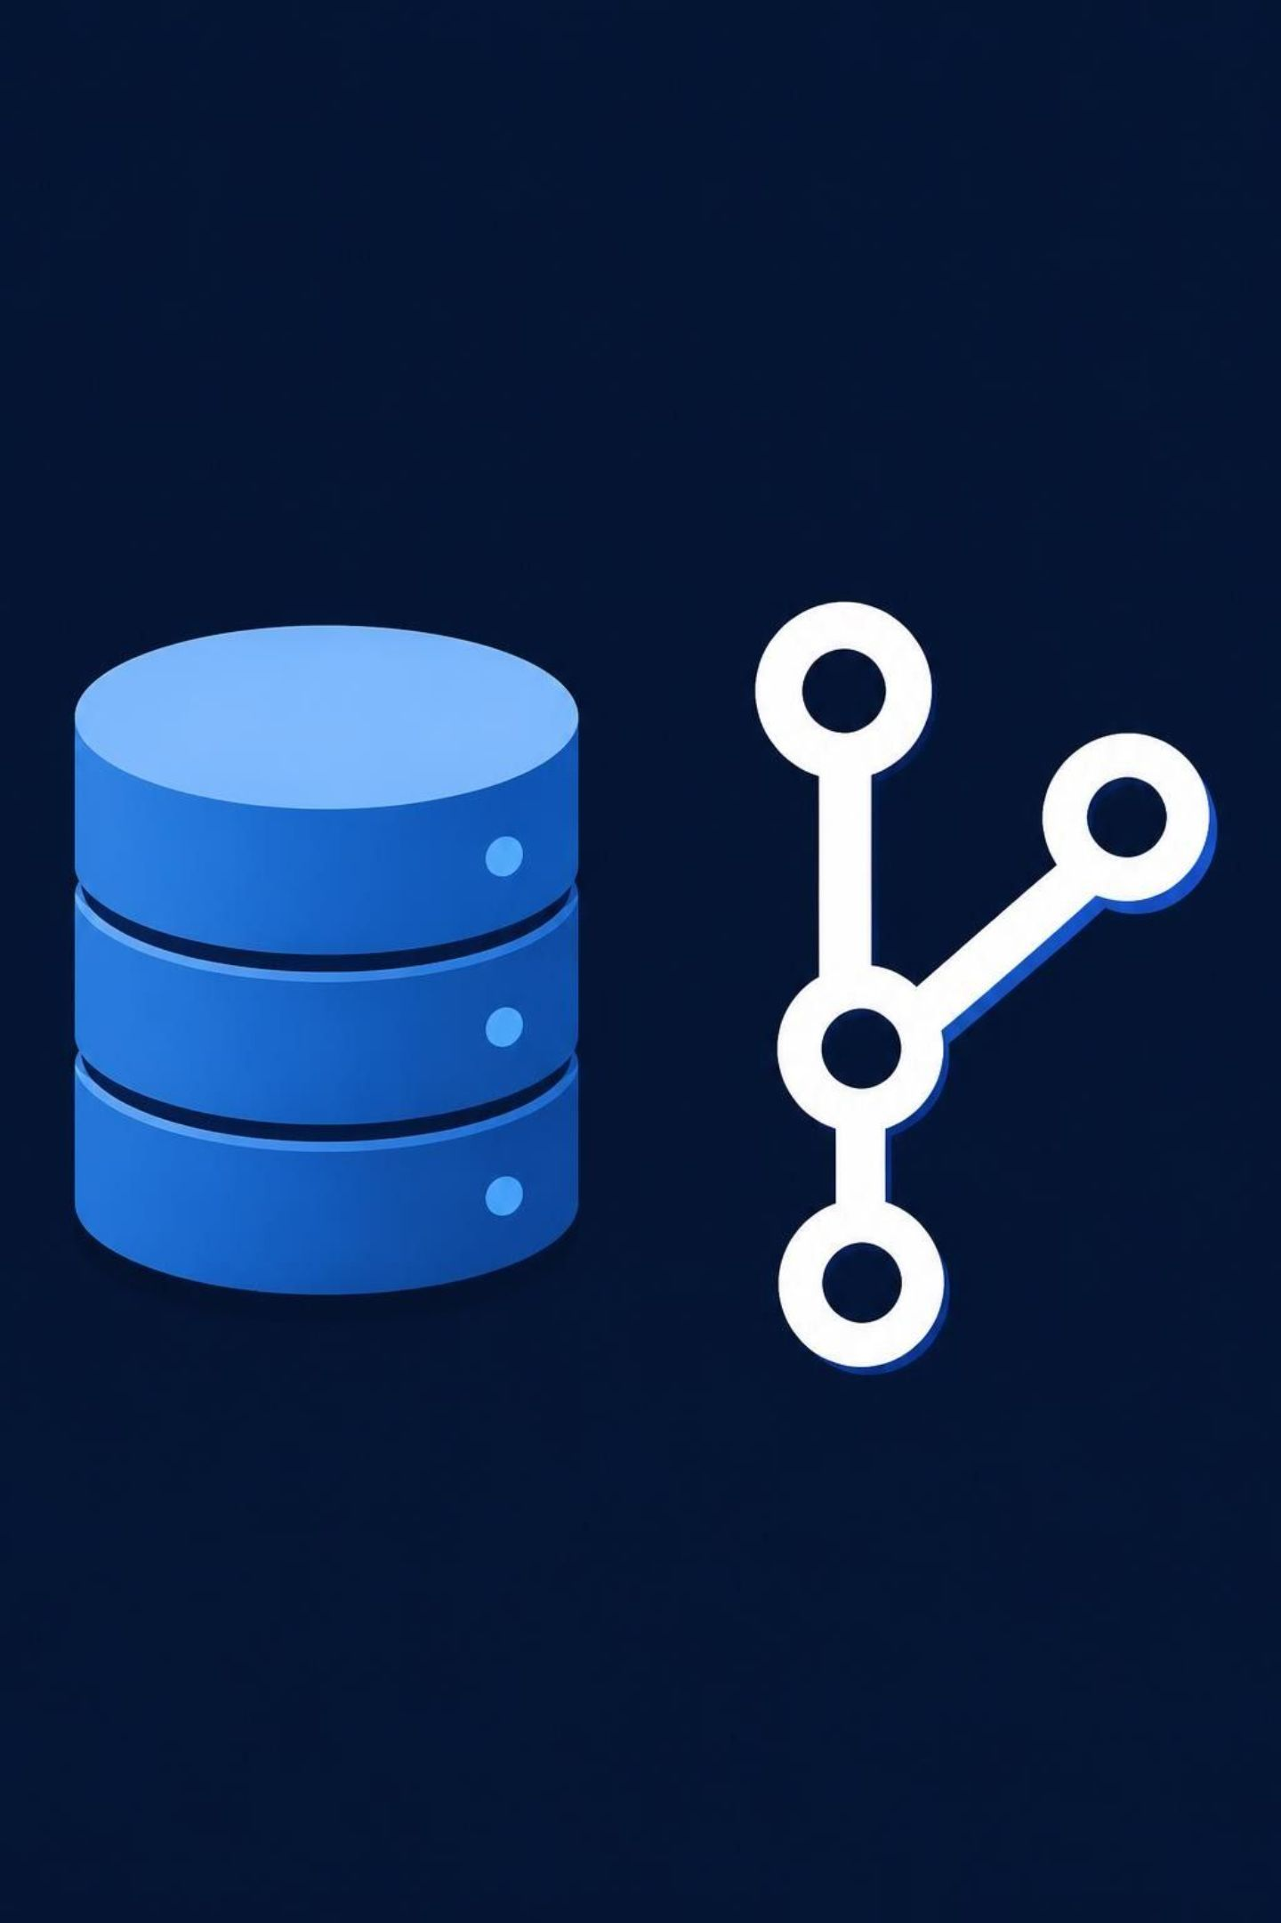
FLYWAY
Flyway Database Migrations
Version Control and Automation for Database Changes

Slide 2




What Is Flyway?
A database migration tool that versions and automates changes using SQL scripts.
Git
SQL Scripts
Database
Deployment Environments
Version control
Database changes
Automation and traceability
Automated changes
Supports SQL Server, PostgreSQL, Oracle, MySQL and other databases.

Slide 3

Why Use Database Migrations?
Flyway standardizes the order and tracking of database changes.
Before
After →
Manual SQL execution
Inconsistent environments
Manual tracking
Versioned migrations
Automated execution
Centralized migration history

Slide 4





How Flyway Works
Connect to the database and read flyway_schema_history to identify pending migrations.
Migration Files
Flyway Validation
Pending Migrations
Database
Migration History
Validate applied migrations
Execute in version order
Update history
V1__create_customer_table.sql
V2__add_customer_email.sql
V3__create_customer_index.sql
Each versioned migration normally runs once per database.

Slide 5
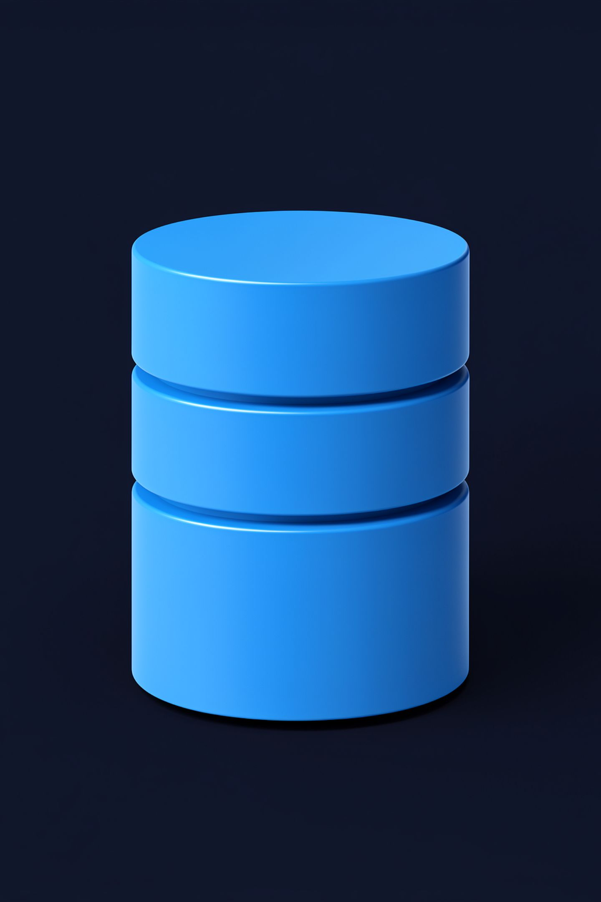
Flyway — Live Demo
Database Migration in Action
01
02
Create a migration.
Execute Flyway against SQL Server.
03
04
Verify the schema.
Check flyway_schema_history.
05
Run again to confirm previously applied versioned migrations do not rerun.
Write once, execute once, track forever.

Slide 6





Flyway Best Practices
Keep Applied Migrations Immutable
Use Descriptive Filenames
Keep Migrations Focused
V4__add_customer_status.sql
Keep each migration focused and independent.
In shared environments, add a new migration. Never modify an applied one.
Validate Before Production
Coordinate Versions
Validate in lower environments first.
Coordinate across branches to avoid conflicts.

Slide 7


Flyway — Advantages & Disadvantages
Advantages
Disadvantages
Version control
Automation
Traceability through migration history
Consistency of execution order
No universal automatic rollback
Version conflicts
Checksum failures if applied migrations change
Configuration and process complexity

Slide 8


Thank You

