Slide 1
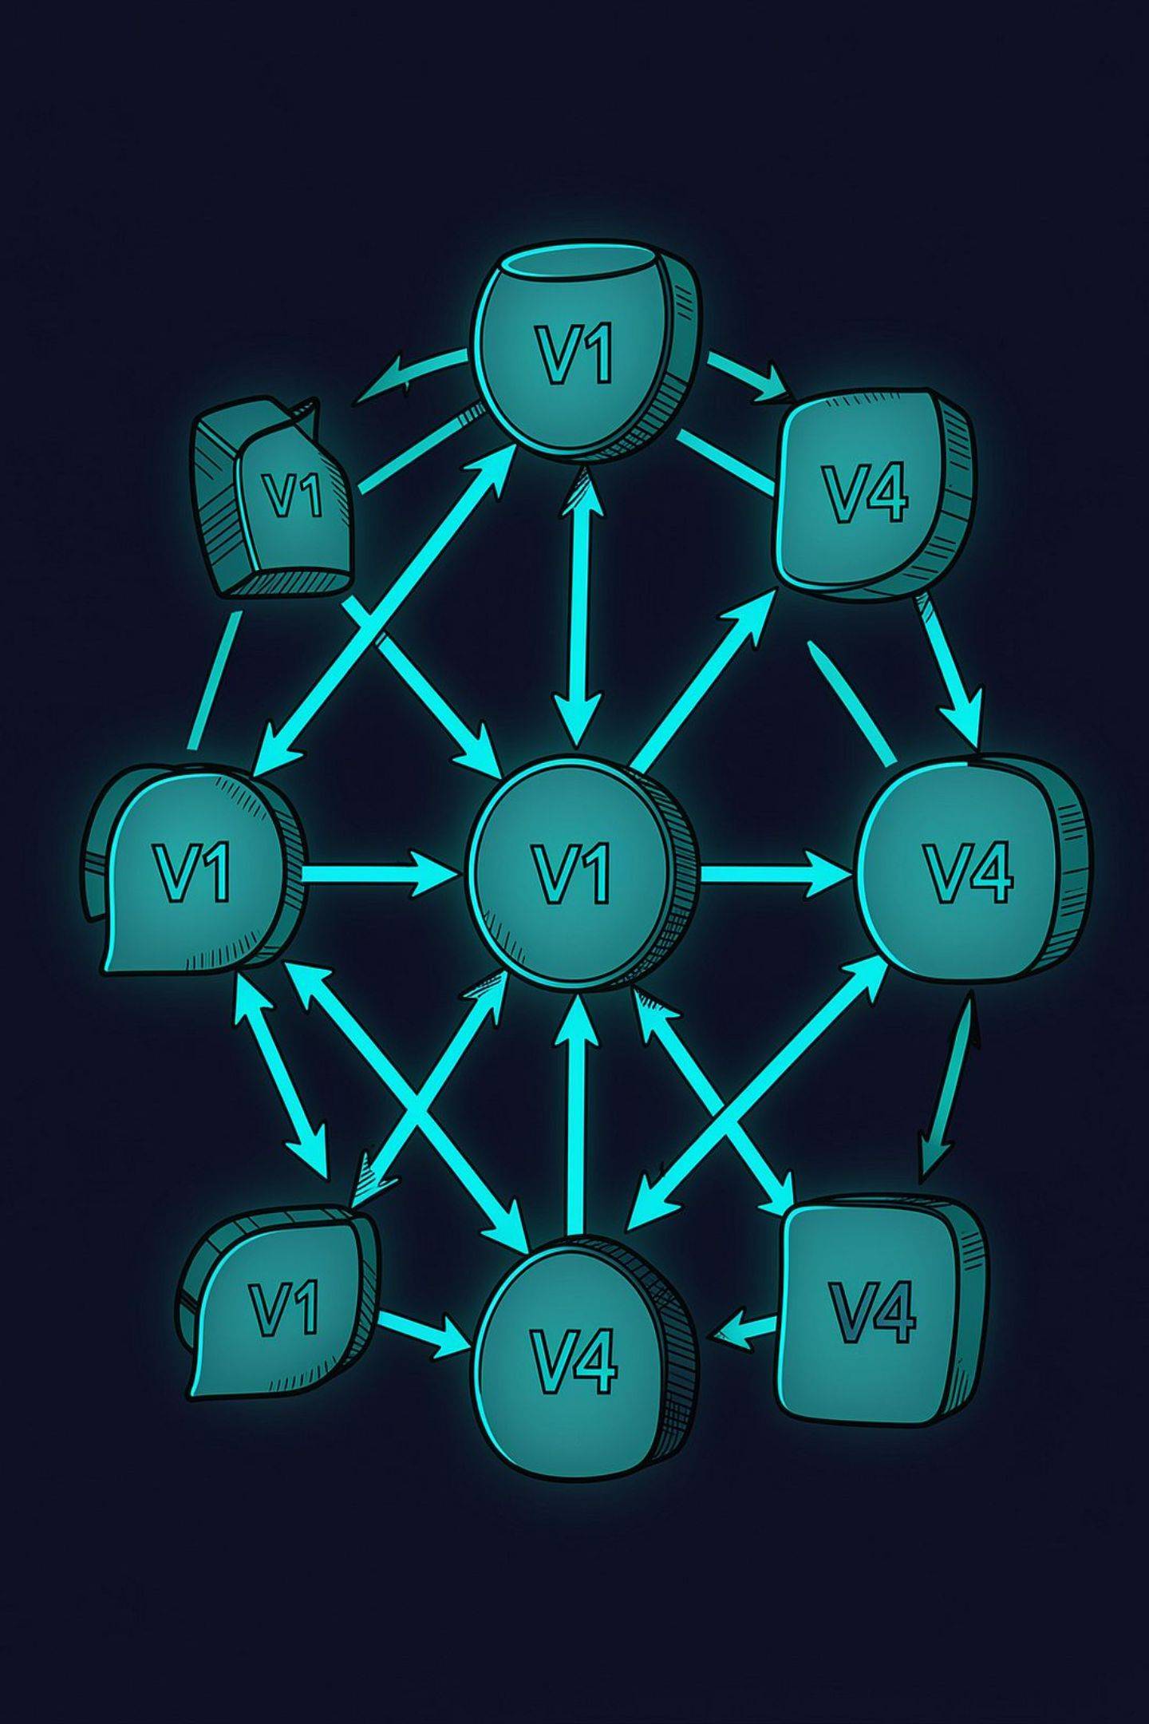
Flyway Migrations
Versioning and Managing Database Changes

Slide 2
Why Database Migrations?
Without a structured approach, database changes become a source of risk and uncertainty.
❌ Without Migrations
✅ With Migrations
Manual, ad-hoc SQL changes
Each environment diverges
No audit trail of what changed
High deployment risk
"What's the current schema?"
Versioned, repeatable SQL files
Consistent environments by design
Full history tracked automatically
Predictable, safe deployments
Schema is code

Slide 3

What is Flyway?
Flyway is an open-source database migration tool that versions, executes, and tracks schema changes — making database evolution a controlled, repeatable part of your deployment pipeline.
Migration Files
Flyway
Database
Versioned
Automated
Every change has a unique version number
Runs at startup or during CI/CD
Traceable
Repeatable
Full audit log in flyway_schema_history
Same result on every environment

Slide 4

How Flyway Works
Dev creates migration
Flyway scans pending
Validate history
Run migrations
Schema updated
Only pending migrations are executed. Flyway consults flyway_schema_history to determine which migrations have already been applied — nothing runs twice.

Slide 5



Migration Structure
Project Layout
Naming Convention
src/
└── main/
└── resources/
└── db/
└── migration/
├── V1__create_users.sql
├── V2__create_orders.sql
├── V3__add_user_status.sql
└── V4__create_indexes.sql
V2
__
Version number — determines execution order
Double underscore separator
add_user_status
.sql
Snake_case description of the change
Versioned SQL migration file
Migrations execute strictly in version order. Version numbers are never reused.

Slide 6
LIVE DEMO
Demo — Flyway in Action
Migration: V2__add_user_status.sql
Schema Before → After
ALTER TABLE users
ADD COLUMN status VARCHAR(20);
BEFORE: users
├── id
├── name
└── email
AFTER: users
├── id
├── name
├── email
└── status ← new column
Runtime Flow
Add migration file to db/migration/
Start Spring Boot application
Flyway detects pending migration
SQL executes against database
flyway_schema_history updated

Slide 7
Flyway + Spring Boot
Flyway integrates natively with Spring Boot — migrations run automatically at startup, before any application code touches the database.
Configuration (application.yml)
Startup Sequence
01
spring:
flyway:
enabled: true
locations: classpath:db/migration
Spring Boot starts
02
Flyway bean initializes
Migration Location
03
src/main/resources/db/migration/
Scans db/migration/ for pending files
04
Executes migrations in version order
05
Application ready — schema is current

Slide 8


From Development to Production
Database changes travel through your CI/CD pipeline alongside application code — reviewed, versioned, and deployed together.
Flyway DB Migration
App Deployment
Code Commit & CI
DEV/UAT
BENCH
PROD
Local migrations during development
Validated against test data
Applied as part of release deployment
Database changes become part of the deployment. Treat migration files as application code — review them in pull requests and version-control them alongside your source.

Slide 9






Flyway Best Practices
Keep Migrations Small
Never Modify Applied Migrations
One logical change per file. Easier to review, test, and rollback.
Once executed, a versioned migration is immutable. Create a new one instead.
Use Meaningful Names
Review Migrations as Code
V5__add_email_index.sql — the name should explain the change.
Include SQL files in pull requests. Require peer review before merge.
Avoid Destructive Changes
Test Before Production
Use DROP TABLE or DROP COLUMN with extreme caution — always test first.
Run migrations against a realistic staging database before any production release.

Slide 10
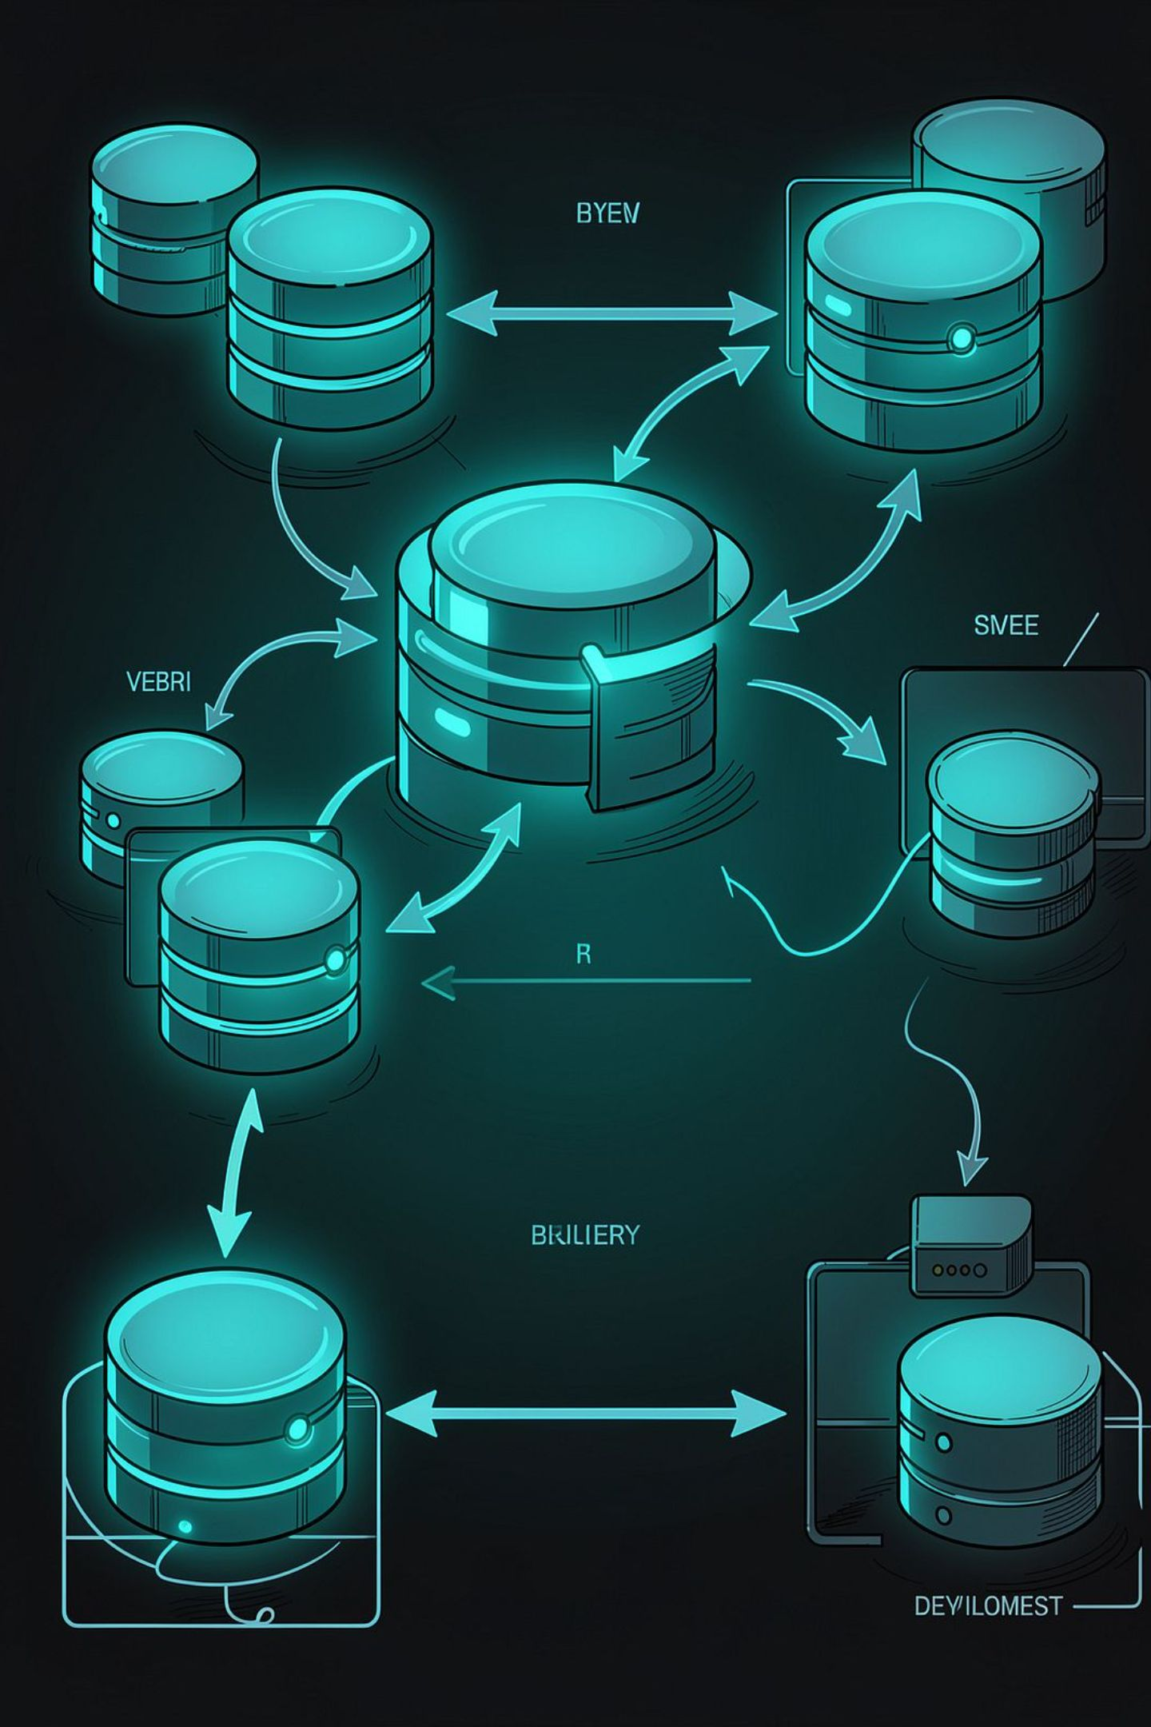
Key Takeaways
Version Your Changes
Every schema change gets a numbered migration file
Automate Execution
Flyway runs at startup — no manual SQL
Track History
flyway_schema_history is your audit log
Integrate CI/CD
Database changes deploy with your application
Flyway turns database evolution into a controlled, versioned process.

