Slide 1
RicoSLAM: Long-Term Localization and
Mapping in Dynamic Environments
Ricardo B. Sousa
Thesis Research Plan – Doctoral Program in Electrical and Computers Engineering
Zoom Meeting, January 12, 2023
Prof. António Paulo Moreira, PhD (Supervisor)
Héber Miguel Sobreira, PhD (Second Supervisor)
Notes:
My name is Ricardo Sousa. I am here to present my PhD thesis proposal, named RicoSLAM: Long-Term Localization and Mapping in Dynamic Environments.
This proposal has as supervisors Professor António Paulo Moreira from FEUP and INESC TEC and Héber Miguel Sobreira from INESC TEC.

Slide 2
Outline
Introduction
Literature Review
Thesis Statement
Preliminary Developments
Research Plan
Notes:
The presentation follows the structure of the Thesis Research Plan document.

Slide 3
Outline
Introduction
  Context
  Motivations
  Goals
Literature Review
Thesis Statement
Preliminary Developments
Research Plan
Notes:
First,

Slide 4
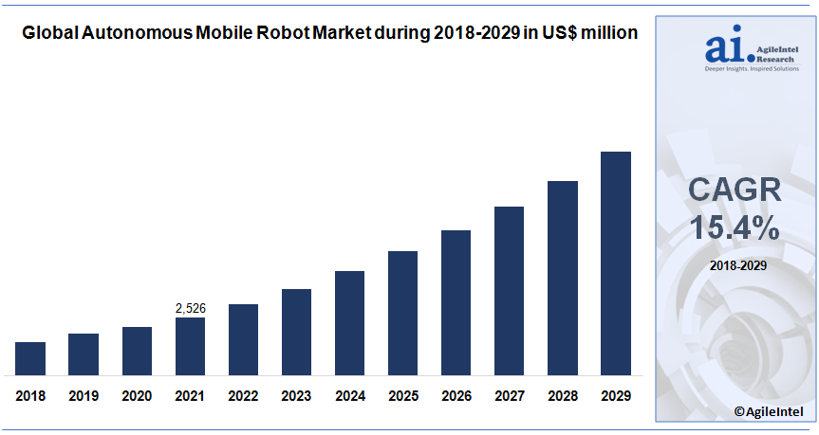
Introduction: Context
Fig. 1: Global Autonomous Mobile Robot (AMR) market estimated growth by AgileIntel Research during 2018–2029 in US$ million [1]
Notes:
…, the global interest in Autonomous Mobile Robots, also called AMR, have been increasing in the past 5 years contributing to the growth of the global economy.
As shows the figure, the value of the global AMR market is estimated to continue growing at a Compound Annual Growth Rate of 15.4 per cent between 2022 and 2029, showing the relevance of AMR systems for the global economy.

Slide 5
Context
Autonomous Mobile Robots (AMRs) requires an environment representation
Simultaneous Localization and Mapping (SLAM)
  Robot pose estimation
  Mapping the environment
Notes:
These systems require a representation of their surroundings to be able to localize itself relative to the environment.
SLAM is a possible approach to obtain that representation, estimating concurrently the robot pose in the environment and the map of the scene.

Slide 6
Context
Autonomous Mobile Robots (AMRs) requires an environment representation
Simultaneous Localization and Mapping (SLAM)
  Robot pose estimation
  Mapping the environment
Static scene only requires mapping once the environment
Real world is not static!
  Moving elements
  Environment reconfiguration
  Appearance variations
Notes:
In the case of static scenes, from a theoretical point of view, would only require a single pass through the environment to obtain the map, due to the map remaining a consistent representation of the scene throughout time.
However, the real world is not static, having moving elements in the scene, appearance variations due to lighting, seasonal and weather changes, and environment reconfigurations.

Slide 7
Context
Autonomous Mobile Robots (AMRs) requires an environment representation
Simultaneous Localization and Mapping (SLAM)
  Robot pose estimation
  Mapping the environment
Static scene only requires mapping once the environment
Real world is not static!
  Moving elements
  Environment reconfiguration
  Appearance variations
How to update the map?
  Only most current state?
  Only static elements?
When?
  When changes occur?
  After a certain time?
Notes:
Two questions arise of how to update the map and when!

Slide 8
Motivation
Strategic Research, Innovation and Deployment Agenda (SRIDA) (September 2020) [2]
  Deal with unpredictable and unknown environments, and irreversible actions
  Avoid unrecoverable states that require the reset of AMRs system
Notes:
So, this thesis frames into the SRIDA agenda elaborated by several European partners related to AI and robotics research fields, specifically, in how to deal with unpredictable and unknown environments, trying to avoid unrecoverable states that requires an operator to reset the AMR system.

Slide 9
Motivation
Strategic Research, Innovation and Deployment Agenda (SRIDA) (September 2020) [2]
  Deal with unpredictable and unknown environments, and irreversible actions
  Avoid unrecoverable states that require the reset of AMRs system
Dynamic elements can make map representations outdated and unusable
  Changes in the scene not updated in the map
  Outdated map would require a specialized operator for remapping the scene
Notes:
Indeed, dynamic elements can make map representations outdated and unusable for localization

Slide 10
Motivation
Strategic Research, Innovation and Deployment Agenda (SRIDA) (September 2020) [2]
  Deal with unpredictable and unknown environments, and irreversible actions
  Avoid unrecoverable states that require the reset of AMRs system
Dynamic elements can make map representations outdated and unusable
  Changes in the scene not updated in the map
  Outdated map would require a specialized operator for remapping the scene
Interpretation and dealing with dynamic changes online would improve the efficiency and self-awareness of those systems
Notes:
Leading to the main motivation of this proposal that is improving the efficiency and self-awareness of AMR systems interpreting and dealing with dynamic environment changes.

Slide 11
Goals
Modeling of environment dynamics perceived by different sensors
Incorporate the modeled dynamics in both localization and mapping
Lifelong SLAM in dynamic environments with an AMR
Notes:
Three goals for the PhD thesis:
- Model environment dynamics using different sensors
- Incorporate the dynamics in both localization and mapping processes to improve the consequent results
- And, finally, achieve lifelong SLAM in dynamic environments with an AMR

Slide 12
Outline
Introduction
Literature Review
  Methodology
  SLAM
  Long-term SLAM in Dynamic Environments
  Open Challenges
Thesis Statement
Preliminary Developments
Research Plan
Notes:
Next,

Slide 13
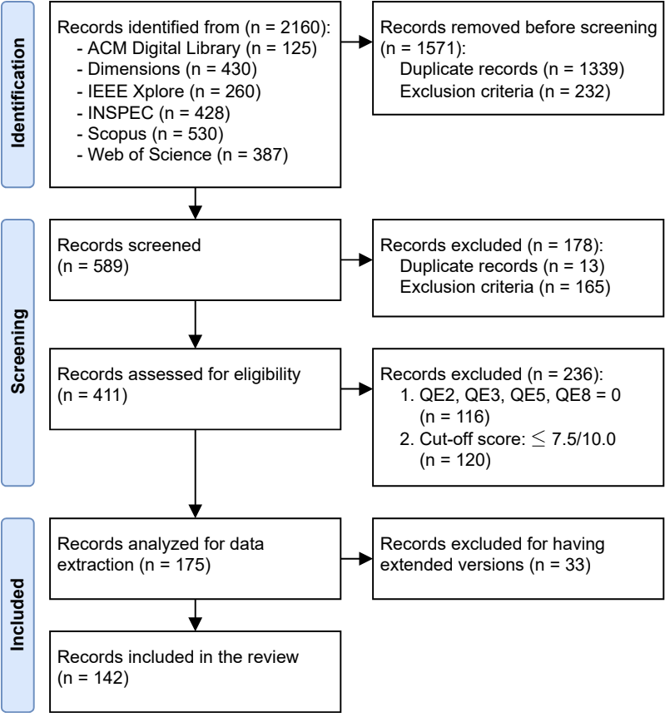
Literature Review: Methodology
Search base string
(robot* OR vehicle*) AND
((locali* AND map*) OR “slam”) AND
(“long term” OR “life long” OR
lifelong)
Last full inquiry on May 17, 2022
  Update on October 25, 2022, for dynamic environments
Selection Process
  Identification
  Screening
  Quality Assessment
Fig. 2: PRISMA flow diagram
Notes:
…, a systematic literature review was performed following the Preferred Reporting Items for Systematic reviews and Meta-Analysis statement, also know as the PRISMA guidelines.
The scope of the literature review was not limited to only the challenge of dealing with dynamic elements, trying to identify works related to long-term SLAM, as shown in the search base string.
Although the last inquiry was on May 2022,

Slide 14
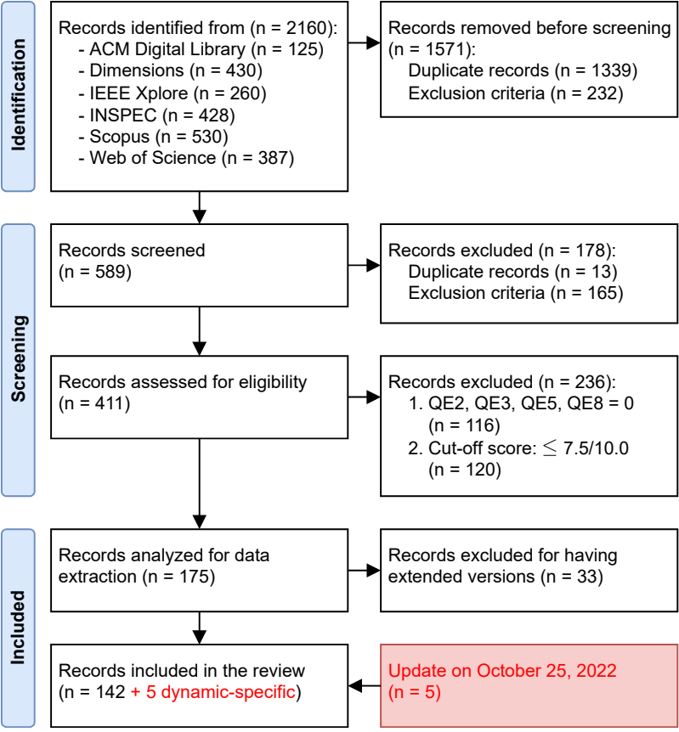
Literature Review: Methodology
Search base string
(robot* OR vehicle*) AND
((locali* AND map*) OR “slam”) AND
(“long term” OR “life long” OR
lifelong)
Last full inquiry on May 17, 2022
  Update on October 25, 2022, for dynamic environments
Selection Process
  Identification
  Screening
  Quality Assessment
Fig. 2: PRISMA flow diagram
Notes:
…, for the purpose of elaborating this PhD Thesis Research Plan, another inquiry was made on October 2022, performing the identification, screening and quality assessment for all the works published between the two dates, but effectively only analysing the ones related to the main challenge that this thesis focuses on, that is, dealing with dynamic environments.

Slide 15
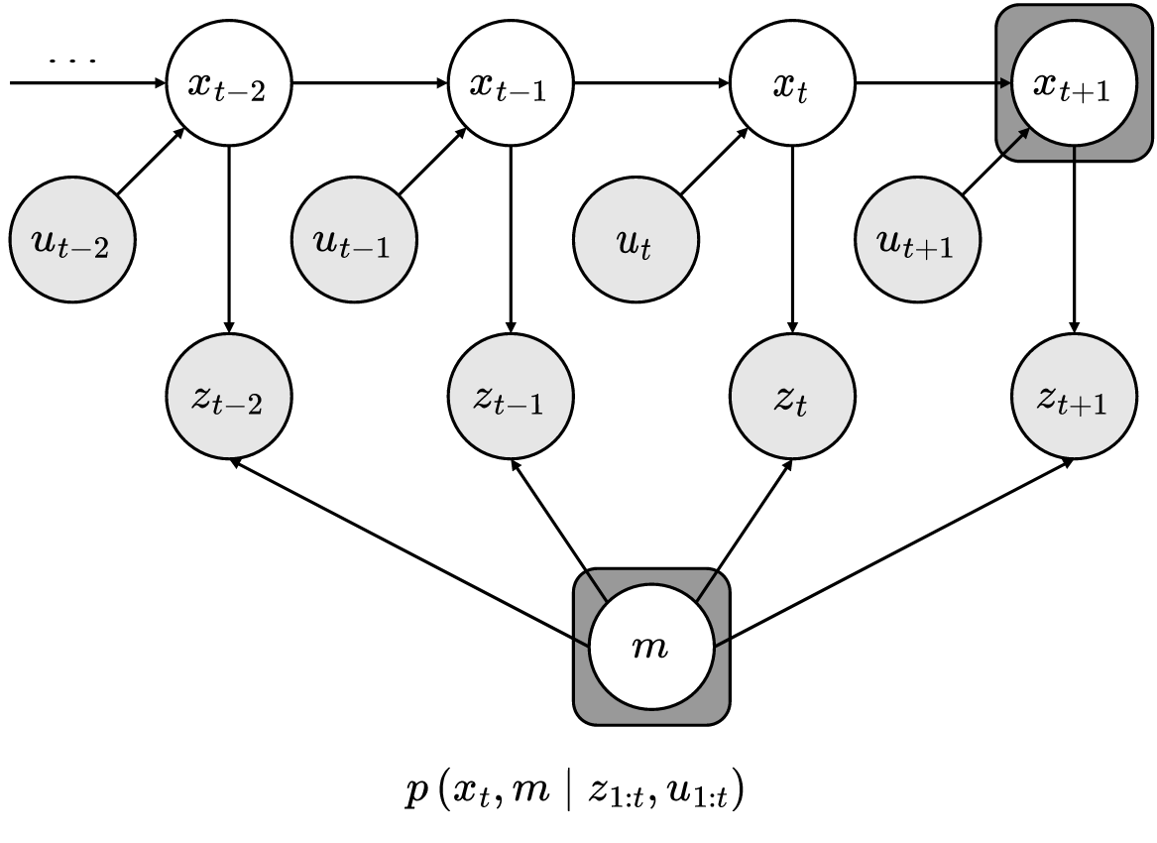
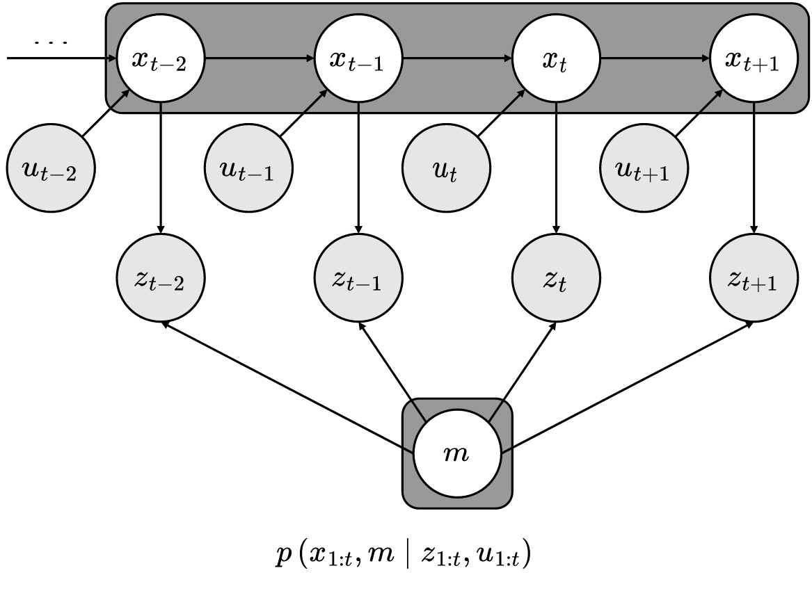
SLAM
Fig. 3: Online SLAM problem [4]
Fig. 4: Full SLAM problem [4]
Notes:
In terms of traditional SLAM problem, there are two main approaches: online and full SLAM, with the difference between them being the variables estimated, where full SLAM estimated the full robot trajectory, unlike online SLAM that only estimates the current pose.

Slide 16
SLAM
Scan matching
  Align sensor data with current map
  Update the map with the latest sensor scan
Particle filter
  Rao-Blackwellized Particle Filters (RBPFs)
  Probabilistic approach
  SLAM = robot localization + map estimation conditioned on robot pose estimate
Pose graph
  Front (identify constraints) and back-end (refine graph) modules
  Optimization approach
  Maximum Likelihood Estimation (MLE) formulation for optimizing the pose graph
Notes:
As also noted in the literature review, there are three main implementations to solve the traditional SLAM problem: Scan matching, Particle filter, and Pose graph

Slide 17
SLAM
Scan matching
  Align sensor data with current map
  Update the map with the latest sensor scan
Particle filter
  Rao-Blackwellized Particle Filters (RBPFs)
  Probabilistic approach
  SLAM = robot localization + map estimation conditioned on robot pose estimate
Pose graph
  Front (identify constraints) and back-end (refine graph) modules
  Optimization approach
  Maximum Likelihood Estimation (MLE) formulation for optimizing the pose graph
Notes:
Where the first aligns the sensor data with the current map and integrates the data into the map.
The second one implements Rao-Blackwellized Particle Filters for decomposing and factoring the posterior probability, being a probabilistic approach.
And finally, the one used more recently the pose graph framework, in which a node represents a robot pose and the respective sensor observations, the front end module tries to create edges / constraints between nodes and the backend refines by optimizing the convergence between the sensor measurements modelled in the edges.

Slide 18
Long-term SLAM in Dynamic Environments
Map representation
  Short/Long-Term Memory (S/LTM)
  Static vs dynamic maps
  Multi-hypothesis framework
Notes:
In terms of dealing with dynamic elements, the literature proposes different map representations.

Slide 19
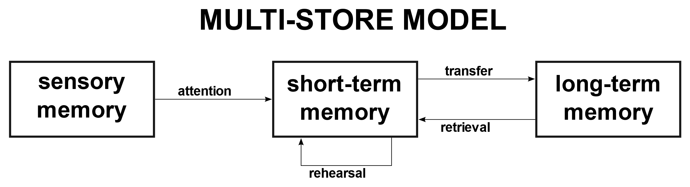
Long-term SLAM in Dynamic Environments
Map representation
  Short/Long-Term Memory (S/LTM)
    Multi-store model of human memory
    Multiple timescales
    Use LTM maps for localization
  Static vs dynamic maps
  Multi-hypothesis framework
Fig. 5: Multi-store model of human memory proposed by Atkinson
and Shiffrin (1968)
Source: https://commons.wikimedia.org/wiki/File:Memory_multistore_model.svg
Notes:
The first tries to follow the multi-store model of the human memory show in the figure, having a long-term memory to filter unstable features, using the stable ones for localization.

Slide 20
Long-term SLAM in Dynamic Environments
Map representation
  Short/Long-Term Memory (S/LTM)
  Static vs dynamic maps
    Identification of moving elements
    Distinction between static – semi-static – dynamic changes
    Ignore dynamic elements for static map
    Use static map for localization
  Multi-hypothesis framework
(not possible to show examples due to require payment of copyright fees…)
Notes:
A similar approach is defining static versus dynamic maps, using the static ones for localization.
These approaches clearly perform a binary classification on the features between static and dynamic ones.

Slide 21
Long-term SLAM in Dynamic Environments
Map representation
  Short/Long-Term Memory (S/LTM)
  Static vs dynamic maps
  Multi-hypothesis framework
    Group landmarks positions based on signature
    Hypothesis likelihood ~ matched measurements vs missed detections
    Assume uniquely identifiable landmarks
(not possible to show examples due to require payment of copyright fees…)
Notes:
While the multi-hypothesis framework tries to cluster the map landmarks in terms of their position, but assumes uniquely identifiable signatures for the landmarks.

Slide 22
Long-term SLAM in Dynamic Environments
Map matching
  Observation vs map
  Clustering properties of observations
  Ray tracing
  NDT + occupancy grid map hybrid representation
Notes:
Next, using map matching methods, such as ray tracing or NDT, the authors in the literature also try to identify the dynamic features and removing them from the map. Plus, the authors also hypothesize on the clustering properties of observations, stating that features near dynamic ones tend to have a similar behaviour.

Slide 23
Long-term SLAM in Dynamic Environments
Prediction modeling
  Markov-based processes
    State holding time associated to Markov processes
  Patterns periodicity
    Fourier analysis
    Time series as stationary stochastic processes
  CNN-based prediction
Notes:
In terms of predicting the dynamics of the environment, three different methodologies were found in the literature:
- Markov processes to model the state holding time associated to them, however, only intended for offline computation
- Evaluation of the periodicity of the patters, using Fourier analysis for periodic signals, or time series as stochastic processes to also predict aperiodic dynamics changes
- And finally, CNN-based prediction, using training data from previous sessions to predict the dynamics in the different areas in the environment

Slide 24
Long-term SLAM in Dynamic Environments
Dynamic objects detection
  Assume certain semantic classes as dynamic
  Use features associated to static objects for localization and mapping
  Bounding box segmentation (YOLO)
  Pixel-wise segmentation
Notes:
As for detecting dynamic objects, semantic information is used to classify the objects classes, and then, assuming that some of them are a prior dynamic observations, only use static objects’ observations for localization and mapping

Slide 25
Open Challenges
Heterogeneous sensor configurations
Multi-modal maps
Tightly-coupling of dynamics estimation into localization and mapping
Online estimation of the observations’ dynamicity
Human-Machine Interfaces (HMI)
Notes:
Overall, the following open challenges were identified after the literature review:
- Dealing with dynamic elements considering heterogeneous sensor configurations
- How to leverage multi-modal maps (e.g., having simultaneously grid and feature map representations for localization) for long-term SLAM
- Tightly-coupling dynamics estimation into localization and mapping processes
- Estimating the observations dynamics online
- And finally, how to interact with the user of AMR systems in long-term SLAM using Human-Machine interfaces

Slide 26
Outline
Introduction
Literature Review
Thesis Statement
  Problem Statement
  Research Questions (RQ) and Hypotheses (H)
Preliminary Developments
Research Plan
Notes:
As a result of the literature analysis, …

Slide 27
Thesis Statement: Problem Statement
Localize a mobile robot within dynamic indoor environment
Decide how and when to update the map
No assumption on the environment dynamics
Notes:
This PhD thesis proposal focuses on localizing a robot in an indoor dynamic environment, without considering any assumption on the environment dynamics.

Slide 28
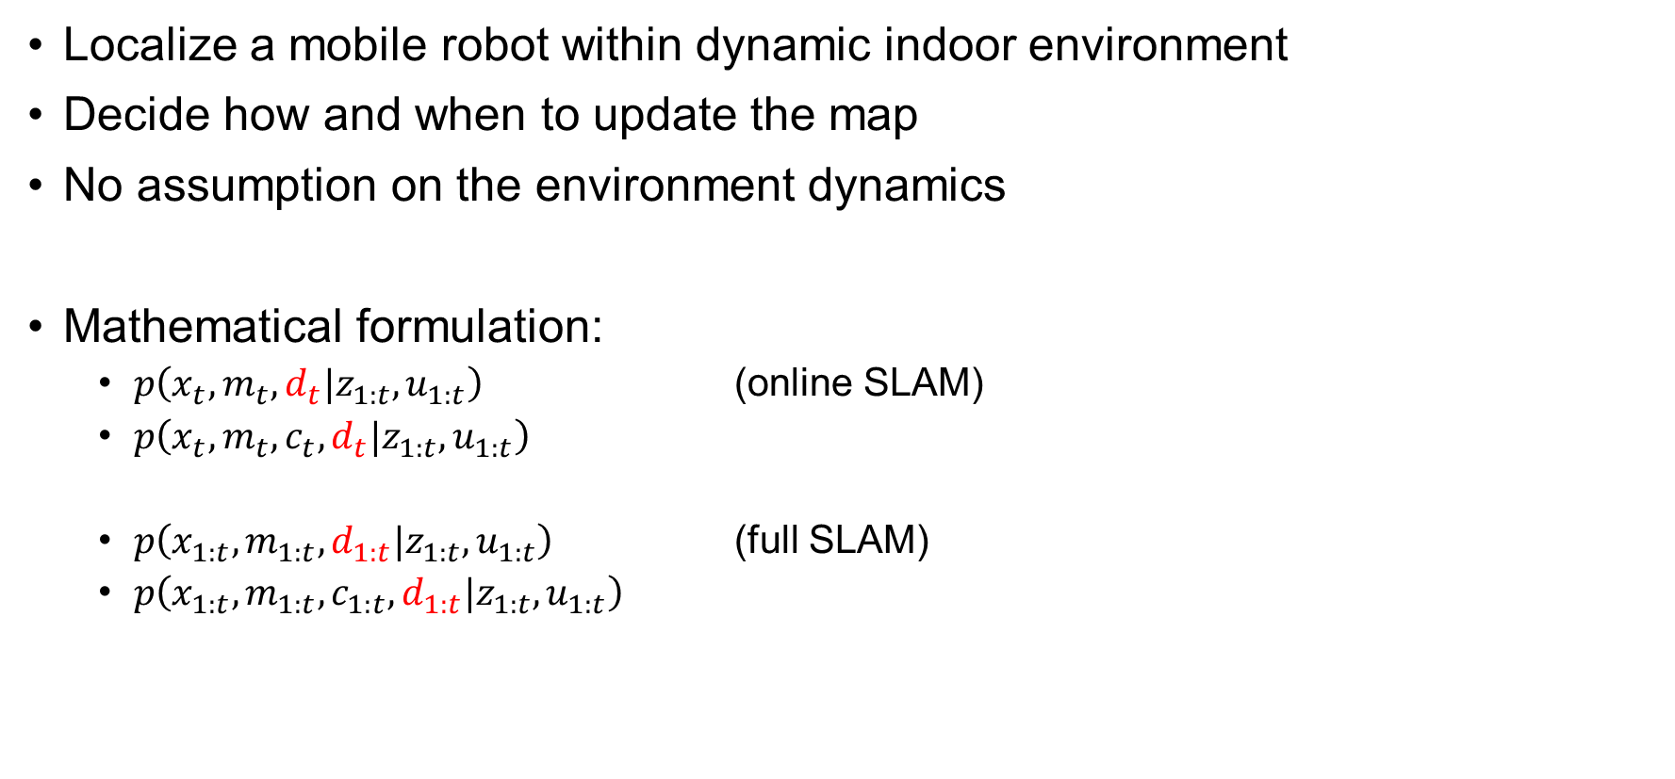
Thesis Statement: Problem Statement
Localize a mobile robot within dynamic indoor environment
Decide how and when to update the map
No assumption on the environment dynamics
Mathematical formulation:
  $p\left(x_{t},m_{t},d_{t}|z_{1:t},u_{1:t}\right)$ (online SLAM)
  $p\left(x_{t},m_{t},c_{t},d_{t}|z_{1:t},u_{1:t}\right)$
  $p\left(x_{1:t},m_{1:t},d_{1:t}|z_{1:t},u_{1:t}\right)$ (full SLAM)
  $p\left(x_{1:t},m_{1:t},c_{1:t},d_{1:t}|z_{1:t},u_{1:t}\right)$
Notes:
Based on the mathematical formulation of the traditional SLAM problem, this thesis’ statement may be formulated as including the dynamics into the estimation process

Slide 29
Research Questions (RQ) and Hypotheses (H)
RQ1: Extrinsic parameter calibration without external equipment
  H1: Convergence on relative motion of each sensor in the same coordinate frame should be maximum for the true value of the sensors’ extrinsic parameters
RQ2: Improve mapping results and their long-term stability when performing SLAM in a dynamic indoor environment
  H2.1: Dynamics history in an area, the points state (position, velocity), their existence throughout time, and dynamics clustering properties relative to neighborhood should give a model for the environment dynamics
  H2.2: Tightly-coupling of the environment dynamics modeling into mapping process using the dynamics as weights while also rejecting highly dynamic observations, giving more importance to static observations, should improve mapping results
Notes:
In terms of research questions, the first is relative to robot sensor calibration without external equipment, in which a hypothesis arises in the TRP that the convergence on relative motion between sensors in the same frame should be maximum for the true value of the sensor extrinsic parameters.
The second question is associated to how to improve mapping in dynamic environments.
Two hypotheses are formulated, where 2.1 focuses on how to model the environment dynamics, while 2.2 focuses on integrating and tightly-coupling the estimated environment dynamics into the mapping process.

Slide 30
Research Questions (RQ) and Hypotheses (H)
RQ3: Integrate environment dynamics into the localization process
  H3: Similar to H2.2, tightly-coupling of environment into the localization estimation process should achieve long-term stability of the localization results in a dynamic indoor environment
Notes:
And the final question is over the integration of the environment dynamics into the localization process, with a similar hypotheses to H2.2

Slide 31
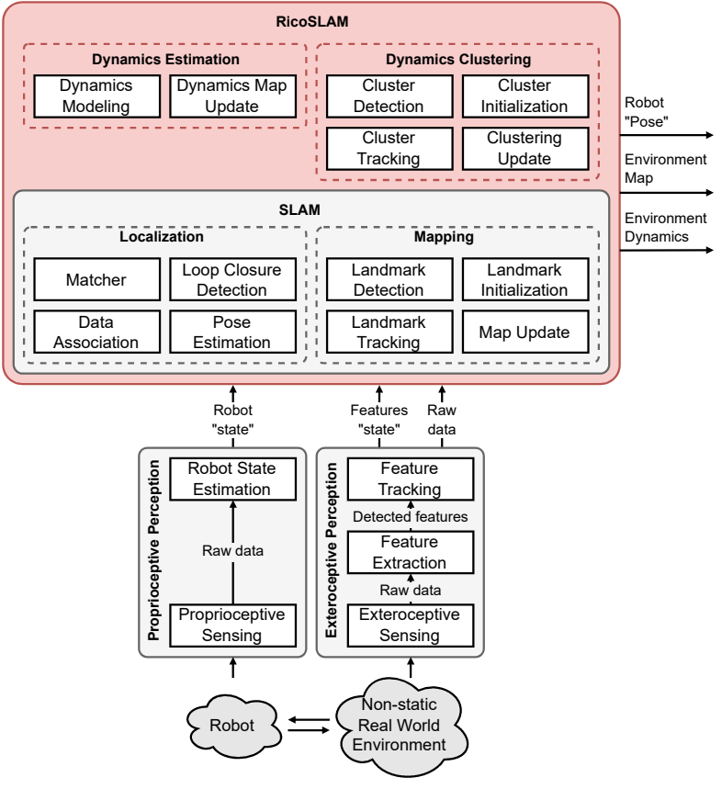
Research Questions (RQ) and Hypotheses (H)
Fig. 6: Generic block diagram for this PhD thesis research proposal in the context of SLAM
Notes:
The following figure illustrates how RicoSLAM, this thesis proposal, intends to wrap around the traditional SLAM problem by modelling and creating a dynamics map of the environment, leveraging also clustering properties of the sensor observations in terms of their dynamicity.

Slide 32
Outline
Introduction
Literature Review
Thesis Statement
Preliminary Developments
Research Plan
Notes:
Certain preliminary developments are already in progress, …

Slide 33
Preliminary Developments
Preparation of the mobile platforms for data acquisition
Preliminary study on the Hypothesis H1 for automatic robot calibration
Introduction to SLAM
Notes:
.. Including the preparation of mobile platforms required for data acquisition and testing beds of the algorithms to be studied and researched in this PhD proposal, a preliminary study on the hypothesis H1 demonstrating the validity of it, as shown in the TRP document, and also a little introduction to the SLAM problem and respective experimentation with mobile robots.

Slide 34
Outline
Introduction
Literature Review
Thesis Statement
Preliminary Developments
Research Plan
Notes:
Finally, …

Slide 35
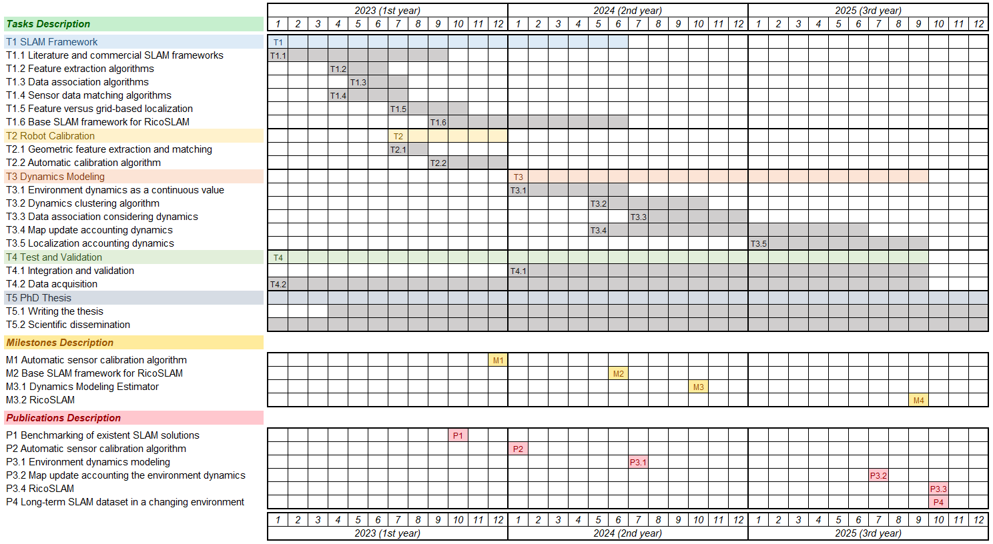
Research Plan
Fig. 7: Timeline of the PhD research plan
Notes:
…, the research plan of this PhD thesis proposal is illustrated in the following figure.

Slide 36
Research Plan
Fig. 7: Timeline of the PhD research plan
Notes:
The first main task will be the study, research, and benchmarking of existing SLAM solutions in the literature and, if possible, commercial systems. This task will also increase knowledge on the traditional SLAM problem, going over several modules such as feature extraction, data association, and sensor data matching algorithms.

Slide 37
Research Plan
Fig. 7: Timeline of the PhD research plan
Notes:
Given the knowledge on features obtained in Task 1, the second task will leverage that knowledge to improve the sensor matching results from which the convergence of relative motion will be researched to accomplish an automatic calibration algorithm, as stated in the hypothesis H1.

Slide 38
Research Plan
Fig. 7: Timeline of the PhD research plan
Notes:
In the second year of the thesis, the dynamics modelling task will begin after concluding the robot calibration one, and also having in progress the research on a base SLAM framework for RicoSLAM (Task T1.6).
This third main task of the proposal intends to validate the research hypotheses H2.1, H2.2, and also H2.3.

Slide 39
Research Plan
Fig. 7: Timeline of the PhD research plan
Notes:
In parallel to the first three tasks, the test and validation of the research results will be performed throughout the thesis. Also note for a specific sub task dedicated to the data acquisition, essential for testing the studied and researched algorithms within the scope of this thesis.

Slide 40
Research Plan
Fig. 7: Timeline of the PhD research plan
Notes:
And similarly in parallel, the writing of the thesis itself and the scientific dissemination will be performed throughout the three years foreseen for this proposal.

Slide 41
Research Plan
Fig. 7: Timeline of the PhD research plan
Notes:
The milestones align with the competition of the tasks T2.2, T1.6, T3.2, and T3.5. The first milestone is obtaining the automatic sensor calibration algorithm and the second one the base SLAM framework of RicoSLAM. And the final two are relative to dynamics modelling, of which the first is the dynamics model estimator and the final one is the final RicoSLAM framework.

Slide 42
Research Plan
Fig. 7: Timeline of the PhD research plan
Notes:
As for the publications, these align with the competition of the tasks T1.5 relative to benchmarking existent SLAM solutions, T2 for the robot calibration algorithm, T3.1 for the model of the environment dynamics as a continuous value, and T3.4 and T3.5 for accounting the dynamics in the mapping and localization processes, respectively.
Another publication is foreseen relative to the long-term SLAM dataset intended to be acquired throughout the thesis.

Slide 43
Research Plan
Fig. 7: Timeline of the PhD research plan
Notes:
I conclude my presentation and open the space for discussion!

Slide 44
Any questions?
Ricardo B. Sousa
Thesis Research Plan – Doctoral Program in Electrical and Computers Engineering
Zoom Meeting, January 12, 2023
Prof. António Paulo Moreira, PhD (Supervisor)
Héber Miguel Sobreira, PhD (Second Supervisor)

Slide 45
RicoSLAM: Long-Term Localization and
Mapping in Dynamic Environments
Ricardo B. Sousa
Thesis Research Plan – Doctoral Program in Electrical and Computers Engineering
Zoom Meeting, January 12, 2023
Prof. António Paulo Moreira, PhD (Supervisor)
Héber Miguel Sobreira, PhD (Second Supervisor)

Slide 46
References
[1] | AgileIntel Research. Global autonomous mobile robot market – trends, COVID-19 impact and growth forecasts to 2029. Tech. rep. AgileIntel Research, May 2022. URL: https://www.agileintelresearch.com/reportdetails/Global-Autonomous-Mobile-Robot-Market/43.
[2] | Thomas Hahn, Morten Irgens, Bernd Liepert, Barry O’Sullivan, Arnold WM Smeulders, David Bisset, Edward Curry, Michela Milano, and Sonja Zillner. Strategic Research, Innovation and Deployment Agenda (SRIDA). Tech. rep. Big Data Value Association (BDVA), Confederation of Laboratories for Artificial Intelligence Research in Europe (CLAIRE), European Lab for Learning & Intelligent Systems (ELLIS), European Association for Artificial Intelligence (EurAI), and euRobotics, Sept. 2020. URL: https://adr-association.eu/wp-content/uploads/2020/09/AI-Data-Robotics-Partnership-SRIDA-V3.0-1.pdf.
[3] | United Nations. Transforming our world: the 2030 agenda for sustainable development. Last accessed on Oct. 17, 2022. Sept. 2015. URL: https://sdgs.un.org/publications/transforming-our-world-2030-agenda-sustainable-development-17981.
[4] | S. Thrun, W. Burgard, and D. Fox. Probabilistic robotics. The MIT Press, 2005. ISBN: 978-0-262-20162-9.
[5] | Ken Peffers, Tuure Tuunanen, Marcus A. Rothenberger, and Samir Chatterjee. “A design science research methodology for information systems research”. In: Journal of Management Information Systems 24.3 (2007), pp. 45–77. DOI: 10.2753/MIS0742-1222240302.

Slide 47



Introduction: Goals
2030 Agenda for Sustainable Development by the United Nations (UN) [3]

Slide 48
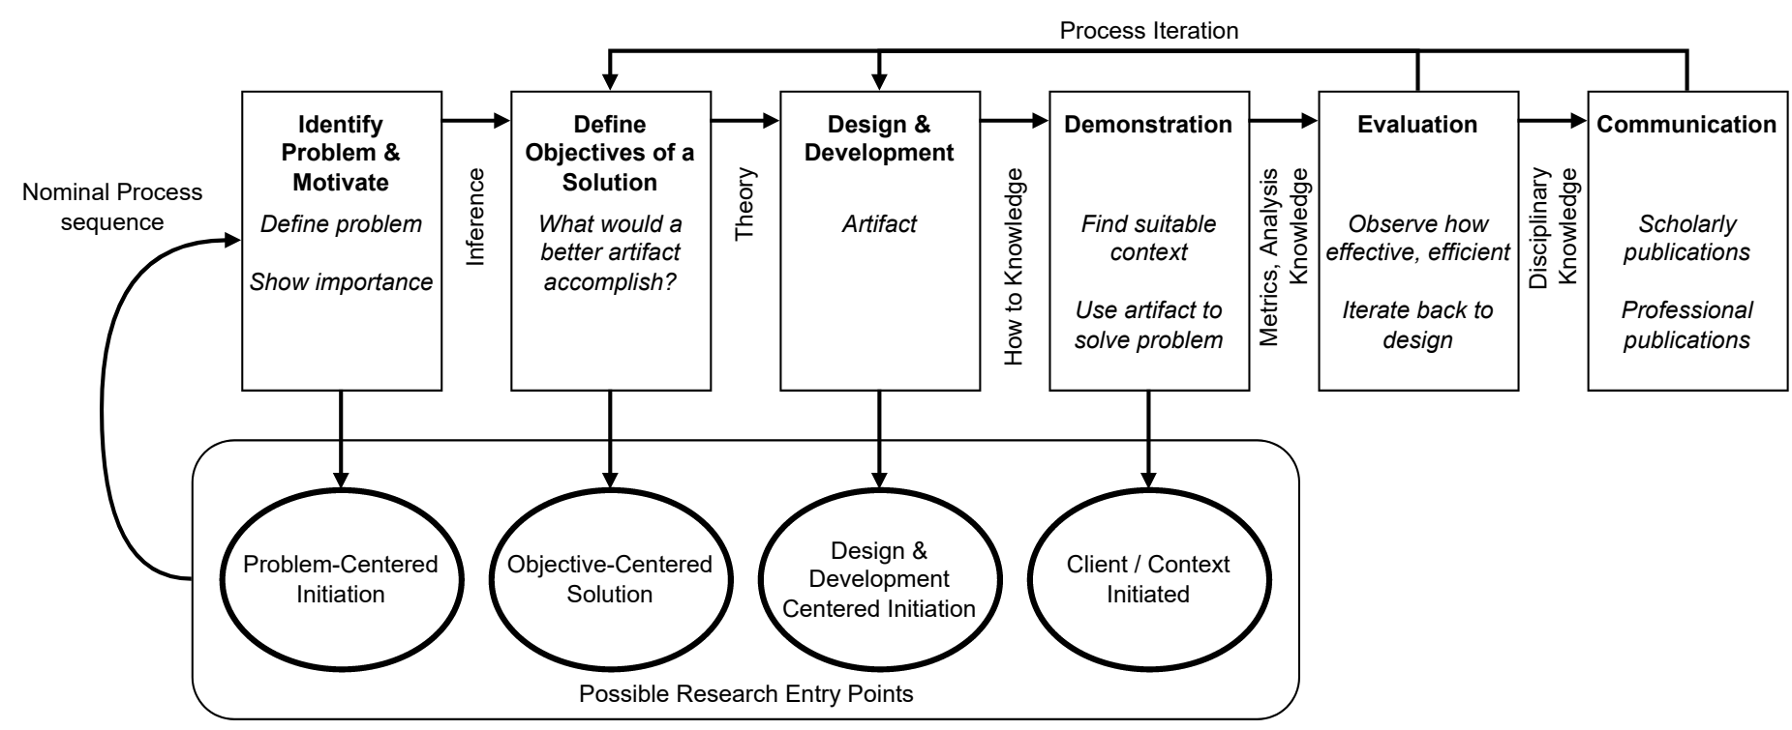
Introduction: Research Methodology
Fig.: Process model of the Design Science Research Methodology (DSRM) [5]

Slide 49
Outline (main topics)
Introduction
Literature Review
Thesis Statement
Preliminary Developments
Research Plan

Slide 50
Outline (estimated times per topic)
Introduction (~3min)
  Context (1.5min)
  Motivation (1min)
  Goals (0.5min)
Literature Review (~6min)
  Methodology (1.5min)
  SLAM (1min)
  Long-term SLAM in Dynamic Environments (3.5min)
Thesis Statement (~3min)
  Statement (1min)
  Q+H (2min)

Slide 51
Outline (estimated times per topic)
Preliminary Developments (~1min)
Research Plan (~2min)
  Tasks
  Milestones
  Publications

