Slide 1
A Systematic Review on Long-Term Localization and Mapping for Mobile Robots
Ricardo B. Sousa, Héber M. Sobreira, António Paulo Moreira
Location of the presentation / Context
Month Day, Year

Slide 2
Outline
Introduction
PICO Framework
Methodology
Results Overview
Discussion
Challenges and Future Directions
Conclusions

Slide 3
Outline
Introduction
Context
Motivation
Goals
PICO Framework
Methodology
Results Overview
Discussion
Challenges and Future Directions
Conclusions

Slide 4
Introduction: Context
Autonomous mobile robot requires an environment representation
Simultaneous Localization and Mapping (SLAM)
Robot pose estimation
Mapping the environment

Slide 5
Introduction: Context
Autonomous mobile robot requires an environment representation
Simultaneous Localization and Mapping (SLAM)
Robot pose estimation
Mapping the environment
Static scene only requires mapping once the environment
Real world is not static!
Moving elements
Environment reconfiguration
Appearance variations

Slide 6
Introduction: Context
Autonomous mobile robot requires an environment representation
Simultaneous Localization and Mapping (SLAM)
Robot pose estimation
Mapping the environment
Static scene only requires mapping once the environment
Real world is not static!
Moving elements
Environment reconfiguration
Appearance variations
How and when to update the map
Consider most current state, only static?
Update when changes occur, after certain time?

Slide 7
Introduction: Context
Autonomous mobile robot requires an environment representation
Simultaneous Localization and Mapping (SLAM)
Robot pose estimation
Mapping the environment
Static scene only requires mapping once the environment
Real world is not static!
Moving elements
Environment reconfiguration
Appearance variations
Limited computational resources
Indefinitely growth of the map
How and when to update the map
Consider most current state, only static?
Update when changes occur, after certain time?

Slide 8
Motivation
Several existent studies overview SLAM literature
Past, present, and future of simultaneous localization and mapping: Toward the robust-perception age (2016)
Simultaneous localization and mapping: A survey of current trends in autonomous driving (2017)
…

Slide 9
Motivation
Several existent studies overview SLAM literature
Past, present, and future of simultaneous localization and mapping: Toward the robust-perception age (2016)
Simultaneous localization and mapping: A survey of current trends in autonomous driving (2017)
…
However,
No overview on challenges related to long-term SLAM
No clear methodology for selecting the papers

Slide 10
Goals
Systematic Literature Review (based on PRISMA)
Bibliographic analysis
Keywords co-occurrence
Co-authorship
Focus on challenges related to long-term SLAM
Appearance variance
Environment dynamics
Map sparsification
Multi-session
Computational concerns

Slide 11
Goals
Analysis on the experimental data used in the literature
Public datasets
Environment conditions
Sensory setup
Distance and time properties
Evaluation metrics

Slide 12
Outline
Introduction
PICO Framework
Methodology
Results Overview
Discussion
Challenges and Future Directions
Conclusions

Slide 13
PICO Framework
Population – Intervention – Comparison – Outcome (PICO)
PICO as a template for the review’s topic

Slide 14
PICO Framework
Population: mobile robots
Intervention: localization, mapping, SLAM
Comparison: not applicable
Outcome: long-term operation, lifelong autonomy, robust

Slide 15
Outline
Introduction
PICO Framework
Methodology
Search & Selection
Data Extraction
Results Overview
Discussion
Challenges and Future Directions
Conclusions

Slide 16
Methodology: Search & Selection
Search base string
(robot* OR vehicle*) AND
((locali* AND map*) OR “slam”) AND
(“long term” OR “life long” OR
lifelong)
Last full inquiry on May 17, 2022

Slide 17
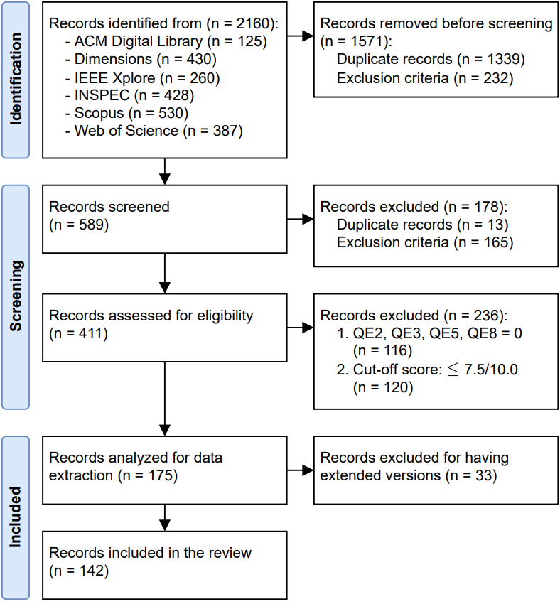
Methodology: Search & Selection
Search base string
(robot* OR vehicle*) AND
((locali* AND map*) OR “slam”) AND
(“long term” OR “life long” OR
lifelong)
Last full inquiry on May 17, 2022
Selection Process
Identification
Screening
Quality Assessment
Fig. 1: PRISMA flow diagram for the selection process

Slide 18
Data Extraction
Long-term considerations
Localization
Mapping
Multi-robot
Execution mode
Environment and domain
Sensory setup
Non-public experiments?
Ground-truth
Distance and time
Datasets
Evaluation metrics

Slide 19
Data Extraction
Long-term considerations
Localization
Mapping
Multi-robot
Execution mode
Environment and domain
Sensory setup
Non-public experiments?
Ground-truth
Distance and time
Datasets
Evaluation metrics
Further details available in the preprint…

Slide 20
Outline
Introduction
PICO Framework
Methodology
Results Overview
Keywords Co-occurrence
Co-authorship Analysis
Discussion
Challenges and Future Directions
Conclusions

Slide 21
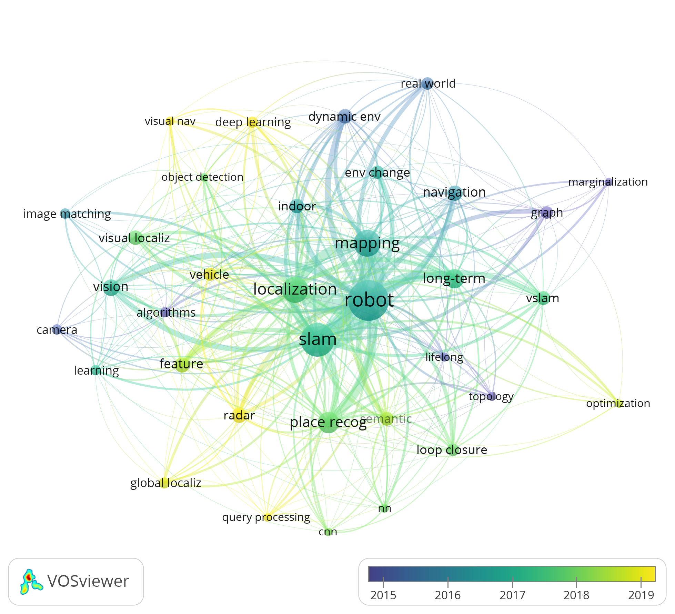
Results Overview: Keywords Co-occurrence
Fig. 2: Keywords co-occurrence analysis on the 142 included records generated by VOSviewer with overlay visualization by the average publication year

Slide 22
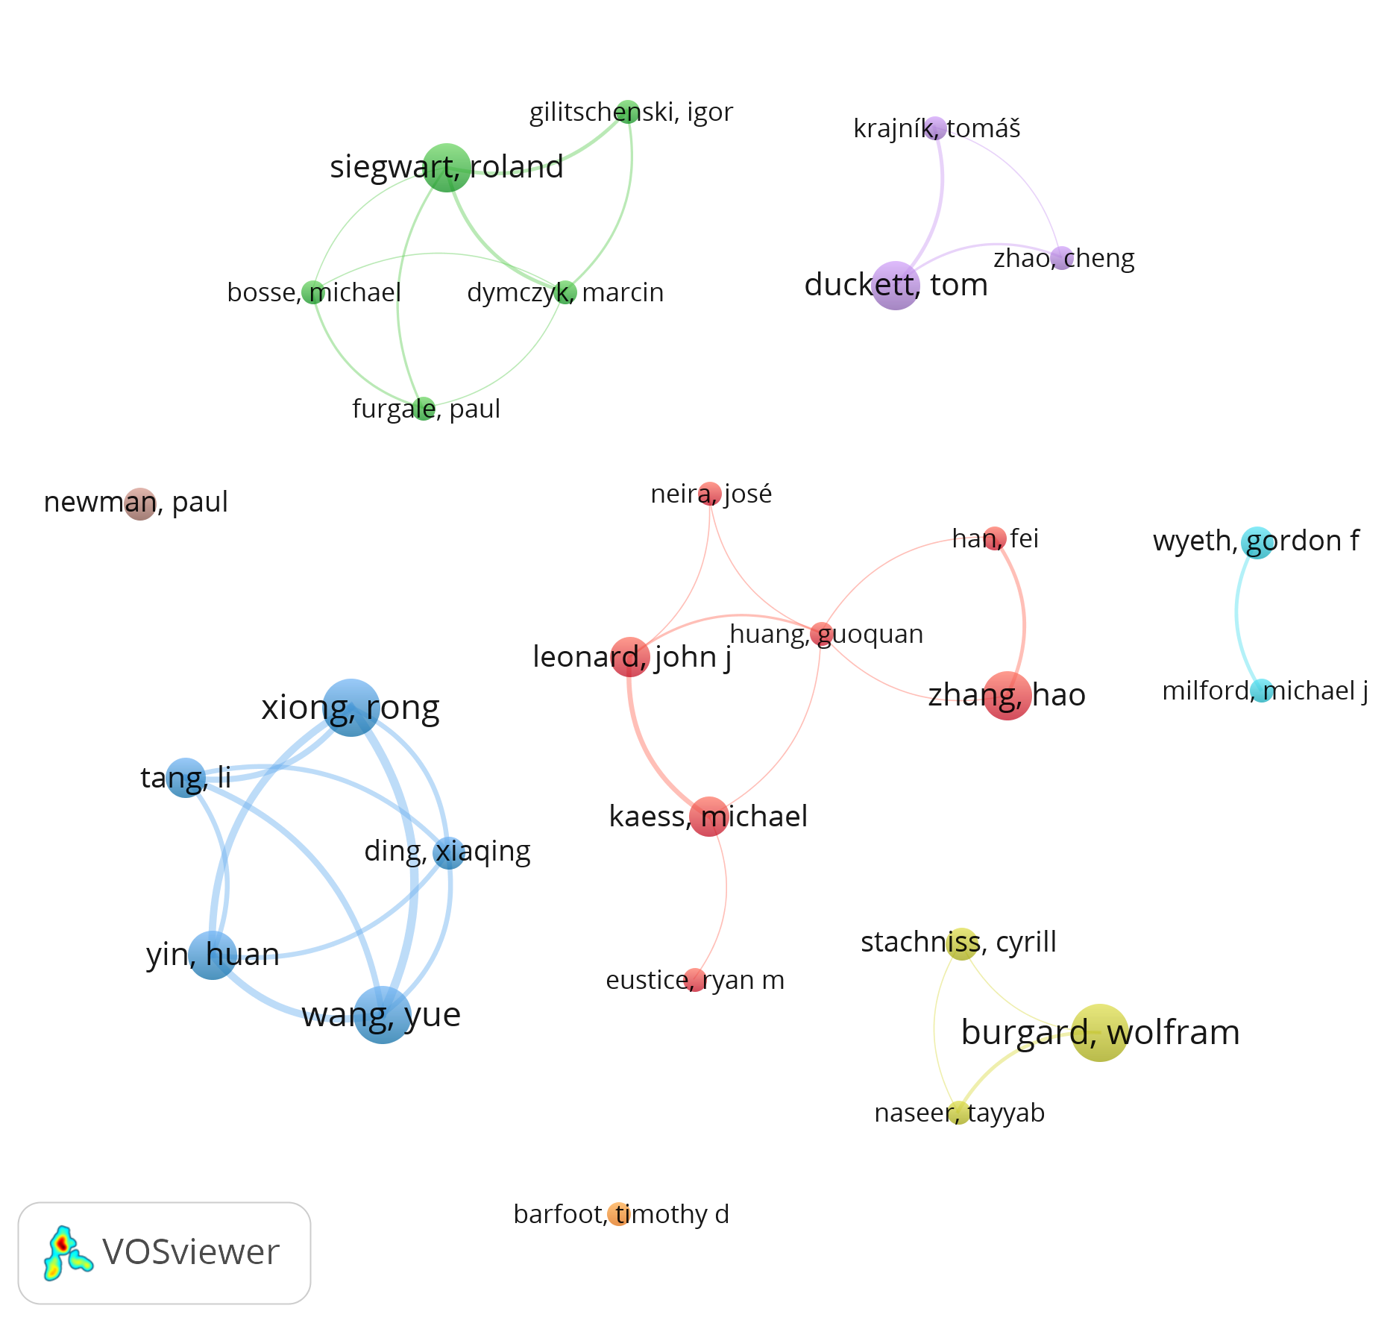
Co-authorship Analysis
Fig. 3: Co-authorship analysis on the 142 included records generated by VOSviewer

Slide 23
Outline
Introduction
PICO Framework
Methodology
Results Overview
Discussion
Appearance Invariance
Dynamics Modeling
Map Sparsification
Multi-Session
Computational
Long-Term Experimental Data
Evaluation Metrics
Challenges and Future Directions
Conclusions

Slide 24
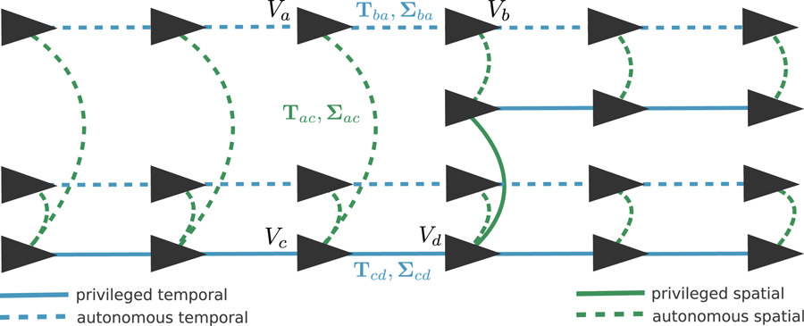
Discussion: Appearance Invariance
Experience maps
Topological maps
Experience ~ view of the environment
Invariance ~ accumulated knowledge
Possible application on Visual Teach & Repeat (VT&R) systems
Not scalable in dynamic environments
Fig. 4: Spatiotemporal pose graph data structure used to represent a multi-experience network of paths in a VT&R system
Source: K. MacTavish, M. Paton, T.D. Barfoot: Selective memory: Recalling relevant experience for long‐term visual localization (2018). Journal of Field Robotics, 35(8), pp. 1265–1292. doi: 10.1002/rob.21838

Slide 25
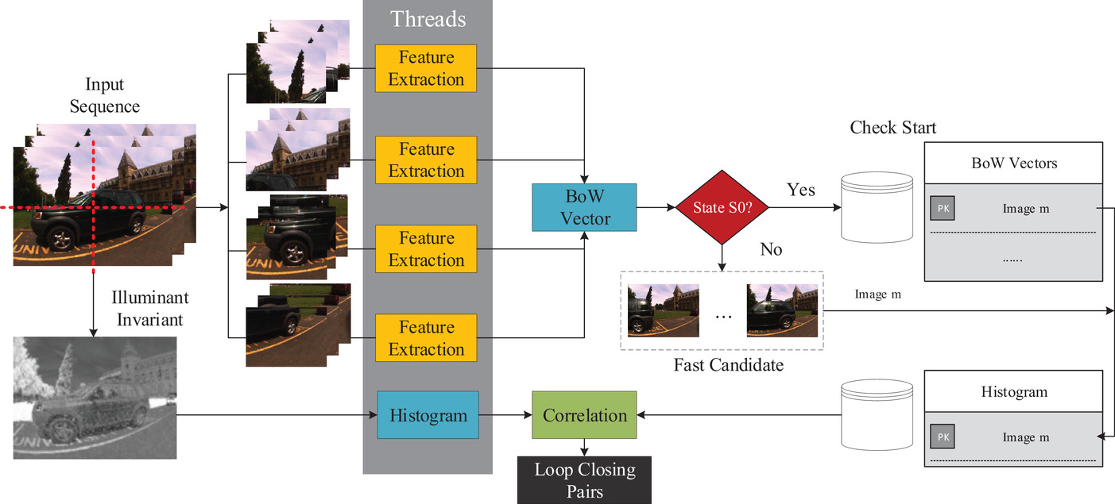
Appearance Invariance
Illumination transformations
Preprocessing process
Applied to color images
Increase invariance on changing lightning conditions
Examples
Illumination invariant space
Learning transformations
Gamma correction
Fig. 5: Example of using the illumination invariant space for place recognition
Source: Z. Yang, Y. Pan, L. Deng, Y. Xie, R. Huan: PLSAV: Parallel loop searching and verifying for loop closure detection (2021). IET Intelligent Transport Systems, 15(5), pp. 683–698. doi: 10.1049/itr2.12054

Slide 26
Appearance Invariance
Handcrafted features
Keypoint detector + descriptor computation
Visual features
Position Invariant Robust Features (PIRF) ~ only select stable local features
Capture gradient information for improve seasonal invariance
Histogram of Oriented Gradients (HOG)
Local Difference Binary (LDB)
2D/3D laser point cloud > 2D image representation > feature extraction
Similar for radar sensor data
Environment structure features
Lines, corners, edges, planes
Ceiling salient edge points
Poles

Slide 27
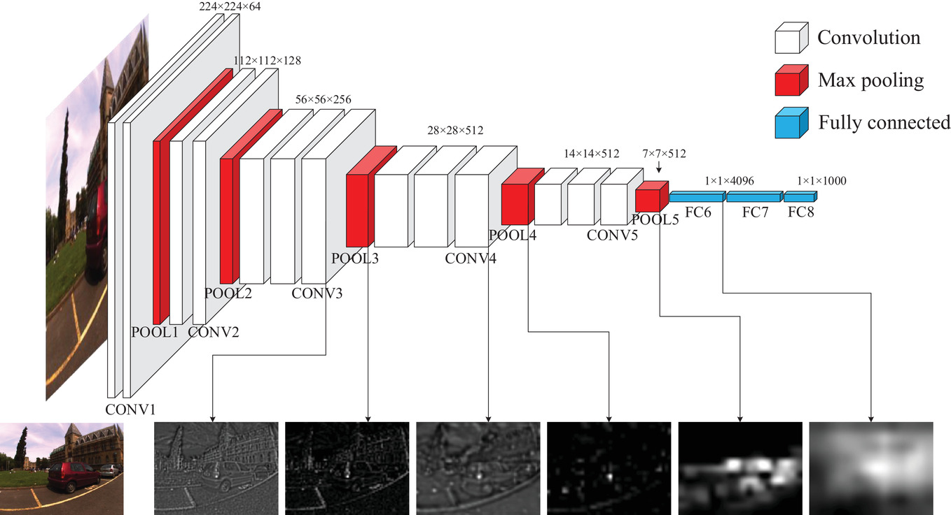
Appearance Invariance
Convolutional Neural Networks (CNN)
CNN-based features more discriminative than handcrafted ones
CNN feature maps
Local features
Place recognition as classification task
Geometry cues in lower levels vs semantic information in higher levels
Not only image data, also 3D LiDAR and radar place recognition
Semantic segmentation
Appearance-content disentanglement
Fig. 6: Overview of the VGG16 architecture to exemplify feature maps retrieved from different layers
Source: Z. Yang, Y. Pan, L. Deng, Y. Xie, R. Huan: PLSAV: Parallel loop searching and verifying for loop closure detection (2021). IET Intelligent Transport Systems, 15(5), pp. 683–698. doi: 10.1049/itr2.12054

Slide 28
Appearance Invariance
Convolutional Neural Networks (CNN)
CNN-based features more discriminative than handcrafted ones
CNN feature maps
Semantic segmentation
Stable features
Pixel-wise segmentation
Graph embedding of semantic features
Applicable to other sensors (3D LiDAR)
Appearance-content disentanglement
(not possible to show examples due to require payment of copyright fees…)

Slide 29
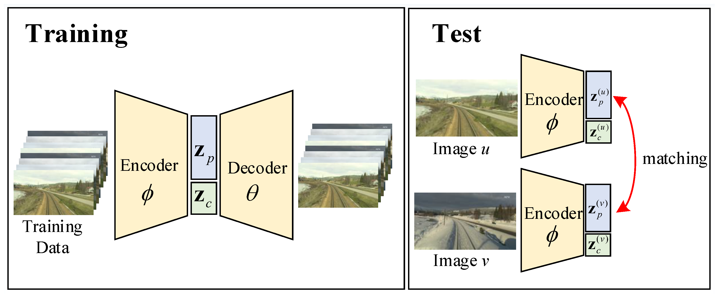
Appearance Invariance
Convolutional Neural Networks (CNN)
CNN-based features more discriminative than handcrafted ones
CNN feature maps
Semantic segmentation
Appearance-content disentanglement
Image ~ appearance + content
Use content features to improve appearance invariance
Encoder-decoder-based networks
Fig. 7: Variational Autoencoder for appearance-content disentanglement
Source: J. Oh, G. Eoh: Variational Bayesian Approach to Condition-Invariant Feature Extraction for Visual Place Recognition (2021). Applied Sciences, 11(19), pp. 8976. doi: 10.3390/app11198976

Slide 30
Appearance Invariance
Feature stability
Predictor functions (#observations, concentration ratio, …)
Consecutive observations, observation time
Multi-modal features
Multi-modal as more discriminative than single feature spaces
Image sequence matching
Temporal coherence of visual data
Sensor modalities
Instead of image-only, consider 2D/3D lasers, radar, thermal, depth, …

Slide 31
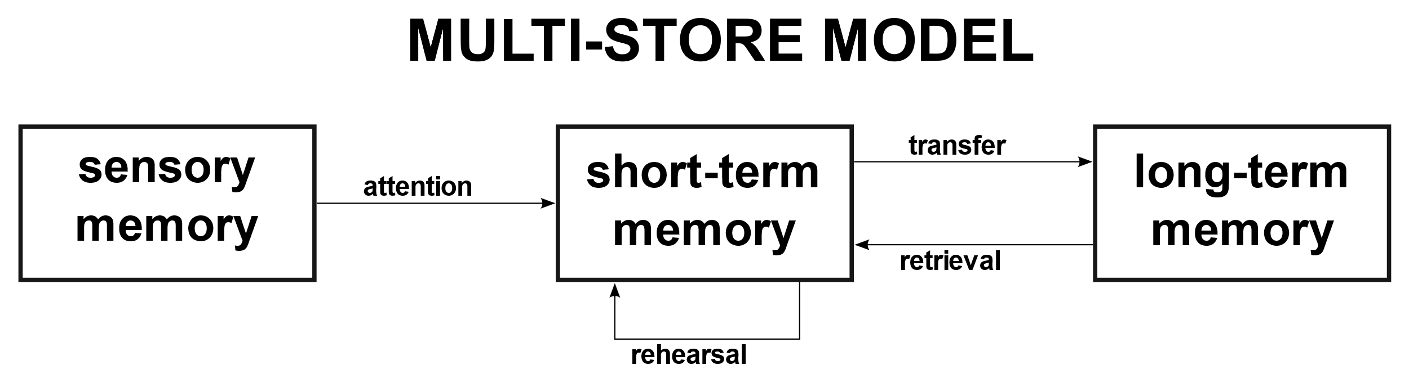
Dynamics Modeling
Map representation
Short/Long-Term Memory (S/LTM)
Multi-store model of human memory
Multiple timescales
Use LTM maps for localization
Static vs dynamic maps
Fig. 8: Multi-store model of human memory proposed by Atkinson
and Shiffrin (1968)
Source: https://commons.wikimedia.org/wiki/File:Memory_multistore_model.svg

Slide 32
Dynamics Modeling
Map representation
Short/Long-Term Memory (S/LTM)
Static vs dynamic maps
Identification of moving elements
Distinction between static – semi-static – dynamic changes
Ignore dynamic elements for static map
Use static map for localization
(not possible to show examples due to require payment of copyright fees…)

Slide 33
Dynamics Modeling
Map matching
Observation vs map
Clustering properties of observations
Ray tracing
NDT + occupancy grid map hybrid representation

Slide 34
Dynamics Modeling
Prediction modeling
Markov-based processes
State holding time associated to Markov processes
Patterns periodicity
Fourier analysis
Time series as stationary stochastic processes
CNN-based prediction

Slide 35
Dynamics Modeling
Dynamic objects detection
Assume certain semantic classes as dynamic
Use features associated to static objects for localization and mapping
Bounding box segmentation (YOLO)
Pixel-wise segmentation

Slide 36
Map Sparsification
Ever growing problem of continuously performing SLAM
Pose graph SLAM
Mutual information between nodes
Outdated information of sensor observations
Nodes’ spatial density and time recency
Information fusion
Also appliable to Keyframe SLAM

Slide 37
Map Sparsification
Features management
Spatial distribution
Matching observations vs number of attempts
Predictor functions (#observations, concentration ratio, …) to evaluate feature stability
Merge ambiguous information

Slide 38
Multi-Session
Global multi-session
Common frame between all sessions
Assume that localization always possible to perform in current map
Independent sessions
Each run starts a new mapping session
Offline / online processes try to formulate inter-session loop closures
Anchor nodes
Representation of independent sessions in the same graph
Each session has an associated anchor node
Anchor node links a transformation from the global to the session’s frame

Slide 39
Computational
Other challenges in addition to map sparsification
Map management
RAM vs disk memory
Geodetic quadtree tiling for Earth-scale mapping
Dimension reduction of feature descriptor
Contributes for reducing the map size requirements
Principal Component Analysis (PCA)
Sparse Random Projection
Max-pooling of CNN-based feature maps
Semantic hashing

Slide 40
Computational
Parallel computing
Multi-thread/process computing
External computation (cloud/edge devices

Slide 41
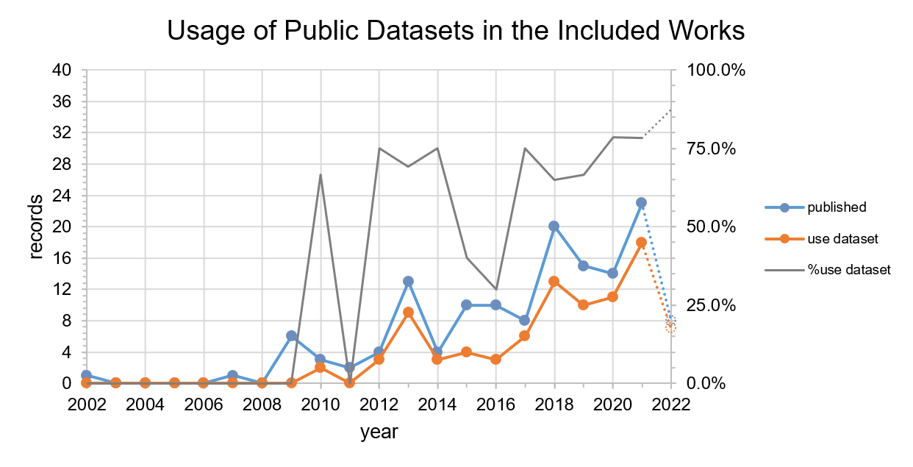
Long-Term Experimental Data
Fig. 9: Evolution of the usage of public datasets per year considering the 142 included records in the review

Slide 42
Long-Term Experimental Data
Public datasets
89/142 (62.7%) included works use public datasets
Examples
Oxford RobotCar
USyd Campus
COLD
…
Ground-truth data
Manual (annotation/labelling, alignment)
GPS
External tracking systems (OptiTrack, Vicon)
SLAM / laser-based data
CAD

Slide 43
Evaluation Metrics
Place recognition
Precision-recall metrics
F-score, F-beta
Confusion matrix
Robot pose
Mean, standard deviation, Root Mean Square Error (RMSE)
Absolute Trajectory Error (ATE)

Slide 44
Evaluation Metrics
Map sparsity
Map size (#nodes, #edges, #features)
Kullback-Leibler Divergence (KLD) for pose graph SLAM
Computational performance
Execution time
Memory
Computational complexity (O(N), …)

Slide 45
Outline
Introduction
PICO Framework
Methodology
Results Overview
Discussion
Challenges and Future Directions
Conclusions

Slide 46
Challenges and Future Directions
Vision-based global place recognition
Omnidirectional vision
Data augmentation

Slide 47
Challenges and Future Directions
Vision-based global place recognition
Dynamics modeling
Definition of environment dynamics
Account dynamics in both localization and mapping

Slide 48
Challenges and Future Directions
Vision-based global place recognition
Dynamics modeling
Online graph sparsification
Online sparsification
Sparsification in highly dynamic environments

Slide 49
Challenges and Future Directions
Vision-based global place recognition
Dynamics modeling
Online graph sparsification
Decentralized computation
Application of decentralized computation in long-term localization and mapping
External compute agents (edge/cloud devices) for off-loading computation tasks

Slide 50
Challenges and Future Directions
Vision-based global place recognition
Dynamics modeling
Online graph sparsification
Decentralized computation
Multi-robot long-term SLAM
Decentralized and distributed SLAM execution
Heterogeneous robots

Slide 51
Challenges and Future Directions
Vision-based global place recognition
Dynamics modeling
Online graph sparsification
Decentralized computation
Multi-robot long-term SLAM
Active exploration
Active navigation to improve long-term performance of SLAM algorithms

Slide 52
Challenges and Future Directions
Vision-based global place recognition
Dynamics modeling
Online graph sparsification
Decentralized computation
Multi-robot long-term SLAM
Active exploration
Human-to-Machine Interfaces (HMI)
User provide information on environment dynamics/changes
Usage of high-level geometric and semantic features to interact with the end-user

Slide 53
Outline
Introduction
PICO Framework
Methodology
Results Overview
Discussion
Challenges and Future Directions
Conclusions

Slide 54
Conclusions
Appearance variance
CNN-based features more discriminative than handcrafted ones
Geometric/semantic cues more robust than appearance ones

Slide 55
Conclusions
Appearance variance
CNN-based features more discriminative than handcrafted ones
Geometric/semantic cues more robust than appearance ones
Environment dynamics
Static – semi-static – dynamic identification most common approach
Usage of static permanent changes for localization

Slide 56
Conclusions
Appearance variance
CNN-based features more discriminative than handcrafted ones
Geometric/semantic cues more robust than appearance ones
Environment dynamics
Static – semi-static – dynamic identification most common approach
Usage of static permanent changes for localization
Map sparsification
Goal: constrain map size to explored environment area
Mutual information rejection

Slide 57
Conclusions
Appearance variance
CNN-based features more discriminative than handcrafted ones
Geometric/semantic cues more robust than appearance ones
Environment dynamics
Static – semi-static – dynamic identification most common approach
Usage of static permanent changes for localization
Map sparsification
Goal: constrain map size to explored environment area
Mutual information rejection
There are still open challenges on long-term SLAM

Slide 58
Any questions?
Corresponding author: Ricardo B. Sousa
up201503004@edu.fe.up.pt

Slide 59
A Systematic Review on Long-Term Localization and Mapping for Mobile Robots
Ricardo B. Sousa, Héber M. Sobreira, António Paulo Moreira
Location of the presentation / Context
Month Day, Year

Slide 60
References
R.B. Sousa, H.M. Sobreira, A.P. Moreira: A Systematic Review on Long-Term Localization and Mapping for Mobile Robots (2022). DOI: 10.22541/au.166739295.55264285/v1
C. Cadena et. al.: Past, present, and future of simultaneous localization and mapping: Toward the robust-perception age (2016). IEEE Transactions on Robotics, 32(6), pp. 1309–1332. DOI: 10.1109/TRO.2016.2624754
G. Bresson et. al.: Simultaneous localization and mapping: A survey of current trends in autonomous driving (2017). IEEE Transactions on Intelligent Vehicles, 2(3), pp. 194–220. DOI: 10.1109/TIV.2017.2749181
M.J. Page et. al.: PRISMA 2020 explanation and elaboration: Updated guidance and exemplars for reporting systematic reviews (2021). BMJ, 372(160). DOI: 10.1136/bmj.n160
M. Borrego, M.J. Foster, J.E. Froyd: Systematic Literature Reviews in Engineering Education and Other Developing Interdisciplinary Fields (2014). Journal of engineering education, 103(1), pp. 45–76. DOI: 10.1002/jee.20038

