Slide 1
Transfer Learning Part I: Overview
Sinno Jialin Pan Institute for Infocomm Research (I2R), Singapore

Slide 2
Transfer of Learning A psychological point of view
The study of dependency of human conduct, learning or performance on prior experience.
[Thorndike and Woodworth, 1901] explored how individuals would transfer in one context to another context that share similar characteristics.
C++ → Java
Maths/Physics → Computer Science/Economics

Slide 3
Transfer Learning In the machine learning community
The ability of a system to recognize and apply knowledge and skills learned in previous tasks to novel tasks or new domains, which share some commonality.
Given a target task, how to identify the commonality between the task and previous (source) tasks, and transfer knowledge from the previous tasks to the target one?

Slide 4
Fields of Transfer Learning
Transfer learning for reinforcement learning.
[Taylor and Stone, Transfer Learning for Reinforcement Learning Domains: A Survey, JMLR 2009]
Transfer learning for classification and regression problems.
[Pan and Yang, A Survey on Transfer Learning, IEEE TKDE 2009]
Focus!

Slide 5
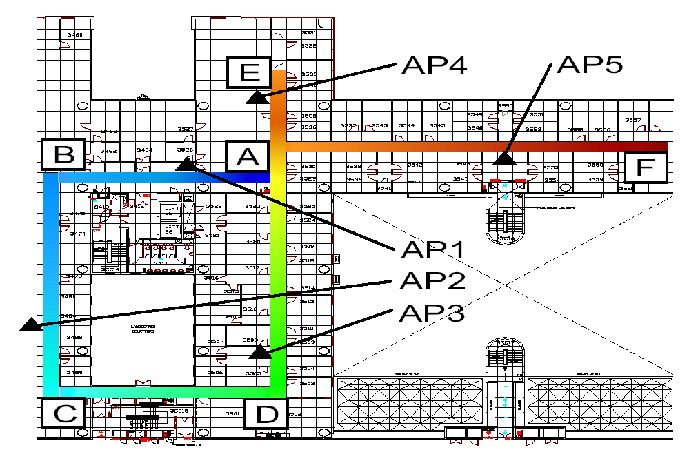

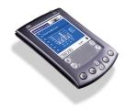
Motivating Example I: Indoor WiFi localization
-30dBm | -70dBm | -40dBm

Slide 6
Indoor WiFi Localization (cont.)
Average Error Distance
Training
Test
~1.5 meters
S=(-37dbm, .., -77dbm), L=(1, 3)
S=(-41dbm, .., -83dbm), L=(1, 4)
…
S=(-49dbm, .., -34dbm), L=(9, 10)
S=(-61dbm, .., -28dbm), L=(15,22)
Localization model
S=(-37dbm, .., -77dbm)
S=(-41dbm, .., -83dbm)
…
S=(-49dbm, .., -34dbm)
S=(-61dbm, .., -28dbm)
Drop!
Time Period A
Time Period A
Training
Test
S=(-37dbm, .., -77dbm), L=(1, 3)
S=(-41dbm, .., -83dbm), L=(1, 4)
…
S=(-49dbm, .., -34dbm), L=(9, 10)
S=(-61dbm, .., -28dbm), L=(15,22)
Localization model
S=(-37dbm, .., -77dbm)
S=(-41dbm, .., -83dbm)
…
S=(-49dbm, .., -34dbm)
S=(-61dbm, .., -28dbm)
~6 meters
Time Period B
Time Period A

Slide 7
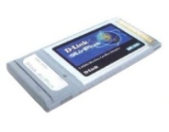
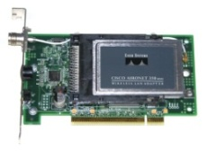
Indoor WiFi Localization (cont.)
Average Error Distance
Training
Test
Localization model
~ 1.5 meters
S=(-37dbm, .., -77dbm), L=(1, 3)
S=(-41dbm, .., -83dbm), L=(1, 4)
…
S=(-49dbm, .., -34dbm), L=(9, 10)
S=(-61dbm, .., -28dbm), L=(15,22)
S=(-37dbm, .., -77dbm)
S=(-41dbm, .., -83dbm)
…
S=(-49dbm, .., -34dbm)
S=(-61dbm, .., -28dbm)
Drop!
Device A
Device A
Training
Test
Localization model
S=(-37dbm, .., -77dbm)
S=(-41dbm, .., -83dbm)
…
S=(-49dbm, .., -34dbm)
S=(-61dbm, .., -28dbm)
~10 meters
S=(-33dbm, .., -82dbm), L=(1, 3)
… S=(-57dbm, .., -63dbm), L=(10, 23)
Device B
Device A

Slide 8
Difference between Tasks/Domains
Time Period A
Time Period B
Device A
Device B

Slide 9
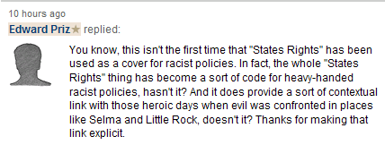


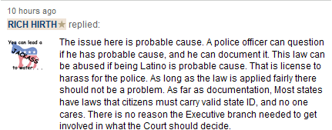
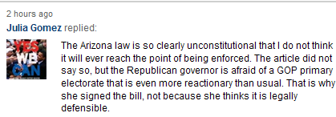

Motivating Example II: Sentiment Classification

Slide 10
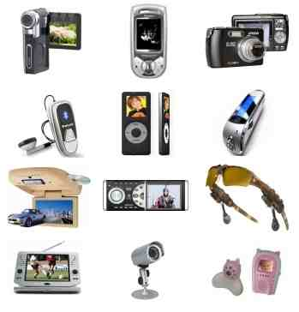


Sentiment Classification (cont.)
Classification Accuracy
Training
Test
Sentiment Classifier
~ 84.6%
Drop!
Electronics
Electronics
Training
Test
Sentiment Classifier
~72.65%
DVD
Electronics

Slide 11
Difference between Tasks/Domains
Electronics | Video Games
(1) Compact; easy to operate; very good picture quality; looks sharp! | (2) A very good game! It is action packed and full of excitement. I am very much hooked on this game.
(3) I purchased this unit from Circuit City and I was very excited about the quality of the picture. It is really nice and sharp. | (4) Very realistic shooting action and good plots. We played this and were hooked.
(5) It is also quite blurry in very dark settings. I will never buy HP again. | (6) The game is so boring. I am extremely unhappy and will probably never buy UbiSoft again.

Slide 12
A Major Assumption
Training and future (test) data come from
a same task and a same domain.
Represented in same feature and label spaces.
Follow a same distribution.

Slide 13
The Goal of Transfer Learning
Target Task/Domain
Target Task/Domain
Training
Training
Classification or Regression Models
Electronics
A few labeled training data
Time Period A
Device A
Electronics
Time Period A
Device A
Source Tasks/Domains
Time Period B
Device B
DVD

Slide 14

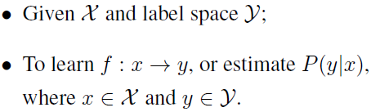


Notations
Domain:
Task:

Slide 15
Transfer learning
settings
Heterogeneous Transfer Learning
Heterogeneous
Transfer Learning
Feature space
Tasks
Homogeneous
Identical
Different
Single-Task Transfer Learning
Inductive Transfer Learning
Focus on optimizing a target task
Domain difference is caused by sample bias
Domain difference is caused by feature representations
Tasks are learned simultaneously
Sample Selection Bias / Covariate Shift
Domain Adaption
Multi-Task Learning

Slide 16
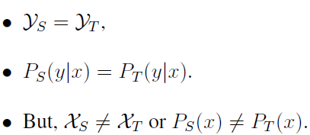
Tasks
Identical
Different
Assumption
Single-Task Transfer Learning
Inductive Transfer Learning
Domain difference is caused by sample bias
Domain difference is caused by feature representations
Focus on optimizing a target task
Tasks are learned simultaneously
Sample Selection Bias / Covariate Shift
Domain Adaption
Multi-Task Learning

Slide 17
Single-Task Transfer Learning
Case 1
Case 2
Sample Selection Bias / Covariate Shift
Domain Adaption in NLP
Instance-based Transfer Learning Approaches
Feature-based Transfer Learning Approaches

Slide 18
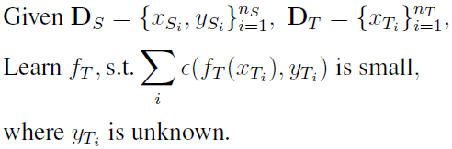
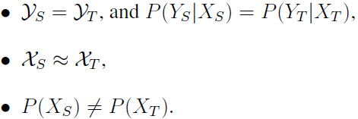
Single-Task Transfer Learning
Case 1
Problem Setting
Assumption
Sample Selection Bias / Covariate Shift
Instance-based Transfer Learning Approaches

Slide 19
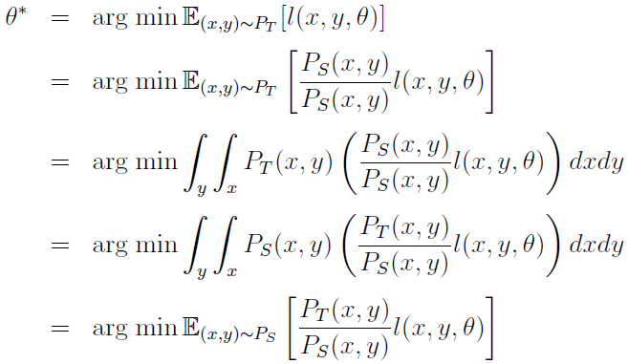
Single-Task Transfer Learning Instance-based Approaches
Recall, given a target task,

Slide 20



Single-Task Transfer Learning Instance-based Approaches (cont.)

Slide 21
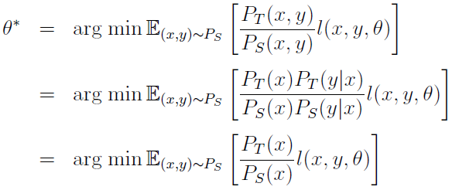
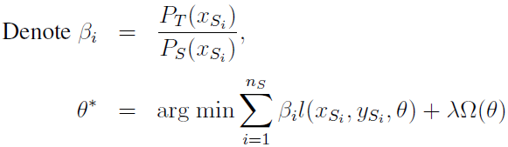
Single-Task Transfer Learning Instance-based Approaches (cont.)
Assumption:

Slide 22

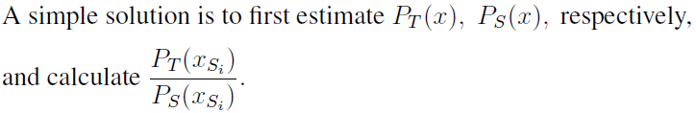
Single-Task Transfer Learning Instance-based Approaches (cont.)
Sample Selection Bias / Covariate Shift
[Quionero-Candela, etal, Data Shift in Machine Learning, MIT Press 2009]

Slide 23
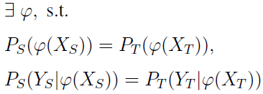

Single-Task Transfer Learning Feature-based Approaches
Case 2
Problem Setting
Explicit/Implicit Assumption

Slide 24
Single-Task Transfer Learning Feature-based Approaches (cont.)
How to learn ?
Solution 1: Encode domain knowledge to learn the transformation.
Solution 2: Learn the transformation by designing objective functions to minimize difference directly.

Slide 25
Single-Task Transfer Learning Solution 1: Encode domain knowledge to learn the transformation
Electronics | Video Games
(1) Compact; easy to operate; very good picture quality; looks sharp! | (2) A very good game! It is action packed and full of excitement. I am very much hooked on this game.
(3) I purchased this unit from Circuit City and I was very excited about the quality of the picture. It is really nice and sharp. | (4) Very realistic shooting action and good plots. We played this and were hooked.
(5) It is also quite blurry in very dark settings. I will never_buy HP again. | (6) The game is so boring. I am extremely unhappy and will probably never_buy UbiSoft again.

Slide 26
Single-Task Transfer Learning Solution 1: Encode domain knowledge to learn the transformation (cont.)
Electronics Domain specific features
Common features
Video game domain specific features
sharp
good
realistic
hooked
compact
exciting
never_buy
blurry
boring
never_buy
blurry
boring
exciting
compact
good
realistic
sharp
hooked

Slide 27
Single-Task Transfer Learning Solution 1: Encode domain knowledge to learn the transformation (cont.)
How to select good pivot features is an open problem.
Mutual Information on source domain labeled data
Term frequency on both source and target domain data.
How to estimate correlations between pivot and domain specific features?
Structural Correspondence Learning (SCL) [Biltzer etal. 2006]
Spectral Feature Alignment (SFA) [Pan etal. 2010]

Slide 28
Single-Task Transfer Learning Solution 2: learning the transformation without domain knowledge
Source
Target
Latent factors
Temperature
Signal properties
Power of APs
Building structure

Slide 29
Single-Task Transfer Learning Solution 2: learning the transformation without domain knowledge
Source
Target
Latent factors
Temperature
Signal properties
Power of APs
Building structure
Cause the data distributions between domains different

Slide 30
Single-Task Transfer Learning Solution 2: learning the transformation without domain knowledge (cont.)
Source
Target
Noisy component
Signal properties
Building structure
Principal components

Slide 31
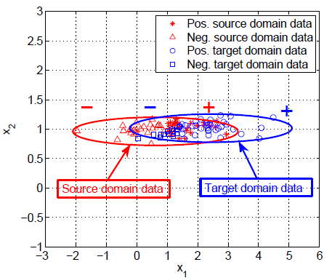
Single-Task Transfer Learning Solution 2: learning the transformation without domain knowledge (cont.)
Learning by only minimizing distance between
distributions may map the data to noisy factors.

Slide 32

Single-Task Transfer Learning Transfer Component Analysis [Pan etal., 2009]
Main idea: the learned should map the source and
target domain data to the latent space spanned by the
factors which can reduce domain difference and
preserve original data structure.
High level optimization problem

Slide 33


Single-Task Transfer Learning Maximum Mean Discrepancy (MMD)
[Alex Smola, Arthur Gretton and Kenji Kukumizu, ICML-08 tutorial]

Slide 34
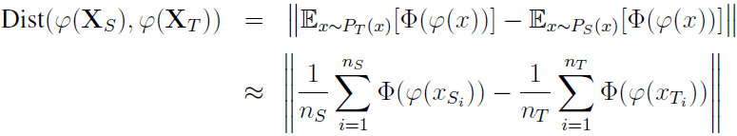

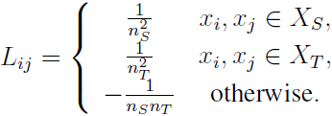

Single-Task Transfer Learning Transfer Component Analysis (cont.)

Slide 35


Single-Task Transfer Learning Transfer Component Analysis (cont.)

Slide 36
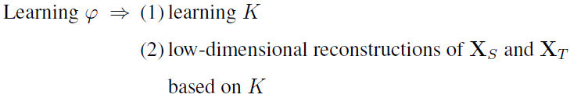
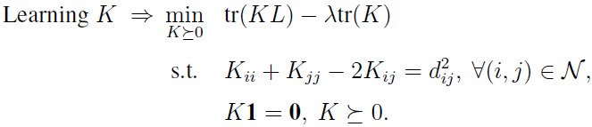
Single-Task Transfer Learning Transfer Component Analysis (cont.)
[Pan etal., 2008]
To minimize the distance between domains
To maximize the data variance
To preserve the local geometric structure
It is a SDP problem, expensive!
It is transductive, cannot generalize on unseen instances!
PCA is post-processed on the learned kernel matrix, which may potentially discard useful information.

Slide 37


Single-Task Transfer Learning Transfer Component Analysis (cont.)
Empirical kernel map
Resultant parametric kernel
Out-of-sample kernel evaluation

Slide 38


Single-Task Transfer Learning Transfer Component Analysis (cont.)
To minimize the distance between domains
Regularization on W
To maximize the data variance

Slide 39
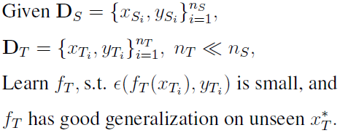
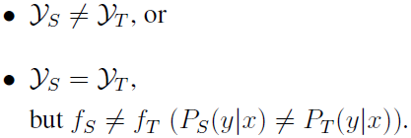
Tasks
Identical
Different
Problem Setting
Single-Task Transfer Learning
Inductive Transfer Learning
Inductive Transfer Learning
Domain difference is caused by sample bias
Focus on optimizing a target task
Domain difference is caused by feature representations
Focus on optimizing a target task
Tasks are learned simultaneously
Tasks are learned simultaneously
Assumption
Sample Selection Bias / Covariate Shift
Multi-Task Learning
Domain Adaption
Multi-Task Learning

Slide 40
Inductive Transfer Learning
Parameter-based Transfer Learning Approaches
Modified from Multi-Task Learning Methods
Feature-based Transfer Learning Approaches
Self-Taught Learning Methods
Target-Task-Driven Transfer Learning Methods
Instance-based Transfer Learning Approaches

Slide 41
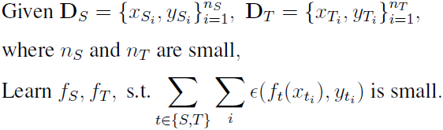
Inductive Transfer Learning Multi-Task Learning Methods
Parameter-based Transfer Learning Approaches
Modified from Multi-Task Learning Methods
Feature-based Transfer Learning Approaches
Setting

Slide 42

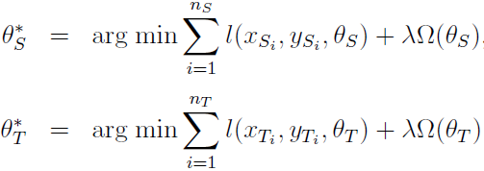
Inductive Transfer Learning Multi-Task Learning Methods
Recall that for each task (source or target)
Tasks are learned independently
Motivation of Multi-Task Learning:
Can the related tasks be learned jointly?
Which kind of commonality can be used across tasks?

Slide 43
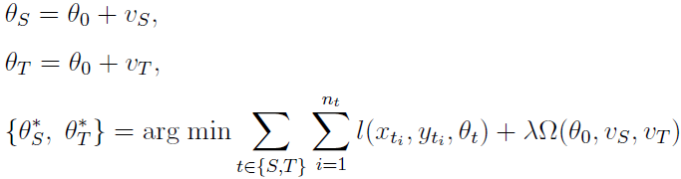
Inductive Transfer Learning Multi-Task Learning Methods -- Parameter-based approaches
Assumption:
If tasks are related, they should share similar parameter vectors.
For example [Evgeniou and Pontil, 2004]
Common part
Specific part for individual task

Slide 44
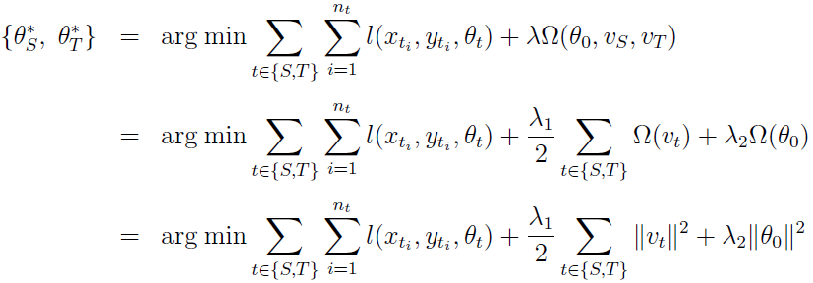
Inductive Transfer Learning Multi-Task Learning Methods -- Parameter-based approaches (cont.)

Slide 45
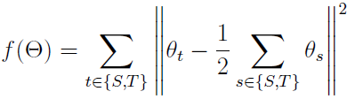





Inductive Transfer Learning Multi-Task Learning Methods -- Parameter-based approaches (summary)
A general framework:
[Zhang and Yeung, 2010]
[Saha etal, 2010]

Slide 46
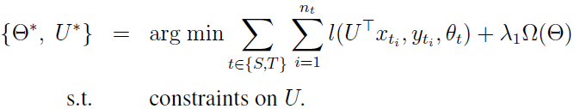

Inductive Transfer Learning Multi-Task Learning Methods -- Feature-based approaches
Assumption:
If tasks are related, they should share some good common features.
Goal:
Learn a low-dimensional representation shared across related tasks.

Slide 47
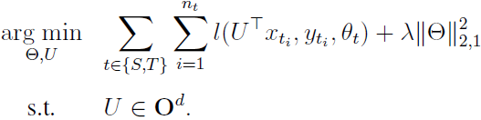

Inductive Transfer Learning Multi-Task Learning Methods -- Feature-based approaches (cont.)
[Argyriou etal., 2007]

Slide 48




Inductive Transfer Learning Multi-Task Learning Methods -- Feature-based approaches (cont.)
Illustration

Slide 49
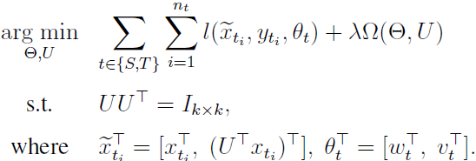


Inductive Transfer Learning Multi-Task Learning Methods -- Feature-based approaches (cont.)

Slide 50


Inductive Transfer Learning Multi-Task Learning Methods -- Feature-based approaches (cont.)
[Ando and Zhang, 2005]
[Ji etal, 2008]

Slide 51
Inductive Transfer Learning
Self-Taught Learning Methods
Feature-based Transfer Learning Approaches
Target-Task-Driven Transfer Learning Methods
Instance-based Transfer Learning Approaches

Slide 52
Inductive Transfer Learning Self-taught Learning Methods -- Feature-based approaches
Motivation:
There exist some higher-level features that can help the target
learning task even only a few labeled data are given.
Steps:
1, Learn higher-level features from a lot of unlabeled data from the source tasks.
2, Use the learned higher-level features to represent the data of the target task.
3, Training models from the new representations of the target task with corresponding labels.

Slide 53
Inductive Transfer Learning Self-taught Learning Methods -- Feature-based approaches (cont.)
Higher-level feature construction
Solution 1: Sparse Coding [Raina etal., 2007]
Solution 2: Deep learning [Glorot etal., 2011]

Slide 54

Inductive Transfer Learning Target-Task-Driven Methods -- Instance-based approaches
Assumption
TrAdaBoost [Dai etal 2007]
Main Idea
For each boosting iteration,
Use the same strategy as AdaBoost to update the weights of target domain data.
Propose a new mechanism to decrease the weights of misclassified source domain data.
Intuition
Part of the labeled data from the source domain can be reused after re-weighting

Slide 55
Summary
Tasks
Identical
Different
Single-Task Transfer Learning
Inductive Transfer Learning
Feature-based Transfer Learning Approaches
Feature-based Transfer Learning Approaches
Instance-based Transfer Learning Approaches
Instance-based Transfer Learning Approaches
Parameter-based Transfer Learning Approaches

Slide 56
Some Research Issues
How to avoid negative transfer? Given a target domain/task, how to find source domains/tasks to ensure positive transfer.
Transfer learning meets active learning
Given a specific application, which kind of transfer learning methods should be used.

Slide 57
Reference
[Thorndike and Woodworth, The Influence of Improvement in one mental function upon the efficiency of the other functions, 1901]
[Taylor and Stone, Transfer Learning for Reinforcement Learning Domains: A Survey, JMLR 2009]
[Pan and Yang, A Survey on Transfer Learning, IEEE TKDE 2009]
[Quionero-Candela, etal, Data Shift in Machine Learning, MIT Press 2009]
[Biltzer etal.. Domain Adaptation with Structural Correspondence Learning, EMNLP 2006]
[Pan etal., Cross-Domain Sentiment Classification via Spectral Feature Alignment, WWW 2010]
[Pan etal., Transfer Learning via Dimensionality Reduction, AAAI 2008]

Slide 58
Reference (cont.)
[Pan etal., Domain Adaptation via Transfer Component Analysis, IJCAI 2009]
[Evgeniou and Pontil, Regularized Multi-Task Learning, KDD 2004]
[Zhang and Yeung, A Convex Formulation for Learning Task Relationships in Multi-Task Learning, UAI 2010]
[Saha etal, Learning Multiple Tasks using Manifold Regularization, NIPS 2010]
[Argyriou etal., Multi-Task Feature Learning, NIPS 2007]
[Ando and Zhang, A Framework for Learning Predictive Structures from Multiple Tasks and Unlabeled Data, JMLR 2005]
[Ji etal, Extracting Shared Subspace for Multi-label Classification, KDD 2008]

Slide 59
Reference (cont.)
[Raina etal., Self-taught Learning: Transfer Learning from Unlabeled Data, ICML 2007]
[Dai etal., Boosting for Transfer Learning, ICML 2007]
[Glorot etal., Domain Adaptation for Large-Scale Sentiment Classification: A Deep Learning Approach, ICML 2011]

Slide 60
Thank You

