Slide 1

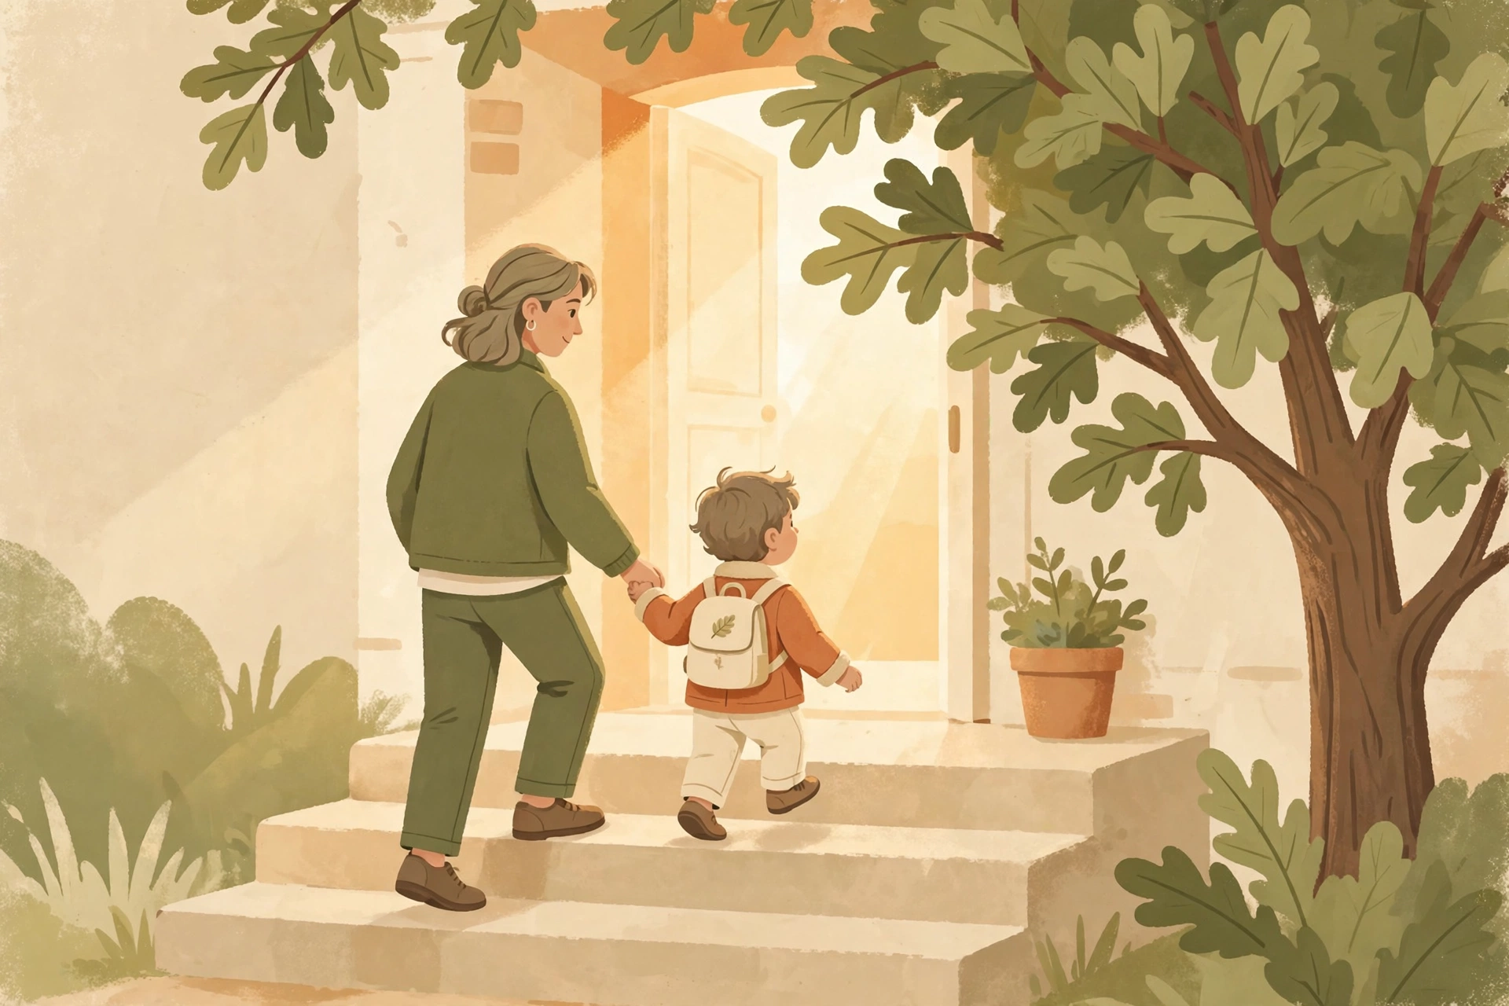
SSI Basics
for Parents
The first steps, in plain words.
Jessica Alvarez
Southern Oak Financial & Wellness
Free Zoom Class • Tuesday, October 20, 2026 • 6:30 PM
Notes:
[Minutes 0–3 · WELCOME]
"Welcome, everyone. I'm Jessica Alvarez with Southern Oak Financial & Wellness here in San Antonio. Thank you for giving me your evening — I know your time is precious."
Set the tone: "This class is the one I wish someone had given me. Plain words. No legal talk. And nothing you hear tonight is a promise — every child's case is different. What I CAN promise is that you will leave knowing the first steps."
House rules: "Keep your questions for the end, or drop them in the chat and I'll get to them. Please keep your child's private details private — no names or medical details out loud tonight.

Slide 2

Tonight, in 4 simple stops
▸ 1. What SSI is
▸ 2. The two tests every child must pass
▸ 3. The first steps to apply
▸ 4. What happens next — and what if the answer is no
▸ Short, plain, and honest. Questions at the end.
Southern Oak Financial & Wellness • southernoakfw.org
Notes:
[Minutes 3–5 · ROAD MAP]
Walk the four stops quickly. "If you only remember one thing tonight, remember this: SSI has TWO tests — a disability test and a money test. A child has to pass both. Almost everything tonight hangs on those two hooks."
Point at the picture: "Most of this starts right here — at your own kitchen table, with a folder of papers. By the end of tonight, you'll know what goes in that folder."

Slide 3
What is SSI?
▸ SSI = Supplemental Security Income
▸ A monthly payment from Social Security for children with disabilities.
▸ It is for families with limited income and limited savings.
▸ It is NOT the same as SSDI (that one comes from work history).
▸ In Texas, a child who gets SSI usually gets Medicaid health coverage too.
Southern Oak Financial & Wellness • southernoakfw.org
Notes:
[Minutes 5–10 · WHAT IS SSI]
Say it slow: "SSI stands for Supplemental Security Income. It's a monthly check from Social Security for a child with a disability, when the family has limited income."
Clear up the mix-up almost every parent has: "SSI is not SSDI. SSDI comes from someone's work record. SSI is based on need — the disability plus the family's money situation."
Texas bonus worth saying out loud: "In Texas, when a child is approved for SSI, Medicaid usually comes with it. For many families, the health coverage matters as much as the check."
Do NOT quote a dollar amount for the payment — it changes, and it depends on the family's income. If asked: "The amount depends on your family's income. Social Security figures it after you apply."

Slide 4
Every child must pass TWO tests
TEST 1
TEST 2
The Disability Test
The Money Test
Does the child's condition limit their daily life in a big way — and will it last at least 12 months?
Does the family have limited income and limited savings? Parents' income counts for a child at home.
Pass BOTH, and SSI can start. Miss one, and Social Security says no — even if the other one is strong.
Southern Oak Financial & Wellness • southernoakfw.org
Notes:
[Minutes 10–12 · THE TWO TESTS]
This is the heart of the whole class — slow down here.
"A child has to pass two tests. Test 1: the disability test. Test 2: the money test. Both. Not one or the other."
Give the example parents always relate to: "A child can have a very serious condition — but if the family's income is over the limit, the answer is no. And a family can have very low income — but if the condition doesn't limit the child's daily life the way Social Security measures it, the answer is also no."
"So tonight we look at both, one at a time."

Slide 5
Test 1 — The disability test
▸ Big limits on daily life. Social Security calls it “marked and severe” limits — learning, talking, moving, playing, or caring for themselves.
▸ It must last. At least 12 months, or be expected to last that long.
▸ A diagnosis alone is not enough. The name of the condition does not decide it. What it does to your child's everyday life decides it.
▸ Records tell the story. Doctors, therapists, teachers — their notes are the proof.
Southern Oak Financial & Wellness • southernoakfw.org
Notes:
[Minutes 12–19 · THE DISABILITY TEST]
Key line, say it twice: "A diagnosis alone is not enough." Parents think the diagnosis decides the case. It doesn't. "Social Security asks: what can your child NOT do, that other children their age can do? Learning. Talking and being understood. Moving around. Playing with others. Bathing, dressing, feeding themselves. Staying healthy."
"And the condition has to last at least 12 months."
"The proof is paper: doctor records, therapy notes, school records. If it isn't written down by a professional, Social Security may act like it never happened. That's why keeping appointments matters so much — every visit is evidence."

Slide 6
Test 2 — The money test
▸ Parents' income counts. For a child living at home, Social Security counts part of the parents' pay. They call it “deeming.”
▸ Savings count too. There is a limit on savings and things of value the family owns.
▸ Some things usually do NOT count: the home you live in, and usually one car.
▸ Every family's numbers are different. Social Security does this math after you apply — you do not have to figure it out alone first.
Southern Oak Financial & Wellness • southernoakfw.org
Notes:
[Minutes 19–24 · THE MONEY TEST]
Plain words for deeming: "Because your child lives with you, Social Security counts part of YOUR income as if it were your child's. Their word for it is 'deeming.'"
Reassure before they panic: "Your home does not count. Usually one car does not count. This is about wages and savings, not about being poor enough to own nothing."
Honesty line: "I can't tell any family tonight 'you pass' or 'you don't' — the math depends on your paycheck, your household, and who lives at home. Social Security runs the real numbers when you apply. What I can do in a free consultation is help you get ready."

Slide 7
What Social Security looks at
▸ Doctor and clinic records — visits, tests, medicines
▸ Therapy notes — speech, OT, PT, ABA
▸ School records — grades, behavior, support plans
▸ Your words — what a normal day looks like for your child
▸ If a record is missing, Social Security decides without it. Complete files get fairer answers.
Southern Oak Financial & Wellness • southernoakfw.org
Notes:
[Minutes 24–28 · THE EVIDENCE]
"Social Security almost never meets your child. They decide from paper." Walk the four sources.
"Your words count too — they will ask you what a normal day looks like: getting dressed, eating, playing, sleeping, meltdowns, all of it. Be honest and be specific. 'He struggles' is weak. 'He is 8 and still cannot dress himself' is strong."
Warning: "If you miss their letters or phone calls, they decide without you. Open every envelope from Social Security the day it comes."

Slide 8
The first steps to apply
▸ Step 1 — Start the claim. Call Social Security at 1-800-772-1213, or visit your local office. For a child, the application starts by phone or in person.
▸ Step 2 — Ask for your filing date. The day you start is your “protective filing date.” Benefits can only go back to that date — so do not wait.
▸ Step 3 — Gather your papers (next slide).
▸ Step 4 — Answer everything. Forms, calls, and letters — answer them all, on time.
Southern Oak Financial & Wellness • southernoakfw.org
Notes:
[Minutes 28–33 · FIRST STEPS]
Show the picture: "Applying feels like a big staircase. It's just steps. One at a time."
Protective filing date — make this land: "The day you first contact Social Security is written down as your protective filing date. If your child is approved, payments count from that date — never from before it. Every month a family waits to start is a month that can never come back. Starting costs nothing."
"For a child's SSI, you start by phone — 1-800-772-1213 — or at the local office. They set an appointment to take the full application."

Slide 9
Papers to gather
Start a folder today. Every paper goes in the folder.
▸ Your child's birth certificate and Social Security card
▸ Proof of your income — pay stubs or a letter from your job
▸ Bank statements and any savings
▸ A list of every doctor, clinic, hospital, and therapist — with dates
▸ School information — reports and support plans
▸ Your ID and proof of address
Southern Oak Financial & Wellness • southernoakfw.org
Notes:
[Minutes 33–36 · THE FOLDER]
"This is your homework, and it's simple: one folder. Everything on this slide goes in it."
Point out the one families forget: "The doctor list — every doctor, clinic, hospital, and therapist your child has EVER seen for this condition, with addresses and dates. Social Security requests the records, but only from the places you name. Leave one out, and that proof never arrives."
"If you don't have a paper, don't let it stop you from starting. Start the claim — Step 1 — and gather while it moves."

Slide 10
After you apply — what happens
▸ Social Security checks the money test first.
▸ A state agency checks the disability test. They read the medical records. They may schedule a free exam with their doctor.
▸ It takes time. Months is normal. Silence does not mean no.
▸ Watch your mail like a hawk. A missed letter or deadline can end a claim.
Southern Oak Financial & Wellness • southernoakfw.org
Notes:
[Minutes 36–39 · THE WAIT]
Set expectations honestly: "Two different offices look at your claim. Social Security checks the money side. Then a state agency — doctors and case workers who never meet you — checks the disability side from the records."
"They may send your child to a free exam with one of their doctors. Go. Missing that exam can end the claim."
"The wait is months for most families. Silence is normal — it does not mean no. What ends claims is missed mail and missed deadlines. Open everything, answer everything."

Slide 11
If the answer is no
▸ A first “no” is common. It is not the end.
▸ You can appeal. There are levels of appeal — and each one has a deadline, usually 60 days.
▸ Keep taking your child to the doctor. New records are new proof.
▸ Do not start over from zero if an appeal is open — ask for help first.
Southern Oak Financial & Wellness • southernoakfw.org
Notes:
[Minutes 39–42 · IF THE ANSWER IS NO]
Say this with warmth — some parents in the room have already been denied: "A first no is common. Many children who are approved, are approved on appeal — with better records. A denial is a door closing, not a wall."
"The deadline is the dangerous part: usually 60 days to appeal. Miss it, and you may have to start all over — losing your filing date. If you get a denial letter, that letter is dated. Act on it right away."
"And keep the doctor visits going. New records are new proof. The file you build after a denial is often the file that wins."

Slide 12
3 mistakes that hurt families
▸ Waiting to apply. Payments can only start from your filing date. Waiting leaves money behind that never comes back.
▸ Missing mail and deadlines. Social Security runs on letters. Open them the day they come.
▸ Stopping doctor visits. No visits = no records = no proof. Keep every appointment.
Southern Oak Financial & Wellness • southernoakfw.org
Notes:
[Minutes 42–44 · MISTAKES — quick, punchy]
"If you remember nothing else: file early, open the mail, keep the appointments."
"These three mistakes are free to avoid — and I have seen each one cost a family months of payments."

Slide 13
How Southern Oak can help
▸ Your first consultation is FREE — by Zoom, in English or Spanish.
▸ We help you get ready: the folder, the forms, the steps — in order.
▸ We build personal plans for children and young adults, ages 5 to 26.
▸ We also help with medication assistance and life insurance questions.
▸ You stay in charge. We walk beside you.
DISCLAIMER: We do not provide refunds for services; there is NO guarantee of approvals, and we are not legal attorneys.
Notes:
[Minutes 44–45 · THE INVITATION — no pressure]
"Here's my invitation, and it's a soft one. If tonight raised questions about YOUR child, your first consultation with me is free. We meet by Zoom, in English or Spanish, and we look at where your family stands and what your next step is."
Read the disclaimer idea in your own words, warmly: "I'm an advocate and consultant, not a lawyer. I never guarantee approvals — nobody honestly can. What I guarantee is that you won't walk the steps alone."
Then point them to the next slide for how to book.

Slide 14
Questions?
You do not have to do this alone.
Book your FREE consultation:
southernoakfw.org/book
Email: southernoakfw@gmail.com
Serving San Antonio, the Rio Grande Valley & surrounding cities
DISCLAIMER: We do not provide refunds for services; there is NO guarantee of approvals, and we are not legal attorneys.
Notes:
[CLOSE · QUESTIONS]
Open the floor: "What questions do you have? General questions here are great — for your child's private details, that's what the free consultation is for."
THE ASK (say it exactly, warmly): "If this class helped you, do two things: book your free consultation at southernoakfw.org/book — and send this class to one parent you know who needs it. Families find help through other families."
Stay on Zoom after the end for anyone who wants to talk. Thank them again by name where you can.
After class: send Rio the names of anyone who asked to book, and Rio prepares the follow-ups.

