Slide 1



No Tricks, Just Clear Steps
SSI, SSDI & DAC Basics for Families
Applying for benefits can feel confusing and overwhelming. Tonight we make it simple.
Jessica Alvarez
Southern Oak Financial & Wellness
Free Zoom Class • Friday, October 30, 2026 • 6:30–7:15 PM CT • Only 20 spots — register to get the Zoom link
Notes:
[Minutes 0–3 · WELCOME]
"Welcome, everyone — and happy almost-Halloween! I'm Jessica Alvarez with Southern Oak Financial & Wellness here in San Antonio. Thank you for spending part of your Friday night with me. Tomorrow is for costumes and candy — tonight is for clear steps, no tricks."
Name the feeling honestly: "I know applying for Social Security benefits can feel confusing, scary, and overwhelming. The letters are hard to read. The rules feel hidden. Tonight we slow it all down, in plain words, so you can see the path."
House rules: "We teach for 35 minutes, and the last 10 minutes are all for your questions — I'll start with the questions families sent when they registered, then open the floor. And please keep your child's private details private tonight — no names or medical details out loud. Private questions are what my free consultation is for."
One honest promise: "I can't promise anyone an approval — nobody honestly can. I CAN promise you will leave knowing what SSI, SSDI, and DAC are, who they're for, and your first steps."

Slide 2
Why we're here tonight
▸ The system feels big and hard to read. Long forms, hard words, and letters that sound scary.
▸ Most families were never told there are THREE different benefits. SSI, SSDI, and DAC — they sound alike, but they work very differently.
▸ Tonight, in plain words: what each one is, who it is for, what it takes to file, and your first steps.
▸ No tricks. No hard words without a plain meaning. No question is a silly question.
Southern Oak Financial & Wellness • southernoakfw.org
Notes:
[Minutes 3–5 · WHY WE'RE HERE]
Start where families really are: "Most parents I meet are not confused because they aren't smart. They're confused because nobody ever explained this in plain words. The letters use hard words. The website uses hard words. And there are THREE benefits with almost the same letters — SSI, SSDI, and DAC — that work in totally different ways."
"So tonight has one job: by 7:15, you will know which benefit fits your child or young adult, what Social Security looks for, and the first step to take on Monday morning."
Reassure the room: "Nothing tonight is a test. Take notes if you want. There's a time for questions at the end, and my free consultation is there for anything private."

Slide 3

Tonight, in 5 simple stops
▸ 1. SSI — the need-based benefit
▸ 2. SSDI — the work-based benefit
▸ 3. DAC — benefits on a parent's work record
▸ 4. The two tests every program shares — and your first steps
▸ 5. Tips that help, mistakes to skip, and what we can do for you
▸ Short, plain, and honest. Questions at the end.
Southern Oak Financial & Wellness • southernoakfw.org
Notes:
[Minutes 5–6 · ROAD MAP]
Walk the five stops quickly. "Three benefits, then the two tests they ALL share, then your toolbox: papers, first steps, and the mistakes to avoid."
The hook to plant early: "Whatever the program, Social Security always asks two things — is there a disability that limits daily life in a big way, and does the money or work side fit the rules? Hold onto those two hooks. Everything tonight hangs on them."
Point at the picture: "And most of this starts at your own kitchen table, with one folder of papers. By the end of tonight you'll know what goes in that folder."

Slide 4
What is SSI?
▸ SSI = Supplemental Security Income
▸ A monthly benefit for a child or young adult with a disability.
▸ It is based on NEED. The family must have limited income and limited savings.
▸ The child does not need any work history — this one is not about work.
▸ In Texas, a child who gets SSI usually gets Medicaid health coverage too.
Southern Oak Financial & Wellness • southernoakfw.org
Notes:
[Minutes 6–10 · WHAT IS SSI]
Say it slow: "SSI stands for Supplemental Security Income. It's a monthly benefit from Social Security for a child — or a young adult — with a disability, when the family has limited income and limited savings."
The key word is NEED: "Nobody has to have worked for SSI. There is no work record behind it. Social Security looks at the disability AND at the family's money."
Clear up the mix-up: "SSI is not SSDI. They sound like twins and they are not. SSDI is next — that one comes from work."
Texas note worth saying out loud: "In Texas, when a child is approved for SSI, Medicaid usually comes with it. For many families, the health coverage matters as much as the monthly benefit."
If someone asks how much the payment is: "The amount depends on your family's income, and Social Security figures it after you apply. What I can do tonight is show you how to get the application started right."

Slide 5
What is SSDI?
▸ SSDI = Social Security Disability Insurance
▸ It is based on WORK. It comes from jobs where Social Security taxes were paid in.
▸ This is the one that can fit a young adult, about 18 to 26, who worked — and now cannot work because of a disability.
▸ Two tests: the disability test, and enough work credits.
▸ Younger workers need less work time than older workers — the rules know they just got started.
Southern Oak Financial & Wellness • southernoakfw.org
Notes:
[Minutes 10–13 · WHAT IS SSDI]
"SSDI stands for Social Security Disability Insurance. Think of it like insurance the worker paid for, a little at a time, out of every paycheck."
Who it fits: "For our families, this usually means a young adult — 18, 19, 25 — who had a job, paid into Social Security, and then their disability made work impossible, or nearly impossible."
Two tests here: "One, the disability test — same as the one we'll cover for everyone. Two, the work test — enough work credits. And here's the kind part of the rule: young workers need far fewer credits than a 50-year-old, because they just started working."
Common question to answer before it's asked: "If your young adult never worked, SSDI is not their door. Don't worry — SSI might be, and DAC might be later. Every family has a door; we just have to find the right one."

Slide 6
What is DAC?
▸ DAC = Disabled Adult Child benefits
▸ Do not let the name fool you — this one is for ADULTS. It fits an adult whose disability began before age 22.
▸ The benefit rides on a PARENT's work record — when the parent retires, becomes disabled, or has died.
▸ The adult child does not need their own work history for this one.
▸ One rule to know early: the adult child usually must be unmarried — getting married usually ends DAC.
Southern Oak Financial & Wellness • southernoakfw.org
Notes:
[Minutes 13–17 · WHAT IS DAC]
"This is the benefit almost nobody tells families about — and for some of your children, it's the biggest one of all. DAC stands for Disabled Adult Child."
Explain it like a story: "Picture your child at 30, or 40. Their disability began before they turned 22. You, the parent, retire — or become disabled — or pass away. At that point, your child may be able to get a benefit based on YOUR work record — all those years you paid in. It's not a favor. You earned it, paycheck by paycheck."
Two points to land: "One — the disability must have begun before age 22, so old records from childhood and school years can matter a lot later. Keep them. Two — the marriage rule: an adult child on DAC usually must stay unmarried. Families need to know that BEFORE wedding bells, not after."
Planning tie-in: "This is exactly why we plan early. The papers you save now are the proof your adult child may need at 30."

Slide 7
Three benefits, one simple picture
SSI
SSDI
DAC
Based on NEED
Based on THEIR work
Based on a PARENT's work
For a child or young adult with a disability, when family income and savings are limited. No work history needed.
For a young adult who worked and paid into Social Security, and now cannot work because of a disability.
For an adult whose disability began before age 22, once a parent retires, becomes disabled, or has died.
One family can touch more than one of these over a lifetime. The right question is: which door fits right now?
Southern Oak Financial & Wellness • southernoakfw.org
Notes:
[Minutes 17–19 · THE PICTURE ON ONE SLIDE]
Slow down here — this is the slide to screenshot. "If you take one photo tonight, take this one."
Read the three boxes like a rhyme: "SSI — need. SSDI — their work. DAC — a parent's work."
Then the living example: "A child might start on SSI at age 8. At 20, after a job, SSDI could enter the picture. At 35, when a parent retires, DAC might be the bigger door. These benefits are chapters in one long story — your family's story. That's why we don't just file papers. We plan."
Transition line: "Now — whatever the chapter, Social Security always asks the same two questions. Let's look at them."

Slide 8
Every program shares TWO tests
TEST 1
TEST 2
The Disability Test
The Money / Work Test
Does the condition limit daily life in a big way — learning, talking, moving, playing, caring for themselves — and will it last at least 12 months?
For SSI: family income and savings. For SSDI: the young adult's own work credits. For DAC: a parent's work record.
Pass BOTH, and the benefit can start. Miss one, and the answer is no — even if the other test is strong.
Southern Oak Financial & Wellness • southernoakfw.org
Notes:
[Minutes 19–21 · THE TWO TESTS]
"This is the heart of the whole class. Every one of these programs — SSI, SSDI, DAC — asks two questions. Test 1: the disability test. Test 2: the money or work test. Both. Not one or the other."
The example that makes it click: "A person can have a very serious condition — but if the money side doesn't fit the rule for that program, the answer is no. And the money can fit perfectly — but if the condition doesn't limit daily life the way Social Security measures it, the answer is also no."
"So for the next few minutes we take the tests one at a time. First the disability test, because it's the same for all three programs."

Slide 9
Test 1 — The disability test
▸ Big limits on daily life. Social Security's words are “marked and severe” limits — in plain words: the condition gets in the way of everyday life in a big way.
▸ Think about these areas: learning, talking and being understood, moving around, playing with others, bathing, dressing, and feeding themselves.
▸ It must last. At least 12 months, or be expected to last that long.
▸ A diagnosis alone is not enough. The name of the condition does not decide it — what it does to everyday life decides it.
▸ Records tell the story. Doctors, therapists, teachers — their notes are the proof.
Southern Oak Financial & Wellness • southernoakfw.org
Notes:
[Minutes 21–24 · THE DISABILITY TEST]
Key line, say it twice: "A diagnosis alone is not enough." Parents believe the diagnosis decides the case. It doesn't. "Social Security asks: what can your child NOT do — or only do with great difficulty — that others their age can do? Learning. Talking and being understood. Moving around. Playing with other children. Bathing, dressing, feeding themselves."
Their hard words, in plain ones: "On paper you'll see 'marked and severe functional limitations.' All that means is: the limits are big, and they show up in real, everyday life."
"And the condition must last at least 12 months — a broken arm that heals is not this. A condition that stays is."
"The proof is paper. Doctor records, therapy notes, school records. If it isn't written down by a professional, Social Security may act like it never happened. That's why keeping appointments matters so much — every visit is evidence."

Slide 10
Test 2 — The money / work test
▸ For SSI — parents' income counts. For a child at home, Social Security counts part of the parents' pay. Their word for it is “deeming.” Savings and things of value count too.
▸ Some things usually do NOT count: the home you live in, and usually one car.
▸ For SSDI — the work test is credits. The young adult's own jobs built the credits. Young workers need fewer.
▸ For DAC — the record is the parent's. The parent must have worked and paid in — and have retired, become disabled, or died.
▸ Every family's numbers are different. Social Security does this math after you apply — you do not have to figure it out alone first.
Southern Oak Financial & Wellness • southernoakfw.org
Notes:
[Minutes 24–27 · THE MONEY / WORK TEST]
Plain words for deeming: "Because your child lives with you, Social Security counts part of YOUR income as if it were your child's. Their word for it is 'deeming.' And savings count too — there is a limit on what a family can hold and still qualify."
Reassure before they panic: "Your home does not count. Usually one car does not count. This is about wages and savings — nobody asks you to own nothing."
Then flip to the work side: "Now the work version of this test. SSDI looks at the young adult's own work credits. DAC looks at the parent's work record — and the door opens when the parent retires, becomes disabled, or has died."
Honesty line: "I can't tell any family tonight 'you pass' or 'you don't pass.' The math depends on your paycheck, your household, and the program. Social Security runs the real numbers after you apply — and in my free consultation, I help you get ready for that."

Slide 11
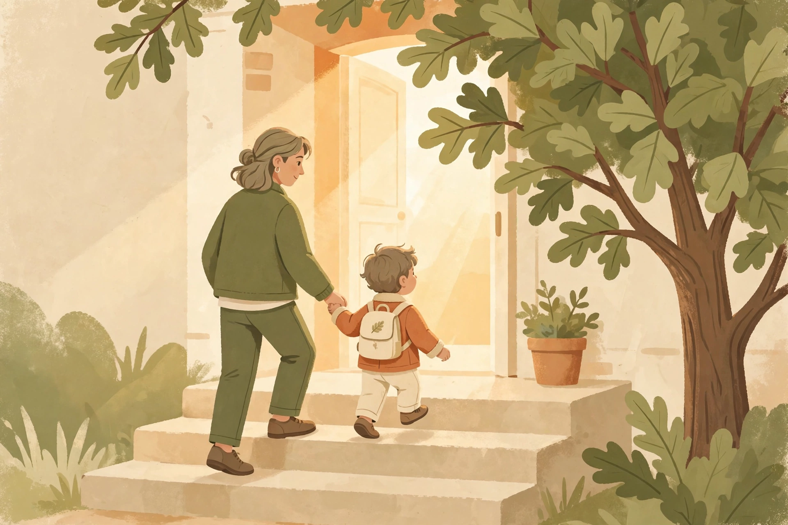
Your first steps to file
▸ Step 1 — Start the claim. Call Social Security at 1-800-772-1213. Adults can also start online at ssa.gov. For a child, the claim starts by phone or at the local office.
▸ Step 2 — Protect your filing date. The day you first contact Social Security is your “protective filing date.” Benefits can only count from that date — so do not wait.
▸ Step 3 — SAVE your Reference number. If you start online or by phone, you get a reference number. Write it down. It proves when you started.
▸ Step 4 — Answer everything. Forms, calls, and letters — answer them all, on time.
Southern Oak Financial & Wellness • southernoakfw.org
Notes:
[Minutes 27–30 · FIRST STEPS]
Show the steps picture: "Applying feels like a big staircase. It's just steps. One at a time — starting with a phone call."
Protective filing date — make this land: "The day you first contact Social Security is written down as your protective filing date. If the claim is approved, benefits count from that date — never from before it. Every month a family waits is a month that can never come back. And starting costs nothing."
The reference number: "Whether you start by phone or online, SAVE your reference number. Write it on the folder. Take a photo of it. That number is your proof of the day you started."
"For a child's SSI, the start is by phone — 1-800-772-1213 — or at the local office. They will set an appointment to take the full application. For an adult claim, you can also begin online at ssa.gov."

Slide 12
Papers to gather
Start one folder today. Every paper goes in the folder.
▸ Birth certificate and Social Security card for the person applying
▸ Proof of income — pay stubs or a letter from the job
▸ Bank statements and any savings information
▸ A list of every doctor, clinic, hospital, and therapist — with dates
▸ School information — reports, grades, and support plans
▸ ID and proof of address for the parent or adult applying
Southern Oak Financial & Wellness • southernoakfw.org
Notes:
[Minutes 30–32 · THE FOLDER]
"This is your homework, and it's simple: one folder. Everything on this slide goes in it. A grocery bag of loose papers works too — just keep it together."
Point out the one families forget: "The doctor list — every doctor, clinic, hospital, and therapist EVER seen for this condition, with addresses and dates. Social Security asks for the records — but only from the places you name. Leave one out, and that proof never arrives."
For the DAC families in the room: "If your child is grown, dig for the old papers too — school records and doctor notes from before age 22. For DAC, those old pages are gold."
"If you don't have a paper, don't let it stop you. Start the claim first — the folder can grow while the claim moves."

Slide 13
Tips that help a filing
▸ Keep copies of EVERYTHING you send. If it isn't in your folder, it may as well not exist.
▸ Write down names and dates. Every call: who you talked to, the date, and what they said.
▸ Answer SSA mail FAST. Open every envelope the day it comes. Deadlines are real — an appeal is usually due within 60 days.
▸ Keep every doctor appointment. No visits = no records = no proof.
▸ If the answer is no, don't give up. A first “no” is common. Many families win on appeal, with better records.
Southern Oak Financial & Wellness • southernoakfw.org
Notes:
[Minutes 32–33 · TIPS THAT HELP]
"These five habits are free — and they win more claims than any trick."
Walk them fast and firmly: "Copies of everything. A notebook with names and dates from every call — the day you need it, you'll be glad it's there. Mail answered fast — Social Security runs on letters, and the appeal clock is usually 60 days from the date on the letter. Doctor visits kept — no visits, no records, no proof."
And the heart line: "If the first answer is no, that is not the end of the road. A first no is common. Families who keep their records strong and appeal on time are the ones who often hear yes later."

Slide 14
3 mistakes that hurt families
All three are free to avoid.
▸ Waiting to apply. Benefits can only count from your filing date. Waiting leaves months behind that never come back.
▸ Missing mail and deadlines. A missed appeal deadline — usually 60 days — can mean starting all over.
▸ Stopping doctor visits. No visits = no records = no proof. Keep every appointment, even in a hard month.
Southern Oak Financial & Wellness • southernoakfw.org
Notes:
[Minutes 33–34 · MISTAKES — quick and punchy]
"Trick-or-treaters get one night. These mistakes cost families all year — and every one of them is free to avoid."
One, two, three: "File early — the calendar cannot run backwards. Open the mail — the 60-day appeal clock starts whether you open the envelope or not. Keep the appointments — the file Social Security reads is built at those visits."
"If you remember nothing else from tonight, remember: file early, open the mail, keep the appointments."

Slide 15
What Southern Oak can do for you
▸ Your first consultation is FREE — by Zoom, in English or Spanish.
▸ SSA filing help: Jessica guides you step by step on Zoom. You file — it must come from you — and you never do it alone.
▸ Personal Plans for ages 5 to 26 — a plan built for your child, in order, with deadlines.
▸ A FREE medication check — we look for programs that help pay for medicines.
▸ Life insurance talks — plain words, no pressure, about protecting your family.
DISCLAIMER: We do not provide refunds for services; there is NO guarantee of approvals, and we are not legal attorneys.
Notes:
[Minutes 34–35 · THE INVITATION — warm, no pressure]
"Here's what I do, and what it costs to find out: your first consultation with me is free. We meet by Zoom, in English or Spanish, and we look at where your family stands — which benefit fits, and what your next step is."
Explain the filing help honestly: "With my filing help, I guide you step by step on Zoom. You do the filing — Social Security requires it to come from you — but you are never alone at the kitchen table wondering what a question means."
The honest line, in your own warm words: "I'm a consultant and advocate, not a lawyer, and I never guarantee approvals — nobody honestly can. What I do guarantee is clear steps and a person walking beside you."
Then point them to the next slide for how to book.

Slide 16
Questions?
You do not have to do this alone.
Book your FREE consultation:
southernoakfw.org/book
Email: southernoakfw@gmail.com
Serving San Antonio, the Rio Grande Valley & surrounding cities
DISCLAIMER: We do not provide refunds for services; there is NO guarantee of approvals, and we are not legal attorneys.
Notes:
[Minutes 35–45 · QUESTIONS + CLOSE — 10 full minutes]
Start with the questions families sent when they registered: "When you registered, some of you sent me your questions — let's start there." Read each one out loud and answer in plain words, one at a time.
Then open the floor: "What other questions do you have? General questions are perfect here. For your family's private details, that's what the free consultation is for."
Keep answers short — about a minute each — so everyone gets a turn. If a question is long or private: "That one deserves a real talk — book the free consultation and we will go through it together."
Last 2 minutes — THE ASK, say it warmly and exactly: "If this class helped you, do two things tonight. One: book your free consultation at southernoakfw.org/book. Two: tell one parent you know — families find help through other families."
Close with the theme: "Tomorrow night is for treats. Tonight, I hope you got the best one of all — clear steps. File early, open the mail, keep the appointments. And remember: you do not have to do this alone."
Stay on Zoom a few minutes after 7:15 for anyone who wants to talk. Thank people by name where you can.
After class: send Rio the names of anyone who asked to book, and Rio prepares the follow-ups.

