Slide 1
Introduction
Piont1
Consumers tend to prefer imported, branded products over domestic ones because of their higher perceived quality (Batra et al., 2014; Essoussi and Merunka, 2007;Ettenson, 1993).
Piont2
Previous studies suggest that COO represents an important factor for
Chinese consumers in wine evaluation, especially for gift purchase and public consumptionsince they are exposed to other people’s judgement
Piont3
Every consumer evaluates the attributes and the traits of the good when they make the purchase decision

Slide 2
Introduction
Piont4
Hedonic price function is determined as the equilibrium between demand and supply conditions.
Piont5
Price is considered a good indicator of quality by consumers who are not knowledgeable about wine.

Slide 3
Hypotheses and methodology
RQ1. How is the COO effect on wine purchase in China?
H1. Foreign COO has a positive effect on the sales of wine bottles in China.
H2. French COO has the highest positive effect on the sales of wine bottles in China.

Slide 4
Details
Indeed, wine prices are controlled by the government both in Sweden (back in the 1990s) and China, although in a different way
Wine imported into China is also subject to 10 percent “consumption tax” and 17 per cent “value added tax”.
Consequently, in China wine from certain countries such as Australia, Chile and New Zealand is not subject to import duties thanks to mutual FTAs (the tariff rate on wine from other countries is 14 per cent for bottled wine or 20 per cent for bulk wine).

Slide 5
Attributes
The intrinsic attributes are those that are recognised by the consumer since they appear on the label: alcoholic content, vintage year, reserve characteristic, COO and body.
The extrinsic attributes include reputational signals, represented by rating and protected indicators of origin.
protected indicators of origin,referred to certificates of origin such as “protected designation of origin” (PDO) or “protected
geographical indication” (PGI),established by entities such as the European Union.

Slide 6
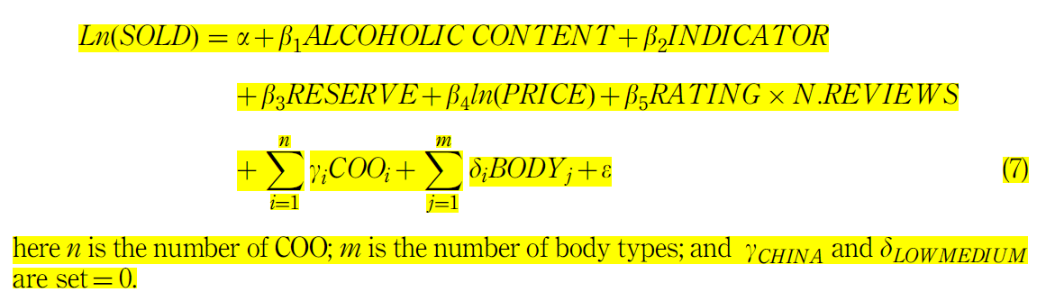
Final specification of the model

Slide 7
Some remarks on the final specification of the hedonic regression
> First, the double-logrelation between the SOLD and PRICE variables is chosen as it provides the most satisfying value of the Ramsey RESET test
> Second, the overall evaluation by users interacts with the number of reviews in order to take into account not only the quality of the wine judged by customers but also the quantity of evaluations made at the same time (indeed, wider the feedback, more reliable is the overall evaluation).
> Third, the COO variable associated to China is set as the reference variable.The coefficients of the foreigners COO will be interpreted with respect to China.

Slide 8
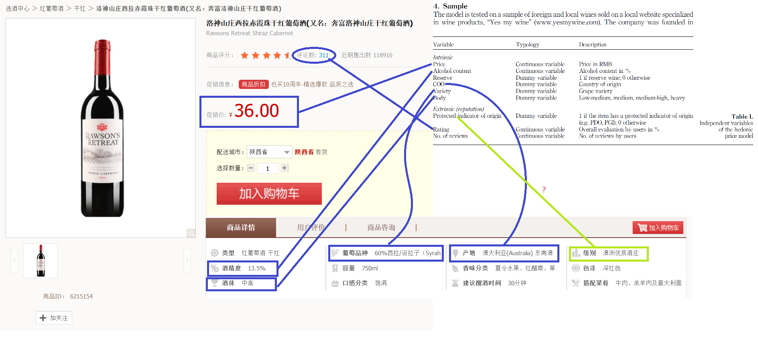
Sample
www.yesmywine.com

Slide 9
Model
(Model 1) includes the variables as specified by Equation (7). As there is evidence of heteroskedasticity ( po0.01 for the White test), robust standard error estimates are used.The R2 of the model is 0.6917, suggesting a goodness of fit.
(Model 2) adds the grape variety (such as Cabernet, Merlot, Crianza and so on) as a variable in the hedonic regression (7).
(Model 3). A regression removing the COO and including the grape variety

Slide 10








Summary

Slide 11
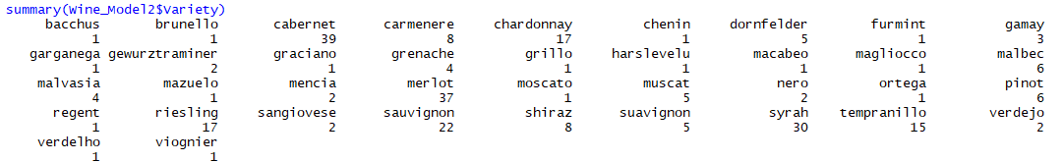
Summary

Slide 12
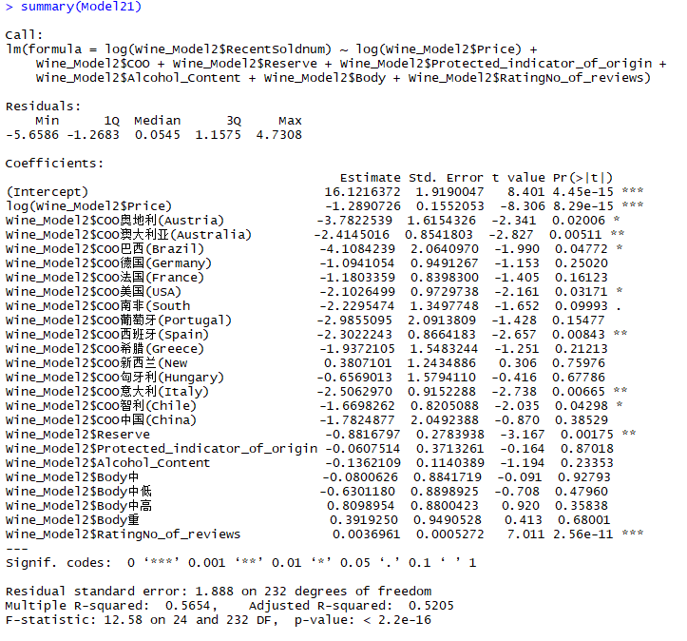
Model1

Slide 13
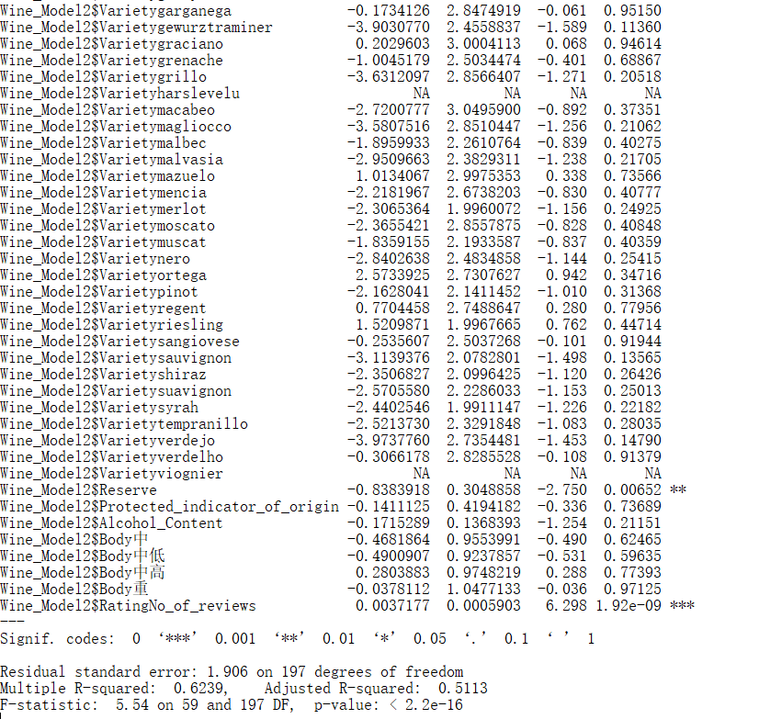
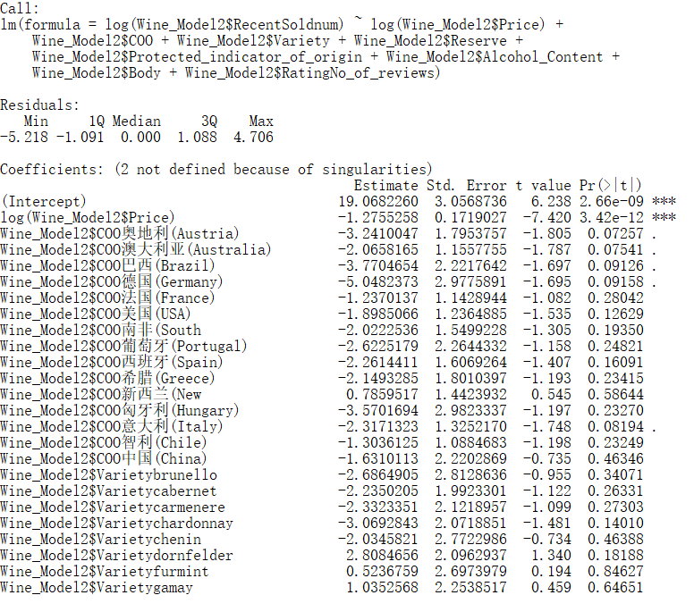
Model2

Slide 14
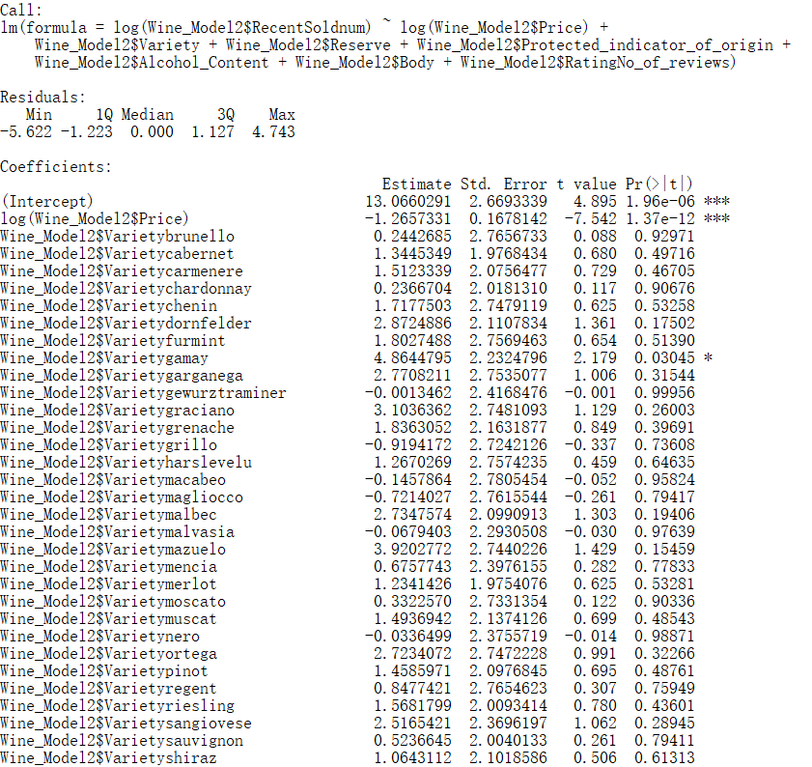
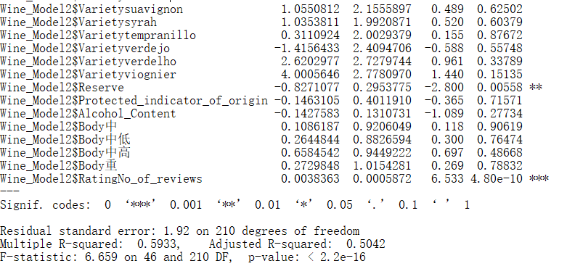
Model3

Slide 15
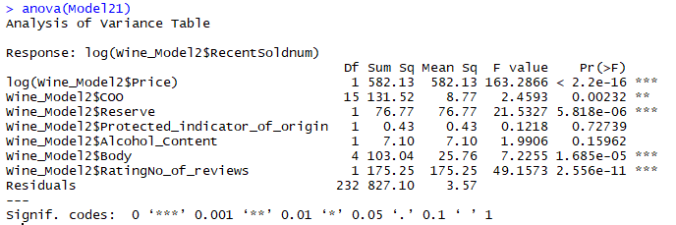
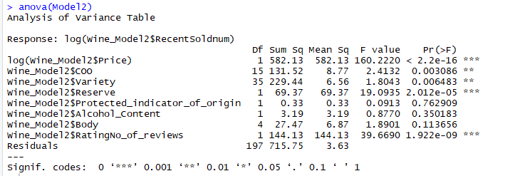
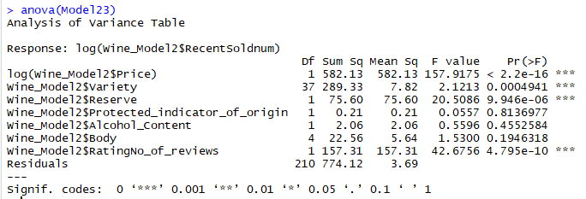
ANOVA

Slide 16
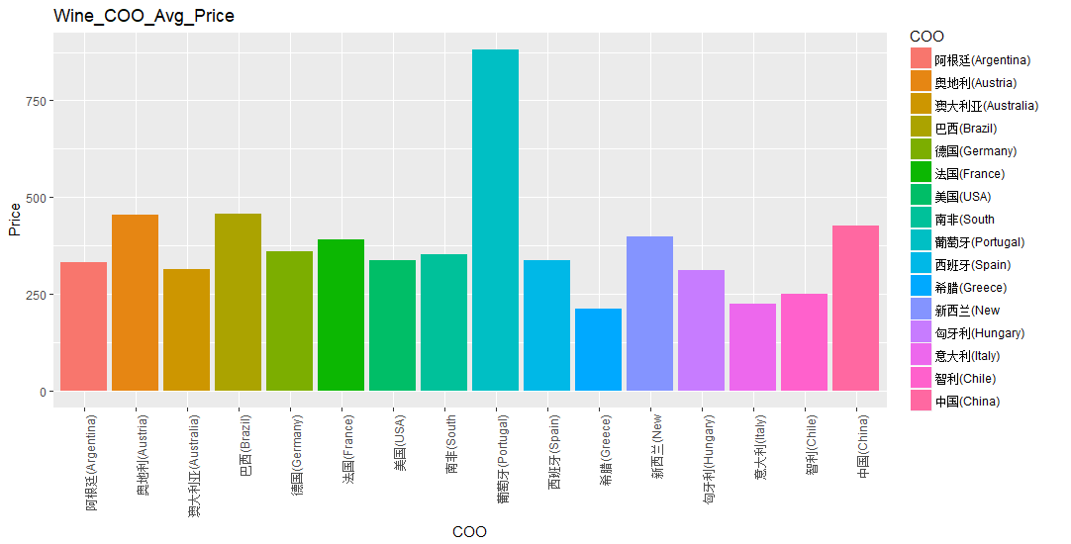
Graphic

Slide 17
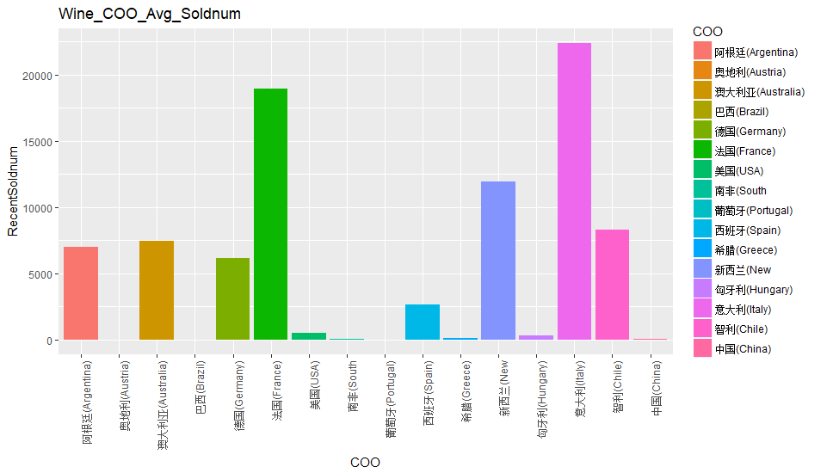
Graphic

Slide 18
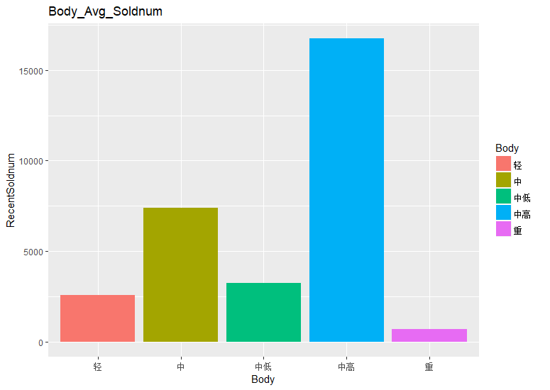
Graphic

