Slide 1
Prediction of Flight Delay
Team member: Weiqing Wang, Xiangyu Cao, Xiaoyi Xie

Slide 2
Introduction of the Project
Goal: Produce a database based website which will provide flight delay time prediction and some other services
Details
Data source
flight delay database: http://apps.bts.gov/xml/ontimesummarystatistics/src/dstat/OntimeSummaryArrivalsData.xml
weather report database: https://www.wunderground.com/history/airport/KSTL/2015/7/28/MonthlyHistory.html?req_city=&req_state=&req_statename=&reqdb.zip=&reqdb.magic=&reqdb.wmo
calendar database: http://nationalholidaydates.com/UnitedStates/2105.aspx
Database server: Amazon Cloud (MySQL)
Website (PHP)
Notes:
The purpose of our project is to create a database based website that will predict whether a flight with a certain date, air company and destination airport will delay and provide some other services. Here are some detailed information of our project. We created a new database based on three different database: flight delay information database, weather report database and a calendar database. Each of the three databases can be visit through the underlined link. We chose MySQL as our database server and used PHP to link the database with our website. The detailed structure and data samples of the database will be shown in the following slides.

Slide 3
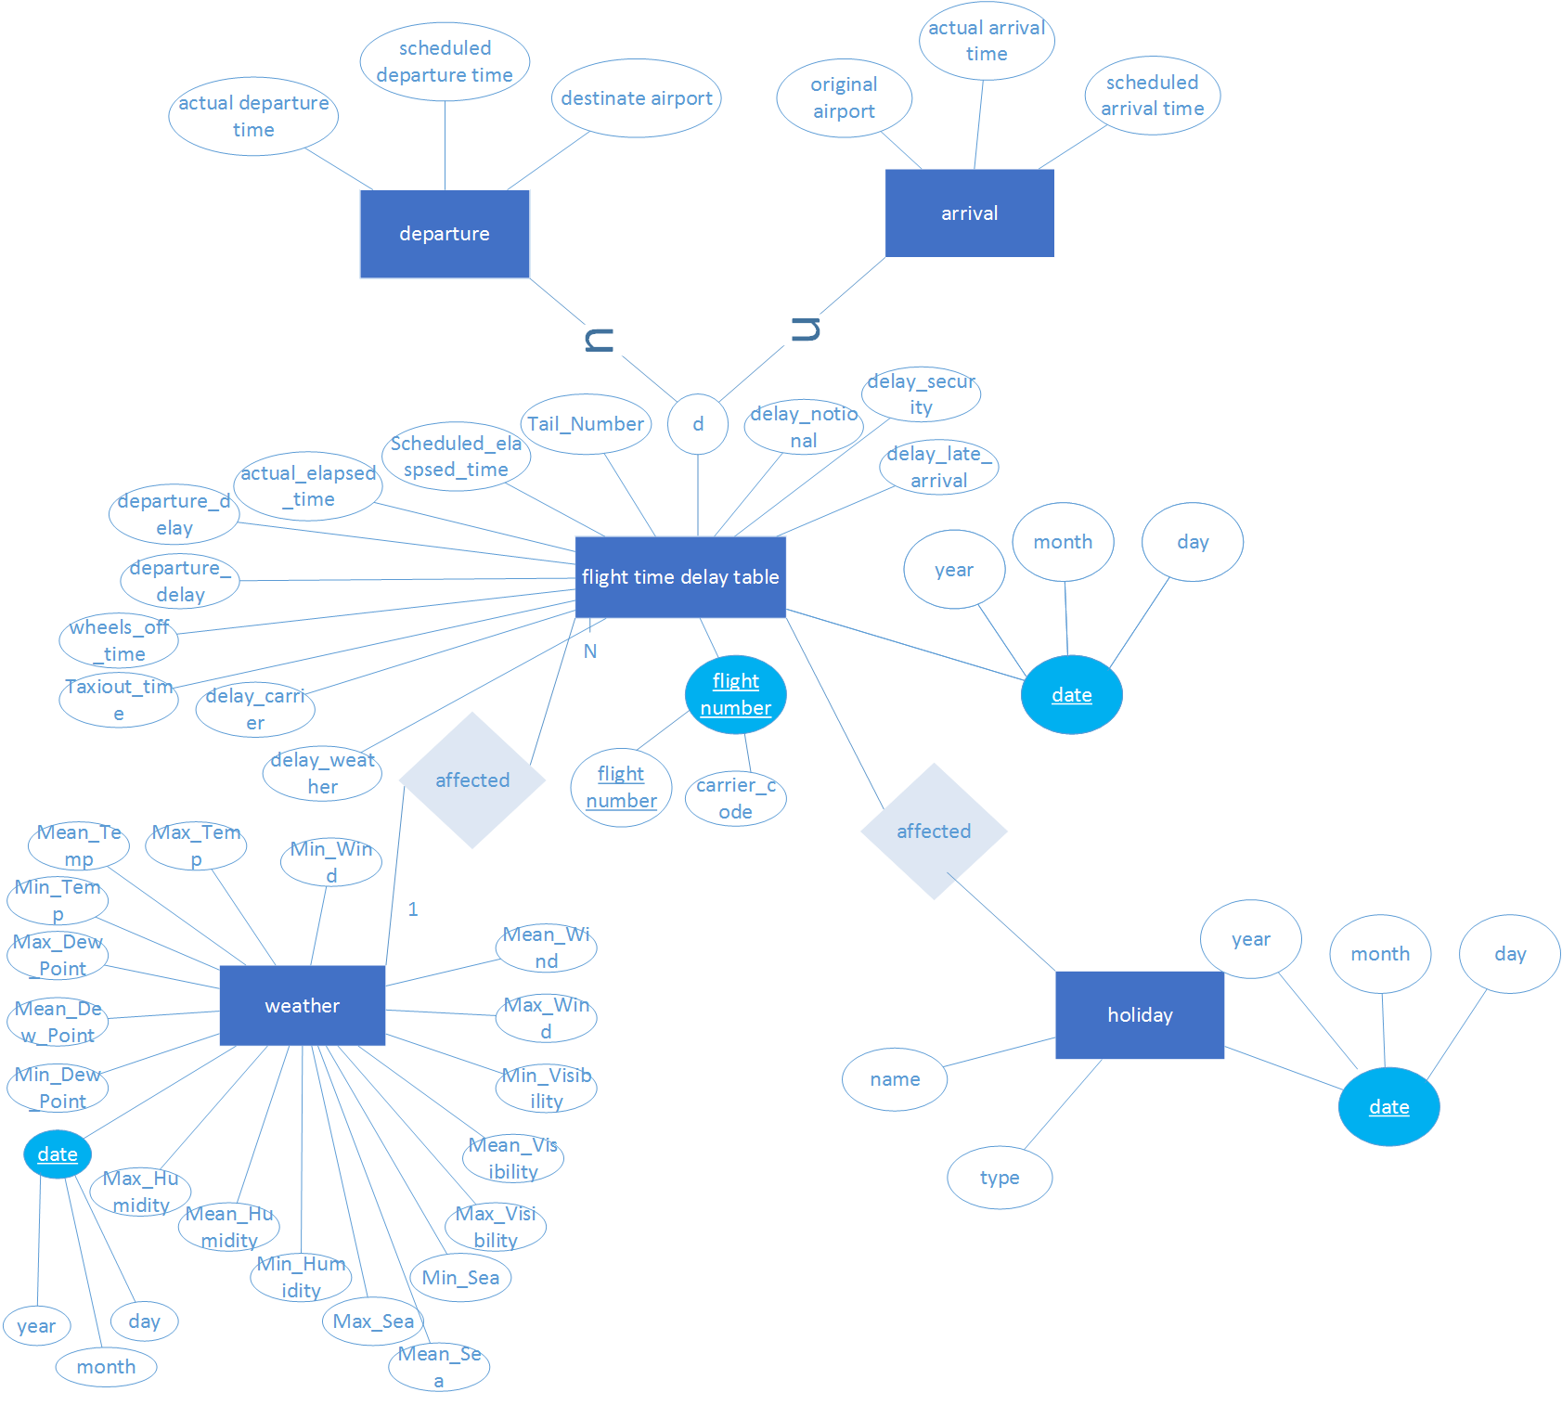
ER Diagram
Notes:
This is our ER-diagram of our database. In our concern, there are two main factors that will affect the flight landing time. So our ER diagram has three main entities shown in blue: flight time delay, weather and holiday. And the flight delay time is a union of departure and arrival. The key attribute is shown in cyan. For flight time delay, it has two candidate key attributes: flight number and date. And key attribute of the weather and holiday are date. The relation of the entities is shown in diamond.

Slide 4
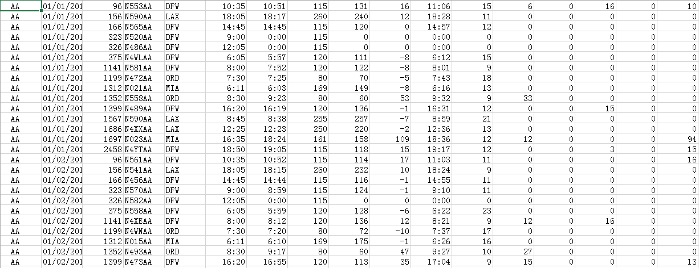
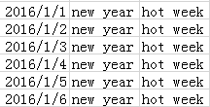
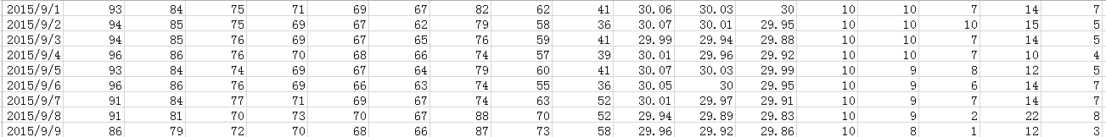
Sample Data
Flight delay time data sample
Holiday data sample
Weather report data sample
Notes:
These are our sample data of weather and flights. We analyzed data from last Sep to this Feb. But at last, we didn’t use all of the attributes . Because some of them don’t have effects on our final result or too difficult to analyze. So we care more about the delay time under different weather conditions. Such as rain, snow or thunderstorm and so on.

Slide 5
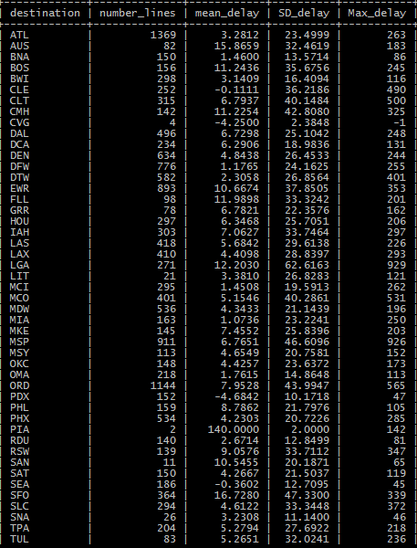
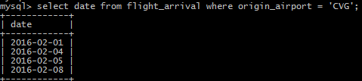

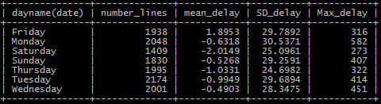
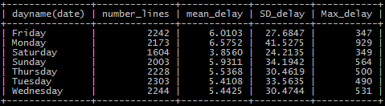
Several things found during the project
Provisional flight or private flight!
Weekday or Weekend may not mater
Notes:
During the process of looking for the result, we found something interesting. Firstly, we can notice that there are only 4 lines to CVG and 2 lines to PIA, so we checked the date of them and found that they may be provisional flight or private plane. Another thing is that at first we thought weekends might have some influences on flights, but from the mean, standard deviation and maximum of delay time, we can see that it may not matter. The difference of them is small.

Slide 6
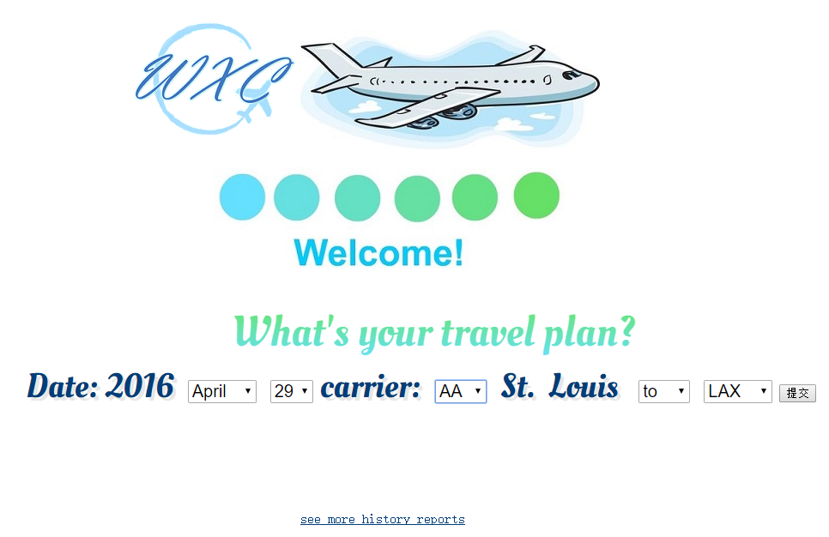
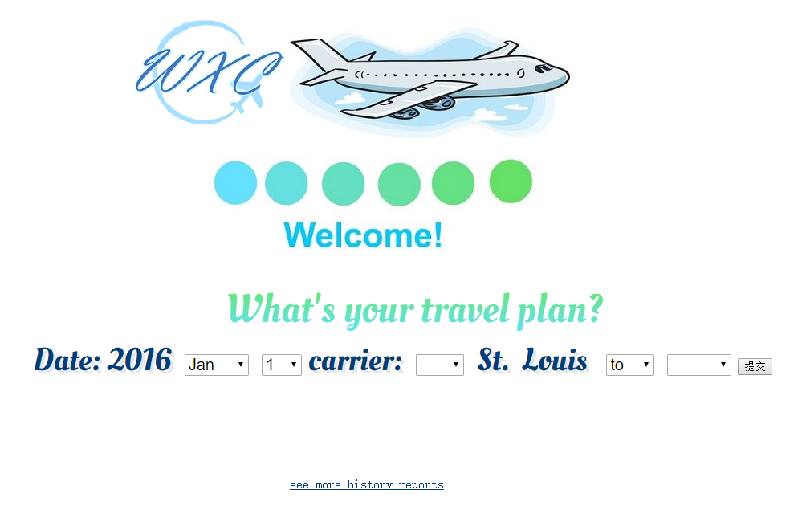
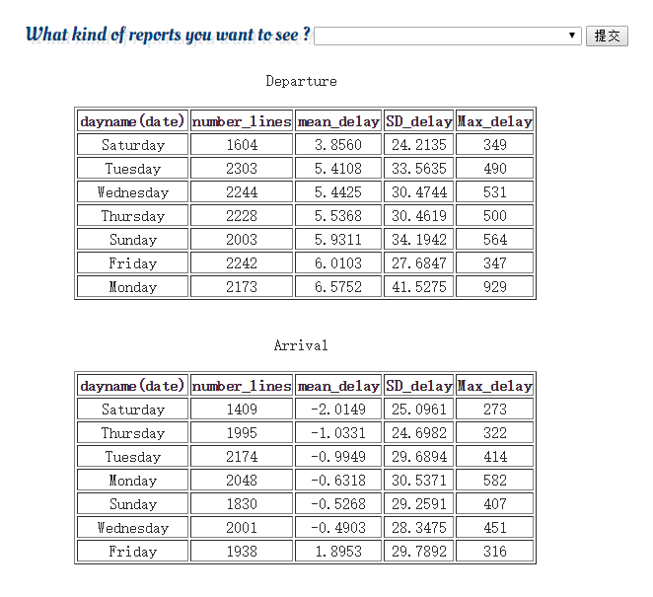
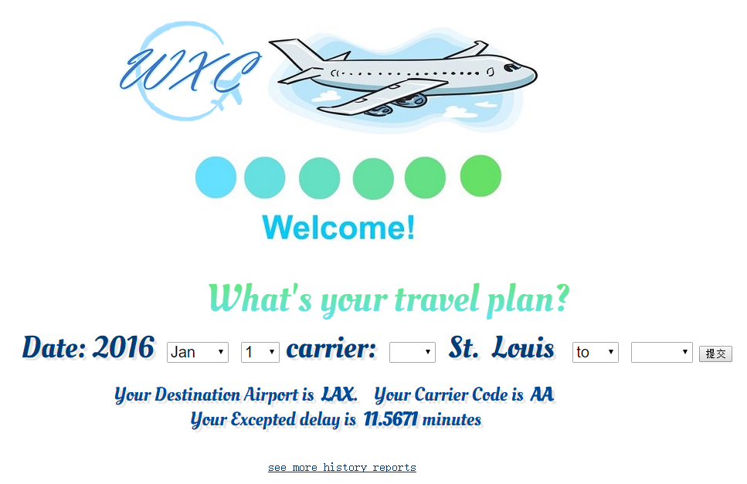

Result- user -interface
Notes:
So this is our website, user can choose their date of flight, carrier code destination at the bar, like April 29 St. Louis to Los angles. but if they haven’t decide which airline company they want to take, that’ ok it can be null, if they haven’t decide where they will go, although I personally won’t do that, they can leave it blank.
Let’s submit it for the result it will show the customer’s carrier code, destination and most important, their expected flight delay time which we calculated base on the history data and weather forecast, because we can only get the forecast for future 5 days, it's more accurate within that interval. If it shows a negative number, congratulations! It means that your flight pro won’t be delayed.
If customer want to see more history reports they can click the link below, it will lead them to another page which they can choose their specific question, say, to what’s the standard delay for each day in a week. Then it will return the table which shows us the Saturday has least delay in average, but the difference is small

