Slide 1
Astrophotonics

Slide 2
What is astrophotonics Need
●
●
Importance Designs Applications
●
●
●

Slide 3
Astrophotonics (Astronomy + Photonics) Space exploration
●
●
●
Telescope and astronomical spacecraft payload instrumentation
Precise analysis
●

Slide 4
Astronomy
●
Study universe from theorotical,observational and computational perspective
Optical astronomy
Radio astronomy , X-Ray astronomy Gravitational wave astronomy
●
●
●

Slide 5
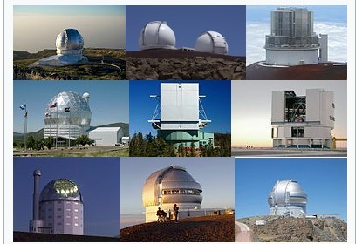

Slide 6
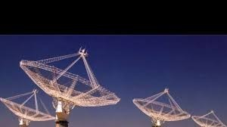

Slide 7
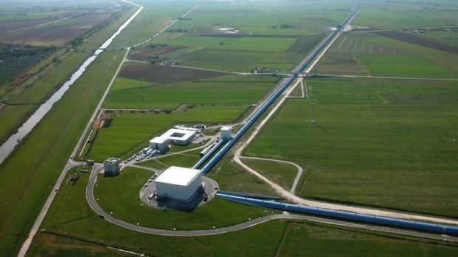

Slide 8
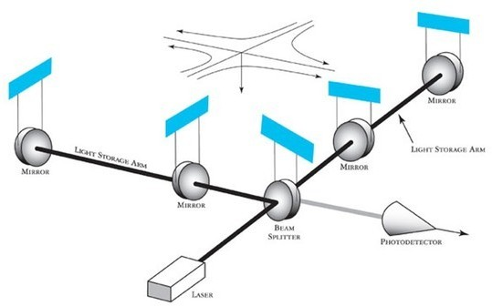

Slide 9
Astronomical Optical Detection Techniques
Photometry Interferometry Spectrometry Astrometry Microlensing
●
●
●
●
●

Slide 10
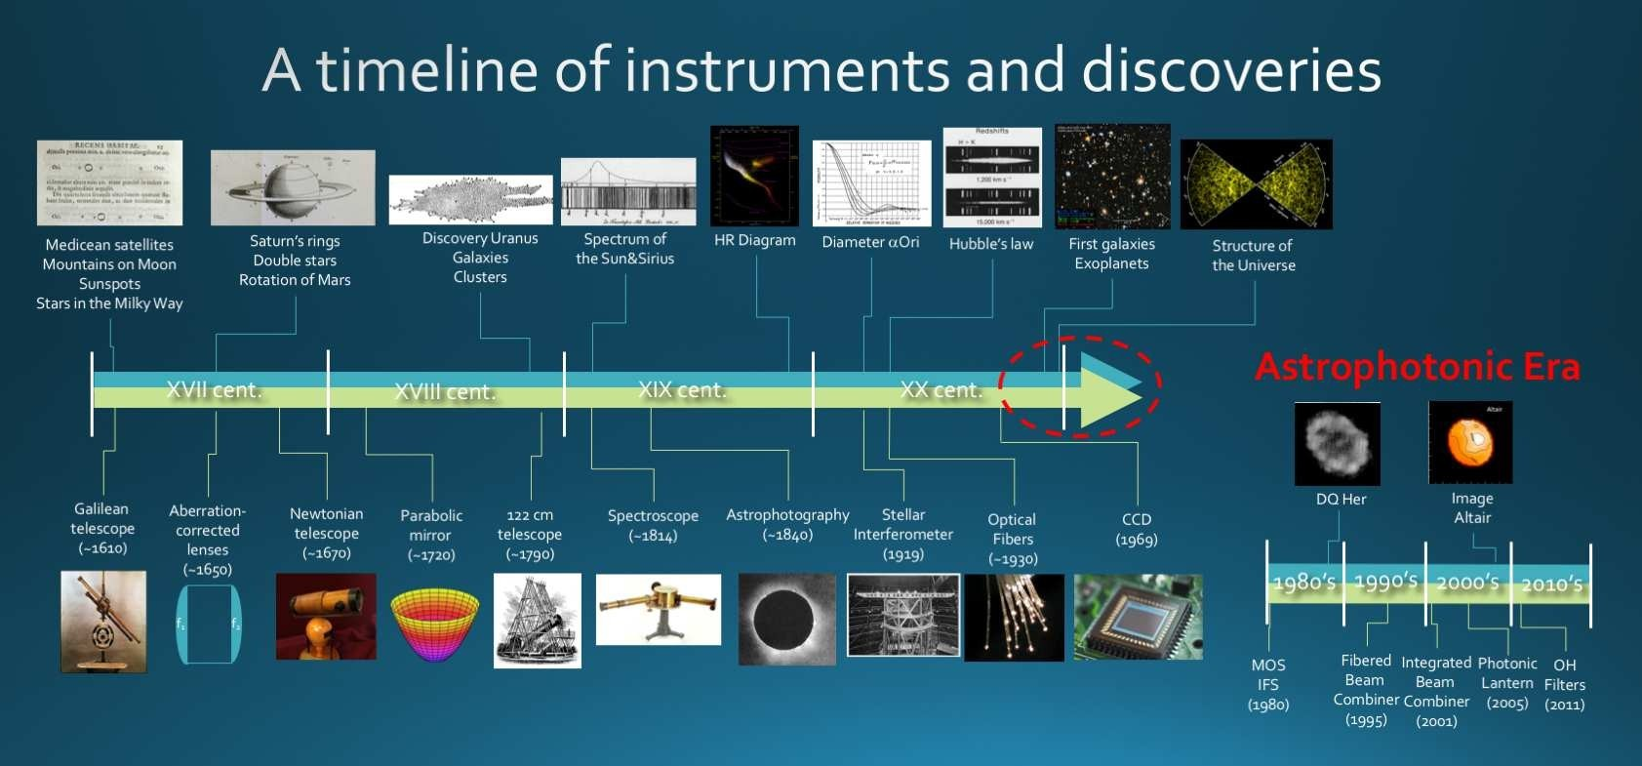

Slide 11
Inferences from Astronomical detection
Detailed study of kinematics of galaxies (Red shift and Blue shift) Observing faint sources in universe
Discovering characterizing exoplanets and their atmosphere Initial galaxies in universe
NIR spectrum, OH background supression challenges for ground based telescopes in J (1100–1300nm) and H bands (1400–1700 nm).
●
●
●
●
●

Slide 12
Challenges
Large instruments Multiple bands Inference
Power consumption Cost
●
●
●
●
●

Slide 13
Photonics
●
Materials used to manipulate light i.e emission,transmission,processing and detection of light.
Similar to electronics but applied to photons by taking consideration of dual property of light
●

Slide 14
Photonics Integrated Circuits
Silicon Photonics Need
Size and cost barrier
●
●
●

Slide 15
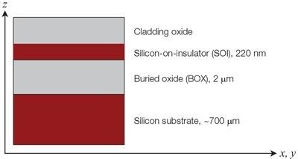

Slide 16
Photonics Components
Waveguides Y branch
Waveguide bends
Fibre grating coupler Laser
Photodetector
●
●
●
●
●
●

Slide 17
Photonics Circuits
Interferometer Ring resonator Directional coupler
●
●
●

Slide 18
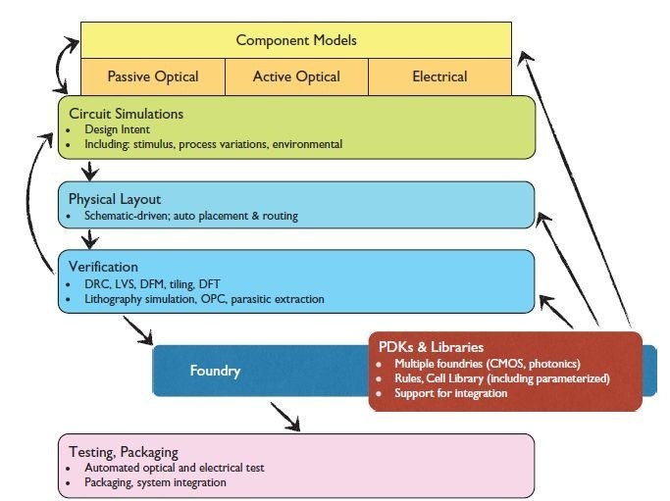
Design and Modelling

Slide 19
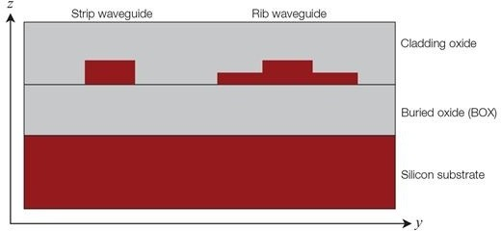

Slide 20
Waveguide Parameters
Effective index Group index
Strip and slab waveguides Waveguide as function of wavelength Low loss (bend waveguide)
●
●
●
●
●

Slide 21
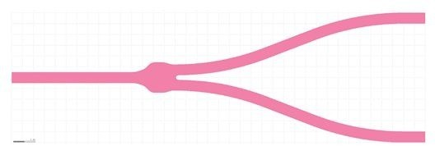

Slide 22
Y Branch
Y Branch splitter and combiner Constructive and destructive interference Group index
Strip and slab waveguides Waveguide as function of wavelength Low loss (bend waveguide)
●
●
●
●
●
●

Slide 23
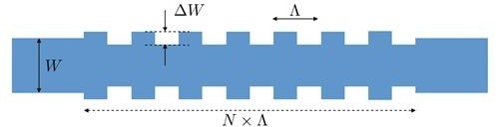

Slide 24
Grating Coupler
Light in and out of silicon chip Variation in refractive index
●
●

Slide 25


Slide 26
Spectrometers for Astronomy
Array Waveguide Grating Fourier Transform Spectrometer Photonic Echelle Grating
●
●
●

Slide 27
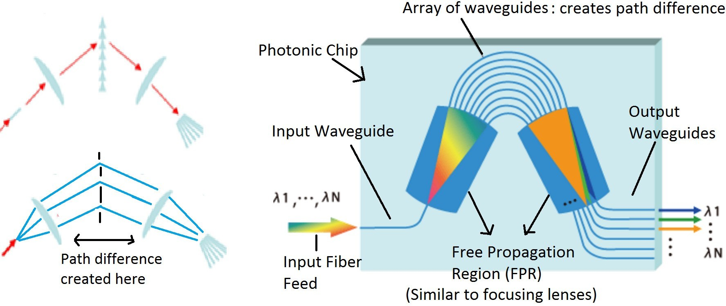

Slide 28
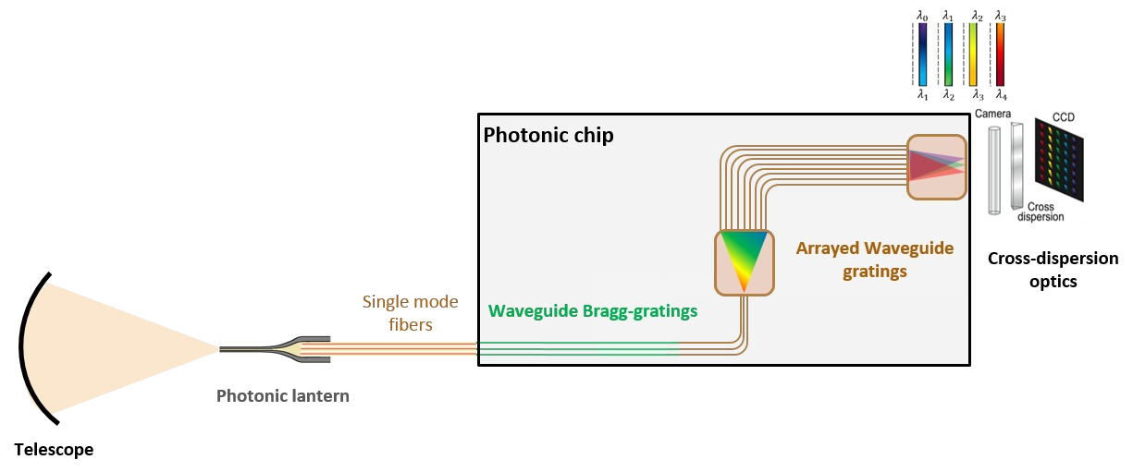

Slide 29
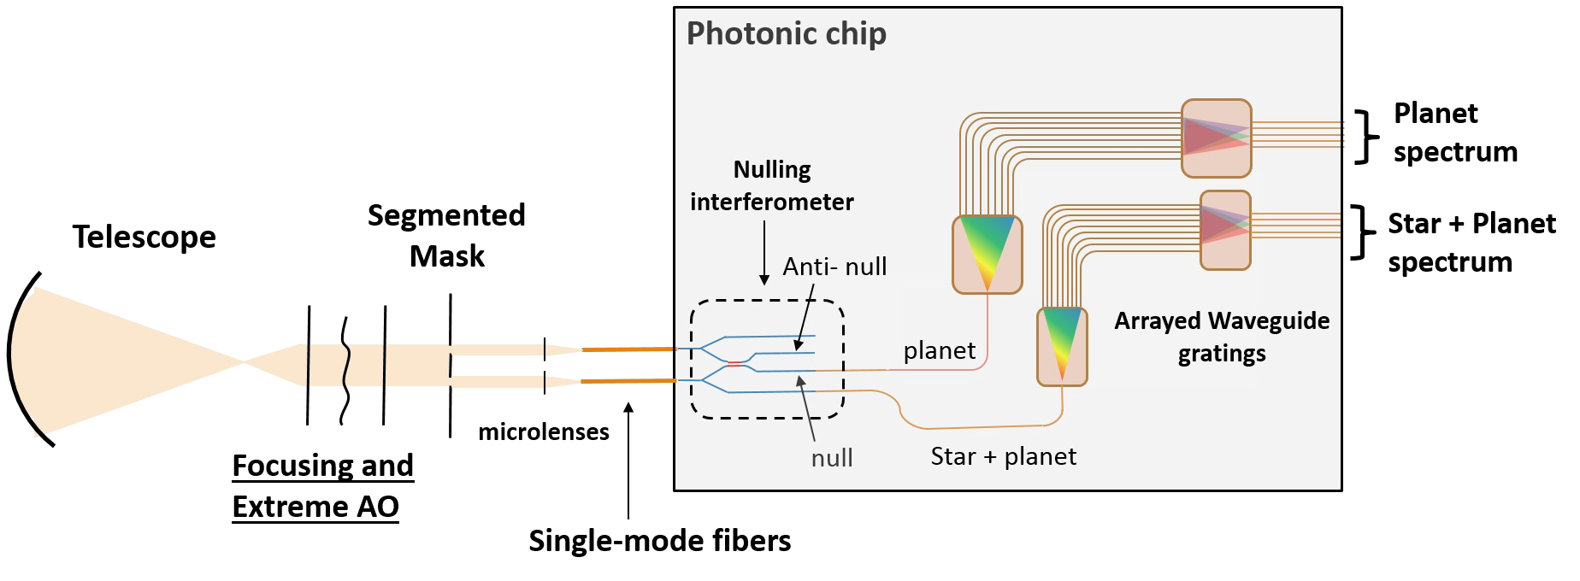

Slide 30
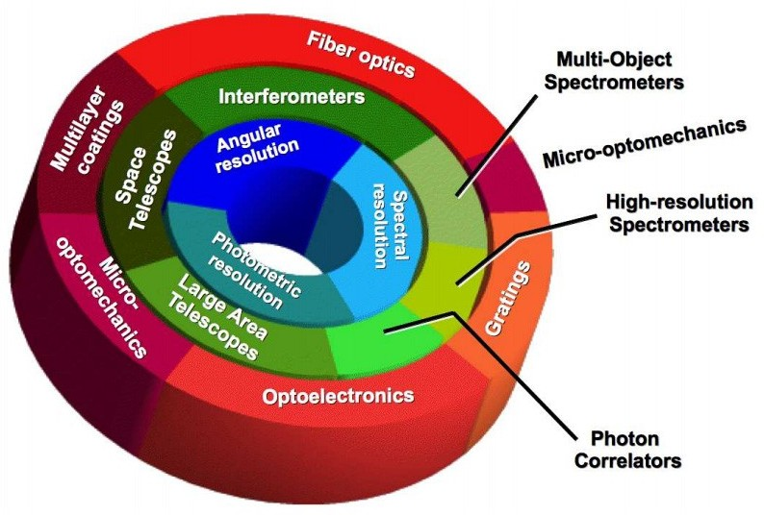

Slide 31
Developement Steps
●Design
●Simulation
●Modelling with EM solvers
●GDS
●Fabrication
●Testing
●Data analysis
●Production

Slide 32
Scope for Researchers
●Design and simulation with various tools like Ansys, optiwave, IPKISS, Nazca etc
●Computational EM and algorithms for solvers
●Fabrication methods
●Data analysis technique

