Slide 1
Machine Learning-Based
Demand Prediction
ML
forecast → plan
Factory production planning for shampoo, body wash, and laundry detergent
Regression final project
Synthetic demonstration dataset
Demand
Prediction
Production
Recommendation
NORTON UNIVERSITY · Graduate School
Course: Machine Learning
Group 16 | Student: SOUT RAHIM
Lecturer: SEK SOCHEAT
Prepared: August 2026
Notes:
Introduce the project title, scope, and that the presentation is based on a regression workflow for factory production planning. Mention that the dataset is synthetic because real factory data was not supplied.

Slide 2
Presentation roadmap
From planning problem to model evidence and production output
1
Problem & objective
2
Data & method
3
Model results
4
Planning output
Core idea
Use historical business features to predict next-month demand, then convert the forecast into a recommended production quantity.
Machine Learning-Based Demand Prediction | Group 16
02
Notes:
Set the story: first explain why the factory needs forecasts, then describe the data and method, show model results, and finish with an example production recommendation.

Slide 3
Production planning problem
Demand error creates real operational costs
Overproduction
• higher storage pressure
• working capital tied up
• possible waste
Stockouts
• delayed fulfillment
• missed sales
• lower customer trust
Better forecast
= better production plan
Project objectives
Predict monthly demand for three product categories
Compare Linear Regression, Decision Tree, and Random Forest
Identify important planning features
Generate an illustrative production recommendation
Machine Learning-Based Demand Prediction | Group 16
03
Notes:
Explain the planning risk: producing too much creates inventory burden, producing too little causes stockouts. The objective is to support better planning with a repeatable regression workflow.

Slide 4
Data status and scope
Transparent disclosure: results demonstrate the workflow only
Important academic integrity note
No authorized historical factory dataset was provided. The project uses a clearly labeled synthetic demonstration dataset and does not claim real Medtherm forecasting performance.
177
3
Feb 2021–Dec 2025
141 / 36
monthly product records
product categories
synthetic period
train / test records
Target variable
Products
Monthly target_demand quantity for the next planning period
Shampoo · Body Wash · Laundry Detergent
Machine Learning-Based Demand Prediction | Group 16
04
Notes:
Emphasize the integrity disclosure: this deck presents a complete reproducible ML workflow, not real factory evidence. The same workflow can later be rerun with authorized records.

Slide 5
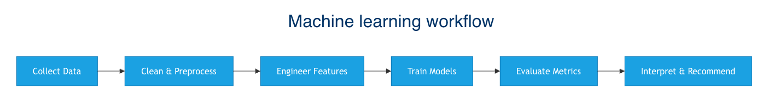
End-to-end machine learning workflow
The pipeline links data preparation, model training, evaluation, and recommendations
Leakage prevention
Preprocessing is fitted on training data only
Time-aware split
Earliest 80% train, latest 20% test
Same split for all candidate models
Model comparison uses MAE, RMSE, R²
Machine Learning-Based Demand Prediction | Group 16
05
Notes:
Walk through the pipeline. Highlight the time-aware train/test split and leakage prevention because those are important for credible ML evaluation.

Slide 6
Features used for regression
Inputs mirror the variables proposed in the midterm plan
Product & calendar
product_type, month, season
Demand signals
previous_sales, customer_order_quantity
Target
next-period monthly demand quantity
Operational context
stock_quantity, previous_production_quantity
Commercial levers
price, promotion
All categorical variables are one-hot encoded; numeric variables are median-imputed and standardized within the training pipeline.
Machine Learning-Based Demand Prediction | Group 16
06
Notes:
Explain the feature groups. These variables are available before or during production planning, which makes them relevant for a forecasting support system.

Slide 7
Candidate models and evaluation
Three supervised regression algorithms were compared on the same test period
Algorithm
Why included
Configuration
Linear Regression
Transparent linear baseline
No tree parameters
Decision Tree
Captures nonlinear rules
max_depth=5, min_samples_leaf=4
Random Forest
Ensemble of randomized trees
400 trees, max_depth=8, min_samples_leaf=2
Evaluation metrics
MAE
average absolute error
RMSE
primary ranking metric
R²
variance explained
Machine Learning-Based Demand Prediction | Group 16
07
Notes:
Describe why a simple model is included. Explain that lower MAE and RMSE are better, while higher R-squared is better. RMSE is used as the main ranking metric.

Slide 8
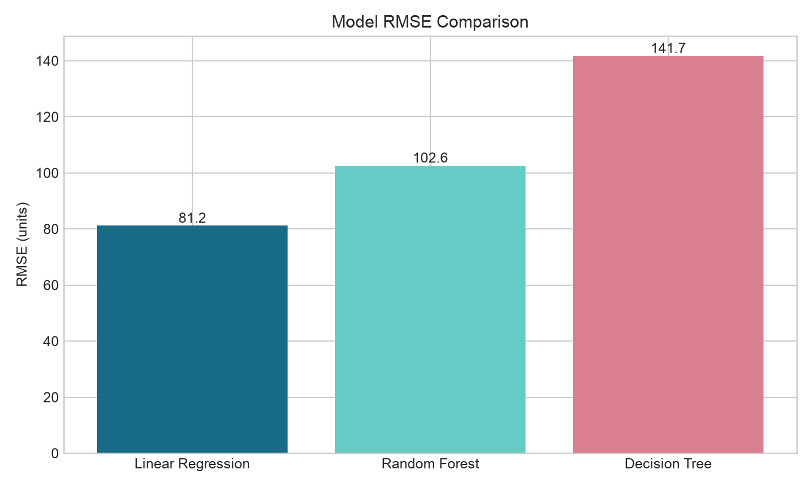
Model performance comparison
Linear Regression produced the lowest error on the synthetic holdout set
Best synthetic test result
62.54
81.15
MAE
RMSE
0.9133
R²
Takeaway
The smoother synthetic relationships favored the linear baseline. This ranking must be re-tested with real factory records.
Machine Learning-Based Demand Prediction | Group 16
08
Notes:
State the key result: Linear Regression had the lowest RMSE. Emphasize that because data is synthetic, the result demonstrates the workflow rather than proving real-world accuracy.

Slide 9
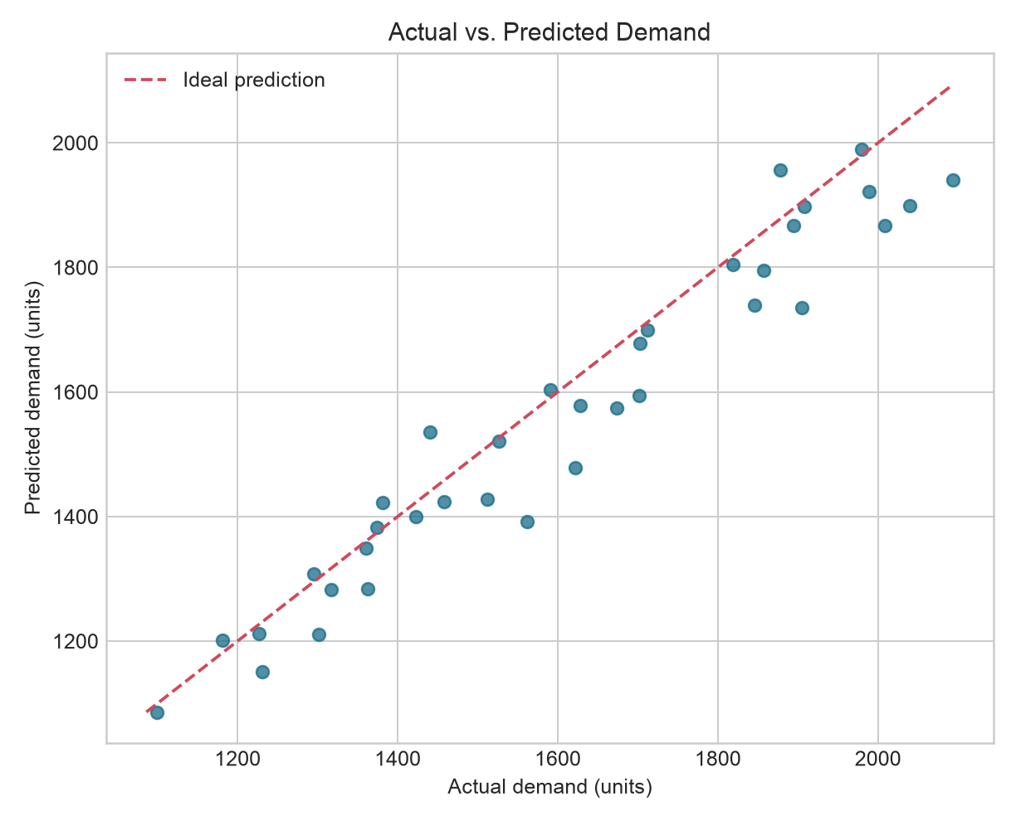
Prediction quality diagnostic
Most predicted values lie near the ideal line
How to read this chart
Points near the diagonal mean small prediction error
The holdout set shows good overall alignment
Residual errors still matter for production risk
Synthetic result: predictions are close, but not perfect.
Planning implication: keep safety stock and management review in the process.
Machine Learning-Based Demand Prediction | Group 16
09
Notes:
Use this slide to connect the numbers to a visual diagnostic. Close points are good, but planning should still consider uncertainty.

Slide 10
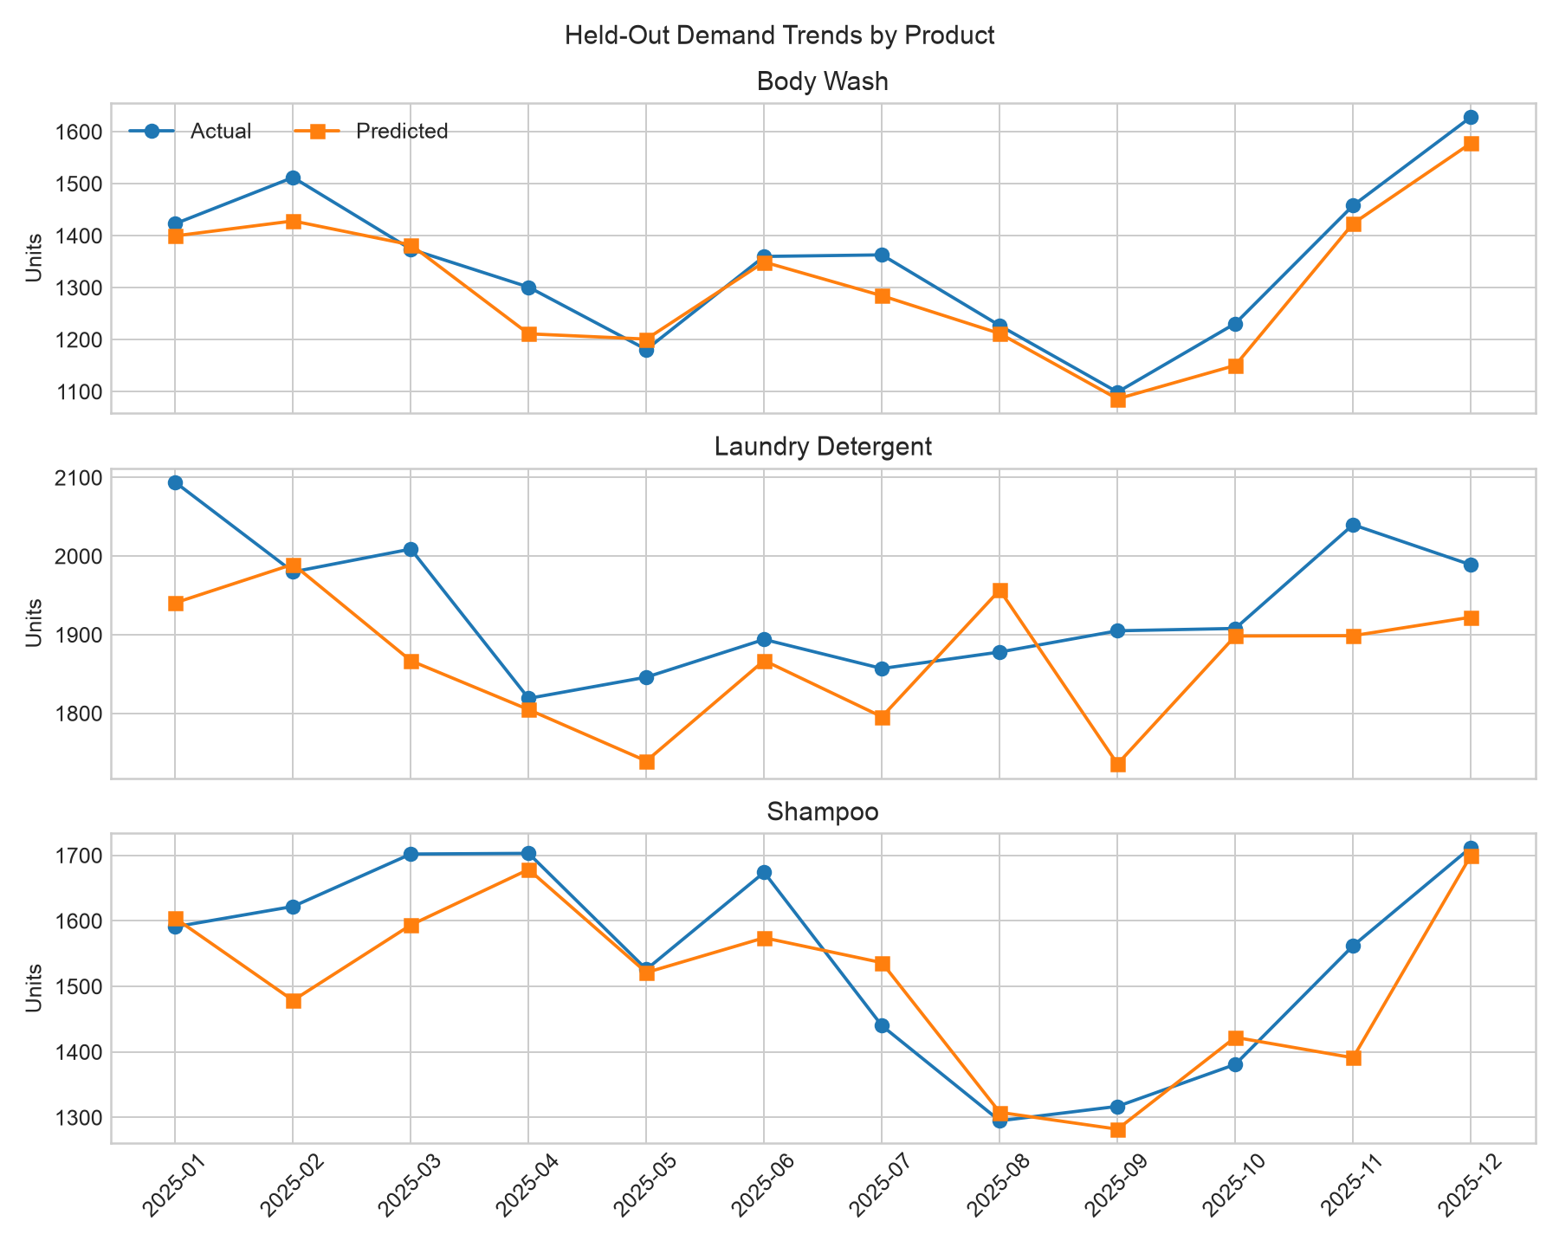
Holdout demand trends by product
Actual and predicted monthly demand during the test year
The model follows the broad product-level movement, with some month-specific deviations.
Machine Learning-Based Demand Prediction | Group 16
10
Notes:
Show that the prediction follows overall movement for each product, but not every month exactly. This is a realistic point to discuss in the defense.

Slide 11
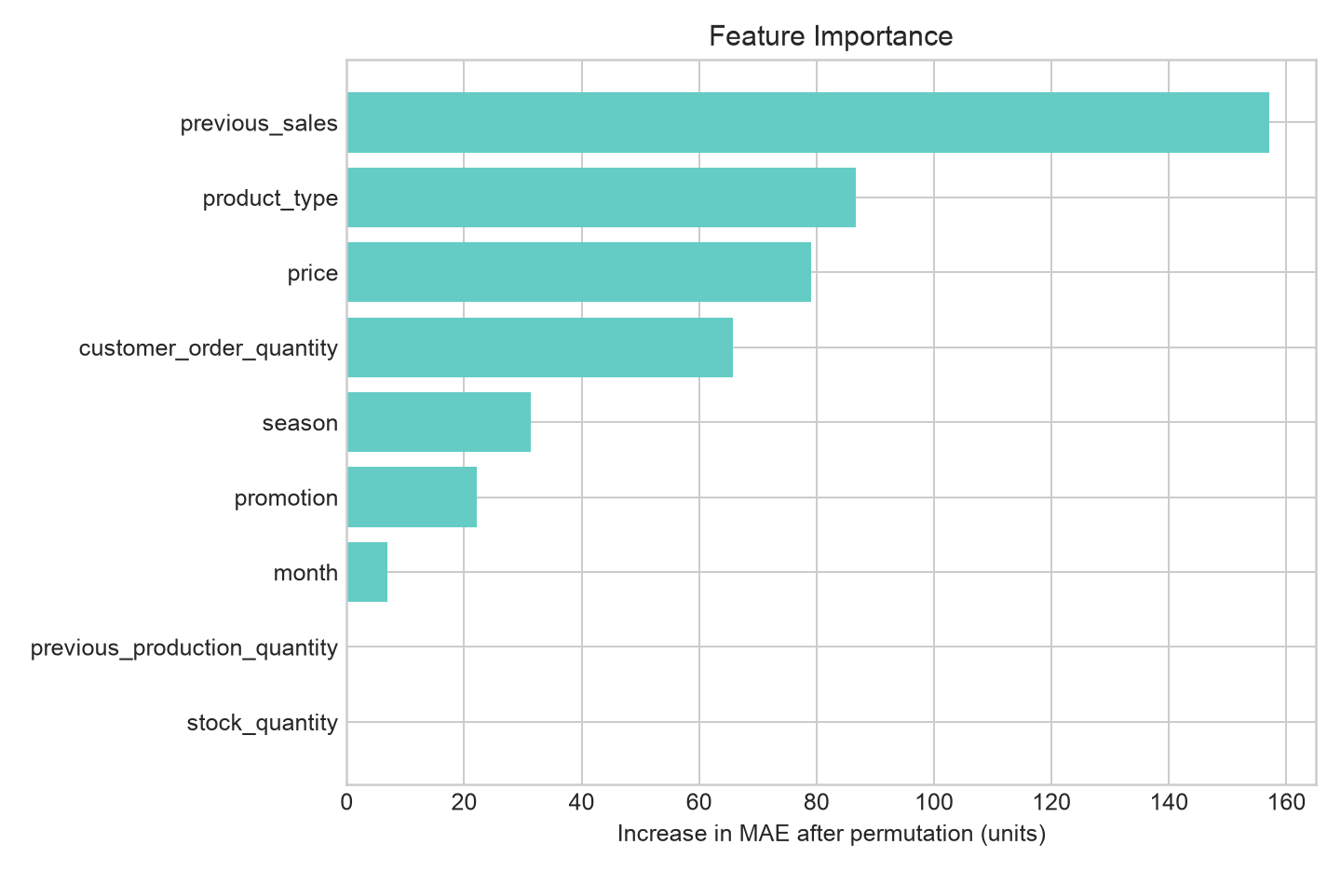
Feature importance interpretation
Permutation importance highlights which inputs most affect synthetic prediction performance
Top planning signals
1. Previous sales
2. Product type
3. Price
4. Customer orders
Interpretation caution
Importance values reflect synthetic data construction and must be re-estimated using authorized real records.
Machine Learning-Based Demand Prediction | Group 16
11
Notes:
Explain that previous sales and order quantity are intuitive signals for demand forecasting. Make clear that feature importance is not a real factory conclusion yet.

Slide 12
From prediction to production recommendation
January 2026 scenario illustrates the intended system output
Recommended production = max(0, predicted demand + 10% safety stock − current stock)
Product
Predicted demand
Current stock
Safety stock
Recommended production
Shampoo
1,653
353
165
1,465
Body Wash
1,167
101
117
1,183
Laundry Detergent
1,741
391
174
1,524
This is an illustrative scenario only. A real rule should account for service level, lead time, batch size, capacity, shelf life, and management policy.
Machine Learning-Based Demand Prediction | Group 16
12
Notes:
Show how a prediction becomes an action. Explain the formula and the three product recommendations. Clarify that the 10% safety stock rule is simple and illustrative.

Slide 13
Limitations and future work
The framework is complete, but real deployment requires real data and stronger planning rules
Current limitations
Recommended next steps
Synthetic dataset cannot prove actual factory accuracy
Only three product categories and small sample size
External factors are not fully represented
Fixed 10% safety stock is not an optimized inventory policy
Replace synthetic CSV with authorized historical records
Add holidays, lead time, channels, promotion intensity, and capacity constraints
Use time-series cross-validation and hyperparameter tuning
Add prediction intervals and a dashboard for planners
Conclusion
The project demonstrates a reproducible ML demand-prediction workflow that can be rerun with real factory data for operational decision support.
Machine Learning-Based Demand Prediction | Group 16
13
Notes:
Be honest about limitations, then close positively: the value of the project is the complete pipeline and clear method, ready to rerun with authorized data.

Slide 14
Thank You
Q&A
Questions & Discussion
Final message
A transparent, reproducible regression workflow can support demand forecasting and production planning once authorized real data is available.
forecast → plan
Group 16 | Machine Learning Final Project
Norton University · Graduate School
Notes:
End the presentation and invite questions.

