Slide 1
Machine Learning-Based Demand Prediction
Factory Production Planning for Shampoo, Body Wash, and Laundry Detergent
Group 16 · SOUT RAHIM · Norton University · August 2026

Slide 2
Problem and Goal
Overproduction raises inventory and storage costs; underproduction risks stockouts and missed sales.
Goal: predict next-month demand and translate the forecast into a clear production recommendation.
Scope: Shampoo, Body Wash, and Laundry Detergent.
Supervised machine-learning regression project

Slide 3
Data and Academic Integrity
177 monthly product records: February 2021–December 2025.
Features: product, month/season, previous sales, stock, price, promotion, customer orders, and previous production.
The dataset is synthetic and is used only to demonstrate the workflow; it is not evidence of actual Medtherm demand.
Replace the CSV with authorized factory records before operational use.

Slide 4
Methodology
Sort observations by month and reserve the latest 20% as a holdout test period (141 train / 36 test).
Fit imputation, one-hot encoding, and scaling only on training data to prevent leakage.
Compare Linear Regression, Decision Tree, and Random Forest on identical data.
Select the lowest-RMSE model; verify with MAE and R².

Slide 5
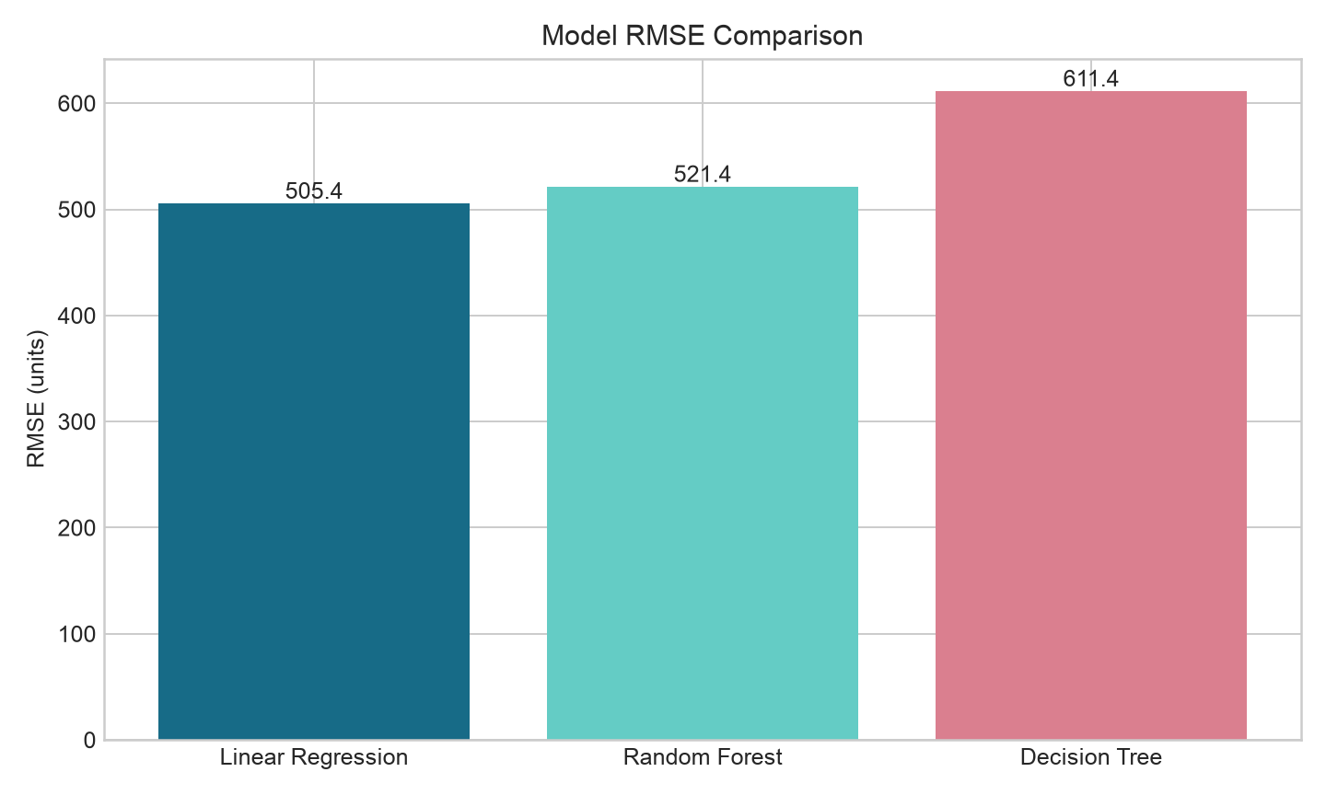
Model Comparison
Selected model: Linear Regression · MAE 379.3 · RMSE 505.4 · R² 0.977

Slide 6
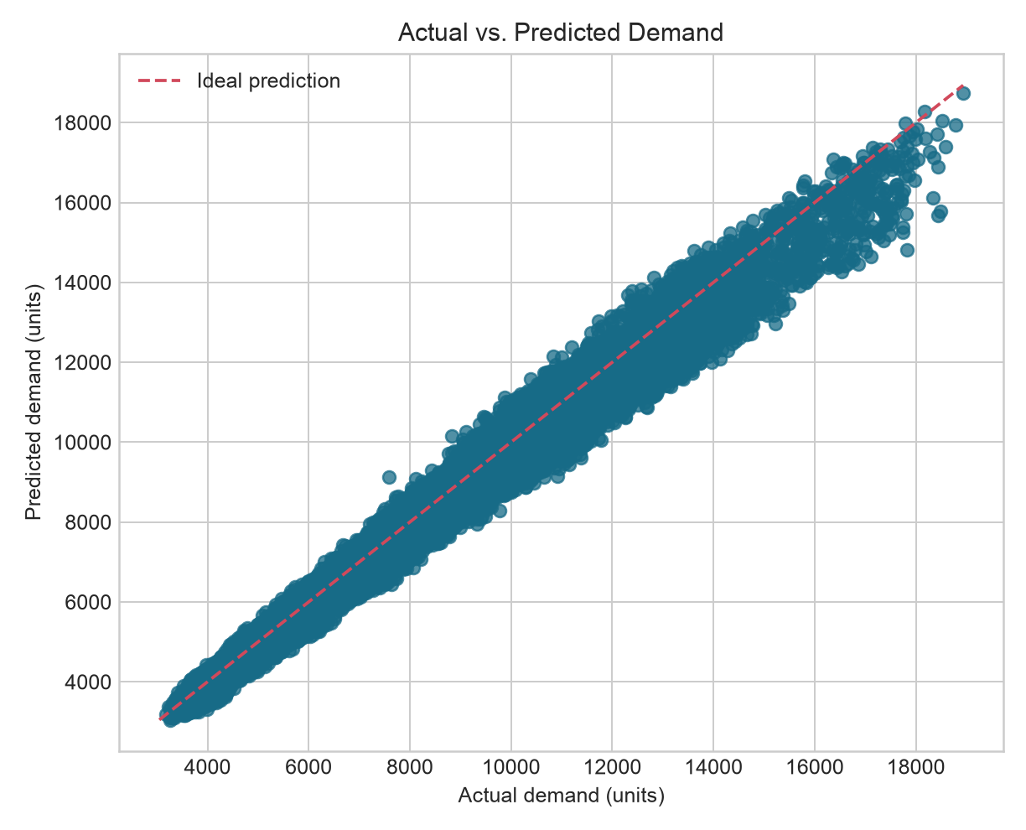
Prediction Quality
Held-out observations near the diagonal indicate closer predictions.

Slide 7
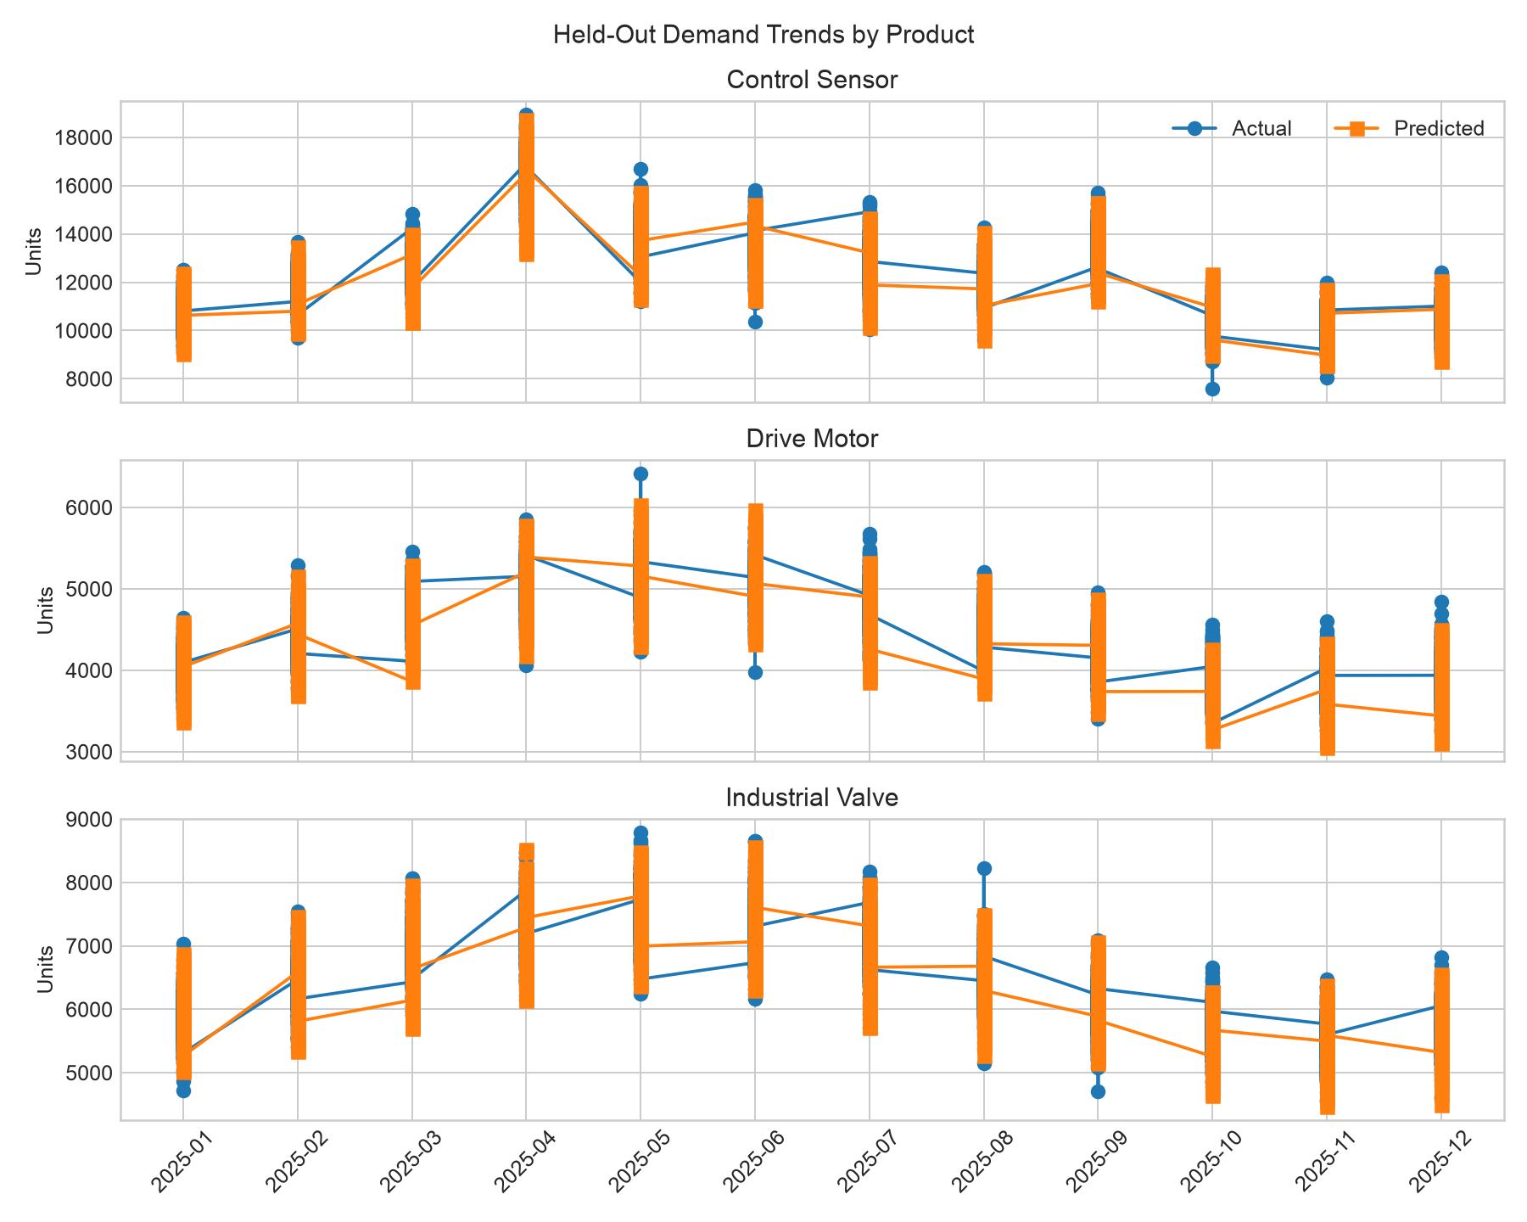
Demand Trends
Actual and predicted demand across the final 12 held-out months.

Slide 8
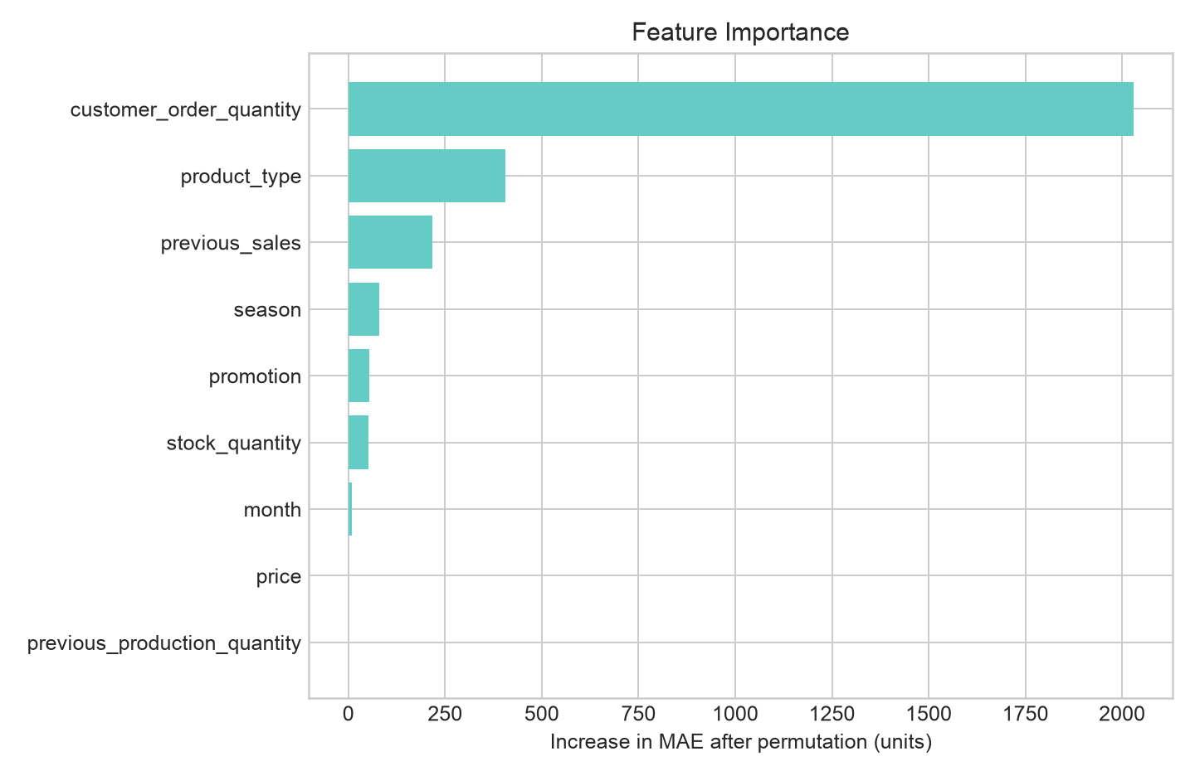
What Drives the Forecast?
Permutation importance measures the increase in error when each feature is shuffled.

Slide 9
Production Planning Rule
Recommended production = max(0, predicted demand + 10% safety stock − current stock).
Shampoo: predict 3,409; recommend 3,397 units
Body Wash: predict 2,357; recommend 2,492 units
Laundry Detergent: predict 2,789; recommend 2,677 units
Illustrative January 2026 scenario; the safety factor is a demonstration policy, not an optimized factory rule.

Slide 10
Practical Value
Managers receive a repeatable forecast instead of relying only on experience or simple averages.
Production teams can prepare materials and schedules earlier.
Sales and inventory teams can review demand, stock, and orders in one planning output.
Human approval remains essential because capacity, lead time, and batch constraints are not modeled.

Slide 11
Limitations and Future Work
Synthetic, small dataset with only three product categories.
External drivers such as holidays, channels, competitor activity, and weather are absent.
Next: use authorized factory data, time-series cross-validation, tuned models, prediction intervals, and capacity-aware optimization.

Slide 12
Conclusion
A complete, reproducible regression workflow was implemented and evaluated.
Linear Regression achieved the best synthetic holdout RMSE (505.4 units).
The project demonstrates how forecasts can support production decisions while clearly separating demonstration evidence from real factory claims.
Questions?
All code, data, outputs, figures, and the paper are included in the submission folder.

