Slide 1
Secure Data Hiding in Image Using Steganography
CAPSTONE PROJECT
Presented By: Souvick Das
Student Name : Souvick Das
College Name & Department : Sister Nivedita University | BCA

Slide 2
OUTLINE
Problem Statement
Technology used
Wow factor
End users
Result
Conclusion
Git-hub Link
Future scope

Slide 3
Problem Statement
Secure communication is essential in today's digital world, but traditional encryption methods can be intercepted. This project uses image steganography to hide text messages inside images, making them difficult to detect. It enhances security with password protection and an end marker for accurate message retrieval. This ensures a safe and reliable way to share sensitive information.

Slide 4
Technology used
Flask – Used as the web framework to build the application.
HTML & CSS – Designed the frontend for a user-friendly interface.
OpenCV – Used for advanced image manipulation and processing.
NumPy – Performs efficient pixel-level operations.
Gunicorn – A WSGI server used for deploying the Flask application.
Flask’s built-in server – Used for local development and testing.
Render – Used for deploying the application on the cloud for wider accessibility.
Visual Studio Code & IDLE – Used as development environments for writing and testing code.
GitHub – Used for version control and project collaboration.

Slide 5
Wow factors
Stealthy Communication – Hides text within images, making it nearly undetectable.
Enhanced Security – Uses password protection and an end marker to ensure accurate message retrieval.
User-Friendly Interface – Simple and intuitive web-based application using Flask.
Cloud Deployment – Hosted on Render for easy accessibility from anywhere.
Efficient Processing – Utilizes OpenCV, Pillow, and NumPy for fast image handling.
Scalability – Can be expanded to support different encryption methods and file formats.

Slide 6
End users
This project is useful for individuals and organizations that require secure and covert communication. It can be used by journalists, activists, and cybersecurity professionals to protect sensitive information. Additionally, students and researchers can utilize it for learning and experimenting with steganography techniques.

Slide 7
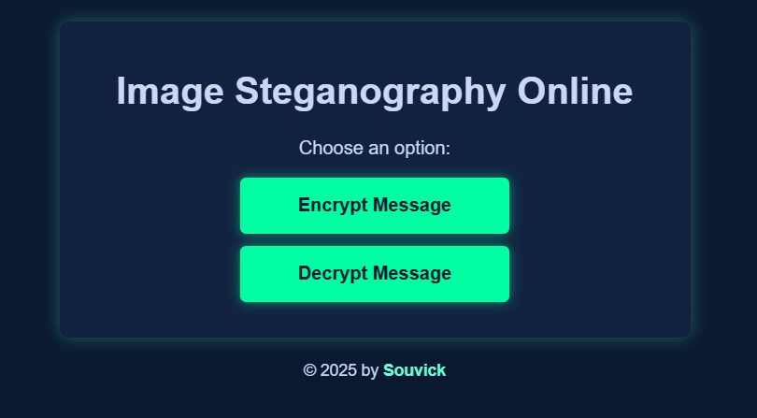
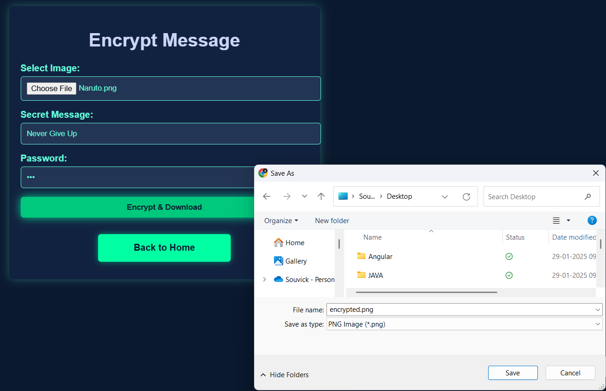

Results
Landing Page:
Encrypt Page:
Input Image:

Slide 8
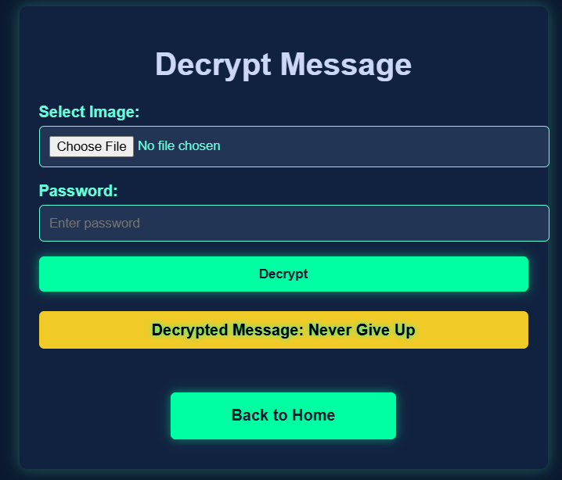

Results
Decrypt Page:
Encrypted Photo(.png format, password: 007):

Slide 9
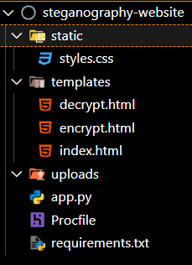
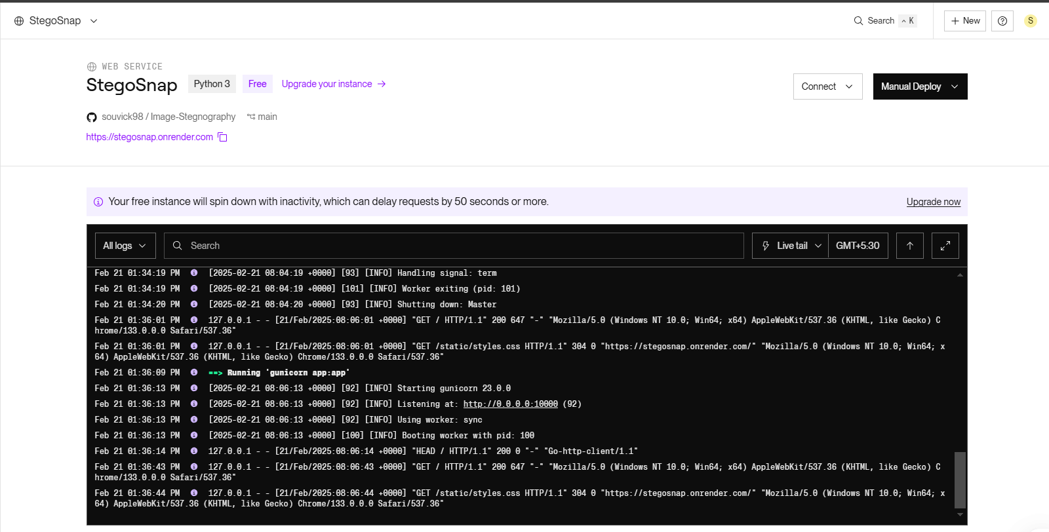
Results
Folder Structure:
Render Dashboard:

Slide 10
Conclusion
Steganography is a powerful technique for securely hiding information within digital media.
It ensures confidentiality and integrity while keeping data hidden in plain sight.
Modern approaches use encryption and advanced algorithms to enhance security.
Steganography is widely used in cybersecurity, digital forensics, and secure communication.
With growing digital threats, it remains a reliable and evolving method for data protection.

Slide 11
GitHub Link
GitHub Link: https://github.com/souvick98/Image-Stegnography.git
Website Link: https://stegosnap.onrender.com
Note: The server might take 30-35 seconds to load, so please wait patiently.

Slide 12
Future scope
Support for Multiple File Formats – Expanding beyond images to include audio, video, and text files.
Enhanced Security – Implementing stronger encryption techniques to further protect hidden data.
AI-Based Steganalysis Resistance – Developing methods to bypass detection by advanced AI tools.
Cloud Integration – Storing and retrieving steganographic data securely over cloud platforms.
Mobile Application Development – Creating user-friendly mobile apps for on-the-go secure messaging.

Slide 13
THANK YOU

