Slide 1
Audio Sentiment
Analysis Pipeline
CMP_SC 8001-06 – Advanced Topics in Computer Science
Team: Srikar Alla | Souvik Bag | Ziyang Jia
Instructor: Prof. T. Malik | Fall 2025

Slide 2
Table of
Contents
Goal and Objective
Pipeline Architecture Overview
Implementation Plan
Milestone 1
Milestone 2
Milestone 3
Conclusion

Slide 3
Goal and Objective
The primary goal is to process raw audio inputs and generate sentiment predictions through sequential speech-to-text transcription and sentiment classification.
It aims to establish a modular and scalable architecture capable of integrating multiple ASR and sentiment models.
The objective is to benchmark these model combinations based on accuracy, latency, throughput, and overall efficiency.
Ultimately, it seeks to evolve into an operational and deployable system suitable for real-time audio sentiment analysis.

Slide 4
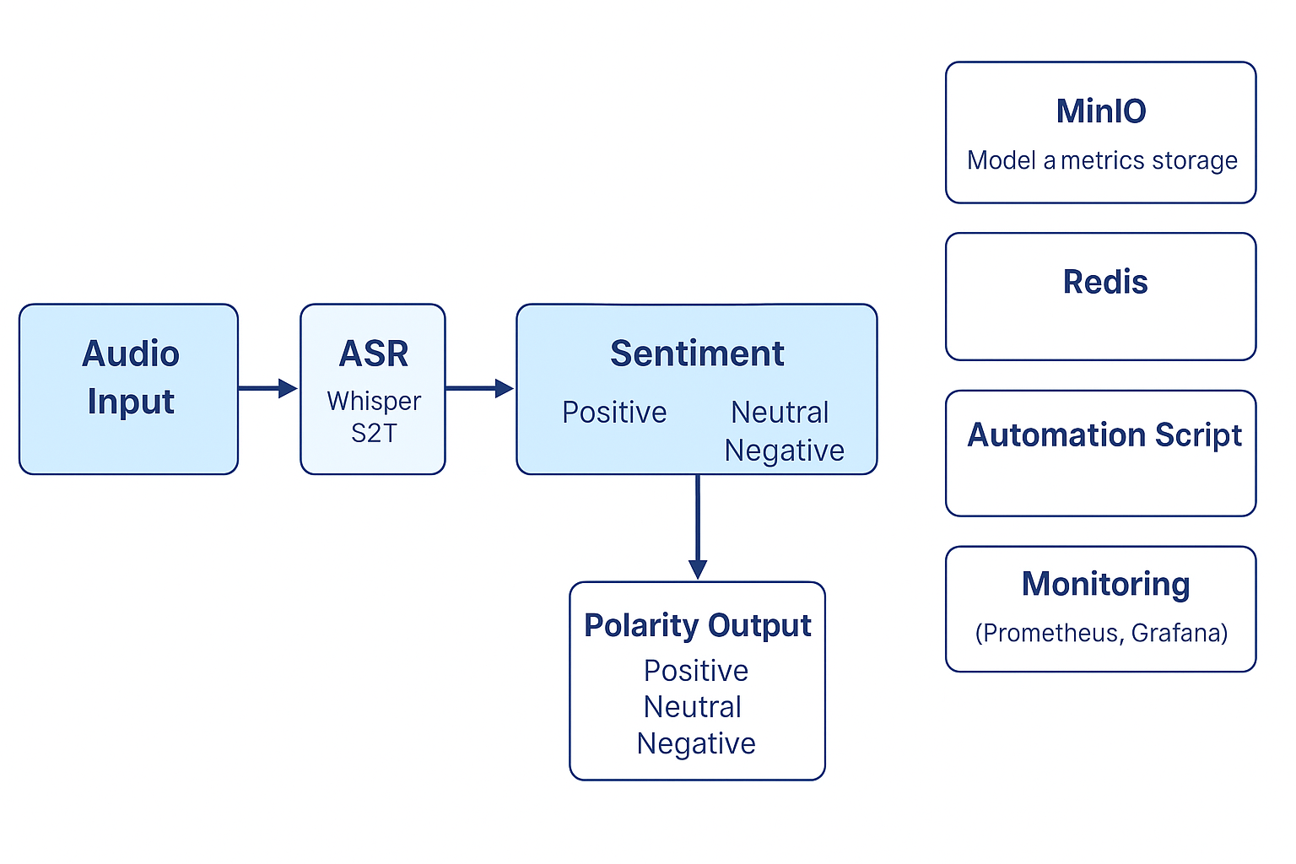
Pipeline Architecture Overview
The pipeline follows a two-stage architecture that converts audio inputs into sentiment outputs through sequential processing.
In the first stage, Automatic Speech Recognition (ASR) models such as Whisper or Facebook S2T transcribe the audio into text.
In the second stage, transformer-based sentiment analysis models interpret the transcribed text to determine sentiment polarity (positive, negative, or neutral).
The modular design allows independent substitution of ASR and sentiment models while evaluating performance using latency, throughput, accuracy, and SLA compliance metrics.

Slide 5
Implementation Plan
Milestone 1 — Functional Pipeline & Baseline Evaluation
Milestone 2 — Automation, Optimization & Operationalization
Milestone 3 — Full MLOps lifecycle with CI/CD + monitoring(Future)

Slide 6
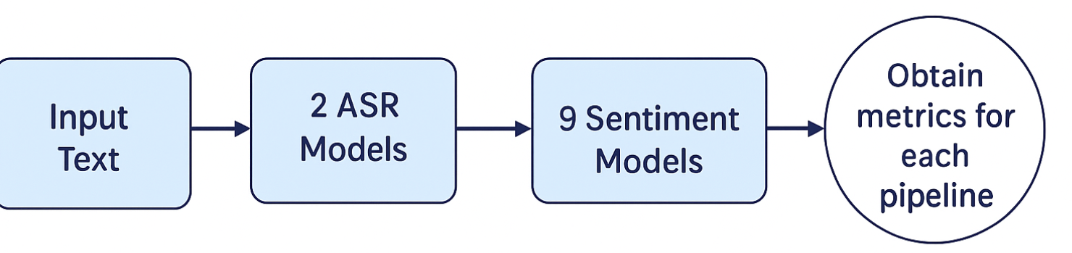
Milestone 1
Functional Pipeline & Baseline Evaluation
The goal for Milestone 1 is to implement at least one complete audio → text → sentiment pipeline and validate several alternative configurations.
The ASR stage uses AventIQ-AI/Whisper and Facebook S2T as alternative speech-to-text backends.
The sentiment stage evaluates nine Hugging Face transformer models (including DistilBERT, RoBERTa, and related variants) on the DynamicSuperb Sentiment_Analysis_SLUE-VoxCeleb dataset.
Each configuration is assessed using latency, throughput, assertion-based accuracy, and SLA compliance as the primary evaluation metrics.

Slide 7
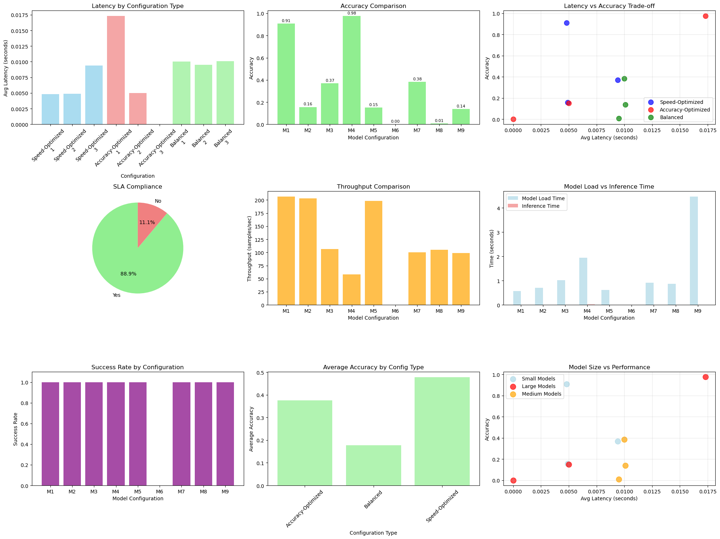
Milestone 1
Deliverables & Results
Implemented 18 pipeline configurations by combining 2 ASR backends with 9 transformer-based sentiment models.
Adopted a modular architecture that allows ASR and sentiment components to be swapped independently.
Established a fully functional end-to-end pipeline implemented and tested in Jupyter/Python.
Delivered all required artifacts, including the written report, Docker container, and shared GitHub repository (e2eml-audio).

Slide 8
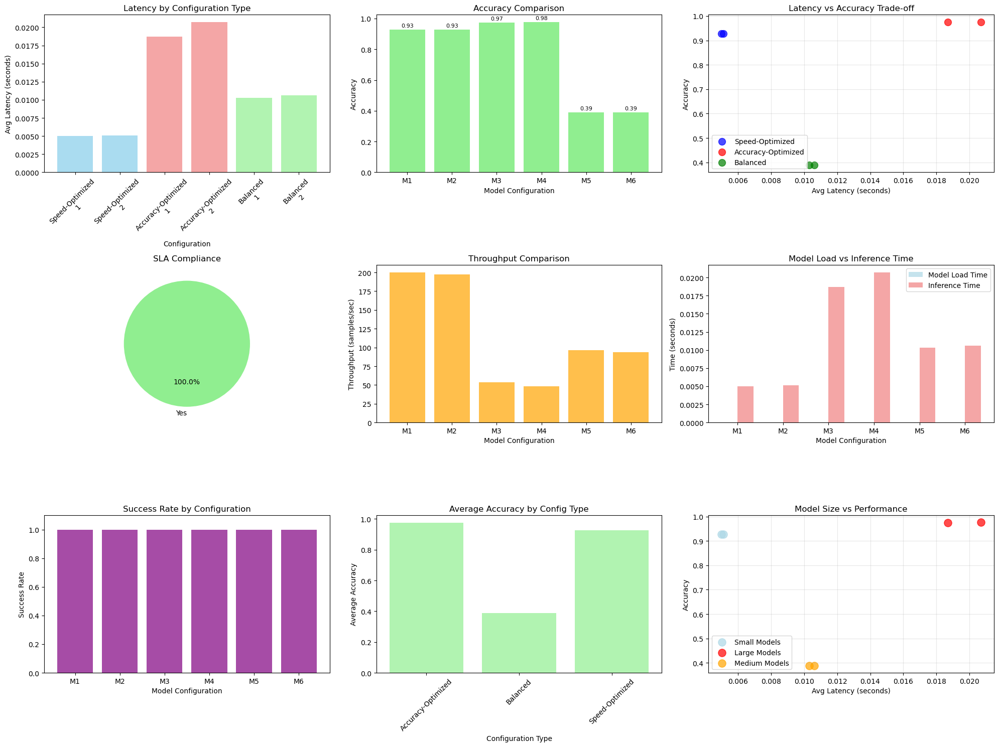
Milestone 2
Automation, Optimization & Operationalization
The goal for Milestone 2 is to evolve the system from a functional prototype into an operational benchmark suite.
Pipeline execution is automated across multiple ASR and sentiment model combinations to systematically generate results.
Sentiment models are optimized using FP32 and FP16 ONNX-based quantization to reduce latency and improve efficiency.
MinIO and Redis are integrated into the architecture to manage model/metrics storage and messaging, enabling automatic collection of latency, accuracy, and throughput metrics.

Slide 9
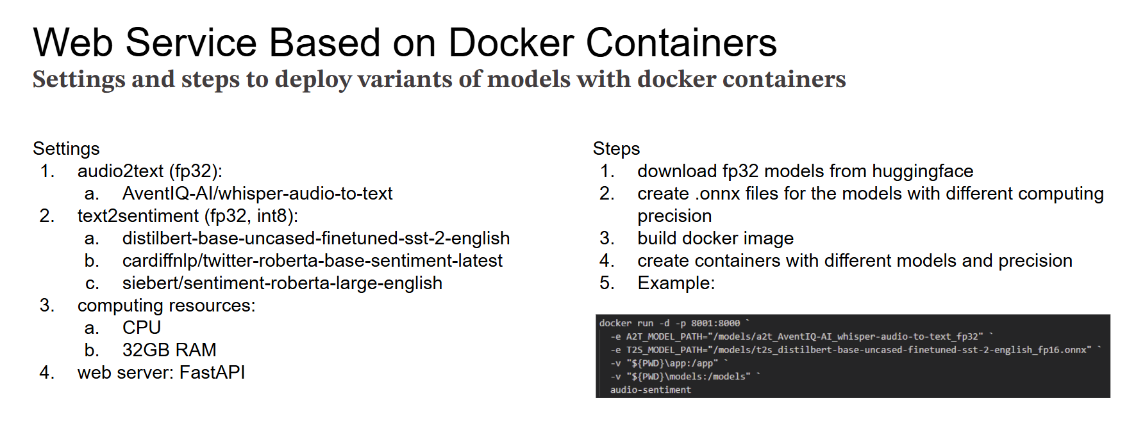

Slide 10
Milestone 2 - Deliverables
All optimized ONNX model variants are securely stored and versioned in MinIO, ensuring centralized model management.
An automated benchmark loop systematically executes multiple ASR × Sentiment model combinations to collect performance data.
Quantized sentiment models (FP32 and FP16) have been successfully evaluated for latency, accuracy, and efficiency improvements.
A consolidated merged metrics file has been generated for comprehensive visual analysis and performance comparison.

Slide 11
Optimization Insights
Quantization achieved approximately 40% faster inference while maintaining less than 5% accuracy degradation across models.
The gRPC-based communication layer introduced an overhead of under 3%, even with asynchronous scaling.
The optimal configuration was identified as FP16 RoBERTa combined with INT8 Whisper, deployed using 2 replicas with 1 CPU each.
The choice of ASR backend (Whisper vs. S2T) influenced overall sentiment accuracy by roughly ±2%, highlighting upstream dependency effects.

Slide 12
Milestone 3 — What Remains
Develop an analysis notebook to visualize latency, accuracy, throughput, and cost trade-offs across all model configurations.
Containerize each service component (ASR, Sentiment, and Worker) to enable consistent deployment and controlled scaling experiments.
Deploy the complete pipeline using Kubernetes or Docker Compose for live SLA monitoring, autoscaling, and performance evaluation under production-like conditions.
Establish a full MLOps lifecycle with CI/CD pipelines, observability, and continuous monitoring for model and system health.
Far Future :
Expose a real-time API for audio sentiment analysis to support interactive and low-latency applications.
Implement adaptive model selection strategies that choose ASR and sentiment models based on input domain, language, or resource constraints.
Extend the pipeline toward multimodal emotion analysis by integrating audio with visual signals (e.g., facial expressions) for richer affective understanding.

Slide 13
References & Links
GitHub Repo: https://github.com/souvik-bag/e2eml-audio
Dataset: https://huggingface.co/datasets/DynamicSuperb/Sentiment_Analysis_SLUE-VoxCeleb
Models: AventIQ-AI/whisper-audio-to-text, facebook/s2t-small-librispeech-asr, RoBERTa, DistilBERT.

Slide 14
Thank You

