Slide 1
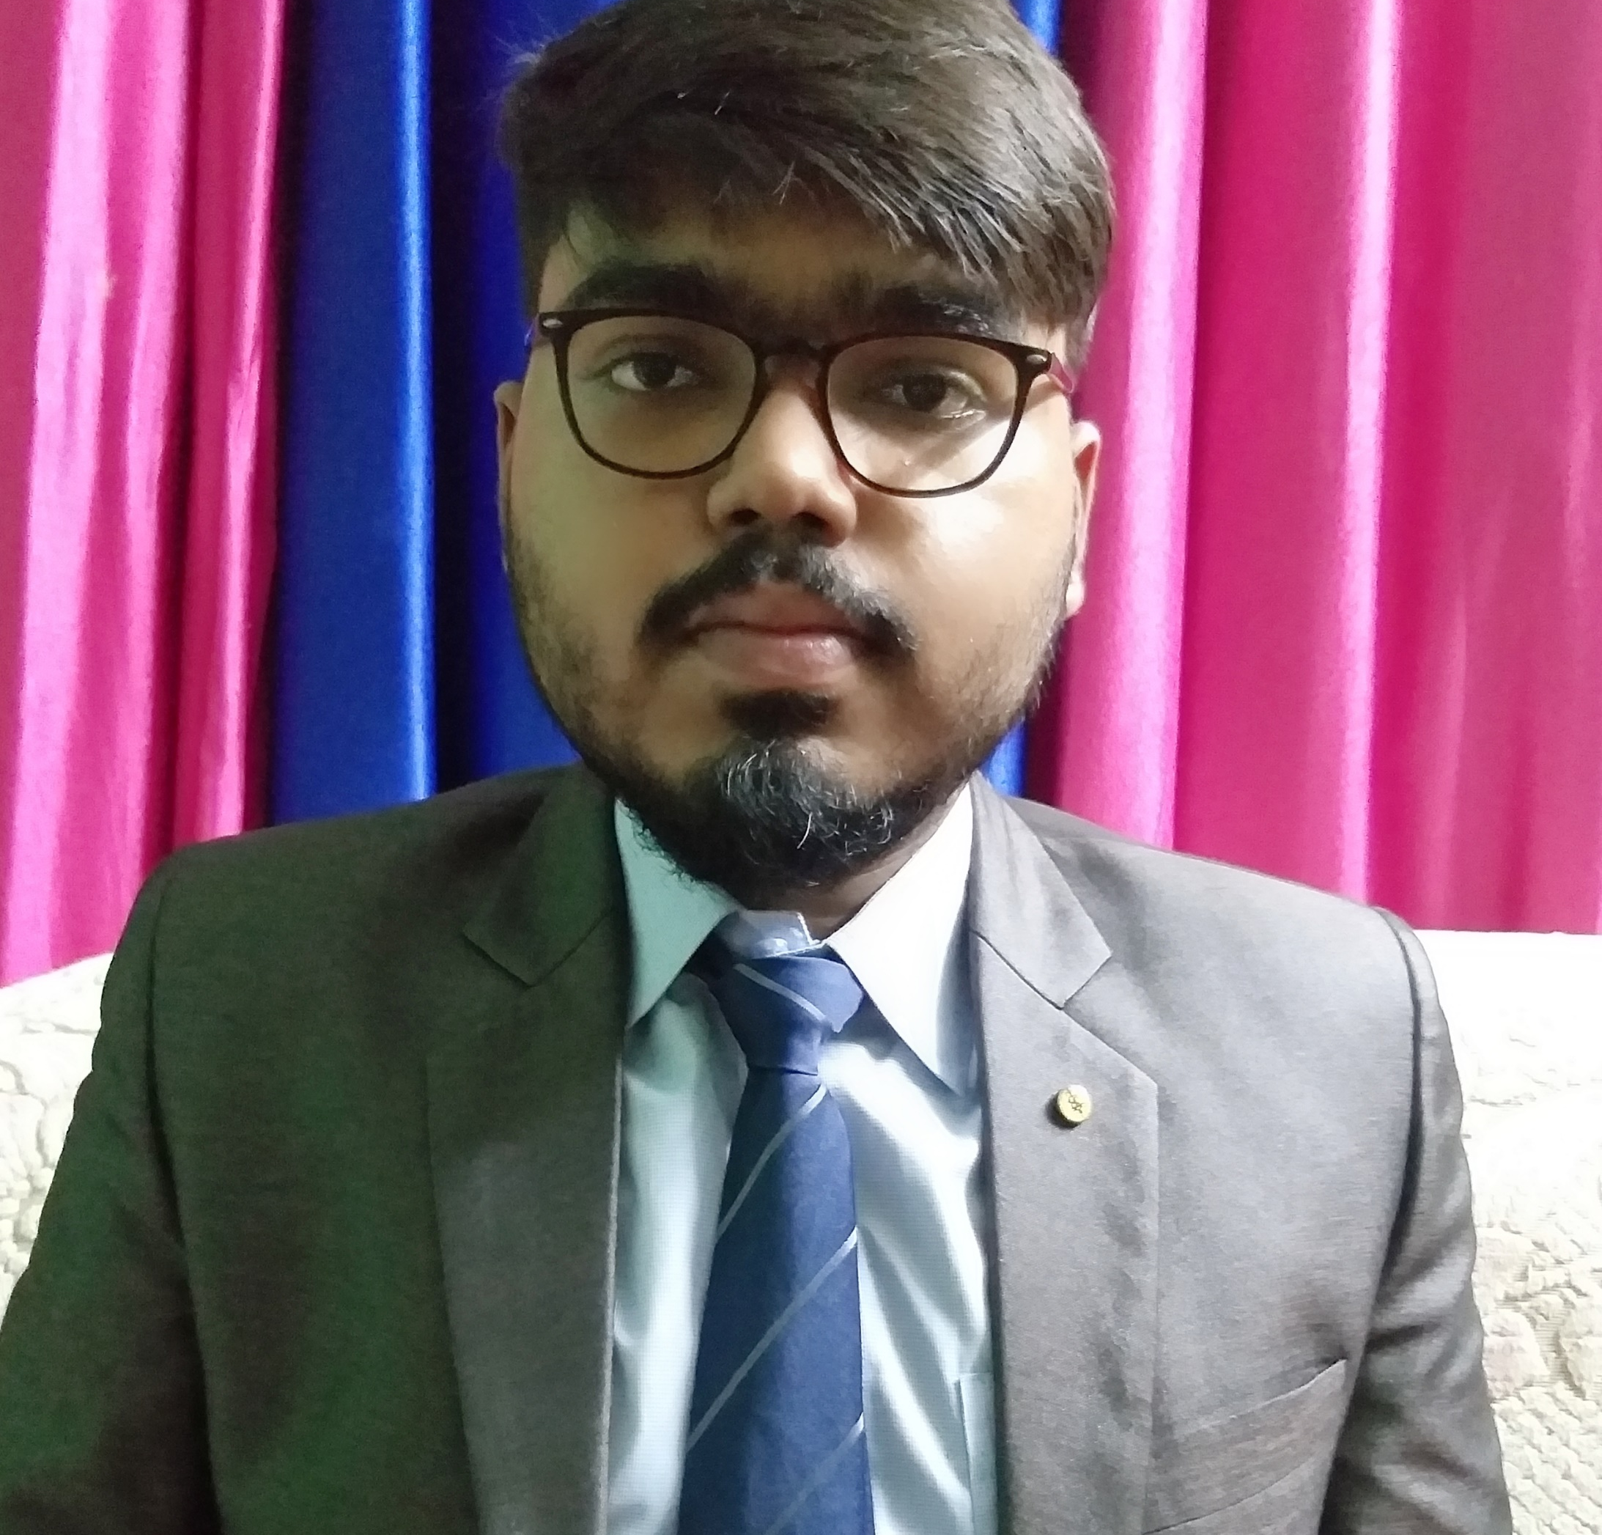


Souvik Biswas
Analyst/Software Engineer
Bachelor of Technology
Electronics and Communication- 2018 - 2022
Skills
Bangalore
souvik.a.biswas@capgemini.com
Java 8 /J2EE | Java Basics, OOPS, Generics, Collections, Arrays, Loops, Junit, Mockito
Spring core | Dependency Injection, Autowire
Spring REST | REST controllers, Implementation of GET, POST, PUT & DELETE.
Spring Boot Microservices | Spring Boot Starters, annotations, Swagger API documents
Spring Cloud | Eureka
React | Components, Hooks, Event handling
Database | MongoDB No SQL Basics My SQL RDBMS Basics
UI Tech | HTML 5 & CSS 3,JavaScript, ES6
Tools | Git, Postman, IDE, Spring Boot
Add On skills | Communications, Team management. Peer learning
+91 7001974069
A4
Full Stack Developer
Hands on experience in creating microservices with Spring boot, Spring Security, Eureka server.
Hands on experience in implementing polyglot architecture with spring boot
Experience in creating documentation with Java docs and swagger and in unit testing using Junit, Mockito.
Java Microservice Development knowledge using Spring boot and spring cloud framework on an beginner level.
Hands on experience in implementing MongoDB Atlas & PostgreSQL
Hands on experience in developing web pages using HTML5, CSS3, ReactJS
Flight Booking System
Completed end to end case study of Flight Booking Application along with JWT authentication, Swagger and Mockito,MongoDB. ReactJS is used for user interface.
Online Food Application
Online Food Application made using Spring Boot, Junit, PostgreSQL.
Completed ” Cloud Computing“ course at Coursera
Completed ” Agile Software Development“ course at Coursera
Check out my Video Profile

