Slide 1
Manual User Interface Industry 4.0

Slide 2
Product Overview
Each Machine provides its own user-friendly Manual Interface on its local server where the operator can enter the current state of the Machine. It is a Web-based Interface accessible both by the dedicated Machine and Smartphones.

Slide 3
Purpose of Manual User Interface
Industry 4.0
The Manual Interface allows to choose states of the Machine that cannot be taken via sensors such as Availability of Operator and Failure of a Certain Components.
The Selected States are stored in a database of the Computer dedicated to a specific Machine. The Manual Interface must be accessible via Desktop as well as Mobile Browsers to facilitate the ease of operation.
It Provides a Generic Template which can be customized for different Machines.

Slide 4
System Requirements
Node js
Mongo DB
Access to “Industry_4_0” database
Web browser (Example : Firefox, Chrome etc.)

Slide 5
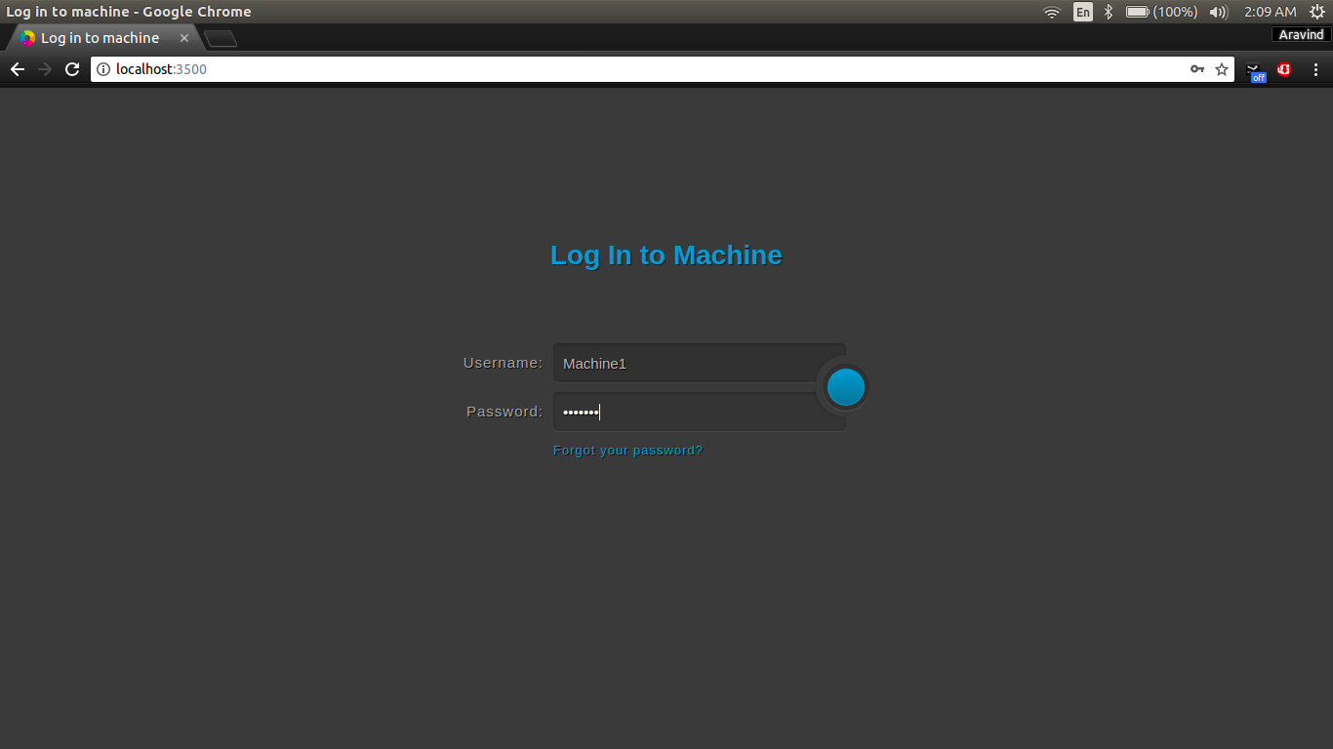
Functionalities
Login Page
Login page hosted on the local server

Slide 6
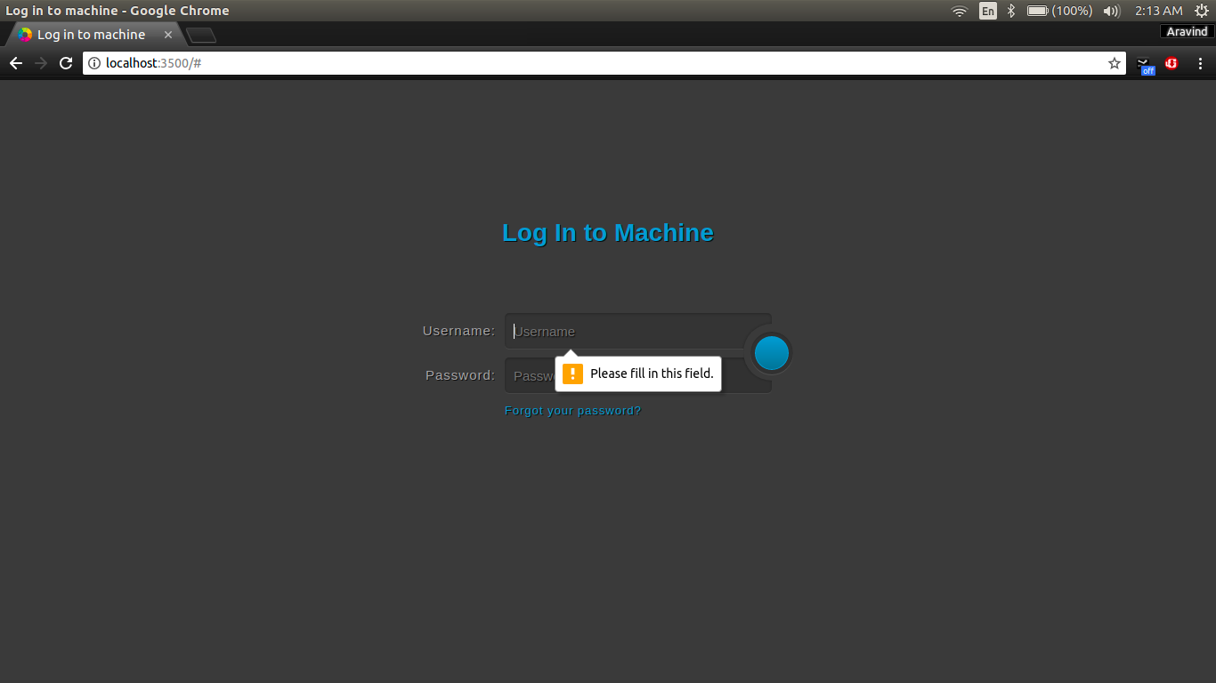
Functionalities
Login Page
The login button verifies the username and password with the database. The username, password cannot be null fields.

Slide 7
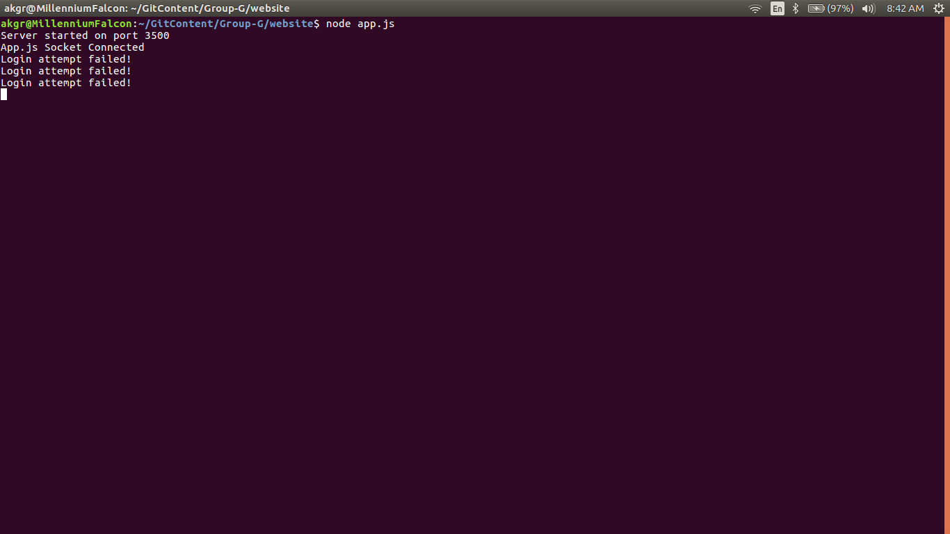
Functionalities
Login Page
If login fails due to incorrect username/password, an error message is generated.

Slide 8
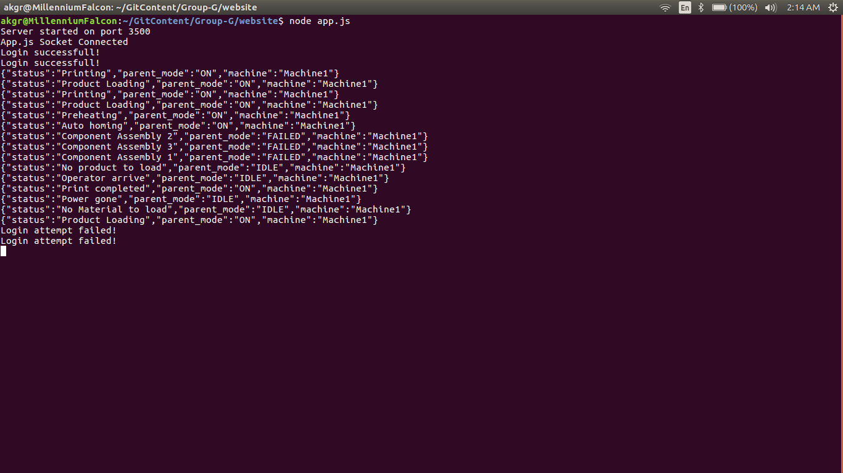
Functionalities
Manual Interface
On successful login the user is logged in, the manual unterface is presented and a successful login message is displayed.

Slide 9
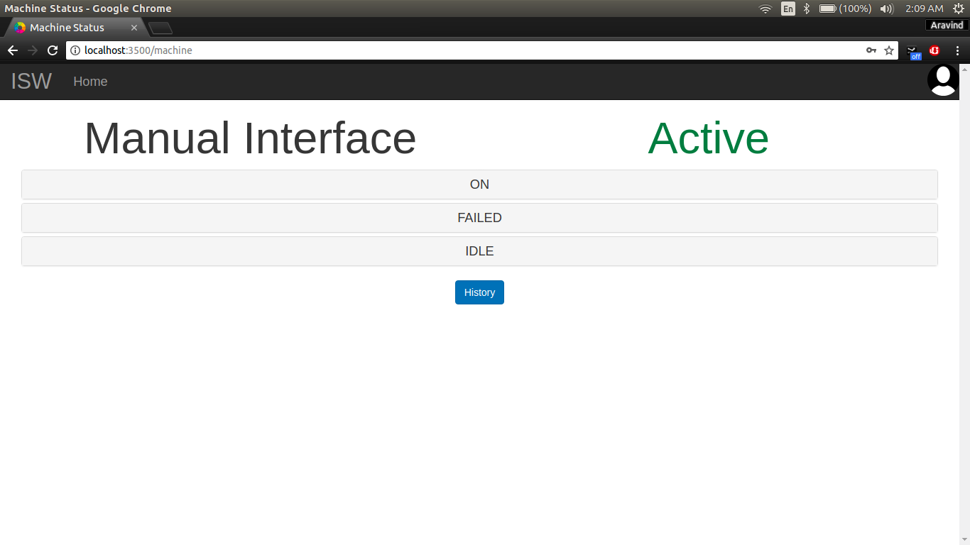
Functionalities
Manual Interface
Default manual interface presented after successful login. There are 3 possible states: On, Failed, Idle.

Slide 10
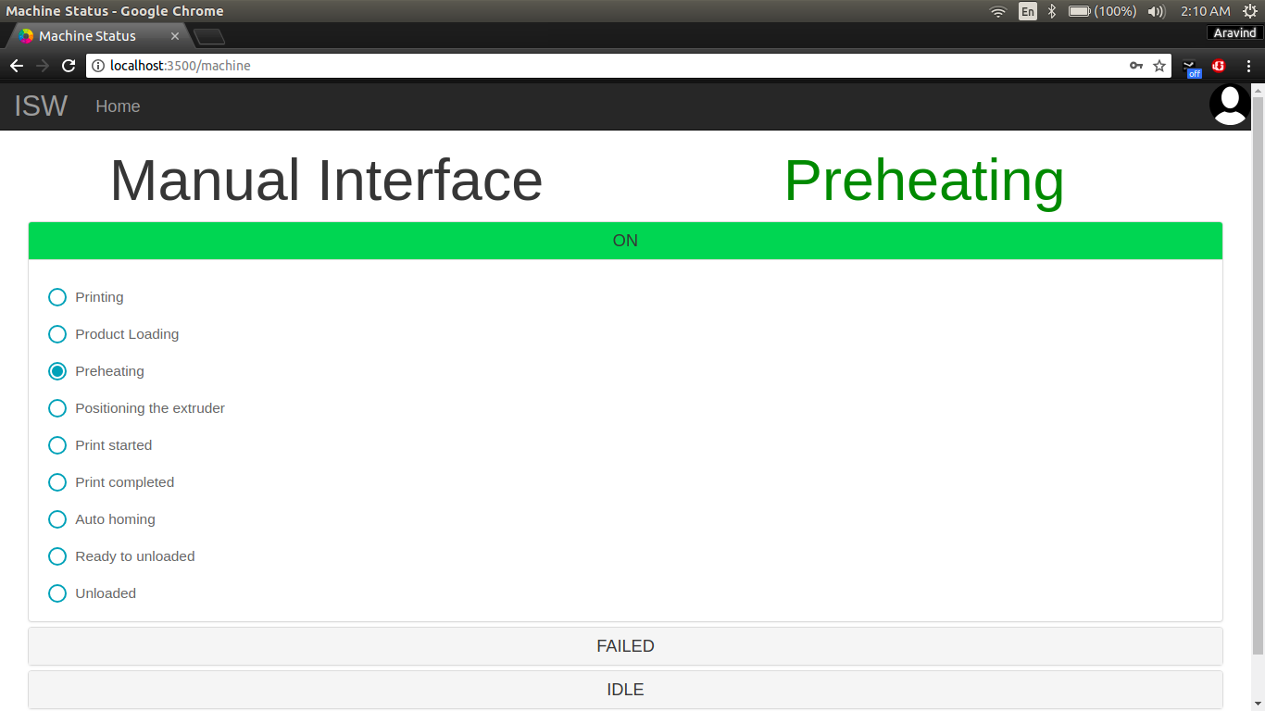
Functionalities
Manual Interface
Every state is further categorized, and the machine can be set to only one of these catagory. The States are pre-defined (before deployment) but can be extended to every Machine.

Slide 11
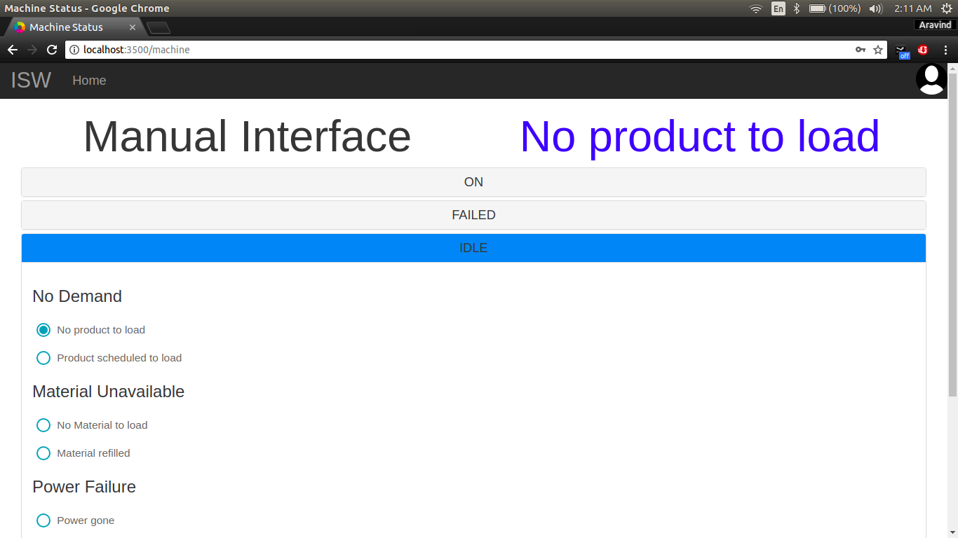
Functionalities
Manual Interface
Each state has many sub-categories

Slide 12
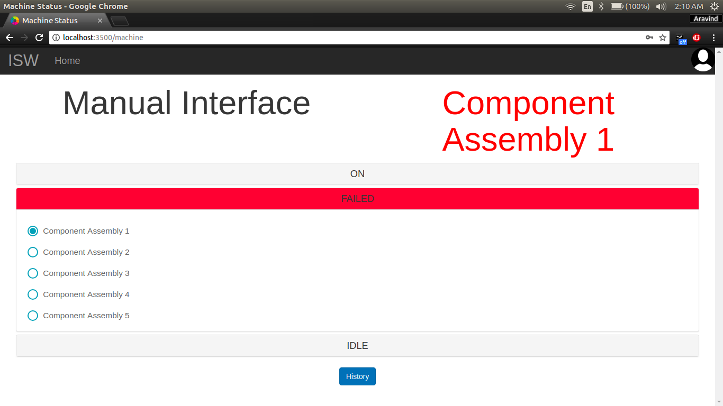
Functionalities
Manual Interface

Slide 13
Functionalities
Manual Interface
Each Machine has a dedicated Server that collects information about the Machine and stores the data locally as well as sends it to the main ISW Server.
The Manual Interface allows to choose states of the Machine that cannot be taken via sensors such as Availability of Operator and Failure of a Certain Components.

Slide 14
Functionalities
Manual Interface
Stored in the local server, thus acts as history of states for the machine.

Slide 15
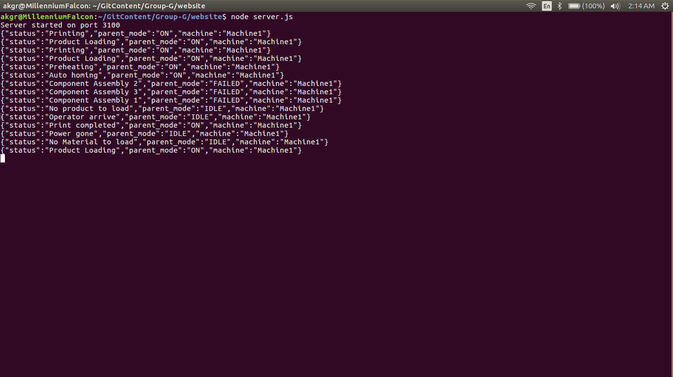
Functionalities
Manual Interface
Data that is sent to the main server.

Slide 16
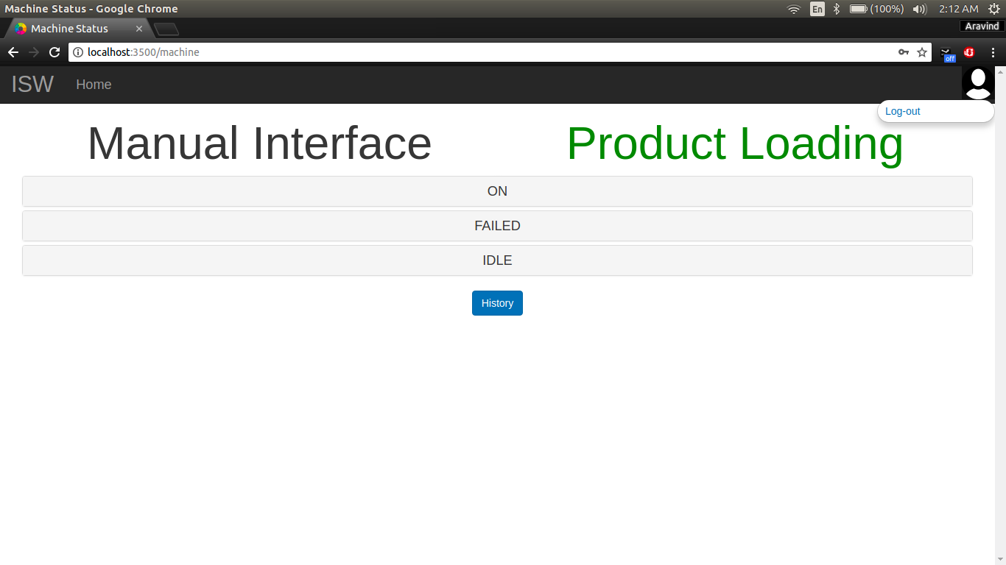
Functionalities
Manual Interface
The logout option terminates the current session and logs out the user. Redirects to login page.

Slide 17
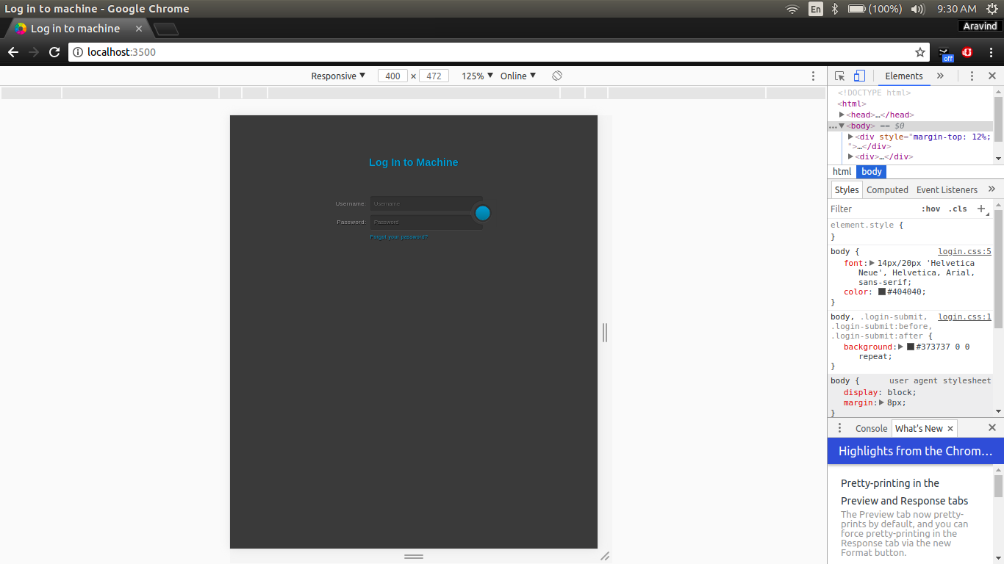
Functionalities
Manual Interface
Login page for the manual interface accessed through a smartphone.

Slide 18
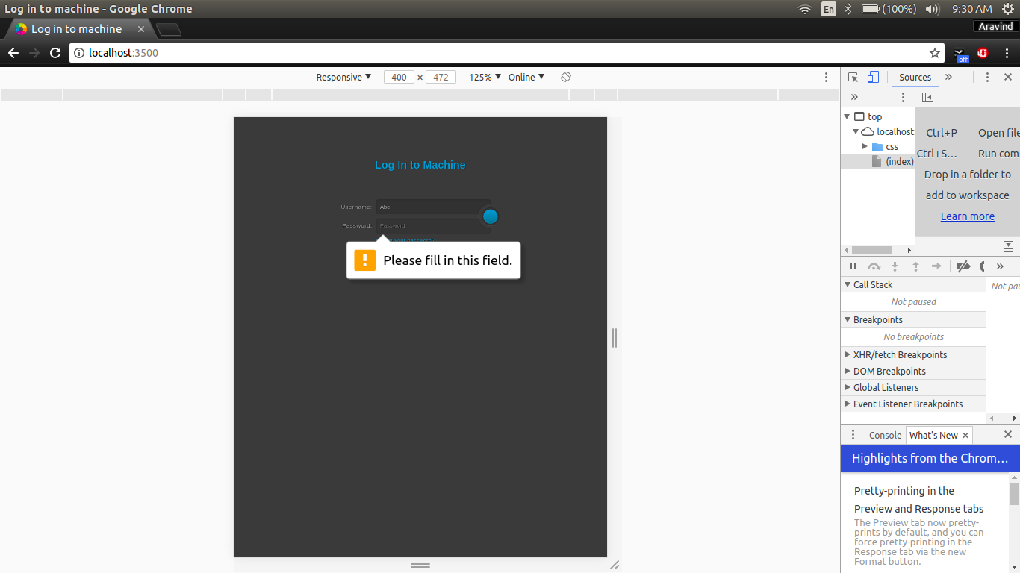
Functionalities
Manual Interface
Login page for the manual interface accessed through a smartphone.

Slide 19
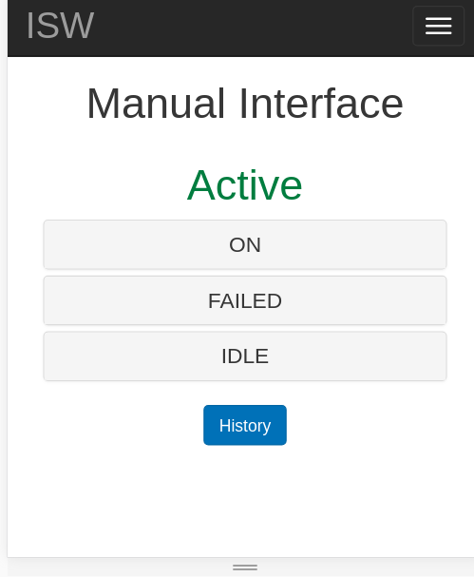
Functionalities
Manual Interface
Manual interface accessed through a smartphone.

Slide 20
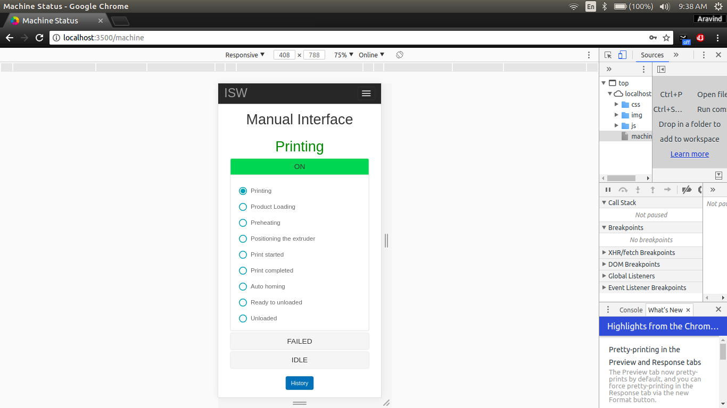
Functionalities
Manual Interface
Manual interface accessed through a smartphone.

Slide 21
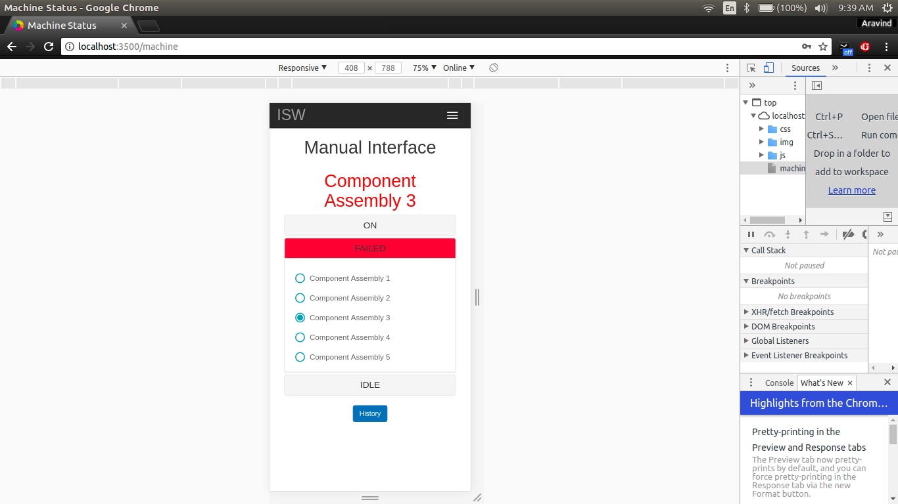
Functionalities
Manual Interface
Manual interface accessed through a smartphone.

Slide 22
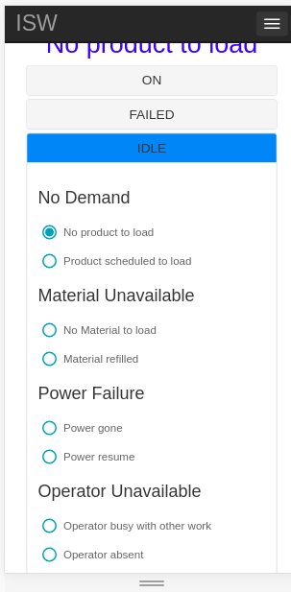
Functionalities
Manual Interface
Manual interface accessed through a smartphone.

Slide 23
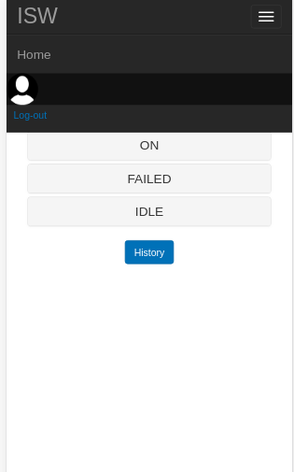
Functionalities
Manual Interface
Logout functionality in the manual interface accessed through a smartphone.

