Slide 1
Travel mate (Travel PLANNER agent)
IBM HACKATHON PROJECT
Presented By:
Souvik Nandi
Ramkrishna Mahato Government Engineering College
Electronics & Communication Engineering

Slide 2
OUTLINE
Problem Statement
Technology used
IBM Cloud Services used
Wow factor
End users
Result
Conclusion
Git-hub Link
Future scope
IBM Certifications

Slide 3
Problem Statement
Travel planning is often time-consuming, complex, and overwhelming due to scattered information about destinations, accommodations, transport, and activities. Travelers face difficulties in managing preferences, budgets, real-time changes, and logistics efficiently.
Proposed Solution: Develop an AI-powered Travel Planner Agent that uses Natural Language Processing (NLP) and Retrieval-Augmented Generation (RAG) to assist users in generating personalized travel plans. It interacts naturally with users, understands their preferences, and fetches real-time travel data to recommend destinations, build itineraries, and optimize travel schedules seamlessly.

Slide 4
Technology used
IBM cloud lite services – Used to host and run the AI agent in a cloud-based environment.
Natural Language Processing (NLP) – Allows the agent to understand user queries and respond in a human-like, conversational manner.
Retrieval Augmented Generation (RAG) – Enhances the agent’s responses by retrieving and integrating real-time data to generate accurate and contextual responses.
IBM Granite model – A powerful open-weight large language model from IBM, used to generate human-like responses.

Slide 5
IBM cloud services used
IBM Cloud Watsonx AI Studio – A collaborative development environment used to build, train, and test AI agents with Granite models.
IBM Cloud Watsonx AI runtime – Provides the runtime environment to deploy and execute the AI models in real-time.
IBM Cloud Agent Lab – A visual interface for designing agent workflows, integrating models, and defining user interactions.
IBM Granite foundation model – A powerful large language model (granite-3-3b-8b-instruct) used for natural language understanding and response generation.

Slide 6
Wow factors
The Travel Planner Agent simplifies complex travel decisions by offering real-time, intelligent, and personalized trip planning. It minimizes manual effort, reduces planning time, and delivers an end-to-end seamless experience—all through natural conversation.
Unique features:
Personalized itineraries based on user preferences & budget
Real-time suggestions for destinations, hotels, and transport
Natural language interaction (chat-style planning)
Updates & alerts on travel disruptions or opportunities
Easy integration with maps and weather services
Quick-start travel queries for faster user engagement

Slide 7
End users
Students & Budget Travelers – Optimize trips within limited budgets with personalized, cost-effective plans.
Solo & First-Time Travelers – Receive step-by-step travel assistance with real-time support and safety info.
Travel Agencies & Tour Operators – Automate itinerary planning, enhance customer service, and boost productivity.
Frequent Travelers – Business or leisure travelers who need quick and optimized plans.
Travel Enthusiasts & Bloggers – Explore offbeat destinations and auto-build content-ready travel plans.

Slide 8
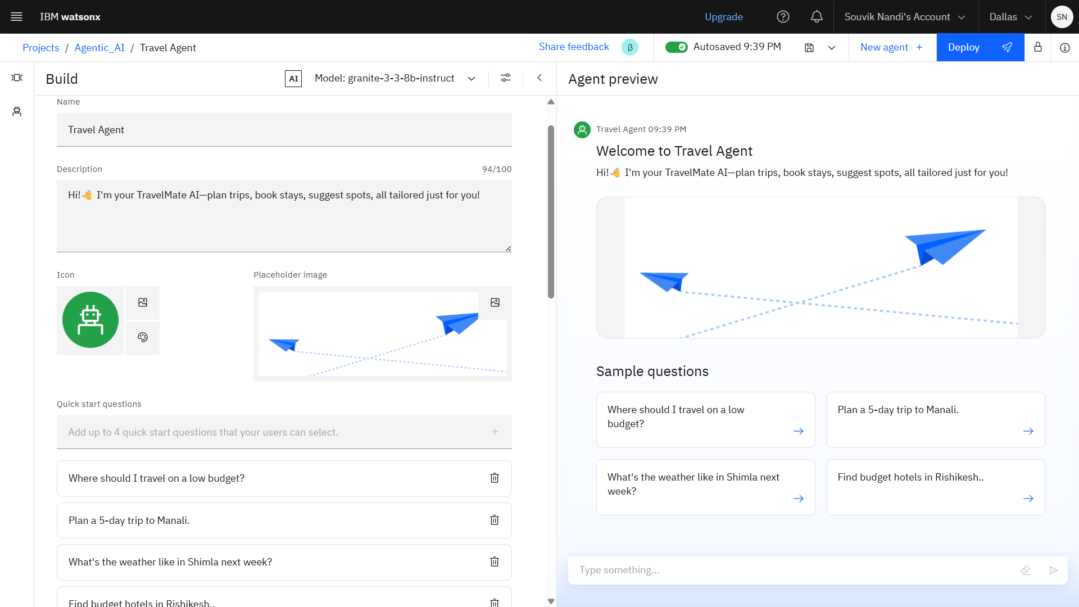
Results

Slide 9
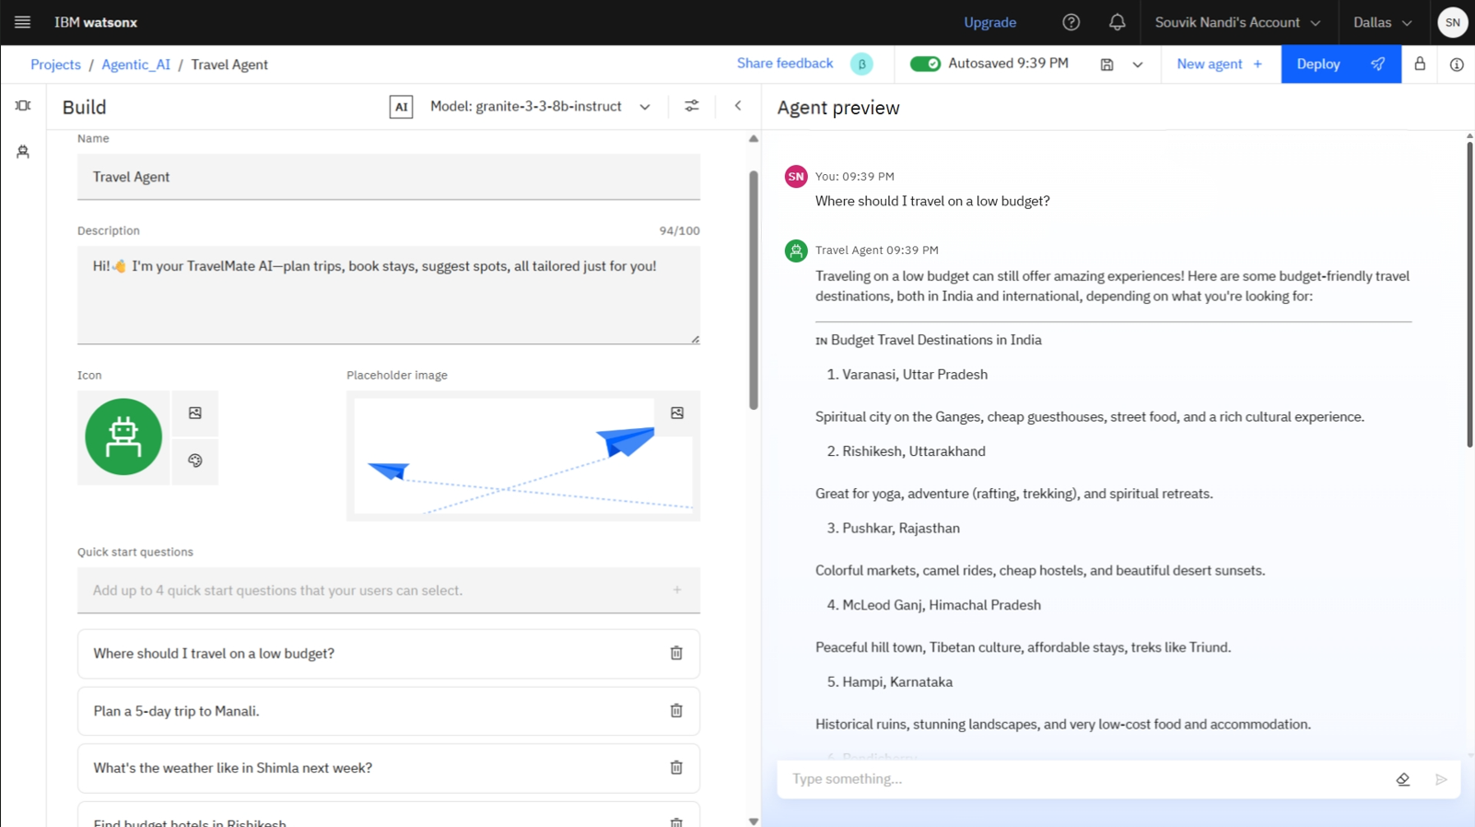
Results

Slide 10
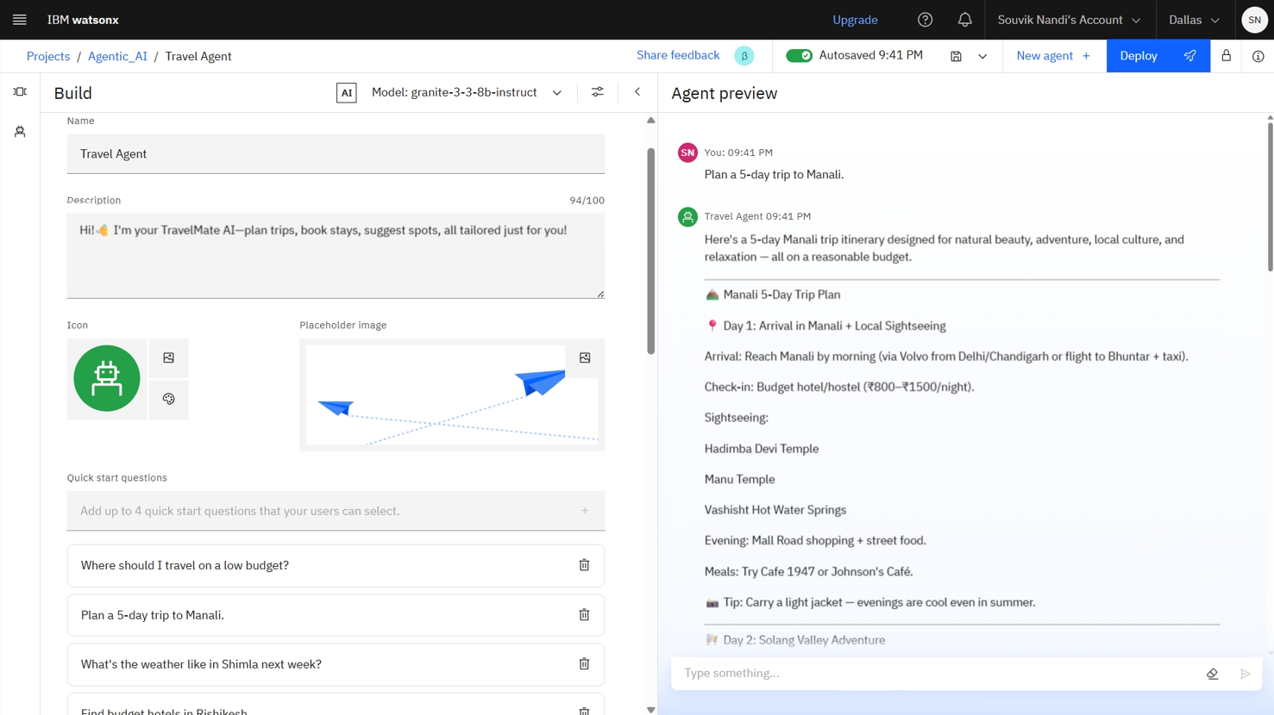
Results

Slide 11
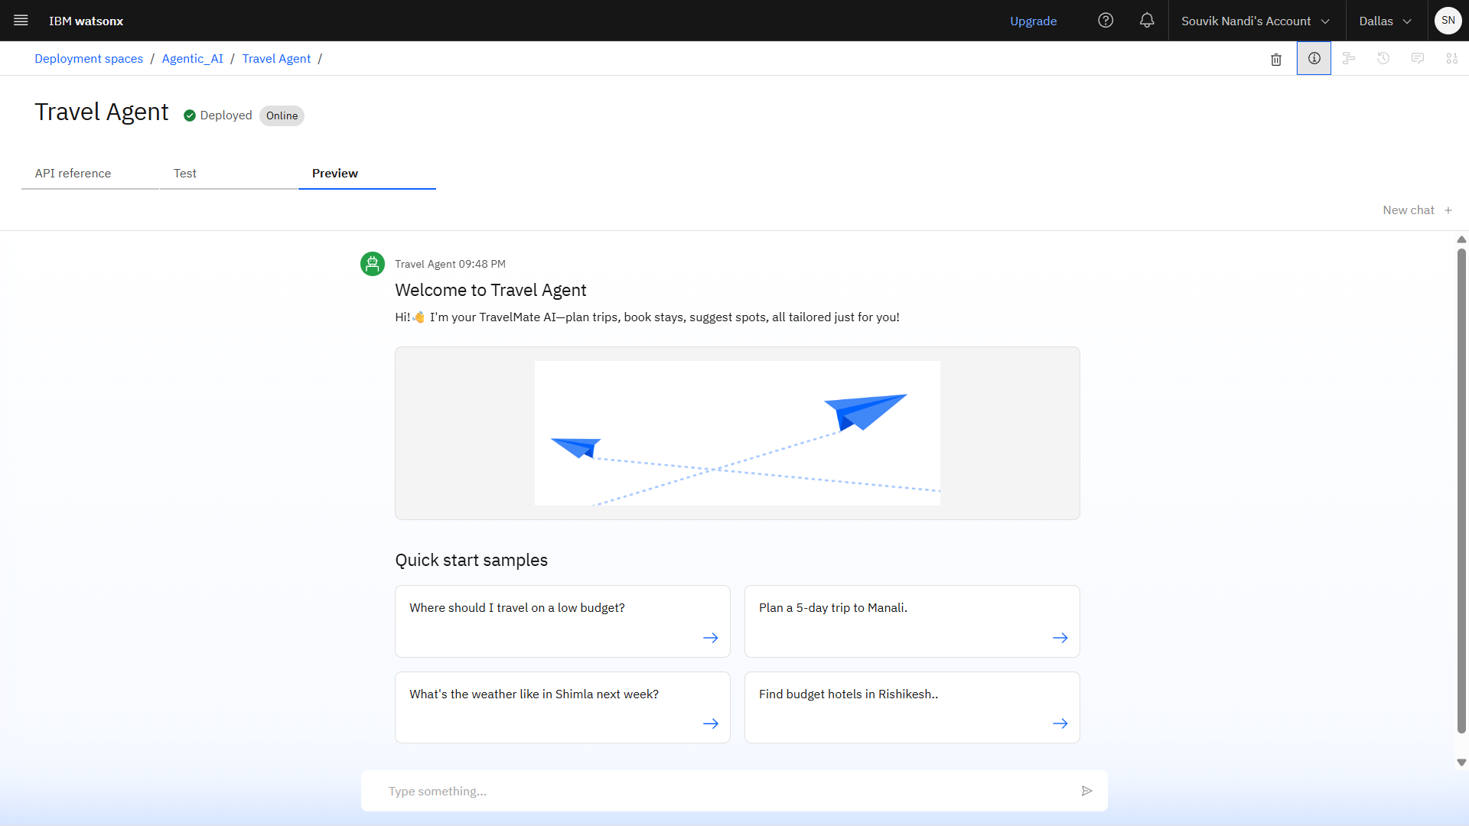
Results
Deployed AI Agent

Slide 12
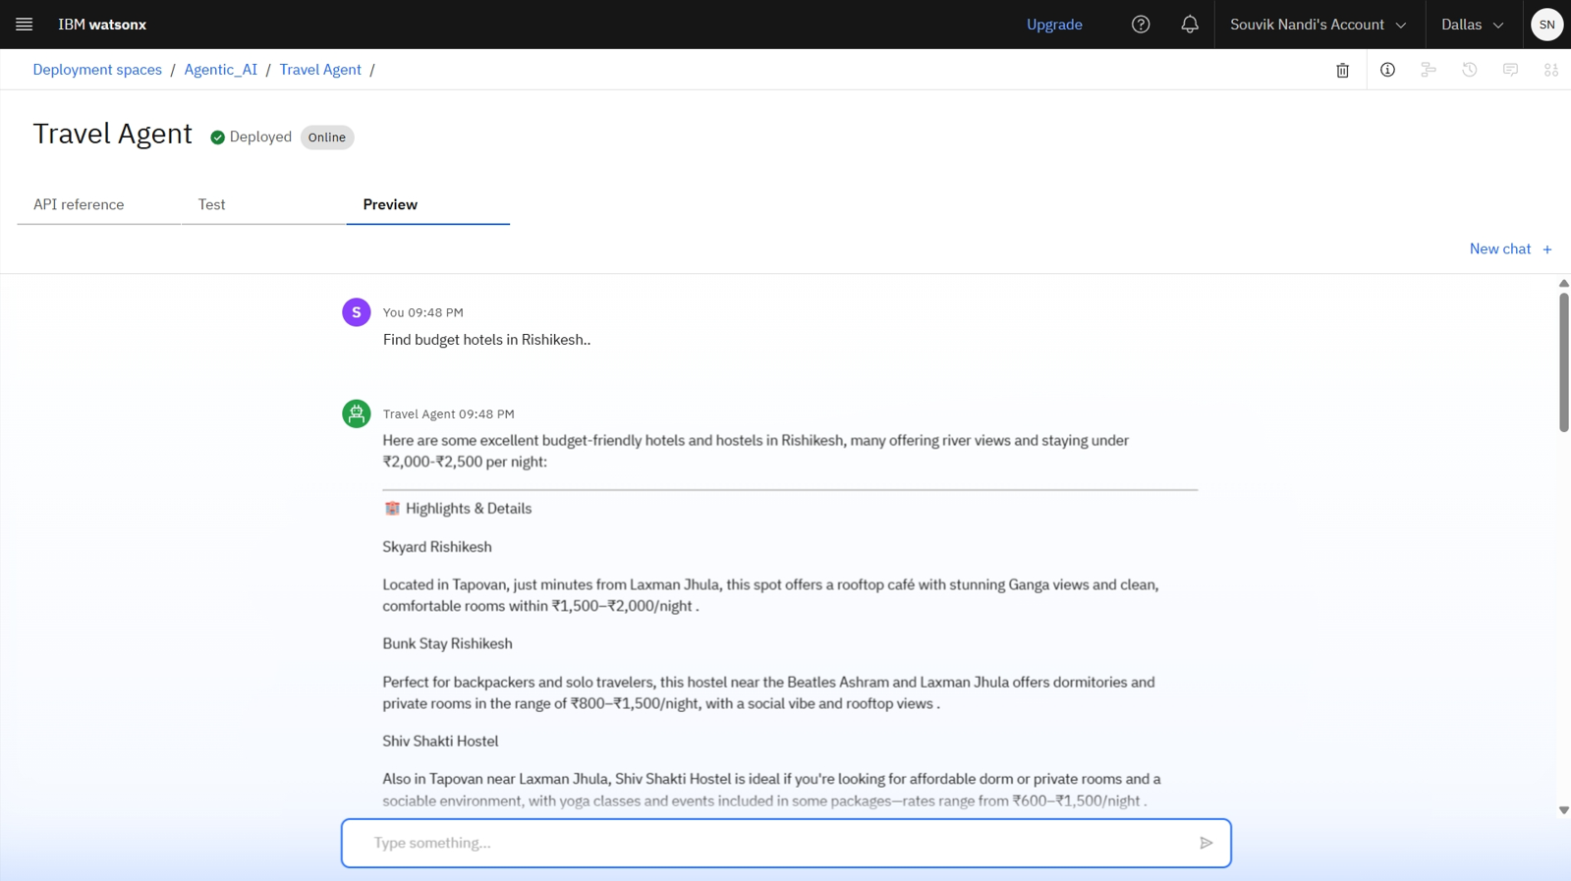
Results
Deployed AI Agent

Slide 13
Conclusion
The Travel Planner Agent streamlines the entire trip planning process through intelligent automation and real-time assistance.
It creates personalized itineraries, recommends destinations, and provides dynamic updates — all via natural conversation.
By reducing manual effort and decision fatigue, it enhances user convenience, confidence, and travel experience.
Whether for solo explorers, budget travelers, or professional agents, this AI solution brings speed, personalization, and simplicity to modern travel.

Slide 14
GitHub Link
Explore the setup, configurations, and documentation of the Travel Planner Agent.
GitHub Repository Link: https://github.com/souvik7781/TravelMate-AI
Includes:
AI agent preview and working.
Configuration files and screenshots.
Sample travel prompts and test results.
Technology used and setup instructions.

Slide 15
Future scope
Multilingual – Support Assist users in multiple languages for broader accessibility and global usability.
Voice-Based Travel Assistant – Enables hands-free travel planning through voice interaction.
Real-Time Booking Features – Allow users to book flights, hotels, and transport directly through the agent.
Weather-Based Suggestions – Recommend plans based on weather updates.
Integration with Smart Wearables – Enable travel alerts, reminders, and real-time updates directly on smartwatches or fitness bands.
Collaborative Trip Planning – Allow multiple users to plan, edit, and view shared itineraries in real-time.

Slide 16
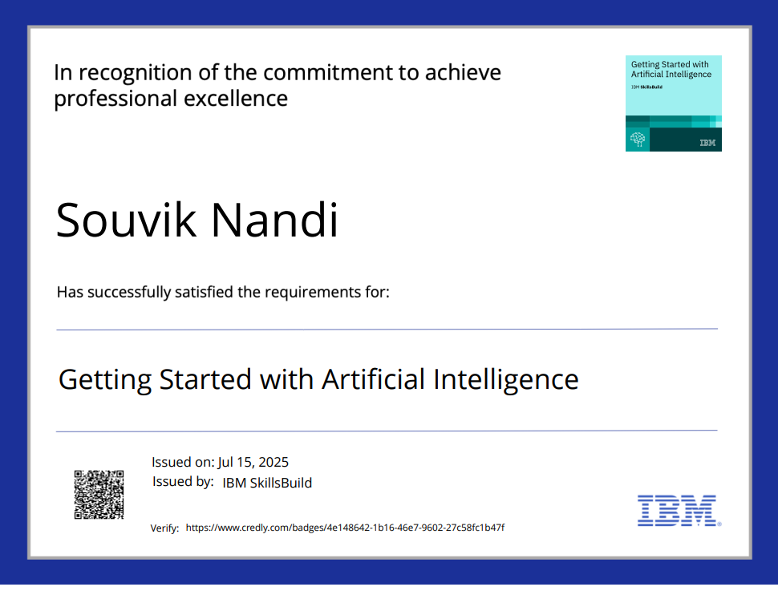
IBM Certifications
Getting started with Artificial Intelligence

Slide 17
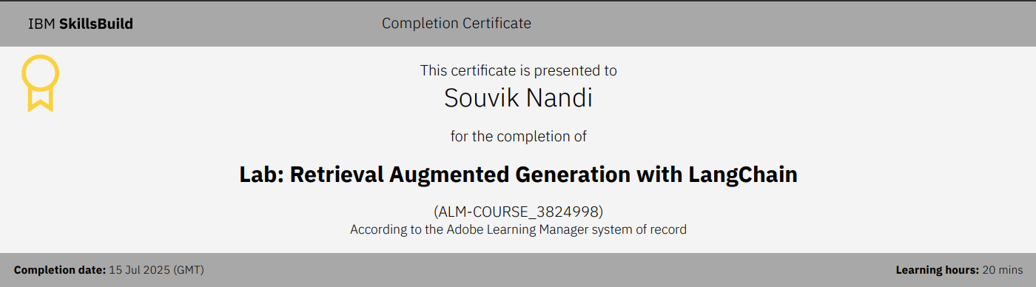
IBM Certifications
Lab: Retrieval Augmented generation with LangChain

Slide 18
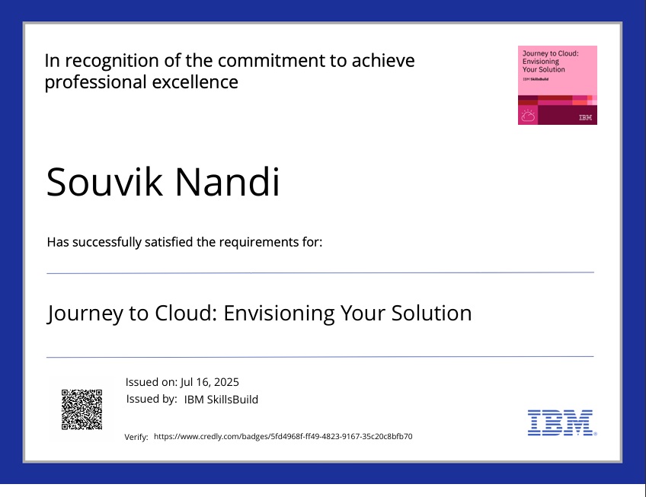
IBM Certifications
Journey to Cloud: Envisioning Your Solution

Slide 19
THANK YOU

