Slide 1
Sustainability Capstone:
Decarbonising Travel
And also, a subheadline that is really awesome.
Speaker name: Souvik Dhara
Institute: Indian Institute of Technology Guwahati
Branch & Year of Study: Mathematice First Year
Email ID: souvikdhara2020@gmail.com

Slide 2
Executive Summary
Total Trips : 65,289
Total Carbon Emissions : 178M kg
Total Travel Cost : 140M USD
Average Carbon per Trip : 2727.72 kg
Insights
Australia is the largest contributor to overall travel-related CO₂ emissions.
Sales and Marketing are the highest-emitting business units.
Air travel (Economy and Business Flights) accounts for the majority of total carbon emissions.
Recommendations
Replace short-haul flights with rail transportation whenever feasible.
Encourage virtual meetings to reduce unnecessary business travel.
Monitor high-emission departments using Celonis dashboards and introduce sustainable travel policies.
Projected Impact
Lower corporate carbon footprint
Reduced travel expenditure
Improved sustainability reporting
Better alignment with Net Zero 2030 goals

Slide 3
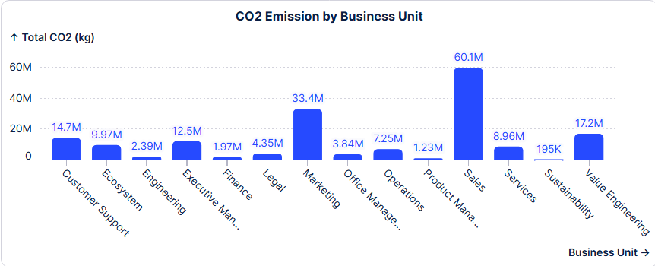
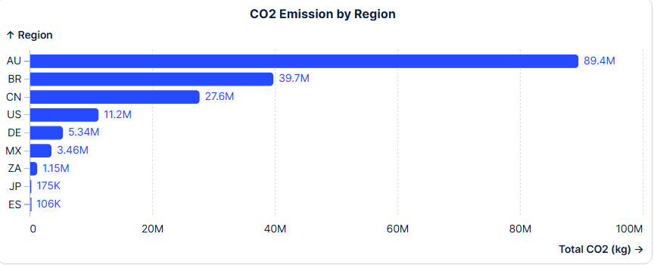
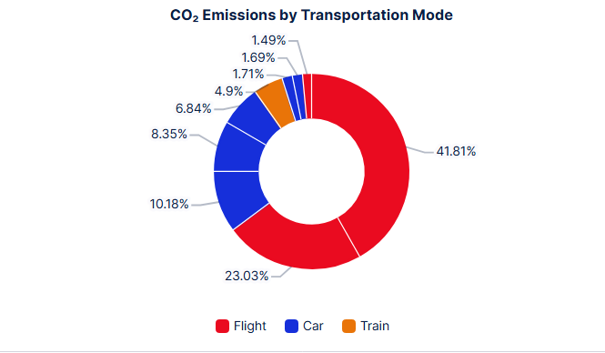
Emissions Profile and Benchmarking
Observations
• Australia highest emissions
• Sales highest-emitting department
• Flights is the largest contributor to carbon emissions

Slide 4
Hotspot Analysis
High Carbon Emission Analysis on Top 3 Region :-
Region | Business Unit | Travel Purpose | Transport Category | Total Carbon Emission (Kg)
Australia | Sales | Enablement | Economy Flight | 982,987.06
Brazil | Sales | Conference/Exhibition | Economy Flight | 2,551,234.36
Chine | Sales | Conference/Exhibition | Economy Flight | 761,687.07

Slide 5
Inefficiencies Identified
Flight-dependency is the core carbon driver Flights account for 66.33% of total emissions despite trains emission less CO2e of all trip (3,450 kg vs. 445 kg). Yet trains make up under 5% of all trips.
2. Policy non-compliance carries a real carbon cost Out-of-policy trips emit 58% more CO2e on average (3,625 kg vs. 2,525 kg) than compliant trips — policy exceptions aren’t
just a cost/governance issue, they're a sustainability one.
3. Regional imbalance in travel carbon intensity AU,CN,JP-originating trips average ~6x more CO2e per trip than DE,ZA,ES trips (3,824 kg vs. 630 kg), driven by long-haul
flight dependency in that region.
4. Process disruptions add cost and inefficiency
9% of trips required a Trip Extension.
6% needed an Itinerary Edit after booking.
4% had a Hotel Change, 4% a Mode of Transportation Change.
3% of trips saw a Flight Change, and 4% needed a Ticket Reissue — signs of booking decisions made too early or
without enough flexibility.
5. Weather and operational disruptions are recurring bottlenecks Nearly 2% of trips hit a Flight Delay or Cancellation, and 1% resulted in a Missed Flight — with weather delay and
mechanical issues as the top two reported causes.

Slide 6
Low Carbon Strategic Recommendations (Quantified)
1. Stop unnecessary Business/First Class flights Business & First Class emit almost 2x more CO2 than Economy — but cost the same. Save 79.7M kg CO2 (25% of total) — at no extra cost.
2. Enforce travel policy rules Trips that break policy pollute 43% more than trips that follow it. Save 35.6M kg CO2 (7% of total).
3. Switch rental cars to electric Diesel/petrol cars emit 35% more CO2 than the electric option already available. Save 6.6M kg CO2 (4% of total).
4. Choose train over flight on short routes Where train is available, flying emits 5x more CO2 — for the same price. Save 1.9M kg CO2 (1% of total)

Slide 7
Strategic Integration Roadmap
Phase 1 — Quick Wins (2026) Enforce policy compliance & cabin-class rules Switch rental fleet to electric Mandate rail on short routes
Target:
Cut emissions fast, with no new budget
Build early momentum for the strategy
Phase 2 — Embed & Scale (2027–2028) Live Celonis dashboard for real-time emissions tracking Auto-flag out-of-policy bookings before approval Expand EV fleet & rail partnerships company-wide
Target:
Make the green choice the default choice
Catch problems before booking, not after
Phase 3 — Net Zero (2029–2030) CO2 budgets tied to Business Unit & manager KPIs Offset remaining unavoidable emissions Full alignment with Net Zero by 2030 commitment
Target:
Make every manager accountable for emissions
Offset what can't be eliminated

Slide 8
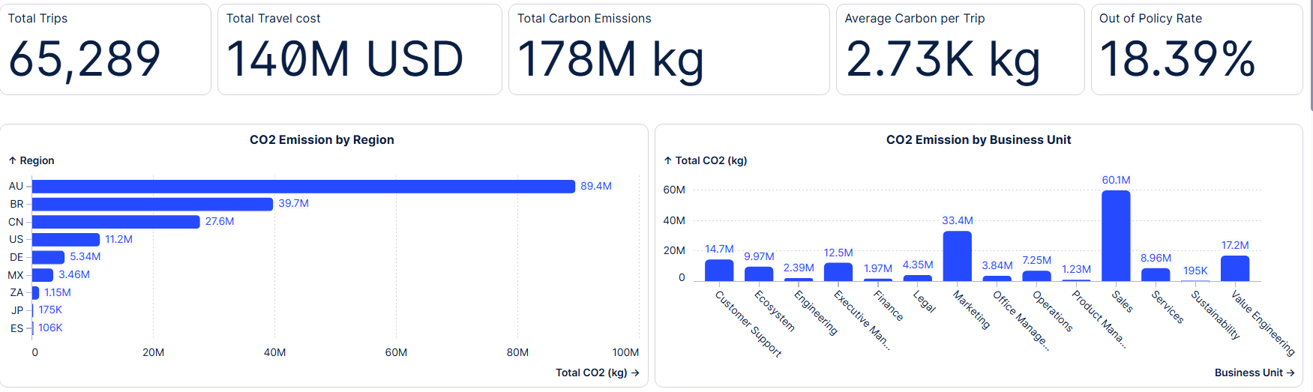
Dashboard Screenshots (max 3 slides) - will be used to shortlist

Slide 9
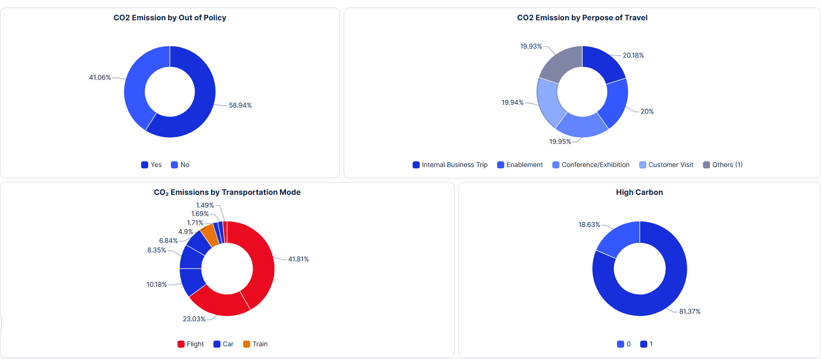
Dashboard Screenshots

Slide 10
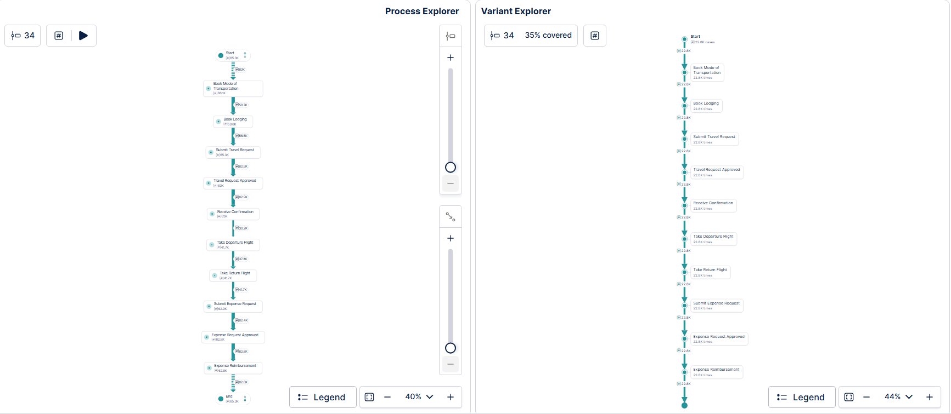
Dashboard Screenshots

