Slide 1
Basics of Microservice Architecture
Presenter: Souvik Ghosh

Slide 2
TOPICS OF DISCUSSION
What is Microservice?
What is Monolithic Architecture and It’s Drawbacks
Why to Use Microservice Architecture?
Challenges in Microservices Implementation and How to Resolve It
What is Service Discovery and Eureka?
Calling Another Microservice and Load Balancing
Use of API Gateway
Fault Tolerance With Hystrix
Centralized Configuration Using Spring Cloud Config Server
A Sample Microservices Architecture

Slide 3
What are Microservices?
Monolithic Architecture Microservices Architecture
Application A
Application a1
Application a2
Application a3
Application a4

Slide 4
Drawbacks of Monolithic Architecture
1. Large monolithic code base is very difficult to understand
2. It’s not fault tolerant
3. Overloaded Web Container and Overloaded IDE
4. Frequent deployment is difficult
5. Scaling the application is difficult
6. “A monolithic architecture forces you to be married to the technology stack
(and in some cases, to a particular version of the technology) you choose at the start of the development.”

Slide 5
Why Microservice Architecture?
1. Code base is better understandable
2. Highly maintainable and testable - enables rapid and frequent
development and deployment
3. Loosely coupled with other services so independently deployable
4. Improved fault isolation
5. Adapting new technologies is easier
6. The faster IDE makes developer more productive

Slide 6
Challenges in Microservices Implementation and Solutions
Discovering all the running services and their instances
Eureka Naming Server by Netflix OSS
Taking care of multiple service calls
Rest Template by Spring Frameworks
Feign Client by Netflix OSS
Finding easier way of load balancing
Ribbon by Netflix OSS
Maintaining configuration of multiple services
Spring Cloud Config Server
Monitoring all the incoming requests to all the services
Zuul API Gateway by Netflix OSS
Handling Fault Tolerance
Hystrix By Netflix OSS

Slide 7
What is Service Discovery?
Eureka
Eureka Naming Server
(port:8761)
Ms-A running on port 8081
Ms-B running on port 8082
Ms-C running on port 8083 & 8084
http://localhost:8761
Ms-A
(8081)
Ms-B
(8082)
Ms-C
(8083)
Ms-C
(8084)

Slide 8

Calling Another Microservice and Load Balancing
Eureka Naming Server
Ms-B
(9092)
1st and 4th call
Ms-A
(9091)
Ribbon
Ms-B
(9093)
2nd call
Client
3rd call
Ms-B
(9094)

Slide 9
Use of API Gateway
Zuul API Gateway Server
Ms-B
Client
Ms-C
Ms-A
Ms-D

Slide 10
Fault Tolerance With Hystrix
Faulty Ms-B returns a default output to make the other services safe
Ms-B
(Faulty Service)
Ms-C
Ms-A
Client

Slide 11
Centralized Configuration By Config Server
Storing All Configurations in a GIT Repository
Ms-A
Spring Cloud Config Server
GIT Repo
Ms-B
Ms-C

Slide 12
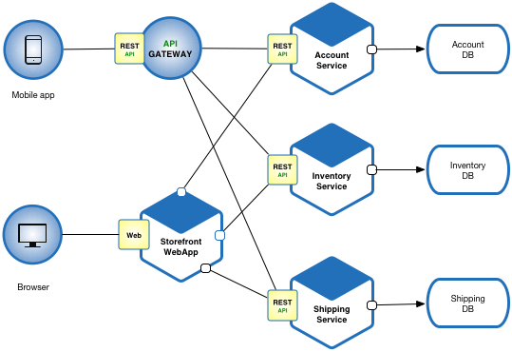
Sample Microservices Architecture

Slide 13

Thank You

