Slide 1
Factor Analysis

Slide 2
Factor Analysis
Factor analysis is an interdependence technique whose primary purpose is to define the underlying structure among the variables in the analysis.
The purpose of FA is to condense the information contained in a number of original variables into a smaller set of new composite dimensions or variates (factors) with a minimum loss of information.

Slide 3
General Steps to FA
Step 1: Selecting and Measuring a set of variables in a given domain
Step 2: Data screening in order to prepare the correlation matrix
Step 3: Factor Extraction
Step 4: Factor Rotation to increase interpretability
Step 5: Interpretation

Slide 4
“Good Factor”
A good factor:
  Makes sense
  will be easy to interpret
  simple structure
  Lacks complex loadings

Slide 5
Problems with FA
It is more art than science
  There are a number of extraction methods (PCA, FA, etc.)
  There are a number of rotation methods (Orthogonal, Oblique)
  Number of factors to extract
  Communality estimates
This is what makes it great…

Slide 6
Problems w/ FA
Life (researcher) saver
  Often when nothing else can be salvaged from research a FA or PCA will be conducted

Slide 7
Types of FA
Exploratory FA
  Summarizing data by grouping correlated variables
  Investigating sets of measured variables related to theoretical constructs

Slide 8
Terminology
Observed Correlation Matrix
Reproduced Correlation Matrix
Residual Correlation Matrix

Slide 9
Terminology
Orthogonal Rotation
  Loading Matrix – correlation between each variable and the factor
Oblique Rotation
  Factor Correlation Matrix – correlation between the factors
  Structure Matrix – correlation between factors and variables
  Pattern Matrix – unique relationship between each factor and variable uncontaminated by overlap between the factors

Slide 10
Terminology
Factor Coefficient matrix – coefficients used to calculate factor scores (like regression coefficients)

Slide 11
FA vs. PCA conceptually
FA produces factors; PCA produces components
Factors cause variables; components are aggregates of the variables

Slide 12
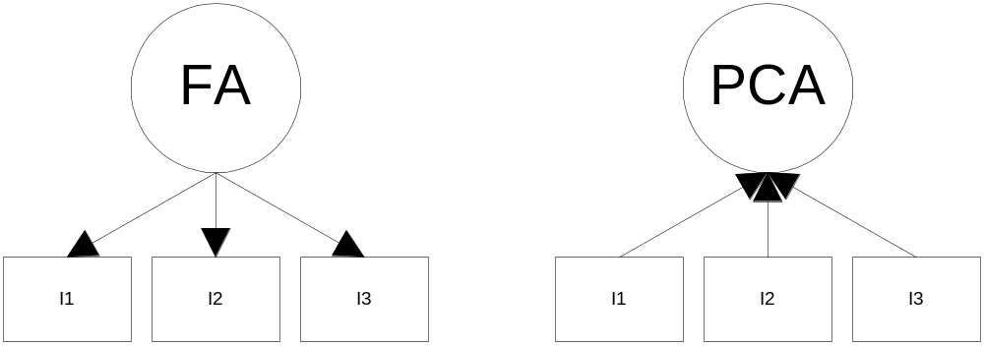
Conceptual FA and PCA

Slide 13
FA vs. PCA conceptually
FA analyzes only the variance shared among the variables (common variance without error or unique variance); PCA analyzes all of the variance
FA: “What are the underlying processes that could produce these correlations?”; PCA: Just summarize empirical associations, very data driven

Slide 14
Questions
Three general goals: data reduction, describe relationships and test theories about relationships
How many interpretable factors exist in the data? or How many factors are needed to summarize the pattern of correlations?

Slide 15
Questions
What does each factor mean? Interpretation?
What is the percentage of variance in the data accounted for by the factors?
Which factors account for the most variance?

Slide 16
Basic Concept
Areas of variance in data are where items can be best discriminated and key underlying phenomena observed
  Areas of greatest “signal” in the data
If two items or dimensions are highly correlated or dependent
  They are likely to represent highly related phenomena
  If they tell us about the same underlying variance in the data, combining them to form a single measure is reasonable
    Parsimony
    Reduction in Error
So we want to combine related variables, and focus on uncorrelated or independent ones, especially those along which the observations have high variance
We want a smaller set of variables that explain most of the variance in the original data, in more compact and insightful form

Slide 17
Basic Concept
What if the dependences and correlations are not so strong or direct?
And suppose you have 3 variables, or 4, or 5, or 10000?
Look for the phenomena underlying the observed covariance/co-dependence in a set of variables
  Once again, phenomena that are uncorrelated or independent, and especially those along which the data show high variance
These phenomena are called “factors” or “principal components” or “independent components,” depending on the methods used

Slide 18
Principal Component Analysis
Most common form of factor analysis
The new variables/dimensions
  Are linear combinations of the original ones
  Are uncorrelated with one another
    Orthogonal in original dimension space
  Capture as much of the original variance in the data as possible
  Are called Principal Components

Slide 19
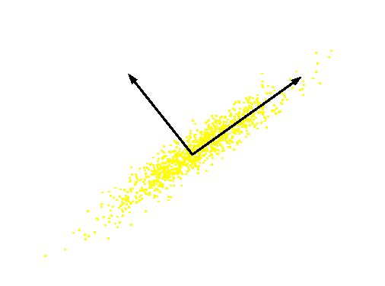
What are the new axes?
Original Variable B
PC 2
PC 1
Original Variable A
Orthogonal directions of greatest variance in data
Projections along PC1 discriminate the data most along any one axis

Slide 20
Computing the Components
E((u.x)²) = E ((u.x) (u.x)^{T}) = E (u.x.x ^{T}.u^{T})
The matrix C = x.x^{T} contains the correlations (similarities) of the original axes based on how the data values project onto them
So we are looking for w that maximizes uCu^{T}, subject to u being unit-length
It is maximized when w is the principal eigenvector of the matrix C, in which case
  uCu^{T} = uλu^{T} = λ if u is unit-length, where λ is the principal eigenvalue of the correlation matrix C
  The eigenvalue denotes the amount of variability captured along that dimension

Slide 21
Why the Eigenvectors?
Maximise u^{T}xx^{T}u s.t u^{T}u = 1
Construct Langrangian u^{T}xx^{T}u – λu^{T}u
Vector of partial derivatives set to zero
xx^{T}u – λu = (xx^{T} – λI) u = 0
As u ≠ 0 then u must be an eigenvector of xx^{T} with eigenvalue λ

Slide 22
Singular Value Decomposition
The first root is called the prinicipal eigenvalue which has an associated orthonormal (u^{T}u = 1) eigenvector u
Subsequent roots are ordered such that λ₁> λ₂ >… > λ_{M} with rank(D) non-zero values.
Eigenvectors form an orthonormal basis i.e. u_{i}^{T}u_{j} = δ_{ij}
The eigenvalue decomposition of xx^{T} = UΣU^{T}
where U = [u₁, u₂, …, u_{M}] and Σ = diag[λ ₁, λ ₂, …, λ _{M}]
Similarly the eigenvalue decomposition of x^{T}x = VΣV^{T}
The SVD is closely related to the above x=U Σ^{1/2} V^{T}
The left eigenvectors U, right eigenvectors V,
singular values = square root of eigenvalues.

Slide 23
PCs, Variance and Least-Squares
The first PC retains the greatest amount of variation in the sample
The k^{th} PC retains the k^{th} greatest fraction of the variation in the sample
The k^{th} largest eigenvalue of the correlation matrix C is the variance in the sample along the k^{th} PC
The least-squares view: PCs are a series of linear least squares fits to a sample, each orthogonal to all previous ones

Slide 24
How Many PCs?
For n original dimensions, correlation matrix is nxn, and has up to n eigenvectors. So n PCs.
Where does dimensionality reduction come from?

Slide 25
References
Lawley, D. N. and Maxwell, A. E. (1963; rev. 1971). Factor Analysis as a Statistical Method. Butterworth, Kent, England. (The standard textbook for mathematical statisticians.)
[13] Lawley, D. N. and Maxwell, A. E. (1973). Biometrika, 60, 331–338.
[14] Maxwell, A. E. (1977). Multivariate Analysis in Behavioural Research. Chapman & Hall, London. (An introductory textbook
which relates the development of factor analysis to that of other multivariate techniques.)
Cortina, J. M. (1993). What is coefficient alpha? An examination of theory and applications. Journal
of Applied Psychology, 78, 98–104. (A very readable paper on Cronbach’s α.)
Dunteman, G. E. (1989). Principal components analysis. Sage University Paper Series on Quantitative
Applications in the Social Sciences, 07-069. Newbury Park, CA: Sage. (This monograph is quite high level but comprehensive.)
Pedhazur, E., & Schmelkin, L. (1991). Measurement, design and analysis. Hillsdale, NJ: Erlbaum.
Tabachnick, B. G. & Fidell, L. S. (2007). Using multivariate statistics (5th ed.). Boston: Allyn &
Bacon. (Chapter 13 is a technical but wonderful overview of factor analysis.)
Harman, H.H. (1976). Modern Factor Analysis. Chicago, University of Chicago Press.
Cattell, R.B. (1978). The Scientific Use of Factor Analysis. New York, Plenum.
Kline, P. (1991). Intelligence. The Psychometric View. Routledge.

