Slide 1
PREDICTIVE ANALYTICS GROUP ASSIGNMENT
Group - 5

Slide 2
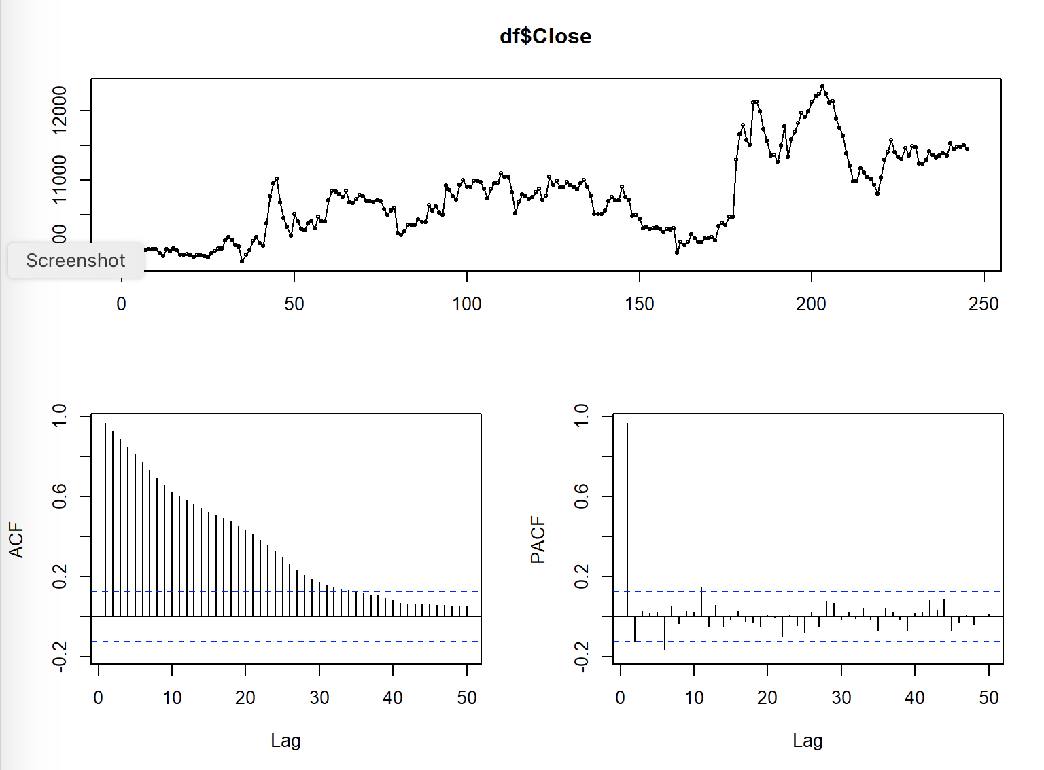
CORRELOGRAM OF TREND SERIES
-> tsdisplay(df$Close, lag=50)
ACF plot indicates that the autocorrelation starts at a very high and is not decaying fast which means the series is non stationary. Hence, we will go for first differencing

Slide 3
ADF TEST FOR TREND SERIES
-> adf.test(df$Close, alternative="stationary", k=6)
OUTPUT
## Augmented Dickey-Fuller Test ## ## data: df$Close ## Dickey-Fuller = -3.2543, Lag order = 6, p-value = 0.07941 ## alternative hypothesis: stationary
-> adf.test(df$Close, alternative="stationary", k=12)
OUTPUT
## Augmented Dickey-Fuller Test ## ## data: df$Close ## Dickey-Fuller = -2.4947, Lag order = 12, p-value = 0.3677 ## alternative hypothesis: stationary
The p-value of the ADF test is greater than 0.05 which is statistically proving that the data is non stationary

Slide 4
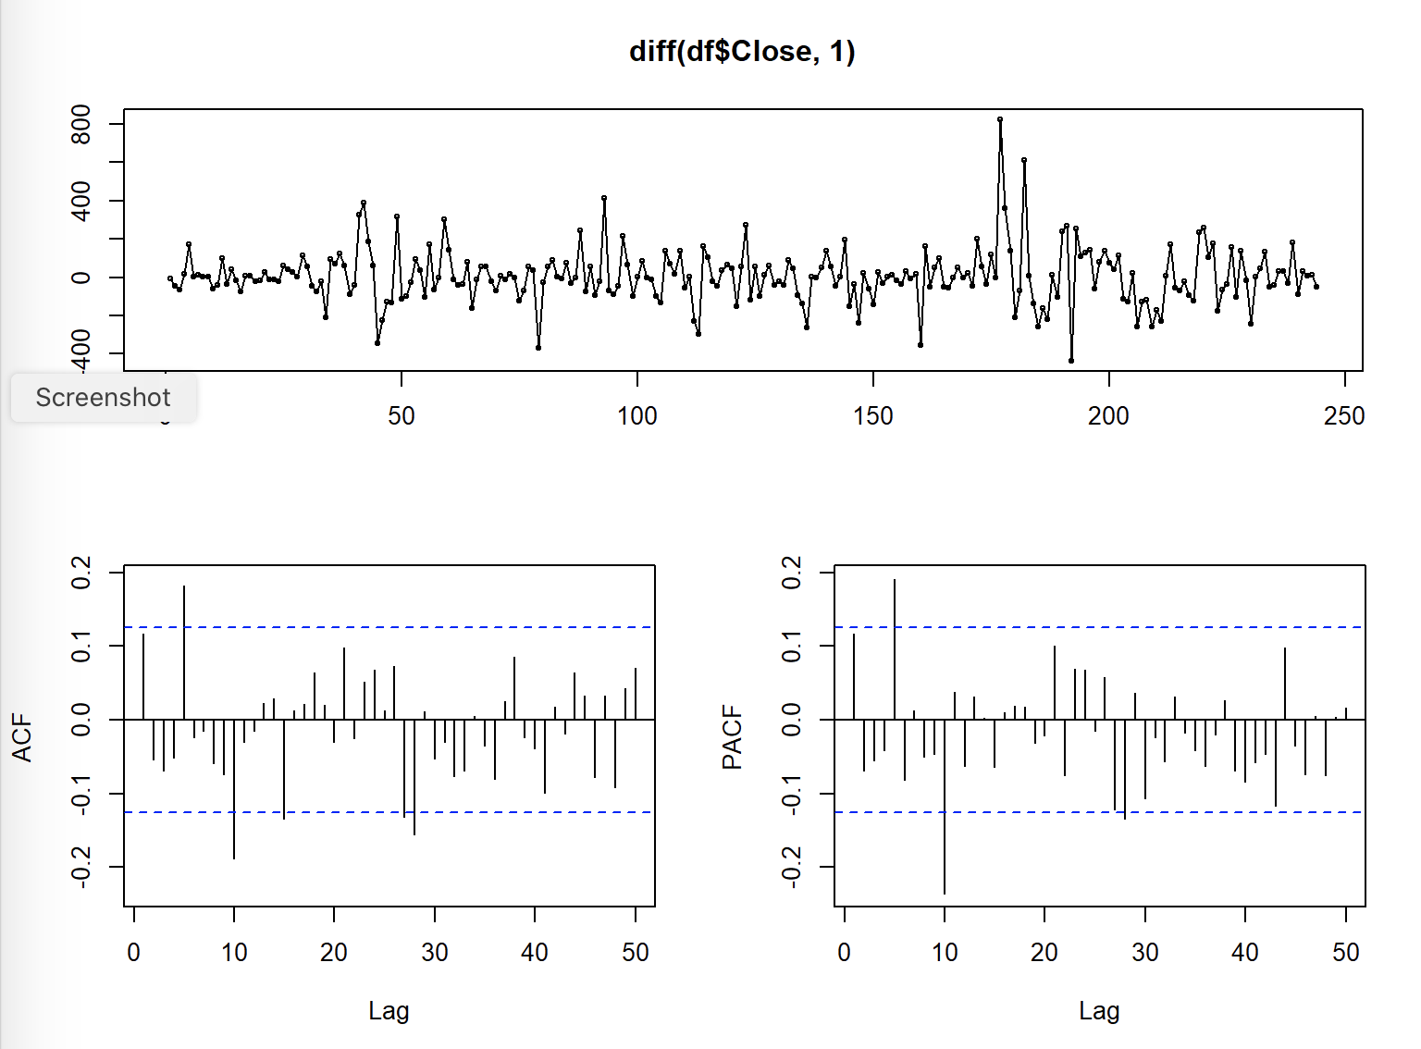
CORRELOGRAM OF TREND DIFFERENCING
tsdisplay(diff(df$Close,1), lag=50
It can be seen that there are some significant lags in pacf plot. Hence, we will consider trend differencing in our arima model

Slide 5
ADF TEST FOR TREND DIFFERENCING
adf.test(diff(df$Close,1), alternative="stationary", k=6)
OUTPUT
## Warning in adf.test(diff(df$Close, 1), alternative = "stationary", k = 6): p- ## value smaller than printed p-value
## ## Augmented Dickey-Fuller Test ## ## data: diff(df$Close, 1) ## Dickey-Fuller = -5.5104, Lag order = 6, p-value = 0.01 ## alternative hypothesis: stationary
->
The ADF test of trend differencing shows that it is stationary as we have reduced the acuteness of the autocorrelation from the component.

Slide 6
ADF TEST FOR SEASONALING DIFFERENCING
-> adf.test(diff(df$Close,5), alternative="stationary", k=6)
OUTPUT
## Warning in adf.test(diff(df$Close, 5), alternative = "stationary", k = 6): p- ## value smaller than printed p-value
## ## Augmented Dickey-Fuller Test ## ## data: diff(df$Close, 5) ## Dickey-Fuller = -5.3472, Lag order = 6, p-value = 0.01 ## alternative hypothesis: stationary
The p-value of the ADF test for seasonal differencing is less than 0.05 which means it is significant and stationary

Slide 7
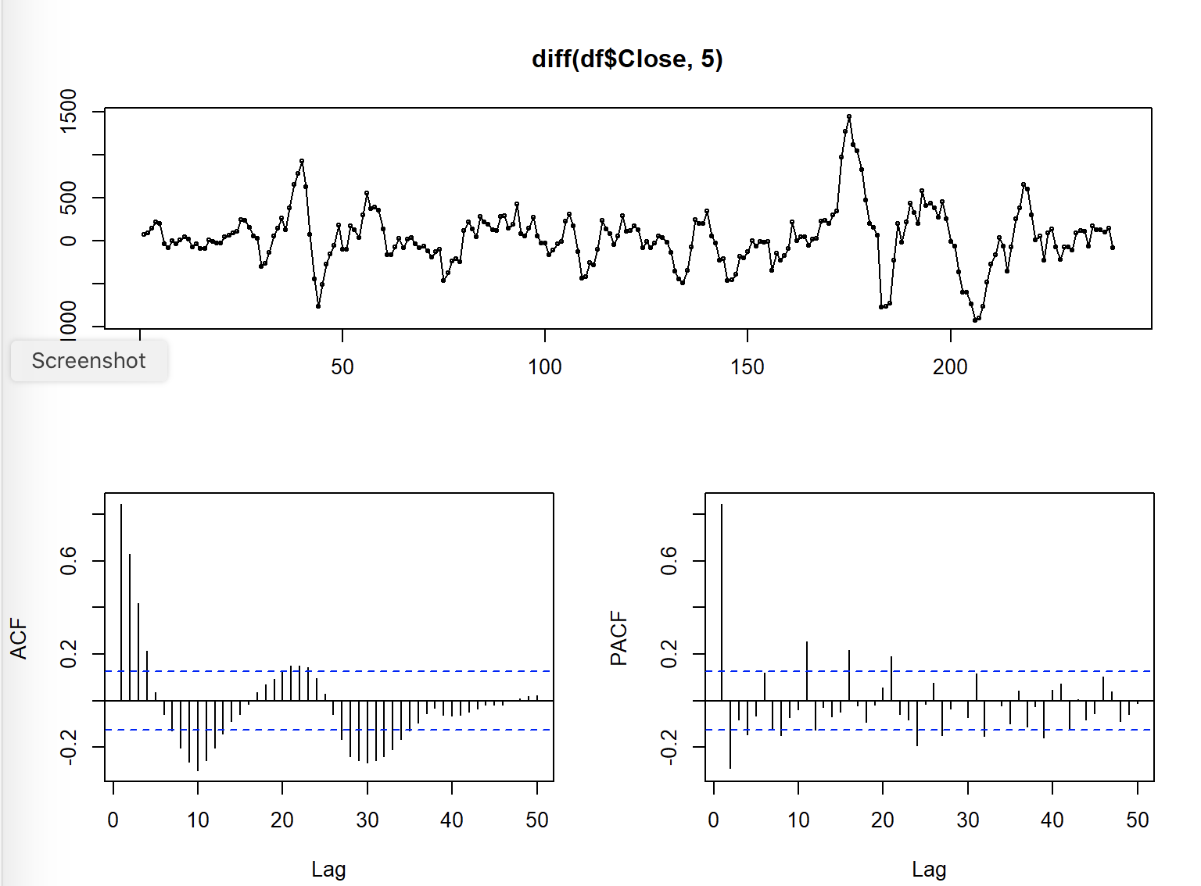
CORRELOGRAM OF SEASONAL DIFFERENCING
-> tsdisplay(diff(df$Close,5), lag=50)
The ACF plot is showing a seasonal pattern
The PACF plot shows which lags are significant

Slide 8
ESTIMATION MODEL 1
fit1 <- Arima(df$Close, order=c(1,0,0), seasonal = list(order = c(1, 1, 1), period=5))
OUTPUT summary(fit1)
## Series: df$Close ## ARIMA(1,0,0)(1,1,1)[5] ## ## Coefficients: ## ar1 sar1 sma1 ## 0.9715 0.1935 -0.9998 ## s.e. 0.0196 0.0665 0.0367 ## ## sigma^2 estimated as 20086: log likelihood=-1536.45 ## AIC=3080.89 AICc=3081.06 BIC=3094.82 ## ## Training set error measures: ## ME RMSE MAE MPE MAPE MASE ACF1 ## Training set 14.67519 139.3936 95.55947 0.1264896 0.8771299 0.9756495 0.1422398
Although the coefficients are less than 1 and significant, model can still be improved further

Slide 9
BOX LJUNG TEST
Box.test(residuals(fit1), lag=5, fitdf=3, type="Ljung")
OUTPUT
## ## Box-Ljung test ## ## data: residuals(fit1) ## X-squared = 6.7351, df = 2, p-value = 0.03447
The box test confirms the presence of autocorrelation in the residual, hence the model is rejected

Slide 10
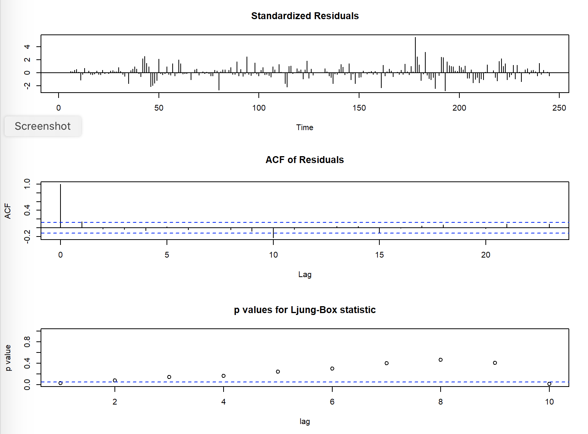
RESIDUAL PLOT OF MODEL 1
->b2<-tsdiag(fit1)
It can be seen in the p values plot that some of the error terms are closer to 0 which means that there is presence of autocorrel- ation

Slide 11
ESTIMATION MODEL 2
fit2 <- Arima(df$Close, order=c(1,0,1), seasonal = list(order = c(4, 1, 0), period=5))
OUTPUT
summary(fit2)
## Series: df$Close ## ARIMA(1,0,1)(4,1,0)[5] ## ## Coefficients: ## ar1 ma1 sar1 sar2 sar3 sar4 ## 0.8827 0.1916 -0.4621 -0.5062 -0.3223 -0.1898 ## s.e. 0.0354 0.0719 0.0682 0.0691 0.0685 0.0646 ## ## sigma^2 estimated as 23026: log likelihood=-1544.99 ## AIC=3103.98 AICc=3104.47 BIC=3128.35 ## ## Training set error measures: ## ME RMSE MAE MPE MAPE MASE ACF1 ## Training set 7.906678 148.2991 106.305 0.06555591 0.9792476 1.08536 0.003728149
We can see that this model is better than the previous model as it has lower AIC and MAPE value. Hence, we will go forward with this model

Slide 12
BOX LJUNG TEST
Box.test(residuals(fit2), lag=10, fitdf=6, type="Ljung")
## Box-Ljung test ## ## data: residuals(fit2) ## X-squared = 4.5058, df = 4, p-value = 0.3419
The box test confirms the absence of autocorrelation in the residual

Slide 13
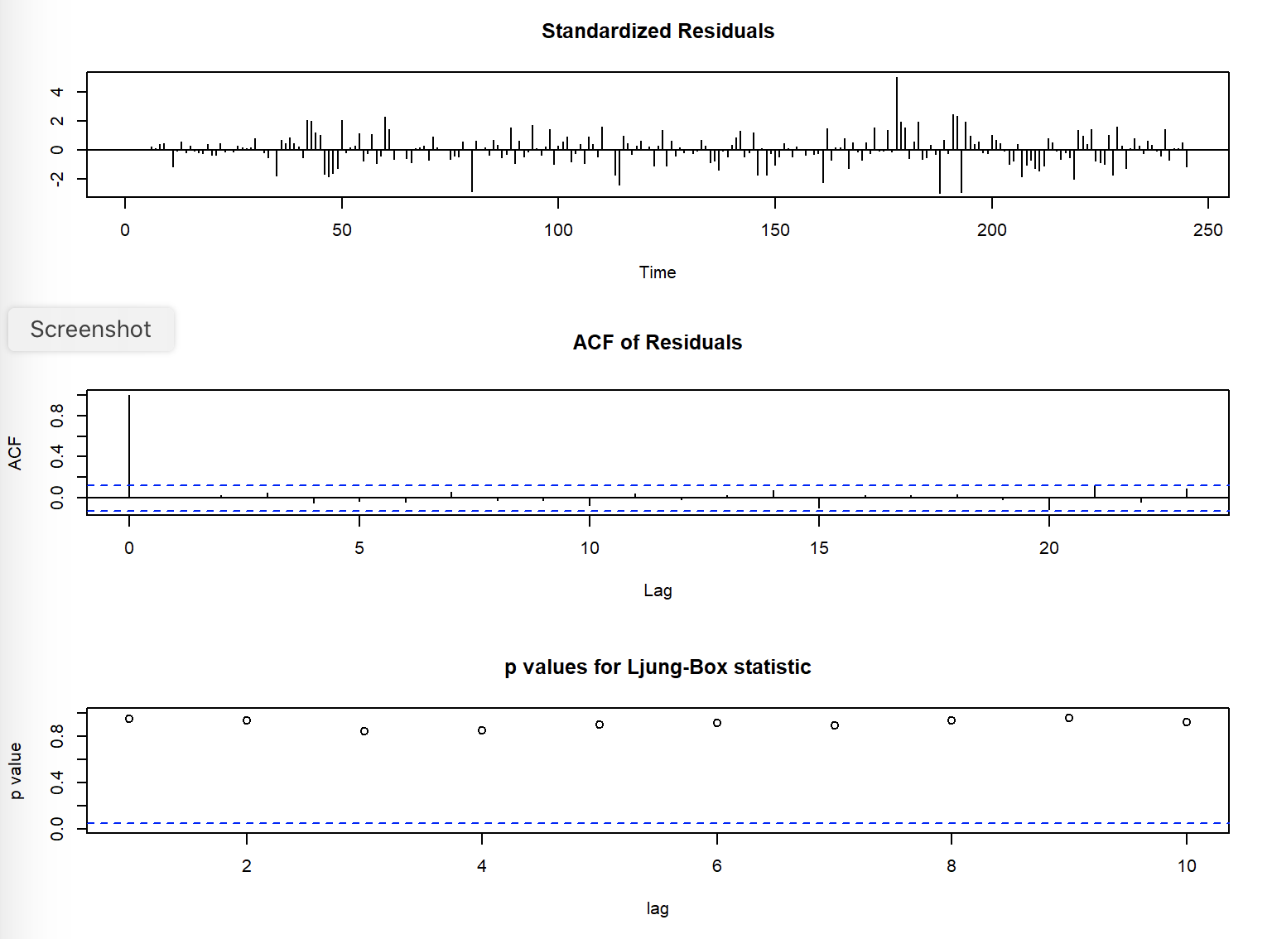
RESIDUAL PLOT OF MODEL 2
-> b2<-tsdiag(fit2)
All the p-values are greater than 0.05 so we are accepting the alternative hypothesis that there is no autocorrelation and all the predictable information has been captured by our model

Slide 14
SIMPLE EXPONENTIAL SMOOTHING
rel_ses <- ses(df$Close)
summary(rel_ses)
## ## Forecast method: Simple exponential smoothing ## ## Model Information: ## Simple exponential smoothing ## ## Call: ## ses(y = df$Close) ## ## Smoothing parameters: ## alpha = 0.9999 ## ## Initial states: ## l = 9917.9666 ## ## sigma: 144.6369 ## ## AIC AICc BIC ## 3789.171 3789.271 3799.675 ## ## Error measures: ## ME RMSE MAE MPE MAPE MASE ## Training set 6.241598 144.0453 97.60369 0.04989359 0.8956246 0.9965207 ## ACF1 ## Training set 0.1162925 ## ## Forecasts: ## Point Forecast Lo 80 Hi 80 Lo 95 Hi 95 ## 246 11447 11261.65 11632.36 11163.52 11730.49 ## 247 11447 11184.88 11709.13 11046.12 11847.89 ## 248 11447 11125.97 11768.04 10956.03 11937.98 ## 249 11447 11076.31 11817.70 10880.08 12013.93 ## 250 11447 11032.56 11861.45 10813.17 12080.84 ## 251 11447 10993.01 11901.00 10752.67 12141.34 ## 252 11447 10956.63 11937.38 10697.04 12196.97 ## 253 11447 10922.77 11971.24 10645.26 12248.75 ## 254 11447 10890.98 12003.03 10596.63 12297.38 ## 255 11447 10860.90 12033.11 10550.63 12343.38
Single Exponential Smoothing, SES for short, also called Simple Exponential Smoothing, is a time series forecasting method for univariate data without a trend or seasonality.
It requires a single parameter, called alpha , also called the smoothing factor or smoothing coefficient.

Slide 15
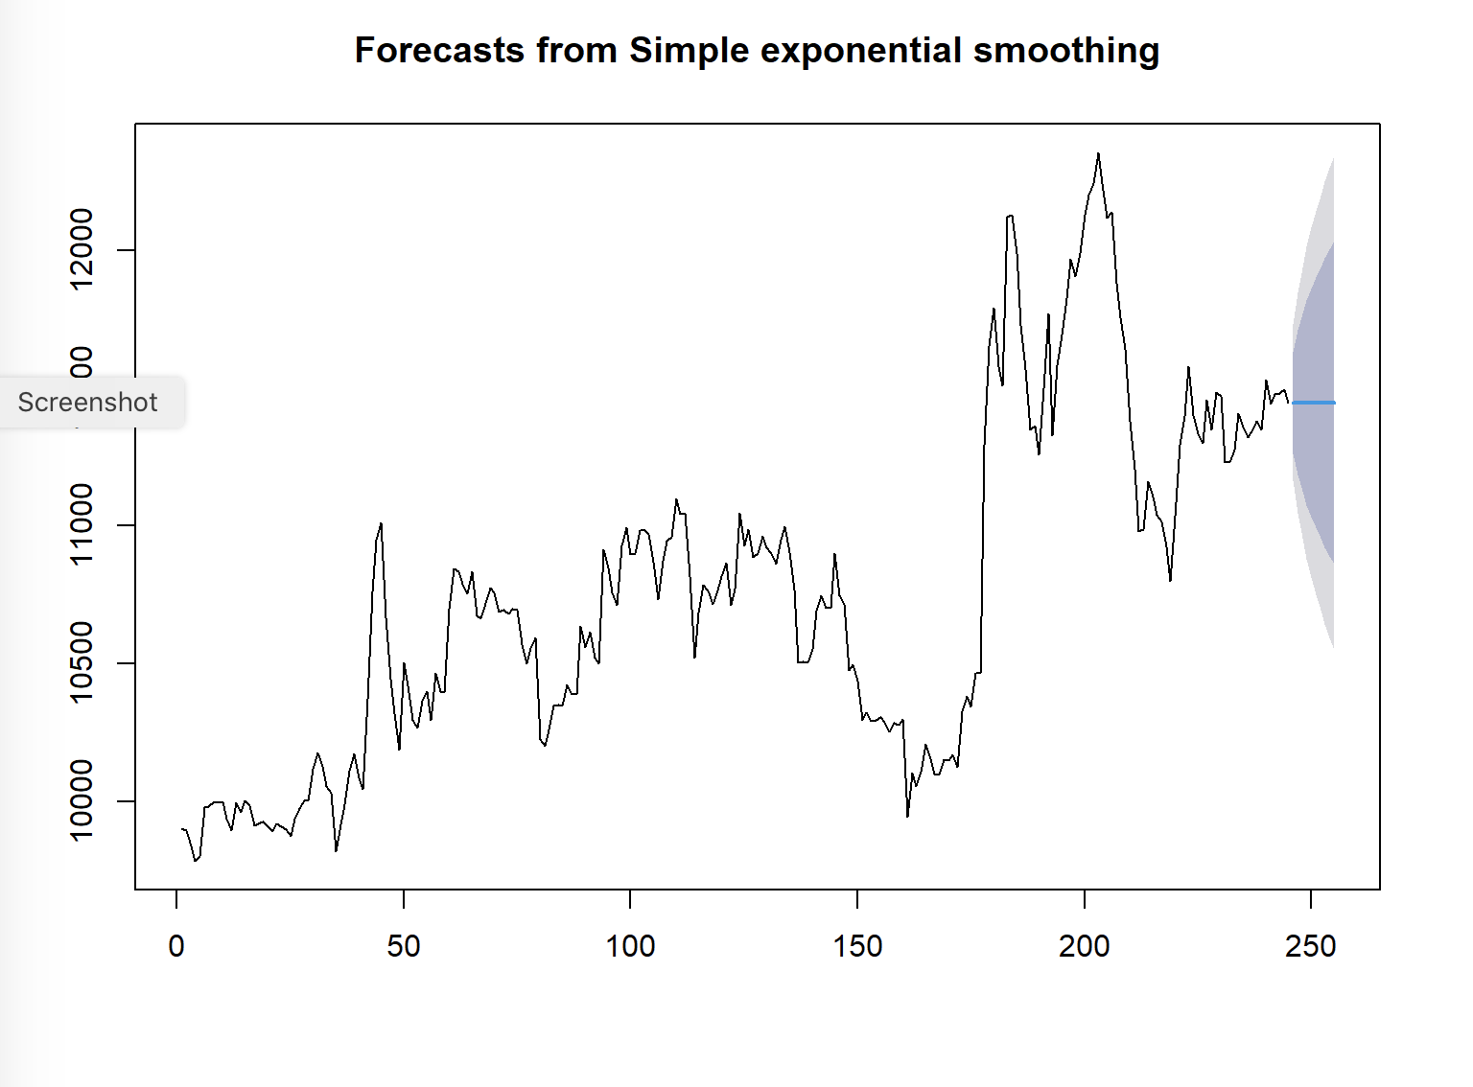
SES PLOT
plot(rel_ses)
Since ses does not takes trend and seasonality into account it fails to make accurate prediction of the data
as our data has both trend and seasonality

Slide 16
HOLT’S LINEAR TREND MODEL
rel_holt <- holt(df$Close)
summary(rel_holt)
## ## Forecast method: Holt's method ## ## Model Information: ## Holt's method ## ## Call: ## holt(y = df$Close) ## ## Smoothing parameters: ## alpha = 0.9994 ## beta = 0.0001 ## ## Initial states: ## l = 9883.2012 ## b = 6.5095 ## ## sigma: 145.1118 ## ## AIC AICc BIC ## 3792.752 3793.003 3810.259 ## ## Error measures: ## ME RMSE MAE MPE MAPE MASE ## Training set -0.1331182 143.9223 98.01858 -0.009470692 0.8999148 1.000757 ## ACF1 ## Training set 0.1166371 ## ## Forecasts: ## Point Forecast Lo 80 Hi 80 Lo 95 Hi 95 ## 246 11453.54 11267.57 11639.51 11169.12 11737.95 ## 247 11460.05 11197.11 11722.98 11057.92 11862.17 ## 248 11466.55 11144.54 11788.56 10974.07 11959.03 ## 249 11473.06 11101.23 11844.89 10904.39 12041.72 ## 250 11479.56 11063.84 11895.29 10843.77 12115.36 ## 251 11486.07 11030.65 11941.49 10789.57 12182.57 ## 252 11492.58 11000.65 11984.50 10740.24 12244.91 ## 253 11499.08 10973.17 12024.99 10694.77 12303.40 ## 254 11505.59 10947.75 12063.43 10652.45 12358.73 ## 255 11512.09 10924.06 12100.13 10612.77 12411.42
#Plot the forecasted values
Double Exponential Smoothing is an extension to Exponential Smoothing that explicitly adds support for trends in the univariate time series.
In addition to the alpha parameter for controlling smoothing factor for the level, an additional smoothing factor is added to control the decay of the influence of the change in trend called beta (b).

Slide 17
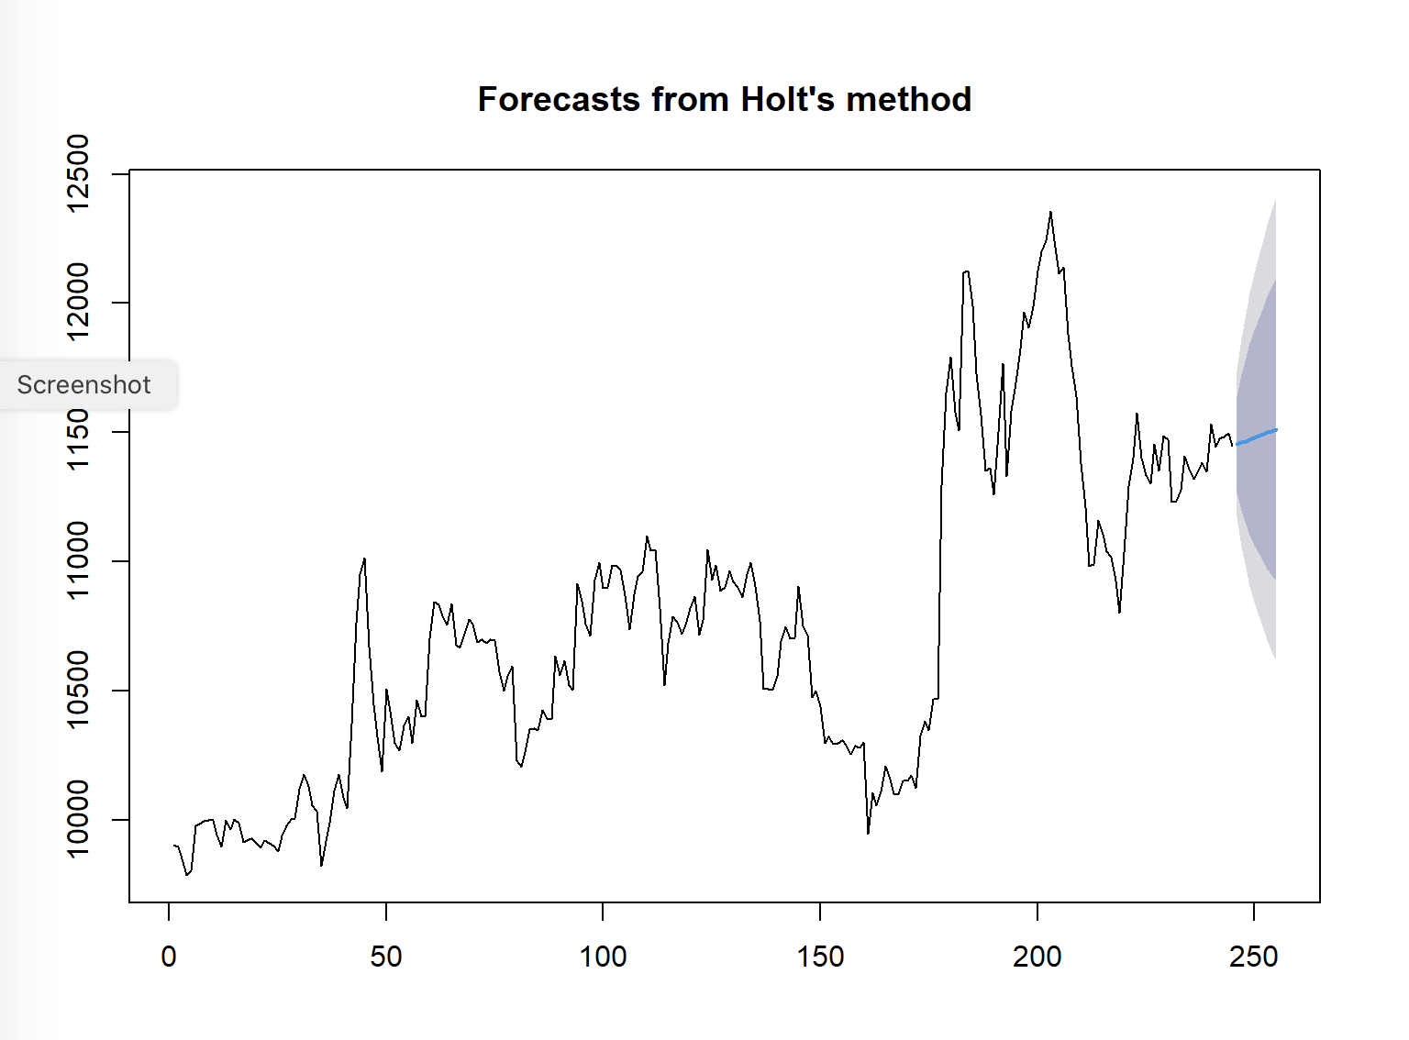
HOLT’S PLOT
plot(rel_holt)

Slide 18
HOLT-WINTERS EXPONENTIAL SMOOTHING MODEL
y <- ts(data.matrix(df$Close), start = as.Date("2019-01-01"), end = as.Date ("2019-12-31"), frequency=5)
y
## Time Series: ## Start = c(17897, 1) ## End = c(18261, 1) ## Frequency = 5 ## [1] 9903.75 9895.00 9850.00 9784.95 9804.20 9978.45 9982.45 9995.65 ## [9] 9998.50 9999.30 9939.75 9896.85 9996.95 9962.00 10003.15 9987.95 ## [17] 9914.85 9921.30 9928.85 9908.80 9892.60 9919.60 9908.75 9898.60 ## [25] 9877.10 9938.50 9977.90 10002.65 10004.45 10118.80 10177.15 10129.85 ## [33] 10055.95 10032.35 9821.60 9917.15 9988.60 10112.05 10174.85 10086.85 ## [41] 10046.20 10371.20 10762.60 10950.85 11013.15 10668.50 10446.00 10320.30 ## [49] 10187.60 10506.20 10395.40 10294.90 10268.80 10364.70 10400.70 10295.30 ## [57] 10465.05 10399.00 10398.05 10701.00 10843.95 10833.55 10791.20 10754.35 ## [65] 10836.35 10675.80 10665.40 10719.35 10777.45 10757.75 10688.75 10696.70 ## [73] 10683.35 10698.65 10695.90 10572.35 10500.80 10556.55 10595.50 10228.25 ## [81] 10203.65 10260.40 10348.90 10353.30 10346.80 10424.30 10391.45 10389.00 ## [89] 10635.40 10559.95 10615.20 10521.80 10501.30 10915.35 10847.30 10759.80 ## [97] 10713.85 10927.85 10996.00 10896.80 10900.40 10985.55 10983.00 10969.60 ## [105] 10869.20 10735.60 10873.05 10944.40 10961.65 11099.05 11041.85 11045.45 ## [113] 10817.95 10520.50 10684.55 10787.60 10765.25 10717.95 10754.50 10818.35 ## [121] 10866.40 10714.85 10771.60 11047.15 10929.65 10986.80 10887.70 10900.10 ## [129] 10962.80 10921.90 10901.35 10861.55 10951.10 10997.35 10903.15 10767.95 ## [137] 10506.15 10506.70 10503.20 10554.95 10692.05 10747.20 10702.00 10704.35 ## [145] 10902.35 10749.55 10715.35 10475.80 10498.70 10437.85 10295.50 10322.50 ## [153] 10293.20 10295.40 10308.10 10290.50 10254.80 10287.05 10279.55 10298.85 ## [161] 9944.30 10105.05 10054.90 10108.15 10209.40 10157.05 10101.85 10098.70 ## [169] 10152.05 10149.90 10171.90 10124.10 10326.75 10382.70 10346.10 10466.40 ## [177] 10466.75 11293.05 11652.95 11790.65 11578.95 11508.35 12119.50 12126.05 ## [185] 11989.40 11729.15 11569.70 11349.85 11363.00 11260.45 11499.65 11768.60 ## [193] 11329.40 11582.85 11693.80 11824.35 11967.40 11905.15 11987.45 12126.25 ## [201] 12199.70 12241.10 12355.25 12242.30 12115.80 12138.85 11881.40 11755.40 ## [209] 11639.70 11379.90 11207.90 10980.85 10988.40 11160.50 11107.05 11039.30 ## [217] 11016.65 10925.15 10801.40 11035.65 11292.65 11399.45 11576.85 11400.05 ## [225] 11334.55 11300.25 11455.85 11350.25 11486.25 11471.05 11229.65 11232.55 ## [233] 11277.05 11409.35 11358.75 11320.35 11349.95 11381.70 11348.85 11531.25 ## [241] 11442.50 11476.15 11481.80 11496.35 11447.00 9903.75 9895.00 9850.00 ## [249] 9784.95 9804.20 9978.45 9982.45 9995.65 9998.50 9999.30 9939.75 ## [257] 9896.85 9996.95 9962.00 10003.15 9987.95 9914.85 9921.30 9928.85 ## [265] 9908.80 9892.60 9919.60 9908.75 9898.60 9877.10 9938.50 9977.90 ## [273] 10002.65 10004.45 10118.80 10177.15 10129.85 10055.95 10032.35 9821.60 ## [281] 9917.15 9988.60 10112.05 10174.85 10086.85 10046.20 10371.20 10762.60 ## [289] 10950.85 11013.15 10668.50 10446.00 10320.30 10187.60 10506.20 10395.40 ## [297] 10294.90 10268.80 10364.70 10400.70 10295.30 10465.05 10399.00 10398.05 ## [305] 10701.00 10843.95 10833.55 10791.20 10754.35 10836.35 10675.80 10665.40 ## [313] 10719.35 10777.45 10757.75 10688.75 10696.70 10683.35 10698.65 10695.90 ## [321] 10572.35 10500.80 10556.55 10595.50 10228.25 10203.65 10260.40 10348.90 ## [329] 10353.30 10346.80 10424.30 10391.45 10389.00 10635.40 10559.95 10615.20 ## [337] 10521.80 10501.30 10915.35 10847.30 10759.80 10713.85 10927.85 10996.00 ## [345] 10896.80 10900.40 10985.55 10983.00 10969.60 10869.20 10735.60 10873.05 ## [353] 10944.40 10961.65 11099.05 11041.85 11045.45 10817.95 10520.50 10684.55 ## [361] 10787.60 10765.25 10717.95 10754.50 10818.35 10866.40 10714.85 10771.60 ## [369] 11047.15 10929.65 10986.80 10887.70 10900.10 10962.80 10921.90 10901.35 ## [377] 10861.55 10951.10 10997.35 10903.15 10767.95 10506.15 10506.70 10503.20 ## [385] 10554.95 10692.05 10747.20 10702.00 10704.35 10902.35 10749.55 10715.35 ## [393] 10475.80 10498.70 10437.85 10295.50 10322.50 10293.20 10295.40 10308.10 ## [401] 10290.50 10254.80 10287.05 10279.55 10298.85 9944.30 10105.05 10054.90 ## [409] 10108.15 10209.40 10157.05 10101.85 10098.70 10152.05 10149.90 10171.90 ## [417] 10124.10 10326.75 10382.70 10346.10 10466.40 10466.75 11293.05 11652.95 ## [425] 11790.65 11578.95 11508.35 12119.50 12126.05 11989.40 11729.15 11569.70 ## [433] 11349.85 11363.00 11260.45 11499.65 11768.60 11329.40 11582.85 11693.80 ## [441] 11824.35 11967.40 11905.15 11987.45 12126.25 12199.70 12241.10 12355.25 ## [449] 12242.30 12115.80 12138.85 11881.40 11755.40 11639.70 11379.90 11207.90 ## [457] 10980.85 10988.40 11160.50 11107.05 11039.30 11016.65 10925.15 10801.40 ## [465] 11035.65 11292.65 11399.45 11576.85 11400.05 11334.55 11300.25 11455.85 ## [473] 11350.25 11486.25 11471.05 11229.65 11232.55 11277.05 11409.35 11358.75 ##

Slide 19
HOLT’S WINTER ADDITIVE METHOD
rel_hw <- hw(y, h = 10, seasonal = c("additive","multiplicative"))
summary(rel_hw)
## ## Forecast method: Holt-Winters' additive method ## ## Model Information: ## Holt-Winters' additive method ## ## Call: ## hw(y = y, h = 10, seasonal = c("additive", "multiplicative")) ## ## Smoothing parameters: ## alpha = 0.9999 ## beta = 0.0012 ## gamma = 0.0001 ## ## Initial states: ## l = 9841.1478 ## b = 13.0192 ## s = 34.2625 30.428 -6.3065 -31.5847 -26.7993 ## ## sigma: 169.2351 ## ## AIC AICc BIC ## 32369.64 32369.76 32424.71 ## ## Error measures: ## ME RMSE MAE MPE MAPE MASE ## Training set -5.077572 168.8164 103.9366 -0.05930966 0.9626468 0.4064624 ## ACF1 ## Training set 0.09013634 ## ## Forecasts: ## Point Forecast Lo 80 Hi 80 Lo 95 Hi 95 ## 18261.20 10732.22 10515.34 10949.10 10400.527 11063.92 ## 18261.40 10759.03 10452.14 11065.93 10289.675 11228.39 ## 18261.60 10797.27 10421.18 11173.37 10222.082 11372.46 ## 18261.80 10802.60 10368.05 11237.14 10138.016 11467.18 ## 18262.00 10743.08 10256.94 11229.22 9999.597 11486.56 ## 18262.20 10739.70 10206.83 11272.58 9924.739 11554.66 ## 18262.40 10766.51 10190.58 11342.44 9885.707 11647.31 ## 18262.60 10804.75 10188.68 11420.82 9862.551 11746.95 ## 18262.80 10810.08 10156.23 11463.92 9810.104 11810.05 ## 18263.00 10750.56 10060.92 11440.20 9695.843 11805.27

Slide 20
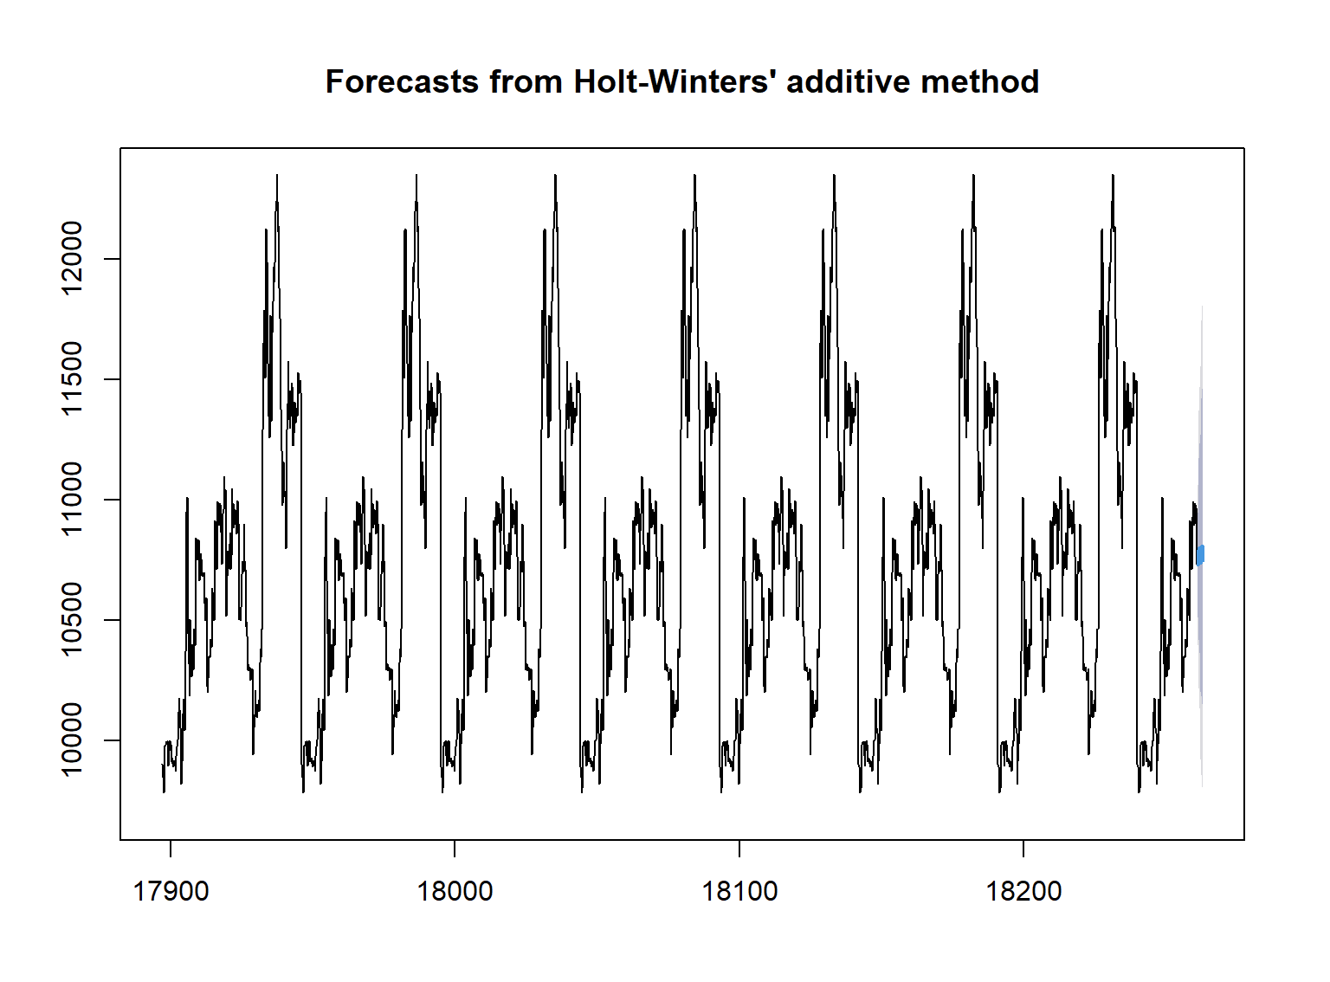
HOLT’S WINTER ADDITIVE PLOT
-> plot(rel_hw)

Slide 21
HOLT’S WINTER FILTERING METHOD
rel_hw <- HoltWinters(y, seasonal = "mult")
rel_hw
## Holt-Winters exponential smoothing with trend and multiplicative seasonal component. ## ## Call: ## HoltWinters(x = y, seasonal = "mult") ## ## Smoothing parameters: ## alpha: 1 ## beta : 0.002521912 ## gamma: 0 ## ## Coefficients: ## [,1] ## a 10650.1422160 ## b 0.1295598 ## s1 1.0041003 ## s2 1.0013849 ## s3 0.9931492 ## s4 0.9933415 ## s5 1.0080241

Slide 22
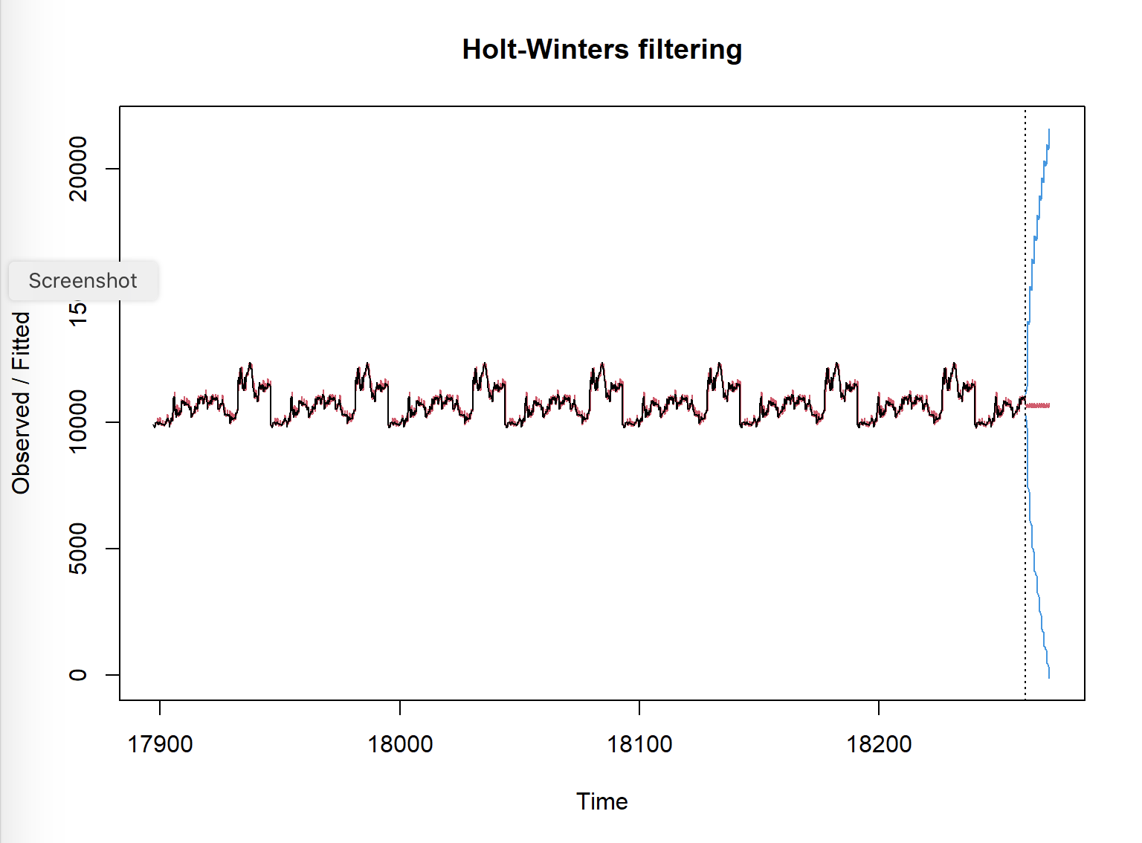
HOLT’S WINTER FILTERING PLOT
pred <- predict(rel_hw, 50, prediction.interval = TRUE) plot(rel_hw, pred)

Slide 23
ARIMA OUT OF SAMPLE FORECAST
hold <- window(ts(df$Close), start=241) fit1_no_holdout <- Arima(ts(df$Close[-c(241:245)]), order=c(1,0,1), seasonal = list(order = c(4, 1, 0), period = 5)) fit1_fcast_no_holdout <- forecast(fit1_no_holdout,h=5)
Here, we are estimating the forecast for our model 2 for 5 days

Slide 24
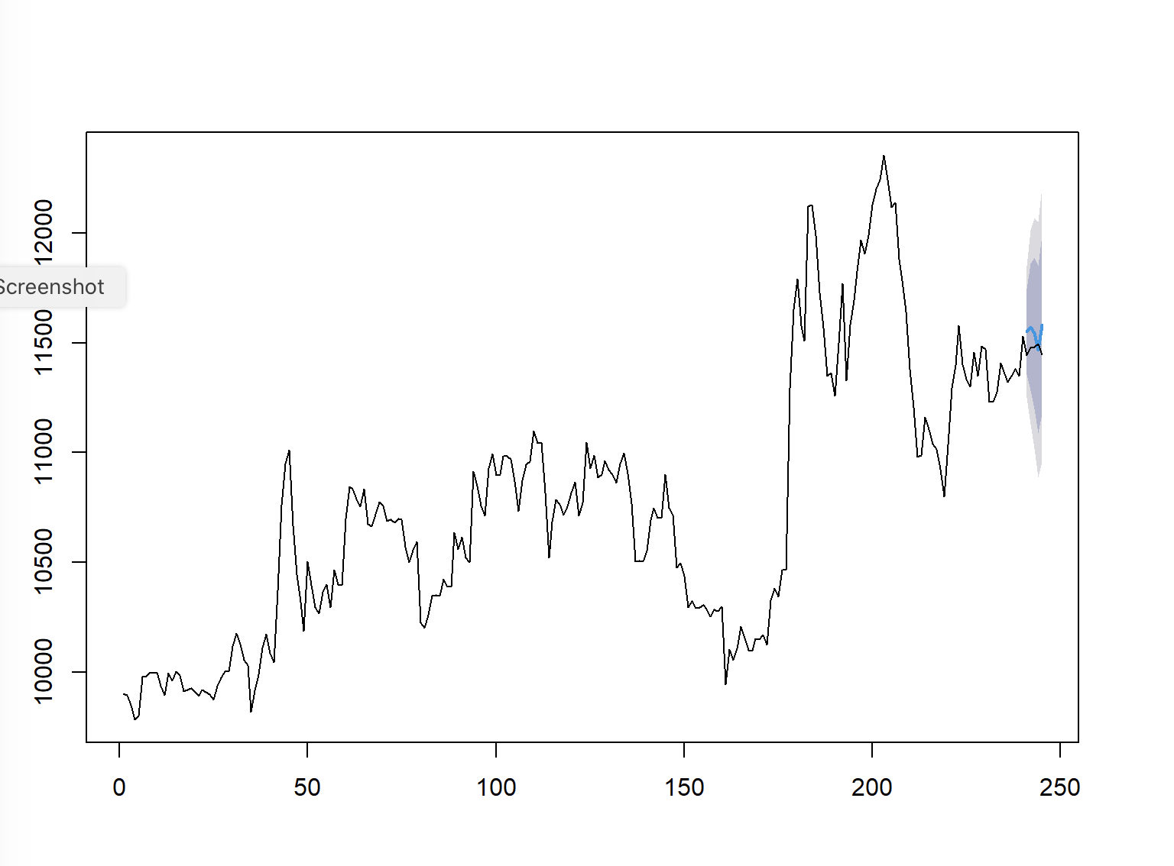
ARIMA OUT OF SAMPLE FORECAST PLOT
plot(fit1_fcast_no_holdout, main=" ") lines(ts(df$Close))

Slide 25
ARIMA OUT OF SAMPLE FORECAST SUMMARY
summary(fit1_fcast_no_holdout)
## ## Forecast method: ARIMA(1,0,1)(4,1,0)[5] ## ## Model Information: ## Series: ts(df$Close[-c(241:245)]) ## ARIMA(1,0,1)(4,1,0)[5] ## ## Coefficients: ## ar1 ma1 sar1 sar2 sar3 sar4 ## 0.8829 0.1997 -0.4533 -0.5095 -0.3277 -0.1940 ## s.e. 0.0359 0.0730 0.0690 0.0697 0.0693 0.0657 ## ## sigma^2 estimated as 23311: log likelihood=-1514.27 ## AIC=3042.55 AICc=3043.04 BIC=3066.77 ## ## Error measures: ## ME RMSE MAE MPE MAPE MASE ## Training set 8.698701 149.1397 107.0502 0.07252796 0.9869897 1.079239 ## ACF1 ## Training set 0.003540183 ## ## Forecasts: ## Point Forecast Lo 80 Hi 80 Lo 95 Hi 95 ## 241 11550.76 11355.09 11746.42 11251.51 11850.00 ## 242 11571.31 11282.94 11859.69 11130.29 12012.34 ## 243 11543.24 11199.53 11886.96 11017.58 12068.91 ## 244 11468.72 11087.40 11850.04 10885.55 12051.90 ## 245 11582.06 11173.83 11990.30 10957.72 12206.41

Slide 26
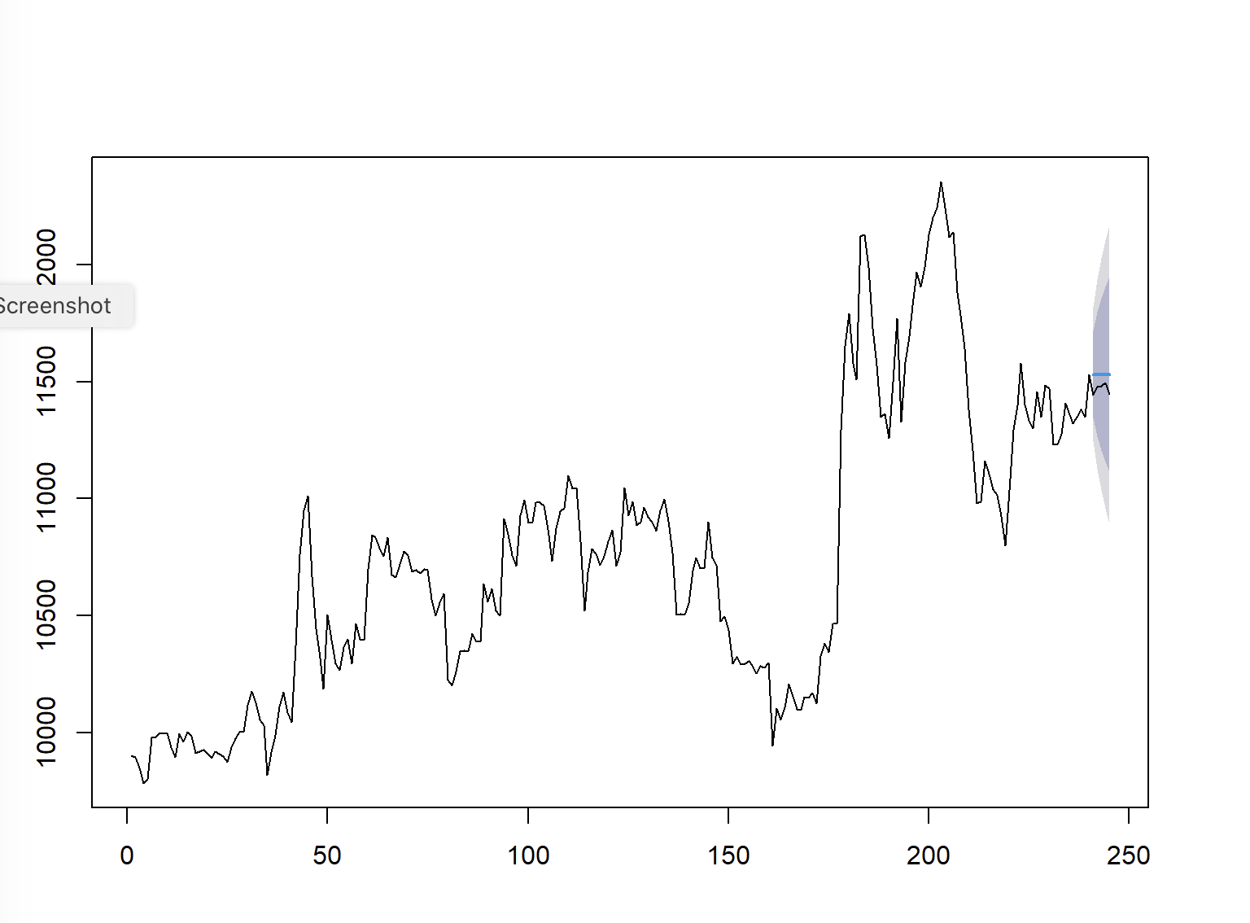
SES OUT OF SAMPLE FORECAST
# For SES hold <- window(ts(df$Close), start=241) fit1_no_holdout <- ses(ts(df$Close[-c(241:245)])) fit1_fcast_no_holdout <- forecast(fit1_no_holdout,h=5) plot(fit1_fcast_no_holdout, main=" ") lines(ts(df$Close))

Slide 27
SES OUT OF SAMPLE FORECAST SUMMARY
summary(fit1_fcast_no_holdout)
## ## Forecast method: Simple exponential smoothing ## ## Model Information: ## Simple exponential smoothing ## ## Call: ## ses(y = ts(df$Close[-c(241:245)])) ## ## Smoothing parameters: ## alpha = 0.9999 ## ## Initial states: ## l = 9917.9666 ## ## sigma: 145.9803 ## ## AIC AICc BIC ## 3711.411 3711.513 3721.853 ## ## Error measures: ## ME RMSE MAE MPE MAPE MASE ## Training set 6.722611 145.3707 98.83741 0.05400645 0.9073021 0.9964415 ## ACF1 ## Training set 0.1205099 ## ## Forecasts: ## Point Forecast Lo 80 Hi 80 Lo 95 Hi 95 ## 241 11531.23 11344.15 11718.31 11245.12 11817.35 ## 242 11531.23 11266.67 11795.79 11126.62 11935.84 ## 243 11531.23 11207.22 11855.24 11035.70 12026.77 ## 244 11531.23 11157.10 11905.37 10959.04 12103.42 ## 245 11531.23 11112.94 11949.52 10891.51 12170.96

Slide 28

HOLT’S OUT OF SAMPLE FORECAST
hold <- window(ts(df$Close), start=241) fit1_no_holdout <- holt(ts(df$Close[-c(241:245)])) fit1_fcast_no_holdout <- forecast(fit1_no_holdout,h=5) plot(fit1_fcast_no_holdout, main=" ") lines(ts(df$Close))

Slide 29
HOLT’S OUT OF SAMPLE FORECAST SUMMARY
summary(fit1_fcast_no_holdout)
## ## Forecast method: Holt's method ## ## Model Information: ## Holt's method ## ## Call: ## holt(y = ts(df$Close[-c(241:245)])) ## ## Smoothing parameters: ## alpha = 0.9989 ## beta = 0.0001 ## ## Initial states: ## l = 9885.2429 ## b = 7.0074 ## ## sigma: 146.4616 ## ## AIC AICc BIC ## 3714.966 3715.222 3732.369 ## ## Error measures: ## ME RMSE MAE MPE MAPE MASE ## Training set -0.1505809 145.2359 99.33422 -0.01010877 0.9123759 1.00145 ## ACF1 ## Training set 0.1213388 ## ## Forecasts: ## Point Forecast Lo 80 Hi 80 Lo 95 Hi 95 ## 241 11538.06 11350.36 11725.76 11251.00 11825.12 ## 242 11545.06 11279.75 11810.37 11139.30 11950.82 ## 243 11552.07 11227.17 11876.96 11055.18 12048.95 ## 244 11559.07 11183.93 11934.21 10985.34 12132.80 ## 245 11566.07 11146.66 11985.49 10924.63 12207.52

Slide 30
HOLT’S WINTER OUT OF SAMPLE FORECAST
hold <- window(ts(df$Close), start=241) y <- ts(data.matrix(df$Close), start = as.Date("2019-01-01"), end = as.Date ("2019-12-26"), frequency=5) fit1_no_holdout <- HoltWinters(y, seasonal = "mult")
## Warning in HoltWinters(y, seasonal = "mult"): optimization difficulties: ERROR: ## ABNORMAL_TERMINATION_IN_LNSRCH
fit1_fcast_no_holdout <- forecast(fit1_no_holdout,h=5) plot(fit1_fcast_no_holdout, main=" ") lines(ts(df$Close))

Slide 31
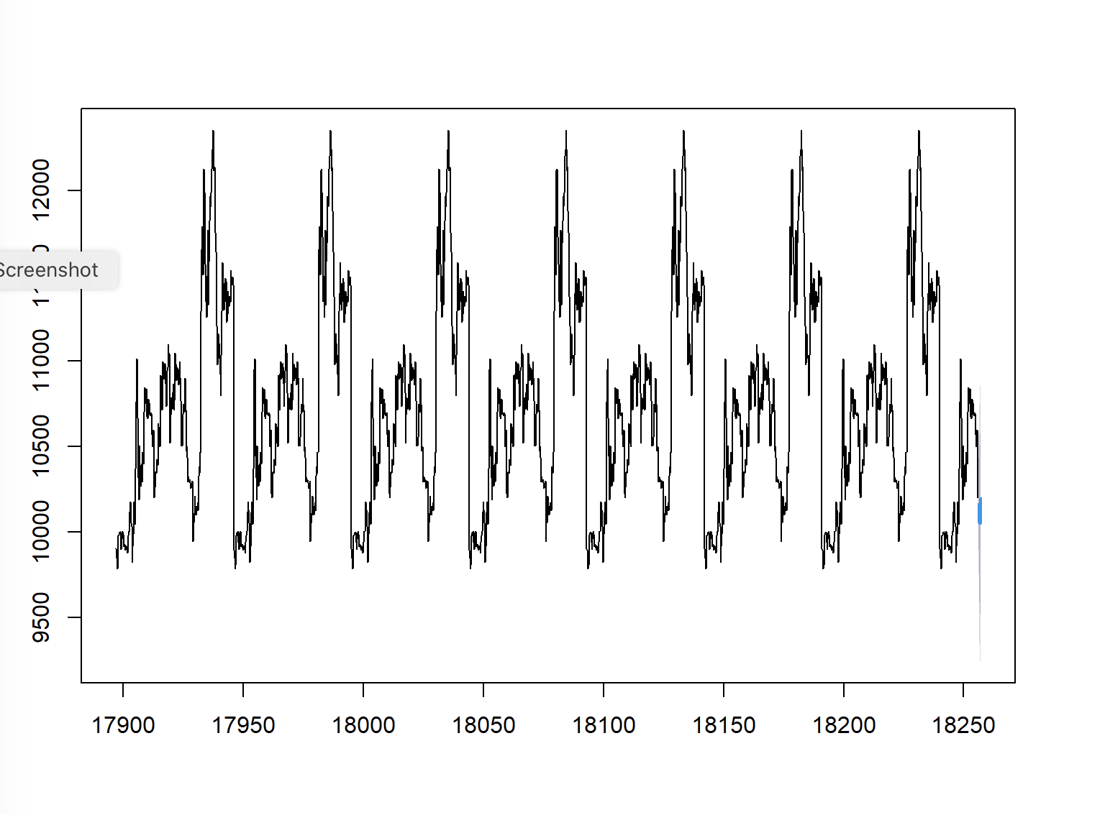
HOLT’S WINTER OUT OF SAMPLE FORECAST PLOT
plot(fit1_fcast_no_holdout, main=" ") lines(ts(df$Close))

Slide 32
HOLT’S WINTER OUT OF SAMPLE FORECAST SUMMARY
summary(fit1_fcast_no_holdout)
## ## Forecast method: HoltWinters ## ## Model Information: ## Holt-Winters exponential smoothing with trend and multiplicative seasonal component. ## ## Call: ## HoltWinters(x = y, seasonal = "mult") ## ## Smoothing parameters: ## alpha: 1 ## beta : 0.002551137 ## gamma: 0 ## ## Coefficients: ## [,1] ## a 10122.4266573 ## b -1.2258295 ## s1 1.0041003 ## s2 1.0013849 ## s3 0.9931492 ## s4 0.9933415 ## s5 1.0080241 ## ## Error measures: ## ME RMSE MAE MPE MAPE MASE ## Training set -7.08693 206.5953 134.375 -0.07945612 1.245765 0.5230799 ## ACF1 ## Training set 0.06624685 ## ## Forecasts: ## Point Forecast Lo 80 Hi 80 Lo 95 Hi 95 ## 18256.20 10162.70 9898.021 10427.38 9757.907 10567.50 ## 18256.40 10133.99 9759.705 10508.27 9561.570 10706.41 ## 18256.60 10049.43 9592.751 10506.10 9351.002 10747.85 ## 18256.80 10050.16 9521.239 10579.07 9241.247 10859.06 ## 18257.00 10197.47 9617.021 10777.92 9309.749 11085.19

Slide 33
COMPARISON BETWEEN ARIMA AND EXPONENTIAL SMOOTHING
 | In Sample |  |  | Out of Sample
PARAMETERS | MAPE | RMSE | AIC | MAPE | RMSE | AIC
ARIMA | 0.979248 | 148.2991 | 3103.98 | 0.986987 | 149.1397 | 3042.55
SES | 0.895625 | 144.0453 | 3789.171 | 0.907302 | 145.3707 | 3711.513
HOLT | 0.899915 | 143.9233 | 3792.752 | 0.912376 | 145.2359 | 3714.966
HOLT-Winter Filtering | NA | NA | NA | 1.245765 | 206.5953 | NA

Slide 34
THANK YOU

