Slide 1
PRA Group Assignment
Group - 5

Slide 2
Loading libraries and data
## Registered S3 method overwritten by 'quantmod': ## method from ## as.zoo.data.frame zoo
## Loading required package: parallel
## ## Attaching package: 'rugarch'
## The following object is masked from 'package:stats': ## ## sigma
## 'data.frame': 245 obs. of 2 variables: ## $ Date : chr "01-Jan-19" "02-Jan-19" "03-Jan-19" "04-Jan-19" ... ## $ Close.Price: num 9904 9895 9850 9785 9804 ...
## [1] 0
## [1] 245

Slide 3
ARIMA modelling
#Plots: Graphs, ACF and PACF------- ##Identification: TREND: Level tsdisplay(df$Close, lag=50) #Graph, ACF, PACF

Slide 4
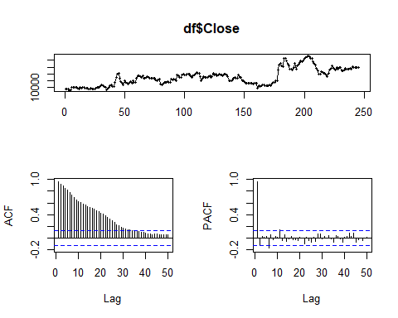

Slide 5
##Unit Root Tests: Trend ----------- k = trunc(length(df$Close)-1)^(1/3) #k= number of lags k
## [1] 6.2488
adf.test(df$Close, alternative="stationary", k=6) #Trend Non-stationarity
## ## Augmented Dickey-Fuller Test ## ## data: df$Close ## Dickey-Fuller = -3.2543, Lag order = 6, p-value = 0.07941 ## alternative hypothesis: stationary
adf.test(df$Close, alternative="stationary", k=12)
## ## Augmented Dickey-Fuller Test ## ## data: df$Close ## Dickey-Fuller = -2.4947, Lag order = 12, p-value = 0.3677 ## alternative hypothesis: stationary
##Identification: First Difference/Trend Differencing tsdisplay(diff(df$Close,1), lag=50) #Graph, ACF, PACF

Slide 6
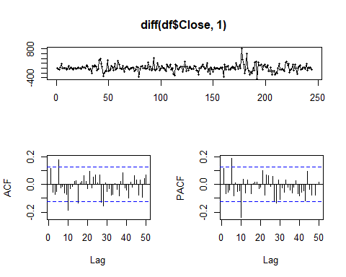

Slide 7
k = trunc((length(diff(df$Close,1))-1)^(1/3)) k
## [1] 6
adf.test(diff(df$Close,1), alternative="stationary", k=6)
## Warning in adf.test(diff(df$Close, 1), alternative = "stationary", k = 6): p- ## value smaller than printed p-value
## ## Augmented Dickey-Fuller Test ## ## data: diff(df$Close, 1) ## Dickey-Fuller = -5.5104, Lag order = 6, p-value = 0.01 ## alternative hypothesis: stationary
adf.test(diff(df$Close,5), alternative="stationary", k=6)
## Warning in adf.test(diff(df$Close, 5), alternative = "stationary", k = 6): p- ## value smaller than printed p-value
## ## Augmented Dickey-Fuller Test ## ## data: diff(df$Close, 5) ## Dickey-Fuller = -5.3472, Lag order = 6, p-value = 0.01 ## alternative hypothesis: stationary
##Identification: SEASONAL: Seasonal Differencing tsdisplay(diff(df$Close,5), lag=50) #Graph, ACF, PACF

Slide 8
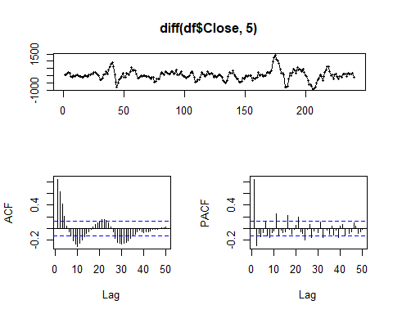

Slide 9
##Estimation fit <- Arima(df$Close, order=c(1,0,1), seasonal = list(order = c(4, 1, 0), period=5)) summary(fit)
## Series: df$Close ## ARIMA(1,0,1)(4,1,0)[5] ## ## Coefficients: ## ar1 ma1 sar1 sar2 sar3 sar4 ## 0.8827 0.1916 -0.4621 -0.5062 -0.3223 -0.1898 ## s.e. 0.0354 0.0719 0.0682 0.0691 0.0685 0.0646 ## ## sigma^2 estimated as 23026: log likelihood=-1544.99 ## AIC=3103.98 AICc=3104.47 BIC=3128.35 ## ## Training set error measures: ## ME RMSE MAE MPE MAPE MASE ACF1 ## Training set 7.906678 148.2991 106.305 0.06555591 0.9792476 1.08536 0.003728149
##Diagnostics #windows() tsdisplay(fit$residuals)

Slide 10
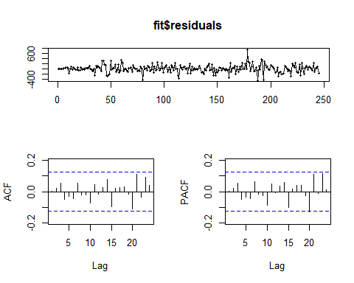

Slide 11
Box.test(residuals(fit), lag=10, fitdf=6, type="Ljung")
## ## Box-Ljung test ## ## data: residuals(fit) ## X-squared = 4.5058, df = 4, p-value = 0.3419
tsdiag(fit)

Slide 12
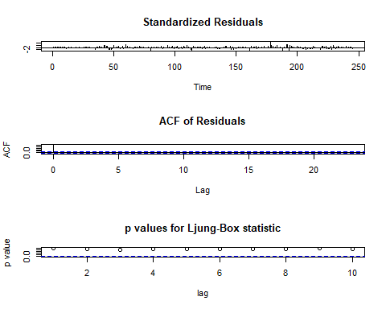

Slide 13
Normality test and ARCH test on residuals from best ARIMA model
#Normality Test jarque.bera.test(fit$residuals)
## ## Jarque Bera Test ## ## data: fit$residuals ## X-squared = 90.096, df = 2, p-value < 0.00000000000000022
#GARCH ESTIMATION #archTest archTest(fit$residuals, lag=30) #long-term
## Q(m) of squared series(LM test): ## Test statistic: 48.18914 p-value: 0.01898068 ## Rank-based Test: ## Test statistic: 60.95393 p-value: 0.0007045919
archTest(fit$residuals, lag=20) #20 day
## Q(m) of squared series(LM test): ## Test statistic: 40.44114 p-value: 0.004391445 ## Rank-based Test: ## Test statistic: 55.77804 p-value: 0.00003139211
archTest(fit$residuals, lag=10) #medium-term
## Q(m) of squared series(LM test): ## Test statistic: 22.41714 p-value: 0.01311498 ## Rank-based Test: ## Test statistic: 39.42998 p-value: 0.00002134286
archTest(fit$residuals, lag=5) #short-term
## Q(m) of squared series(LM test): ## Test statistic: 14.71594 p-value: 0.0116476 ## Rank-based Test: ## Test statistic: 31.44215 p-value: 0.000007660484

Slide 14
Specifyig GARCH models
#GARCH Specification - sGARCH ug_spec1_1 <- ugarchspec(variance.model = list(model = "sGARCH", garchOrder = c(1, 1), submodel = NULL, external.regressors = NULL, variance.targeting = FALSE), mean.model = list(armaOrder=c(0,0), include.mean = FALSE), distribution.model ="std") ug_spec1_2 <- ugarchspec(variance.model = list(model = "sGARCH", garchOrder = c(1, 1), submodel = NULL, external.regressors = NULL, variance.targeting = FALSE), mean.model = list(armaOrder=c(0,0), include.mean = FALSE), distribution.model ="sstd") ug_spec1_3 <- ugarchspec(variance.model = list(model = "sGARCH", garchOrder = c(1, 1), submodel = NULL, external.regressors = NULL, variance.targeting = FALSE), mean.model = list(armaOrder=c(0,0), include.mean = FALSE), distribution.model ="ged") # eGARCH failed to converge #GARCH Specification - gjrGARCH ug_spec2_1 <- ugarchspec(variance.model = list(model = "gjrGARCH", garchOrder = c(1, 1), submodel = NULL, external.regressors = NULL, variance.targeting = FALSE), mean.model = list(armaOrder=c(0,0), include.mean = FALSE), distribution.model ="std") ug_spec2_2 <- ugarchspec(variance.model = list(model = "gjrGARCH", garchOrder = c(1, 1), submodel = NULL, external.regressors = NULL, variance.targeting = FALSE), mean.model = list(armaOrder=c(0,0), include.mean = FALSE), distribution.model ="sstd") ug_spec2_3 <- ugarchspec(variance.model = list(model = "gjrGARCH", garchOrder = c(1, 1), submodel = NULL, external.regressors = NULL, variance.targeting = FALSE), mean.model = list(armaOrder=c(0,0), include.mean = FALSE), distribution.model ="ged")

Slide 15
Fit GARCH models
ug_fit1 <- ugarchfit(spec=ug_spec1_1, data=fit$residuals) ug_fit2 <- ugarchfit(spec=ug_spec1_2, data=fit$residuals) ug_fit3 <- ugarchfit(spec=ug_spec1_3, data=fit$residuals) ug_fit4 <- ugarchfit(spec=ug_spec2_1, data=fit$residuals) ug_fit5 <- ugarchfit(spec=ug_spec2_2, data=fit$residuals) ug_fit6 <- ugarchfit(spec=ug_spec2_3, data=fit$residuals) ug_fit1
## ## *---------------------------------* ## * GARCH Model Fit * ## *---------------------------------* ## ## Conditional Variance Dynamics ## ----------------------------------- ## GARCH Model : sGARCH(1,1) ## Mean Model : ARFIMA(0,0,0) ## Distribution : std ## ## Optimal Parameters ## ------------------------------------ ## Estimate Std. Error t value Pr(>|t|) ## omega 1348.8370 4170.62556 0.32341 0.746382 ## alpha1 0.1769 0.12354 1.43196 0.152156 ## beta1 0.8221 0.29236 2.81197 0.004924 ## shape 3.3526 1.44022 2.32781 0.019922 ## ## Robust Standard Errors: ## Estimate Std. Error t value Pr(>|t|) ## omega 1348.8370 18759.83344 0.07190 0.94268 ## alpha1 0.1769 0.37896 0.46681 0.64063 ## beta1 0.8221 1.30742 0.62879 0.52948 ## shape 3.3526 5.63099 0.59538 0.55159 ## ## LogLikelihood : -1550.931 ## ## Information Criteria ## ------------------------------------ ## ## Akaike 12.693 ## Bayes 12.750 ## Shibata 12.693 ## Hannan-Quinn 12.716 ## ## Weighted Ljung-Box Test on Standardized Residuals ## ------------------------------------ ## statistic p-value ## Lag[1] 0.1668 0.6830 ## Lag[2*(p+q)+(p+q)-1][2] 0.3174 0.7861 ## Lag[4*(p+q)+(p+q)-1][5] 0.8112 0.9007 ## d.o.f=0 ## H0 : No serial correlation ## ## Weighted Ljung-Box Test on Standardized Squared Residuals ## ------------------------------------ ## statistic p-value ## Lag[1] 0.06464 0.7993 ## Lag[2*(p+q)+(p+q)-1][5] 0.78150 0.9068 ## Lag[4*(p+q)+(p+q)-1][9] 2.05566 0.8983 ## d.o.f=2 ## ## Weighted ARCH LM Tests ## ------------------------------------ ## Statistic Shape Scale P-Value ## ARCH Lag[3] 0.6004 0.500 2.000 0.4384 ## ARCH Lag[5] 1.4077 1.440 1.667 0.6169 ## ARCH Lag[7] 2.3133 2.315 1.543 0.6512 ## ## Nyblom stability test ## ------------------------------------ ## Joint Statistic: 1.811 ## Individual Statistics: ## omega 0.35208 ## alpha1 0.04076 ## beta1 0.14825 ## shape 0.34564 ## ## Asymptotic Critical Values (10% 5% 1%) ## Joint Statistic: 1.07 1.24 1.6 ## Individual Statistic: 0.35 0.47 0.75 ## ## Sign Bias Test ## ------------------------------------ ## t-value prob sig ## Sign Bias 1.8222 0.06967 * ## Negative Sign Bias 1.4457 0.14956 ## Positive Sign Bias 0.2207 0.82548 ## Joint Effect 4.6745 0.19724 ## ## ## Adjusted Pearson Goodness-of-Fit Test: ## ------------------------------------ ## group statistic p-value(g-1) ## 1 20 10.43 0.9416 ## 2 30 21.33 0.8470 ## 3 40 28.14 0.9013 ## 4 50 36.84 0.8996 ## ## ## Elapsed time : 0.1436219
ug_fit2
## ## *---------------------------------* ## * GARCH Model Fit * ## *---------------------------------* ## ## Conditional Variance Dynamics ## ----------------------------------- ## GARCH Model : sGARCH(1,1) ## Mean Model : ARFIMA(0,0,0) ## Distribution : sstd ## ## Optimal Parameters ## ------------------------------------ ## Estimate Std. Error t value Pr(>|t|) ## omega 1694.54101 8470.303275 0.20006 0.841436 ## alpha1 0.20139 0.157989 1.27469 0.202418 ## beta1 0.79761 0.573943 1.38971 0.164618 ## skew 0.93427 0.060766 15.37497 0.000000 ## shape 3.27660 1.490264 2.19867 0.027901 ## ## Robust Standard Errors: ## Estimate Std. Error t value Pr(>|t|) ## omega 1694.54101 64920.031446 0.026102 0.97918 ## alpha1 0.20139 1.473163 0.136704 0.89126 ## beta1 0.79761 4.402662 0.181166 0.85624 ## skew 0.93427 0.078345 11.925156 0.00000 ## shape 3.27660 12.811676 0.255751 0.79814 ## ## LogLikelihood : -1550.386 ## ## Information Criteria ## ------------------------------------ ## ## Akaike 12.697 ## Bayes 12.768 ## Shibata 12.696 ## Hannan-Quinn 12.726 ## ## Weighted Ljung-Box Test on Standardized Residuals ## ------------------------------------ ## statistic p-value ## Lag[1] 0.1811 0.6704 ## Lag[2*(p+q)+(p+q)-1][2] 0.3123 0.7889 ## Lag[4*(p+q)+(p+q)-1][5] 0.7964 0.9038 ## d.o.f=0 ## H0 : No serial correlation ## ## Weighted Ljung-Box Test on Standardized Squared Residuals ## ------------------------------------ ## statistic p-value ## Lag[1] 0.1111 0.7389 ## Lag[2*(p+q)+(p+q)-1][5] 0.8462 0.8934 ## Lag[4*(p+q)+(p+q)-1][9] 2.1733 0.8833 ## d.o.f=2 ## ## Weighted ARCH LM Tests ## ------------------------------------ ## Statistic Shape Scale P-Value ## ARCH Lag[3] 0.5915 0.500 2.000 0.4418 ## ARCH Lag[5] 1.4307 1.440 1.667 0.6107 ## ARCH Lag[7] 2.3748 2.315 1.543 0.6383 ## ## Nyblom stability test ## ------------------------------------ ## Joint Statistic: 1.9652 ## Individual Statistics: ## omega 0.38880 ## alpha1 0.04223 ## beta1 0.13974 ## skew 0.06706 ## shape 0.36024 ## ## Asymptotic Critical Values (10% 5% 1%) ## Joint Statistic: 1.28 1.47 1.88 ## Individual Statistic: 0.35 0.47 0.75 ## ## Sign Bias Test ## ------------------------------------ ## t-value prob sig ## Sign Bias 1.8841 0.06076 * ## Negative Sign Bias 1.5324 0.12675 ## Positive Sign Bias 0.2645 0.79162 ## Joint Effect 5.1050 0.16427 ## ## ## Adjusted Pearson Goodness-of-Fit Test: ## ------------------------------------ ## group statistic p-value(g-1) ## 1 20 8.959 0.9742 ## 2 30 18.633 0.9303 ## 3 40 25.531 0.9525 ## 4 50 37.653 0.8810 ## ## ## Elapsed time : 0.148602
ug_fit3
## ## *---------------------------------* ## * GARCH Model Fit * ## *---------------------------------* ## ## Conditional Variance Dynamics ## ----------------------------------- ## GARCH Model : sGARCH(1,1) ## Mean Model : ARFIMA(0,0,0) ## Distribution : ged ## ## Optimal Parameters ## ------------------------------------ ## Estimate Std. Error t value Pr(>|t|) ## omega 1541.80136 2192.318588 0.70327 0.48189 ## alpha1 0.13720 0.091836 1.49397 0.13518 ## beta1 0.81438 0.157670 5.16513 0.00000 ## shape 1.05671 0.125945 8.39029 0.00000 ## ## Robust Standard Errors: ## Estimate Std. Error t value Pr(>|t|) ## omega 1541.80136 3667.29837 0.42042 0.674180 ## alpha1 0.13720 0.11099 1.23612 0.216415 ## beta1 0.81438 0.24688 3.29876 0.000971 ## shape 1.05671 0.16198 6.52387 0.000000 ## ## LogLikelihood : -1551.502 ## ## Information Criteria ## ------------------------------------ ## ## Akaike 12.698 ## Bayes 12.755 ## Shibata 12.697 ## Hannan-Quinn 12.721 ## ## Weighted Ljung-Box Test on Standardized Residuals ## ------------------------------------ ## statistic p-value ## Lag[1] 0.1487 0.6998 ## Lag[2*(p+q)+(p+q)-1][2] 0.2941 0.7990 ## Lag[4*(p+q)+(p+q)-1][5] 0.8046 0.9021 ## d.o.f=0 ## H0 : No serial correlation ## ## Weighted Ljung-Box Test on Standardized Squared Residuals ## ------------------------------------ ## statistic p-value ## Lag[1] 0.02552 0.8731 ## Lag[2*(p+q)+(p+q)-1][5] 0.69863 0.9232 ## Lag[4*(p+q)+(p+q)-1][9] 2.02224 0.9023 ## d.o.f=2 ## ## Weighted ARCH LM Tests ## ------------------------------------ ## Statistic Shape Scale P-Value ## ARCH Lag[3] 0.5271 0.500 2.000 0.4678 ## ARCH Lag[5] 1.3864 1.440 1.667 0.6227 ## ARCH Lag[7] 2.3322 2.315 1.543 0.6472 ## ## Nyblom stability test ## ------------------------------------ ## Joint Statistic: 1.0781 ## Individual Statistics: ## omega 0.32899 ## alpha1 0.07414 ## beta1 0.21047 ## shape 0.36880 ## ## Asymptotic Critical Values (10% 5% 1%) ## Joint Statistic: 1.07 1.24 1.6 ## Individual Statistic: 0.35 0.47 0.75 ## ## Sign Bias Test ## ------------------------------------ ## t-value prob sig ## Sign Bias 1.93400 0.05429 * ## Negative Sign Bias 1.38376 0.16772 ## Positive Sign Bias 0.02905 0.97685 ## Joint Effect 4.74066 0.19180 ## ## ## Adjusted Pearson Goodness-of-Fit Test: ## ------------------------------------ ## group statistic p-value(g-1) ## 1 20 10.10 0.9504 ## 2 30 22.55 0.7967 ## 3 40 29.78 0.8562 ## 4 50 49.90 0.4374 ## ## ## Elapsed time : 0.1426561
ug_fit4
## ## *---------------------------------* ## * GARCH Model Fit * ## *---------------------------------* ## ## Conditional Variance Dynamics ## ----------------------------------- ## GARCH Model : gjrGARCH(1,1) ## Mean Model : ARFIMA(0,0,0) ## Distribution : std ## ## Optimal Parameters ## ------------------------------------ ## Estimate Std. Error t value Pr(>|t|) ## omega 1284.071680 3083.21158 0.41647 0.677065 ## alpha1 0.197564 0.11733 1.68378 0.092224 ## beta1 0.830378 0.21990 3.77619 0.000159 ## gamma1 -0.057883 0.13136 -0.44065 0.659464 ## shape 3.357936 1.28731 2.60849 0.009094 ## ## Robust Standard Errors: ## Estimate Std. Error t value Pr(>|t|) ## omega 1284.071680 10921.17851 0.11758 0.90640 ## alpha1 0.197564 0.17924 1.10226 0.27035 ## beta1 0.830378 0.77133 1.07655 0.28168 ## gamma1 -0.057883 0.17945 -0.32256 0.74703 ## shape 3.357936 3.79501 0.88483 0.37625 ## ## LogLikelihood : -1550.834 ## ## Information Criteria ## ------------------------------------ ## ## Akaike 12.701 ## Bayes 12.772 ## Shibata 12.700 ## Hannan-Quinn 12.729 ## ## Weighted Ljung-Box Test on Standardized Residuals ## ------------------------------------ ## statistic p-value ## Lag[1] 0.2316 0.6303 ## Lag[2*(p+q)+(p+q)-1][2] 0.3775 0.7541 ## Lag[4*(p+q)+(p+q)-1][5] 0.8942 0.8831 ## d.o.f=0 ## H0 : No serial correlation ## ## Weighted Ljung-Box Test on Standardized Squared Residuals ## ------------------------------------ ## statistic p-value ## Lag[1] 0.0450 0.8320 ## Lag[2*(p+q)+(p+q)-1][5] 0.8402 0.8947 ## Lag[4*(p+q)+(p+q)-1][9] 2.1280 0.8892 ## d.o.f=2 ## ## Weighted ARCH LM Tests ## ------------------------------------ ## Statistic Shape Scale P-Value ## ARCH Lag[3] 0.6895 0.500 2.000 0.4063 ## ARCH Lag[5] 1.4987 1.440 1.667 0.5926 ## ARCH Lag[7] 2.4055 2.315 1.543 0.6320 ## ## Nyblom stability test ## ------------------------------------ ## Joint Statistic: 1.9832 ## Individual Statistics: ## omega 0.37493 ## alpha1 0.04822 ## beta1 0.16789 ## gamma1 0.11002 ## shape 0.36475 ## ## Asymptotic Critical Values (10% 5% 1%) ## Joint Statistic: 1.28 1.47 1.88 ## Individual Statistic: 0.35 0.47 0.75 ## ## Sign Bias Test ## ------------------------------------ ## t-value prob sig ## Sign Bias 1.7909 0.07456 * ## Negative Sign Bias 1.3120 0.19077 ## Positive Sign Bias 0.2834 0.77710 ## Joint Effect 4.6827 0.19656 ## ## ## Adjusted Pearson Goodness-of-Fit Test: ## ------------------------------------ ## group statistic p-value(g-1) ## 1 20 13.69 0.8012 ## 2 30 23.04 0.7747 ## 3 40 42.51 0.3223 ## 4 50 40.10 0.8136 ## ## ## Elapsed time : 0.396955
ug_fit5
## ## *---------------------------------* ## * GARCH Model Fit * ## *---------------------------------* ## ## Conditional Variance Dynamics ## ----------------------------------- ## GARCH Model : gjrGARCH(1,1) ## Mean Model : ARFIMA(0,0,0) ## Distribution : sstd ## ## Optimal Parameters ## ------------------------------------ ## Estimate Std. Error t value Pr(>|t|) ## omega 1550.288271 5272.264770 0.29405 0.768723 ## alpha1 0.210900 0.147556 1.42929 0.152920 ## beta1 0.810430 0.362598 2.23506 0.025413 ## gamma1 -0.046398 0.144618 -0.32083 0.748336 ## skew 0.935942 0.063079 14.83759 0.000000 ## shape 3.305901 1.462322 2.26072 0.023777 ## ## Robust Standard Errors: ## Estimate Std. Error t value Pr(>|t|) ## omega 1550.288271 27097.918149 0.057211 0.95438 ## alpha1 0.210900 0.460641 0.457841 0.64707 ## beta1 0.810430 1.858400 0.436090 0.66277 ## gamma1 -0.046398 0.299784 -0.154772 0.87700 ## skew 0.935942 0.086924 10.767357 0.00000 ## shape 3.305901 6.456326 0.512041 0.60862 ## ## LogLikelihood : -1550.335 ## ## Information Criteria ## ------------------------------------ ## ## Akaike 12.705 ## Bayes 12.791 ## Shibata 12.704 ## Hannan-Quinn 12.739 ## ## Weighted Ljung-Box Test on Standardized Residuals ## ------------------------------------ ## statistic p-value ## Lag[1] 0.2194 0.6395 ## Lag[2*(p+q)+(p+q)-1][2] 0.3516 0.7676 ## Lag[4*(p+q)+(p+q)-1][5] 0.8549 0.8915 ## d.o.f=0 ## H0 : No serial correlation ## ## Weighted Ljung-Box Test on Standardized Squared Residuals ## ------------------------------------ ## statistic p-value ## Lag[1] 0.08182 0.7749 ## Lag[2*(p+q)+(p+q)-1][5] 0.86851 0.8887 ## Lag[4*(p+q)+(p+q)-1][9] 2.19479 0.8805 ## d.o.f=2 ## ## Weighted ARCH LM Tests ## ------------------------------------ ## Statistic Shape Scale P-Value ## ARCH Lag[3] 0.6577 0.500 2.000 0.4174 ## ARCH Lag[5] 1.4814 1.440 1.667 0.5972 ## ARCH Lag[7] 2.4237 2.315 1.543 0.6282 ## ## Nyblom stability test ## ------------------------------------ ## Joint Statistic: 2.1243 ## Individual Statistics: ## omega 0.39456 ## alpha1 0.04550 ## beta1 0.15048 ## gamma1 0.10429 ## skew 0.06612 ## shape 0.37104 ## ## Asymptotic Critical Values (10% 5% 1%) ## Joint Statistic: 1.49 1.68 2.12 ## Individual Statistic: 0.35 0.47 0.75 ## ## Sign Bias Test ## ------------------------------------ ## t-value prob sig ## Sign Bias 1.8420 0.0667 * ## Negative Sign Bias 1.4085 0.1603 ## Positive Sign Bias 0.3012 0.7635 ## Joint Effect 4.9770 0.1735 ## ## ## Adjusted Pearson Goodness-of-Fit Test: ## ------------------------------------ ## group statistic p-value(g-1) ## 1 20 6.02 0.9979 ## 2 30 15.69 0.9788 ## 3 40 25.86 0.9475 ## 4 50 47.86 0.5195 ## ## ## Elapsed time : 0.652786
ug_fit6
## ## *---------------------------------* ## * GARCH Model Fit * ## *---------------------------------* ## ## Conditional Variance Dynamics ## ----------------------------------- ## GARCH Model : gjrGARCH(1,1) ## Mean Model : ARFIMA(0,0,0) ## Distribution : ged ## ## Optimal Parameters ## ------------------------------------ ## Estimate Std. Error t value Pr(>|t|) ## omega 1529.783258 1909.48730 0.80115 0.42305 ## alpha1 0.164575 0.10210 1.61190 0.10698 ## beta1 0.823306 0.13995 5.88277 0.00000 ## gamma1 -0.082734 0.10731 -0.77097 0.44072 ## shape 1.073341 0.13004 8.25407 0.00000 ## ## Robust Standard Errors: ## Estimate Std. Error t value Pr(>|t|) ## omega 1529.783258 2970.426638 0.51501 0.606550 ## alpha1 0.164575 0.102876 1.59974 0.109655 ## beta1 0.823306 0.204768 4.02067 0.000058 ## gamma1 -0.082734 0.091601 -0.90320 0.366419 ## shape 1.073341 0.160796 6.67516 0.000000 ## ## LogLikelihood : -1551.221 ## ## Information Criteria ## ------------------------------------ ## ## Akaike 12.704 ## Bayes 12.775 ## Shibata 12.703 ## Hannan-Quinn 12.733 ## ## Weighted Ljung-Box Test on Standardized Residuals ## ------------------------------------ ## statistic p-value ## Lag[1] 0.2603 0.6099 ## Lag[2*(p+q)+(p+q)-1][2] 0.3925 0.7463 ## Lag[4*(p+q)+(p+q)-1][5] 0.9412 0.8728 ## d.o.f=0 ## H0 : No serial correlation ## ## Weighted Ljung-Box Test on Standardized Squared Residuals ## ------------------------------------ ## statistic p-value ## Lag[1] 0.00415 0.9486 ## Lag[2*(p+q)+(p+q)-1][5] 0.78751 0.9056 ## Lag[4*(p+q)+(p+q)-1][9] 2.13961 0.8877 ## d.o.f=2 ## ## Weighted ARCH LM Tests ## ------------------------------------ ## Statistic Shape Scale P-Value ## ARCH Lag[3] 0.6609 0.500 2.000 0.4163 ## ARCH Lag[5] 1.5052 1.440 1.667 0.5909 ## ARCH Lag[7] 2.4769 2.315 1.543 0.6172 ## ## Nyblom stability test ## ------------------------------------ ## Joint Statistic: 1.2677 ## Individual Statistics: ## omega 0.36307 ## alpha1 0.09217 ## beta1 0.23844 ## gamma1 0.16082 ## shape 0.40861 ## ## Asymptotic Critical Values (10% 5% 1%) ## Joint Statistic: 1.28 1.47 1.88 ## Individual Statistic: 0.35 0.47 0.75 ## ## Sign Bias Test ## ------------------------------------ ## t-value prob sig ## Sign Bias 1.8923 0.05965 * ## Negative Sign Bias 1.1060 0.26981 ## Positive Sign Bias 0.1187 0.90562 ## Joint Effect 4.8712 0.18148 ## ## ## Adjusted Pearson Goodness-of-Fit Test: ## ------------------------------------ ## group statistic p-value(g-1) ## 1 20 8.469 0.9813 ## 2 30 26.224 0.6135 ## 3 40 35.000 0.6529 ## 4 50 47.449 0.5362 ## ## ## Elapsed time : 0.619298

Slide 16
Estimated conditional variance
ug_var1 <- ug_fit1@fit$var ug_var2 <- ug_fit2@fit$var ug_var3 <- ug_fit3@fit$var ug_var4 <- ug_fit4@fit$var ug_var5 <- ug_fit5@fit$var ug_var6 <- ug_fit6@fit$var #ARIMA RESIDUALS/ACTUAL variance ug_res <- (fit$residuals)^2

Slide 17
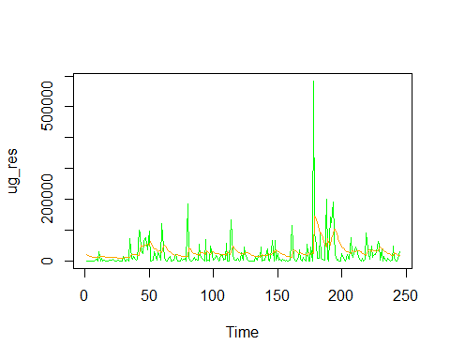
Actual Variance plot for best model

Slide 18
## integer(0)

