Slide 1
PRA Group Assignment
Group - 5

Slide 2
Loading libraries and data
## Registered S3 method overwritten by 'quantmod': ## method from ## as.zoo.data.frame zoo

Slide 3
ARIMA modelling
str(df)
## 'data.frame': 245 obs. of 2 variables: ## $ Date : chr "01-Jan-19" "02-Jan-19" "03-Jan-19" "04-Jan-19" ... ## $ Close.Price: num 9904 9895 9850 9785 9804 ...
sum(is.na(df))
## [1] 0
nrow(df)
## [1] 245
#Plots: Graphs, ACF and PACF------- ##Identification: TREND: Level tsdisplay(df$Close, lag=50) #Graph, ACF, PACF

Slide 4
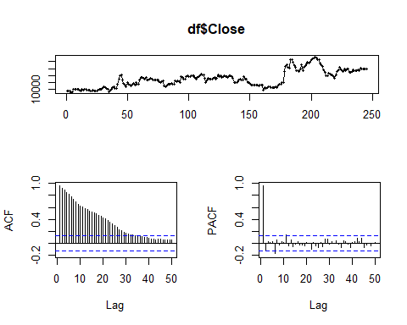

Slide 5
##Unit Root Tests: Trend ----------- k = trunc(length(df$Close)-1)^(1/3) #k= number of lags k
## [1] 6.2488
adf.test(df$Close, alternative="stationary", k=6) #Trend Non-stationarity
## ## Augmented Dickey-Fuller Test ## ## data: df$Close ## Dickey-Fuller = -3.2543, Lag order = 6, p-value = 0.07941 ## alternative hypothesis: stationary
adf.test(df$Close, alternative="stationary", k=12)
## ## Augmented Dickey-Fuller Test ## ## data: df$Close ## Dickey-Fuller = -2.4947, Lag order = 12, p-value = 0.3677 ## alternative hypothesis: stationary
##Identification: First Difference/Trend Differencing tsdisplay(diff(df$Close,1), lag=50) #Graph, ACF, PACF

Slide 6
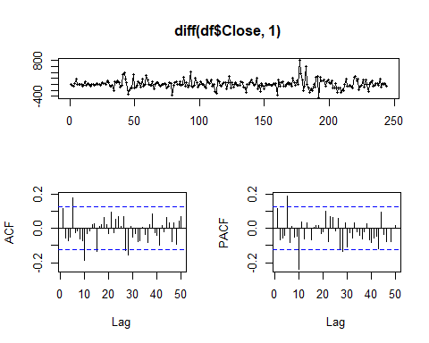

Slide 7
k = trunc((length(diff(df$Close,1))-1)^(1/3)) k
## [1] 6
adf.test(diff(df$Close,1), alternative="stationary", k=6)
## Warning in adf.test(diff(df$Close, 1), alternative = "stationary", k = 6): p- ## value smaller than printed p-value
## ## Augmented Dickey-Fuller Test ## ## data: diff(df$Close, 1) ## Dickey-Fuller = -5.5104, Lag order = 6, p-value = 0.01 ## alternative hypothesis: stationary
adf.test(diff(df$Close,5), alternative="stationary", k=6)
## Warning in adf.test(diff(df$Close, 5), alternative = "stationary", k = 6): p- ## value smaller than printed p-value
## ## Augmented Dickey-Fuller Test ## ## data: diff(df$Close, 5) ## Dickey-Fuller = -5.3472, Lag order = 6, p-value = 0.01 ## alternative hypothesis: stationary
##Identification: SEASONAL: Seasonal Differencing tsdisplay(diff(df$Close,5), lag=50) #Graph, ACF, PACF

Slide 8
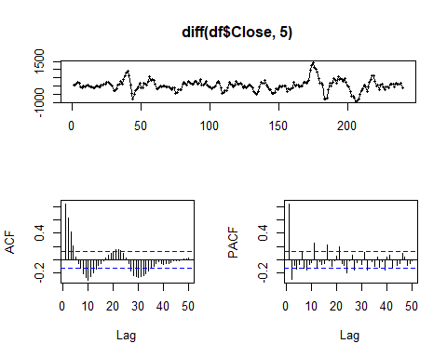

Slide 9
##Estimation fit1 <- Arima(df$Close, order=c(1,0,0), seasonal = list(order = c(1, 1, 1), period=5)) summary(fit1)
## Series: df$Close ## ARIMA(1,0,0)(1,1,1)[5] ## ## Coefficients: ## ar1 sar1 sma1 ## 0.9715 0.1935 -0.9998 ## s.e. 0.0196 0.0665 0.0367 ## ## sigma^2 estimated as 20086: log likelihood=-1536.45 ## AIC=3080.89 AICc=3081.06 BIC=3094.82 ## ## Training set error measures: ## ME RMSE MAE MPE MAPE MASE ACF1 ## Training set 14.67519 139.3936 95.55947 0.1264896 0.8771299 0.9756495 0.1422398
fit2 <- Arima(df$Close, order=c(1,0,1), seasonal = list(order = c(4, 1, 0), period=5)) summary(fit2)
## Series: df$Close ## ARIMA(1,0,1)(4,1,0)[5] ## ## Coefficients: ## ar1 ma1 sar1 sar2 sar3 sar4 ## 0.8827 0.1916 -0.4621 -0.5062 -0.3223 -0.1898 ## s.e. 0.0354 0.0719 0.0682 0.0691 0.0685 0.0646 ## ## sigma^2 estimated as 23026: log likelihood=-1544.99 ## AIC=3103.98 AICc=3104.47 BIC=3128.35 ## ## Training set error measures: ## ME RMSE MAE MPE MAPE MASE ACF1 ## Training set 7.906678 148.2991 106.305 0.06555591 0.9792476 1.08536 0.003728149
##Diagnostics Box.test(residuals(fit1), lag=5, fitdf=3, type="Ljung")
## ## Box-Ljung test ## ## data: residuals(fit1) ## X-squared = 6.7351, df = 2, p-value = 0.03447
b2<-tsdiag(fit1)

Slide 10
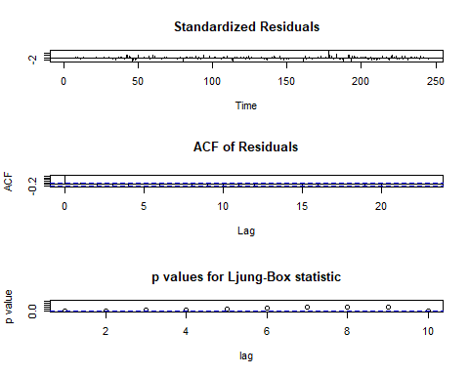

Slide 11
b2
## NULL
Box.test(residuals(fit2), lag=10, fitdf=6, type="Ljung")
## ## Box-Ljung test ## ## data: residuals(fit2) ## X-squared = 4.5058, df = 4, p-value = 0.3419
b2<-tsdiag(fit2)

Slide 12
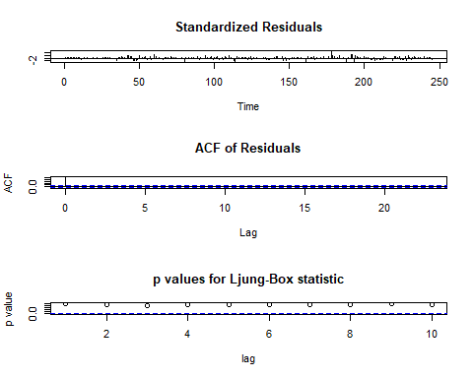

Slide 13
b2
## NULL

Slide 14
Exponential Smoothing
# Exponential smoothing ##Fit simple exponential smoothing model rel_ses <- ses(df$Close) summary(rel_ses)
## ## Forecast method: Simple exponential smoothing ## ## Model Information: ## Simple exponential smoothing ## ## Call: ## ses(y = df$Close) ## ## Smoothing parameters: ## alpha = 0.9999 ## ## Initial states: ## l = 9917.9666 ## ## sigma: 144.6369 ## ## AIC AICc BIC ## 3789.171 3789.271 3799.675 ## ## Error measures: ## ME RMSE MAE MPE MAPE MASE ## Training set 6.241598 144.0453 97.60369 0.04989359 0.8956246 0.9965207 ## ACF1 ## Training set 0.1162925 ## ## Forecasts: ## Point Forecast Lo 80 Hi 80 Lo 95 Hi 95 ## 246 11447 11261.65 11632.36 11163.52 11730.49 ## 247 11447 11184.88 11709.13 11046.12 11847.89 ## 248 11447 11125.97 11768.04 10956.03 11937.98 ## 249 11447 11076.31 11817.70 10880.08 12013.93 ## 250 11447 11032.56 11861.45 10813.17 12080.84 ## 251 11447 10993.01 11901.00 10752.67 12141.34 ## 252 11447 10956.63 11937.38 10697.04 12196.97 ## 253 11447 10922.77 11971.24 10645.26 12248.75 ## 254 11447 10890.98 12003.03 10596.63 12297.38 ## 255 11447 10860.90 12033.11 10550.63 12343.38
#Plot the forecasted values plot(rel_ses)

Slide 15
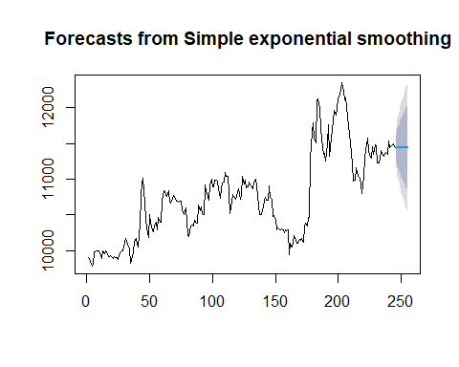

Slide 16
##Fit Holt exponential smoothing model rel_holt <- holt(df$Close) summary(rel_holt)
## ## Forecast method: Holt's method ## ## Model Information: ## Holt's method ## ## Call: ## holt(y = df$Close) ## ## Smoothing parameters: ## alpha = 0.9994 ## beta = 0.0001 ## ## Initial states: ## l = 9883.2012 ## b = 6.5095 ## ## sigma: 145.1118 ## ## AIC AICc BIC ## 3792.752 3793.003 3810.259 ## ## Error measures: ## ME RMSE MAE MPE MAPE MASE ## Training set -0.1331182 143.9223 98.01858 -0.009470692 0.8999148 1.000757 ## ACF1 ## Training set 0.1166371 ## ## Forecasts: ## Point Forecast Lo 80 Hi 80 Lo 95 Hi 95 ## 246 11453.54 11267.57 11639.51 11169.12 11737.95 ## 247 11460.05 11197.11 11722.98 11057.92 11862.17 ## 248 11466.55 11144.54 11788.56 10974.07 11959.03 ## 249 11473.06 11101.23 11844.89 10904.39 12041.72 ## 250 11479.56 11063.84 11895.29 10843.77 12115.36 ## 251 11486.07 11030.65 11941.49 10789.57 12182.57 ## 252 11492.58 11000.65 11984.50 10740.24 12244.91 ## 253 11499.08 10973.17 12024.99 10694.77 12303.40 ## 254 11505.59 10947.75 12063.43 10652.45 12358.73 ## 255 11512.09 10924.06 12100.13 10612.77 12411.42
#Plot the forecasted values plot(rel_holt)

Slide 17
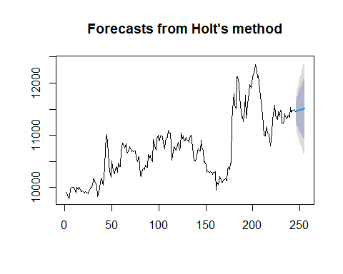

Slide 18
##Fit Holt-Winters exponential smoothing model ##Converting the df as Time Series y <- ts(data.matrix(df$Close), start = as.Date("2019-01-01"), end = as.Date ("2019-12-31"), frequency=5) y
## Time Series: ## Start = c(17897, 1) ## End = c(18261, 1) ## Frequency = 5 ## [1] 9903.75 9895.00 9850.00 9784.95 9804.20 9978.45 9982.45 9995.65 ## [9] 9998.50 9999.30 9939.75 9896.85 9996.95 9962.00 10003.15 9987.95 ## [17] 9914.85 9921.30 9928.85 9908.80 9892.60 9919.60 9908.75 9898.60 ## [25] 9877.10 9938.50 9977.90 10002.65 10004.45 10118.80 10177.15 10129.85 ## [33] 10055.95 10032.35 9821.60 9917.15 9988.60 10112.05 10174.85 10086.85 ## [41] 10046.20 10371.20 10762.60 10950.85 11013.15 10668.50 10446.00 10320.30 ## [49] 10187.60 10506.20 10395.40 10294.90 10268.80 10364.70 10400.70 10295.30 ## [57] 10465.05 10399.00 10398.05 10701.00 10843.95 10833.55 10791.20 10754.35 ## [65] 10836.35 10675.80 10665.40 10719.35 10777.45 10757.75 10688.75 10696.70 ## [73] 10683.35 10698.65 10695.90 10572.35 10500.80 10556.55 10595.50 10228.25 ## [81] 10203.65 10260.40 10348.90 10353.30 10346.80 10424.30 10391.45 10389.00 ## [89] 10635.40 10559.95 10615.20 10521.80 10501.30 10915.35 10847.30 10759.80 ## [97] 10713.85 10927.85 10996.00 10896.80 10900.40 10985.55 10983.00 10969.60 ## [105] 10869.20 10735.60 10873.05 10944.40 10961.65 11099.05 11041.85 11045.45 ## [113] 10817.95 10520.50 10684.55 10787.60 10765.25 10717.95 10754.50 10818.35 ## [121] 10866.40 10714.85 10771.60 11047.15 10929.65 10986.80 10887.70 10900.10 ## [129] 10962.80 10921.90 10901.35 10861.55 10951.10 10997.35 10903.15 10767.95 ## [137] 10506.15 10506.70 10503.20 10554.95 10692.05 10747.20 10702.00 10704.35 ## [145] 10902.35 10749.55 10715.35 10475.80 10498.70 10437.85 10295.50 10322.50 ## [153] 10293.20 10295.40 10308.10 10290.50 10254.80 10287.05 10279.55 10298.85 ## [161] 9944.30 10105.05 10054.90 10108.15 10209.40 10157.05 10101.85 10098.70 ## [169] 10152.05 10149.90 10171.90 10124.10 10326.75 10382.70 10346.10 10466.40 ## [177] 10466.75 11293.05 11652.95 11790.65 11578.95 11508.35 12119.50 12126.05 ## [185] 11989.40 11729.15 11569.70 11349.85 11363.00 11260.45 11499.65 11768.60 ## [193] 11329.40 11582.85 11693.80 11824.35 11967.40 11905.15 11987.45 12126.25 ## [201] 12199.70 12241.10 12355.25 12242.30 12115.80 12138.85 11881.40 11755.40 ## [209] 11639.70 11379.90 11207.90 10980.85 10988.40 11160.50 11107.05 11039.30 ## [217] 11016.65 10925.15 10801.40 11035.65 11292.65 11399.45 11576.85 11400.05 ## [225] 11334.55 11300.25 11455.85 11350.25 11486.25 11471.05 11229.65 11232.55 ## [233] 11277.05 11409.35 11358.75 11320.35 11349.95 11381.70 11348.85 11531.25 ## [241] 11442.50 11476.15 11481.80 11496.35 11447.00 9903.75 9895.00 9850.00 ## [249] 9784.95 9804.20 9978.45 9982.45 9995.65 9998.50 9999.30 9939.75 ## [257] 9896.85 9996.95 9962.00 10003.15 9987.95 9914.85 9921.30 9928.85 ## [265] 9908.80 9892.60 9919.60 9908.75 9898.60 9877.10 9938.50 9977.90 ## [273] 10002.65 10004.45 10118.80 10177.15 10129.85 10055.95 10032.35 9821.60 ## [281] 9917.15 9988.60 10112.05 10174.85 10086.85 10046.20 10371.20 10762.60 ## [289] 10950.85 11013.15 10668.50 10446.00 10320.30 10187.60 10506.20 10395.40 ## [297] 10294.90 10268.80 10364.70 10400.70 10295.30 10465.05 10399.00 10398.05 ## [305] 10701.00 10843.95 10833.55 10791.20 10754.35 10836.35 10675.80 10665.40 ## [313] 10719.35 10777.45 10757.75 10688.75 10696.70 10683.35 10698.65 10695.90 ## [321] 10572.35 10500.80 10556.55 10595.50 10228.25 10203.65 10260.40 10348.90 ## [329] 10353.30 10346.80 10424.30 10391.45 10389.00 10635.40 10559.95 10615.20 ## [337] 10521.80 10501.30 10915.35 10847.30 10759.80 10713.85 10927.85 10996.00 ## [345] 10896.80 10900.40 10985.55 10983.00 10969.60 10869.20 10735.60 10873.05 ## [353] 10944.40 10961.65 11099.05 11041.85 11045.45 10817.95 10520.50 10684.55 ## [361] 10787.60 10765.25 10717.95 10754.50 10818.35 10866.40 10714.85 10771.60 ## [369] 11047.15 10929.65 10986.80 10887.70 10900.10 10962.80 10921.90 10901.35 ## [377] 10861.55 10951.10 10997.35 10903.15 10767.95 10506.15 10506.70 10503.20 ## [385] 10554.95 10692.05 10747.20 10702.00 10704.35 10902.35 10749.55 10715.35 ## [393] 10475.80 10498.70 10437.85 10295.50 10322.50 10293.20 10295.40 10308.10 ## [401] 10290.50 10254.80 10287.05 10279.55 10298.85 9944.30 10105.05 10054.90 ## [409] 10108.15 10209.40 10157.05 10101.85 10098.70 10152.05 10149.90 10171.90 ## [417] 10124.10 10326.75 10382.70 10346.10 10466.40 10466.75 11293.05 11652.95 ## [425] 11790.65 11578.95 11508.35 12119.50 12126.05 11989.40 11729.15 11569.70 ## [433] 11349.85 11363.00 11260.45 11499.65 11768.60 11329.40 11582.85 11693.80 ## [441] 11824.35 11967.40 11905.15 11987.45 12126.25 12199.70 12241.10 12355.25 ## [449] 12242.30 12115.80 12138.85 11881.40 11755.40 11639.70 11379.90 11207.90 ## [457] 10980.85 10988.40 11160.50 11107.05 11039.30 11016.65 10925.15 10801.40 ## [465] 11035.65 11292.65 11399.45 11576.85 11400.05 11334.55 11300.25 11455.85 ## [473] 11350.25 11486.25 11471.05 11229.65 11232.55 11277.05 11409.35 11358.75 ## [481] 11320.35 11349.95 11381.70 11348.85 11531.25 11442.50 11476.15 11481.80 ## [489] 11496.35 11447.00 9903.75 9895.00 9850.00 9784.95 9804.20 9978.45 ## [497] 9982.45 9995.65 9998.50 9999.30 9939.75 9896.85 9996.95 9962.00 ## [505] 10003.15 9987.95 9914.85 9921.30 9928.85 9908.80 9892.60 9919.60 ## [513] 9908.75 9898.60 9877.10 9938.50 9977.90 10002.65 10004.45 10118.80 ## [521] 10177.15 10129.85 10055.95 10032.35 9821.60 9917.15 9988.60 10112.05 ## [529] 10174.85 10086.85 10046.20 10371.20 10762.60 10950.85 11013.15 10668.50 ## [537] 10446.00 10320.30 10187.60 10506.20 10395.40 10294.90 10268.80 10364.70 ## [545] 10400.70 10295.30 10465.05 10399.00 10398.05 10701.00 10843.95 10833.55 ## [553] 10791.20 10754.35 10836.35 10675.80 10665.40 10719.35 10777.45 10757.75 ## [561] 10688.75 10696.70 10683.35 10698.65 10695.90 10572.35 10500.80 10556.55 ## [569] 10595.50 10228.25 10203.65 10260.40 10348.90 10353.30 10346.80 10424.30 ## [577] 10391.45 10389.00 10635.40 10559.95 10615.20 10521.80 10501.30 10915.35 ## [585] 10847.30 10759.80 10713.85 10927.85 10996.00 10896.80 10900.40 10985.55 ## [593] 10983.00 10969.60 10869.20 10735.60 10873.05 10944.40 10961.65 11099.05 ## [601] 11041.85 11045.45 10817.95 10520.50 10684.55 10787.60 10765.25 10717.95 ## [609] 10754.50 10818.35 10866.40 10714.85 10771.60 11047.15 10929.65 10986.80 ## [617] 10887.70 10900.10 10962.80 10921.90 10901.35 10861.55 10951.10 10997.35 ## [625] 10903.15 10767.95 10506.15 10506.70 10503.20 10554.95 10692.05 10747.20 ## [633] 10702.00 10704.35 10902.35 10749.55 10715.35 10475.80 10498.70 10437.85 ## [641] 10295.50 10322.50 10293.20 10295.40 10308.10 10290.50 10254.80 10287.05 ## [649] 10279.55 10298.85 9944.30 10105.05 10054.90 10108.15 10209.40 10157.05 ## [657] 10101.85 10098.70 10152.05 10149.90 10171.90 10124.10 10326.75 10382.70 ## [665] 10346.10 10466.40 10466.75 11293.05 11652.95 11790.65 11578.95 11508.35 ## [673] 12119.50 12126.05 11989.40 11729.15 11569.70 11349.85 11363.00 11260.45 ## [681] 11499.65 11768.60 11329.40 11582.85 11693.80 11824.35 11967.40 11905.15 ## [689] 11987.45 12126.25 12199.70 12241.10 12355.25 12242.30 12115.80 12138.85 ## [697] 11881.40 11755.40 11639.70 11379.90 11207.90 10980.85 10988.40 11160.50 ## [705] 11107.05 11039.30 11016.65 10925.15 10801.40 11035.65 11292.65 11399.45 ## [713] 11576.85 11400.05 11334.55 11300.25 11455.85 11350.25 11486.25 11471.05 ## [721] 11229.65 11232.55 11277.05 11409.35 11358.75 11320.35 11349.95 11381.70 ## [729] 11348.85 11531.25 11442.50 11476.15 11481.80 11496.35 11447.00 9903.75 ## [737] 9895.00 9850.00 9784.95 9804.20 9978.45 9982.45 9995.65 9998.50 ## [745] 9999.30 9939.75 9896.85 9996.95 9962.00 10003.15 9987.95 9914.85 ## [753] 9921.30 9928.85 9908.80 9892.60 9919.60 9908.75 9898.60 9877.10 ## [761] 9938.50 9977.90 10002.65 10004.45 10118.80 10177.15 10129.85 10055.95 ## [769] 10032.35 9821.60 9917.15 9988.60 10112.05 10174.85 10086.85 10046.20 ## [777] 10371.20 10762.60 10950.85 11013.15 10668.50 10446.00 10320.30 10187.60 ## [785] 10506.20 10395.40 10294.90 10268.80 10364.70 10400.70 10295.30 10465.05 ## [793] 10399.00 10398.05 10701.00 10843.95 10833.55 10791.20 10754.35 10836.35 ## [801] 10675.80 10665.40 10719.35 10777.45 10757.75 10688.75 10696.70 10683.35 ## [809] 10698.65 10695.90 10572.35 10500.80 10556.55 10595.50 10228.25 10203.65 ## [817] 10260.40 10348.90 10353.30 10346.80 10424.30 10391.45 10389.00 10635.40 ## [825] 10559.95 10615.20 10521.80 10501.30 10915.35 10847.30 10759.80 10713.85 ## [833] 10927.85 10996.00 10896.80 10900.40 10985.55 10983.00 10969.60 10869.20 ## [841] 10735.60 10873.05 10944.40 10961.65 11099.05 11041.85 11045.45 10817.95 ## [849] 10520.50 10684.55 10787.60 10765.25 10717.95 10754.50 10818.35 10866.40 ## [857] 10714.85 10771.60 11047.15 10929.65 10986.80 10887.70 10900.10 10962.80 ## [865] 10921.90 10901.35 10861.55 10951.10 10997.35 10903.15 10767.95 10506.15 ## [873] 10506.70 10503.20 10554.95 10692.05 10747.20 10702.00 10704.35 10902.35 ## [881] 10749.55 10715.35 10475.80 10498.70 10437.85 10295.50 10322.50 10293.20 ## [889] 10295.40 10308.10 10290.50 10254.80 10287.05 10279.55 10298.85 9944.30 ## [897] 10105.05 10054.90 10108.15 10209.40 10157.05 10101.85 10098.70 10152.05 ## [905] 10149.90 10171.90 10124.10 10326.75 10382.70 10346.10 10466.40 10466.75 ## [913] 11293.05 11652.95 11790.65 11578.95 11508.35 12119.50 12126.05 11989.40 ## [921] 11729.15 11569.70 11349.85 11363.00 11260.45 11499.65 11768.60 11329.40 ## [929] 11582.85 11693.80 11824.35 11967.40 11905.15 11987.45 12126.25 12199.70 ## [937] 12241.10 12355.25 12242.30 12115.80 12138.85 11881.40 11755.40 11639.70 ## [945] 11379.90 11207.90 10980.85 10988.40 11160.50 11107.05 11039.30 11016.65 ## [953] 10925.15 10801.40 11035.65 11292.65 11399.45 11576.85 11400.05 11334.55 ## [961] 11300.25 11455.85 11350.25 11486.25 11471.05 11229.65 11232.55 11277.05 ## [969] 11409.35 11358.75 11320.35 11349.95 11381.70 11348.85 11531.25 11442.50 ## [977] 11476.15 11481.80 11496.35 11447.00 9903.75 9895.00 9850.00 9784.95 ## [985] 9804.20 9978.45 9982.45 9995.65 9998.50 9999.30 9939.75 9896.85 ## [993] 9996.95 9962.00 10003.15 9987.95 9914.85 9921.30 9928.85 9908.80 ## [1001] 9892.60 9919.60 9908.75 9898.60 9877.10 9938.50 9977.90 10002.65 ## [1009] 10004.45 10118.80 10177.15 10129.85 10055.95 10032.35 9821.60 9917.15 ## [1017] 9988.60 10112.05 10174.85 10086.85 10046.20 10371.20 10762.60 10950.85 ## [1025] 11013.15 10668.50 10446.00 10320.30 10187.60 10506.20 10395.40 10294.90 ## [1033] 10268.80 10364.70 10400.70 10295.30 10465.05 10399.00 10398.05 10701.00 ## [1041] 10843.95 10833.55 10791.20 10754.35 10836.35 10675.80 10665.40 10719.35 ## [1049] 10777.45 10757.75 10688.75 10696.70 10683.35 10698.65 10695.90 10572.35 ## [1057] 10500.80 10556.55 10595.50 10228.25 10203.65 10260.40 10348.90 10353.30 ## [1065] 10346.80 10424.30 10391.45 10389.00 10635.40 10559.95 10615.20 10521.80 ## [1073] 10501.30 10915.35 10847.30 10759.80 10713.85 10927.85 10996.00 10896.80 ## [1081] 10900.40 10985.55 10983.00 10969.60 10869.20 10735.60 10873.05 10944.40 ## [1089] 10961.65 11099.05 11041.85 11045.45 10817.95 10520.50 10684.55 10787.60 ## [1097] 10765.25 10717.95 10754.50 10818.35 10866.40 10714.85 10771.60 11047.15 ## [1105] 10929.65 10986.80 10887.70 10900.10 10962.80 10921.90 10901.35 10861.55 ## [1113] 10951.10 10997.35 10903.15 10767.95 10506.15 10506.70 10503.20 10554.95 ## [1121] 10692.05 10747.20 10702.00 10704.35 10902.35 10749.55 10715.35 10475.80 ## [1129] 10498.70 10437.85 10295.50 10322.50 10293.20 10295.40 10308.10 10290.50 ## [1137] 10254.80 10287.05 10279.55 10298.85 9944.30 10105.05 10054.90 10108.15 ## [1145] 10209.40 10157.05 10101.85 10098.70 10152.05 10149.90 10171.90 10124.10 ## [1153] 10326.75 10382.70 10346.10 10466.40 10466.75 11293.05 11652.95 11790.65 ## [1161] 11578.95 11508.35 12119.50 12126.05 11989.40 11729.15 11569.70 11349.85 ## [1169] 11363.00 11260.45 11499.65 11768.60 11329.40 11582.85 11693.80 11824.35 ## [1177] 11967.40 11905.15 11987.45 12126.25 12199.70 12241.10 12355.25 12242.30 ## [1185] 12115.80 12138.85 11881.40 11755.40 11639.70 11379.90 11207.90 10980.85 ## [1193] 10988.40 11160.50 11107.05 11039.30 11016.65 10925.15 10801.40 11035.65 ## [1201] 11292.65 11399.45 11576.85 11400.05 11334.55 11300.25 11455.85 11350.25 ## [1209] 11486.25 11471.05 11229.65 11232.55 11277.05 11409.35 11358.75 11320.35 ## [1217] 11349.95 11381.70 11348.85 11531.25 11442.50 11476.15 11481.80 11496.35 ## [1225] 11447.00 9903.75 9895.00 9850.00 9784.95 9804.20 9978.45 9982.45 ## [1233] 9995.65 9998.50 9999.30 9939.75 9896.85 9996.95 9962.00 10003.15 ## [1241] 9987.95 9914.85 9921.30 9928.85 9908.80 9892.60 9919.60 9908.75 ## [1249] 9898.60 9877.10 9938.50 9977.90 10002.65 10004.45 10118.80 10177.15 ## [1257] 10129.85 10055.95 10032.35 9821.60 9917.15 9988.60 10112.05 10174.85 ## [1265] 10086.85 10046.20 10371.20 10762.60 10950.85 11013.15 10668.50 10446.00 ## [1273] 10320.30 10187.60 10506.20 10395.40 10294.90 10268.80 10364.70 10400.70 ## [1281] 10295.30 10465.05 10399.00 10398.05 10701.00 10843.95 10833.55 10791.20 ## [1289] 10754.35 10836.35 10675.80 10665.40 10719.35 10777.45 10757.75 10688.75 ## [1297] 10696.70 10683.35 10698.65 10695.90 10572.35 10500.80 10556.55 10595.50 ## [1305] 10228.25 10203.65 10260.40 10348.90 10353.30 10346.80 10424.30 10391.45 ## [1313] 10389.00 10635.40 10559.95 10615.20 10521.80 10501.30 10915.35 10847.30 ## [1321] 10759.80 10713.85 10927.85 10996.00 10896.80 10900.40 10985.55 10983.00 ## [1329] 10969.60 10869.20 10735.60 10873.05 10944.40 10961.65 11099.05 11041.85 ## [1337] 11045.45 10817.95 10520.50 10684.55 10787.60 10765.25 10717.95 10754.50 ## [1345] 10818.35 10866.40 10714.85 10771.60 11047.15 10929.65 10986.80 10887.70 ## [1353] 10900.10 10962.80 10921.90 10901.35 10861.55 10951.10 10997.35 10903.15 ## [1361] 10767.95 10506.15 10506.70 10503.20 10554.95 10692.05 10747.20 10702.00 ## [1369] 10704.35 10902.35 10749.55 10715.35 10475.80 10498.70 10437.85 10295.50 ## [1377] 10322.50 10293.20 10295.40 10308.10 10290.50 10254.80 10287.05 10279.55 ## [1385] 10298.85 9944.30 10105.05 10054.90 10108.15 10209.40 10157.05 10101.85 ## [1393] 10098.70 10152.05 10149.90 10171.90 10124.10 10326.75 10382.70 10346.10 ## [1401] 10466.40 10466.75 11293.05 11652.95 11790.65 11578.95 11508.35 12119.50 ## [1409] 12126.05 11989.40 11729.15 11569.70 11349.85 11363.00 11260.45 11499.65 ## [1417] 11768.60 11329.40 11582.85 11693.80 11824.35 11967.40 11905.15 11987.45 ## [1425] 12126.25 12199.70 12241.10 12355.25 12242.30 12115.80 12138.85 11881.40 ## [1433] 11755.40 11639.70 11379.90 11207.90 10980.85 10988.40 11160.50 11107.05 ## [1441] 11039.30 11016.65 10925.15 10801.40 11035.65 11292.65 11399.45 11576.85 ## [1449] 11400.05 11334.55 11300.25 11455.85 11350.25 11486.25 11471.05 11229.65 ## [1457] 11232.55 11277.05 11409.35 11358.75 11320.35 11349.95 11381.70 11348.85 ## [1465] 11531.25 11442.50 11476.15 11481.80 11496.35 11447.00 9903.75 9895.00 ## [1473] 9850.00 9784.95 9804.20 9978.45 9982.45 9995.65 9998.50 9999.30 ## [1481] 9939.75 9896.85 9996.95 9962.00 10003.15 9987.95 9914.85 9921.30 ## [1489] 9928.85 9908.80 9892.60 9919.60 9908.75 9898.60 9877.10 9938.50 ## [1497] 9977.90 10002.65 10004.45 10118.80 10177.15 10129.85 10055.95 10032.35 ## [1505] 9821.60 9917.15 9988.60 10112.05 10174.85 10086.85 10046.20 10371.20 ## [1513] 10762.60 10950.85 11013.15 10668.50 10446.00 10320.30 10187.60 10506.20 ## [1521] 10395.40 10294.90 10268.80 10364.70 10400.70 10295.30 10465.05 10399.00 ## [1529] 10398.05 10701.00 10843.95 10833.55 10791.20 10754.35 10836.35 10675.80 ## [1537] 10665.40 10719.35 10777.45 10757.75 10688.75 10696.70 10683.35 10698.65 ## [1545] 10695.90 10572.35 10500.80 10556.55 10595.50 10228.25 10203.65 10260.40 ## [1553] 10348.90 10353.30 10346.80 10424.30 10391.45 10389.00 10635.40 10559.95 ## [1561] 10615.20 10521.80 10501.30 10915.35 10847.30 10759.80 10713.85 10927.85 ## [1569] 10996.00 10896.80 10900.40 10985.55 10983.00 10969.60 10869.20 10735.60 ## [1577] 10873.05 10944.40 10961.65 11099.05 11041.85 11045.45 10817.95 10520.50 ## [1585] 10684.55 10787.60 10765.25 10717.95 10754.50 10818.35 10866.40 10714.85 ## [1593] 10771.60 11047.15 10929.65 10986.80 10887.70 10900.10 10962.80 10921.90 ## [1601] 10901.35 10861.55 10951.10 10997.35 10903.15 10767.95 10506.15 10506.70 ## [1609] 10503.20 10554.95 10692.05 10747.20 10702.00 10704.35 10902.35 10749.55 ## [1617] 10715.35 10475.80 10498.70 10437.85 10295.50 10322.50 10293.20 10295.40 ## [1625] 10308.10 10290.50 10254.80 10287.05 10279.55 10298.85 9944.30 10105.05 ## [1633] 10054.90 10108.15 10209.40 10157.05 10101.85 10098.70 10152.05 10149.90 ## [1641] 10171.90 10124.10 10326.75 10382.70 10346.10 10466.40 10466.75 11293.05 ## [1649] 11652.95 11790.65 11578.95 11508.35 12119.50 12126.05 11989.40 11729.15 ## [1657] 11569.70 11349.85 11363.00 11260.45 11499.65 11768.60 11329.40 11582.85 ## [1665] 11693.80 11824.35 11967.40 11905.15 11987.45 12126.25 12199.70 12241.10 ## [1673] 12355.25 12242.30 12115.80 12138.85 11881.40 11755.40 11639.70 11379.90 ## [1681] 11207.90 10980.85 10988.40 11160.50 11107.05 11039.30 11016.65 10925.15 ## [1689] 10801.40 11035.65 11292.65 11399.45 11576.85 11400.05 11334.55 11300.25 ## [1697] 11455.85 11350.25 11486.25 11471.05 11229.65 11232.55 11277.05 11409.35 ## [1705] 11358.75 11320.35 11349.95 11381.70 11348.85 11531.25 11442.50 11476.15 ## [1713] 11481.80 11496.35 11447.00 9903.75 9895.00 9850.00 9784.95 9804.20 ## [1721] 9978.45 9982.45 9995.65 9998.50 9999.30 9939.75 9896.85 9996.95 ## [1729] 9962.00 10003.15 9987.95 9914.85 9921.30 9928.85 9908.80 9892.60 ## [1737] 9919.60 9908.75 9898.60 9877.10 9938.50 9977.90 10002.65 10004.45 ## [1745] 10118.80 10177.15 10129.85 10055.95 10032.35 9821.60 9917.15 9988.60 ## [1753] 10112.05 10174.85 10086.85 10046.20 10371.20 10762.60 10950.85 11013.15 ## [1761] 10668.50 10446.00 10320.30 10187.60 10506.20 10395.40 10294.90 10268.80 ## [1769] 10364.70 10400.70 10295.30 10465.05 10399.00 10398.05 10701.00 10843.95 ## [1777] 10833.55 10791.20 10754.35 10836.35 10675.80 10665.40 10719.35 10777.45 ## [1785] 10757.75 10688.75 10696.70 10683.35 10698.65 10695.90 10572.35 10500.80 ## [1793] 10556.55 10595.50 10228.25 10203.65 10260.40 10348.90 10353.30 10346.80 ## [1801] 10424.30 10391.45 10389.00 10635.40 10559.95 10615.20 10521.80 10501.30 ## [1809] 10915.35 10847.30 10759.80 10713.85 10927.85 10996.00 10896.80 10900.40 ## [1817] 10985.55 10983.00 10969.60 10869.20 10735.60
is.ts(y)
## [1] TRUE
str(y)
## Time-Series [1:1821] from 17897 to 18261: 9904 9895 9850 9785 9804 ...
##Fit with HoltWinters rel_hw <- HoltWinters(y, seasonal = "mult") rel_hw
## Holt-Winters exponential smoothing with trend and multiplicative seasonal component. ## ## Call: ## HoltWinters(x = y, seasonal = "mult") ## ## Smoothing parameters: ## alpha: 1 ## beta : 0.002521912 ## gamma: 0 ## ## Coefficients: ## [,1] ## a 10650.1422160 ## b 0.1295598 ## s1 1.0041003 ## s2 1.0013849 ## s3 0.9931492 ## s4 0.9933415 ## s5 1.0080241
pred <- predict(rel_hw, 50, prediction.interval = TRUE) plot(rel_hw, pred)

Slide 19
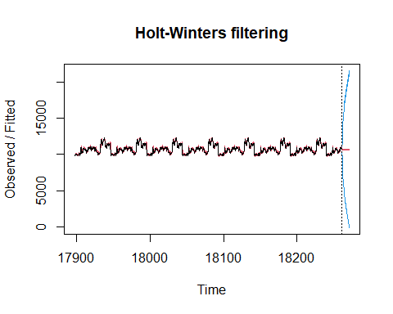

Slide 20
# OUT OF SAMPLE Forecast # For ARIMA hold <- window(ts(df$Close), start=241) fit1_no_holdout <- Arima(ts(df$Close[-c(241:245)]), order=c(1,0,1), seasonal = list(order = c(4, 1, 0), period = 5)) fit1_fcast_no_holdout <- forecast(fit1_no_holdout,h=5) plot(fit1_fcast_no_holdout, main=" ") lines(ts(df$Close))

Slide 21
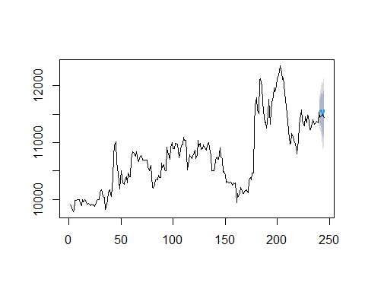

Slide 22
summary(fit1_fcast_no_holdout)
## ## Forecast method: ARIMA(1,0,1)(4,1,0)[5] ## ## Model Information: ## Series: ts(df$Close[-c(241:245)]) ## ARIMA(1,0,1)(4,1,0)[5] ## ## Coefficients: ## ar1 ma1 sar1 sar2 sar3 sar4 ## 0.8829 0.1997 -0.4533 -0.5095 -0.3277 -0.1940 ## s.e. 0.0359 0.0730 0.0690 0.0697 0.0693 0.0657 ## ## sigma^2 estimated as 23311: log likelihood=-1514.27 ## AIC=3042.55 AICc=3043.04 BIC=3066.77 ## ## Error measures: ## ME RMSE MAE MPE MAPE MASE ## Training set 8.698701 149.1397 107.0502 0.07252796 0.9869897 1.079239 ## ACF1 ## Training set 0.003540183 ## ## Forecasts: ## Point Forecast Lo 80 Hi 80 Lo 95 Hi 95 ## 241 11550.76 11355.09 11746.42 11251.51 11850.00 ## 242 11571.31 11282.94 11859.69 11130.29 12012.34 ## 243 11543.24 11199.53 11886.96 11017.58 12068.91 ## 244 11468.72 11087.40 11850.04 10885.55 12051.90 ## 245 11582.06 11173.83 11990.30 10957.72 12206.41
# For SES hold <- window(ts(df$Close), start=241) fit1_no_holdout <- ses(ts(df$Close[-c(241:245)])) fit1_fcast_no_holdout <- forecast(fit1_no_holdout,h=5) plot(fit1_fcast_no_holdout, main=" ") lines(ts(df$Close))

Slide 23


Slide 24
summary(fit1_fcast_no_holdout)
## ## Forecast method: Simple exponential smoothing ## ## Model Information: ## Simple exponential smoothing ## ## Call: ## ses(y = ts(df$Close[-c(241:245)])) ## ## Smoothing parameters: ## alpha = 0.9999 ## ## Initial states: ## l = 9917.9666 ## ## sigma: 145.9803 ## ## AIC AICc BIC ## 3711.411 3711.513 3721.853 ## ## Error measures: ## ME RMSE MAE MPE MAPE MASE ## Training set 6.722611 145.3707 98.83741 0.05400645 0.9073021 0.9964415 ## ACF1 ## Training set 0.1205099 ## ## Forecasts: ## Point Forecast Lo 80 Hi 80 Lo 95 Hi 95 ## 241 11531.23 11344.15 11718.31 11245.12 11817.35 ## 242 11531.23 11266.67 11795.79 11126.62 11935.84 ## 243 11531.23 11207.22 11855.24 11035.70 12026.77 ## 244 11531.23 11157.10 11905.37 10959.04 12103.42 ## 245 11531.23 11112.94 11949.52 10891.51 12170.96
# For HOLT hold <- window(ts(df$Close), start=241) fit1_no_holdout <- holt(ts(df$Close[-c(241:245)])) fit1_fcast_no_holdout <- forecast(fit1_no_holdout,h=5) plot(fit1_fcast_no_holdout, main=" ") lines(ts(df$Close))

Slide 25


Slide 26
summary(fit1_fcast_no_holdout)
## ## Forecast method: Holt's method ## ## Model Information: ## Holt's method ## ## Call: ## holt(y = ts(df$Close[-c(241:245)])) ## ## Smoothing parameters: ## alpha = 0.9989 ## beta = 0.0001 ## ## Initial states: ## l = 9885.2429 ## b = 7.0074 ## ## sigma: 146.4616 ## ## AIC AICc BIC ## 3714.966 3715.222 3732.369 ## ## Error measures: ## ME RMSE MAE MPE MAPE MASE ## Training set -0.1505809 145.2359 99.33422 -0.01010877 0.9123759 1.00145 ## ACF1 ## Training set 0.1213388 ## ## Forecasts: ## Point Forecast Lo 80 Hi 80 Lo 95 Hi 95 ## 241 11538.06 11350.36 11725.76 11251.00 11825.12 ## 242 11545.06 11279.75 11810.37 11139.30 11950.82 ## 243 11552.07 11227.17 11876.96 11055.18 12048.95 ## 244 11559.07 11183.93 11934.21 10985.34 12132.80 ## 245 11566.07 11146.66 11985.49 10924.63 12207.52
# For HOLT Winter hold <- window(ts(df$Close), start=241) y <- ts(data.matrix(df$Close), start = as.Date("2019-01-01"), end = as.Date ("2019-12-26"), frequency=5) fit1_no_holdout <- HoltWinters(y, seasonal = "mult")
## Warning in HoltWinters(y, seasonal = "mult"): optimization difficulties: ERROR: ## ABNORMAL_TERMINATION_IN_LNSRCH
fit1_fcast_no_holdout <- forecast(fit1_no_holdout,h=5) plot(fit1_fcast_no_holdout, main=" ") lines(ts(df$Close))

Slide 27
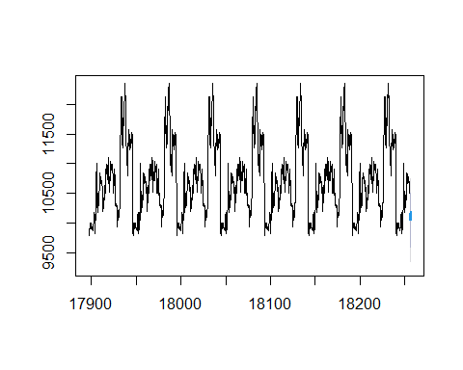

Slide 28
summary(fit1_fcast_no_holdout)
## ## Forecast method: HoltWinters ## ## Model Information: ## Holt-Winters exponential smoothing with trend and multiplicative seasonal component. ## ## Call: ## HoltWinters(x = y, seasonal = "mult") ## ## Smoothing parameters: ## alpha: 1 ## beta : 0.002551137 ## gamma: 0 ## ## Coefficients: ## [,1] ## a 10122.4266573 ## b -1.2258295 ## s1 1.0041003 ## s2 1.0013849 ## s3 0.9931492 ## s4 0.9933415 ## s5 1.0080241 ## ## Error measures: ## ME RMSE MAE MPE MAPE MASE ## Training set -7.08693 206.5953 134.375 -0.07945612 1.245765 0.5230799 ## ACF1 ## Training set 0.06624685 ## ## Forecasts: ## Point Forecast Lo 80 Hi 80 Lo 95 Hi 95 ## 18256.20 10162.70 9898.021 10427.38 9757.907 10567.50 ## 18256.40 10133.99 9759.705 10508.27 9561.570 10706.41 ## 18256.60 10049.43 9592.751 10506.10 9351.002 10747.85 ## 18256.80 10050.16 9521.239 10579.07 9241.247 10859.06 ## 18257.00 10197.47 9617.021 10777.92 9309.749 11085.19

