Slide 1

1000 Movies Data-Exploratory Data Analysis
By Souvik Sanyal

Slide 2
Introduction
Data set : 1000 movies data set
Goal : Find popular and successful movies/genre/actors/directors and finding different pattern in the movies data
Records : 1000 records with 12 columns
Rank
Title
Genre
Description
Director
Actors
Year
Runtime (Minutes)
Rating
Votes
Revenue (Millions)
Metascore

Slide 3
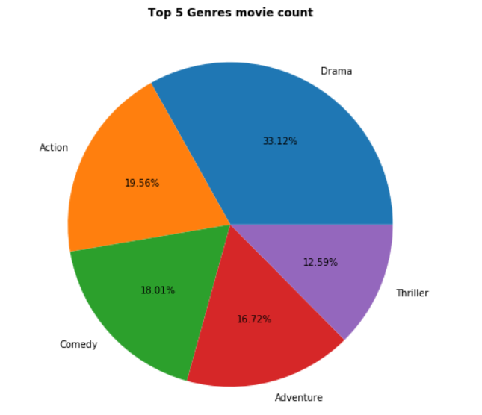
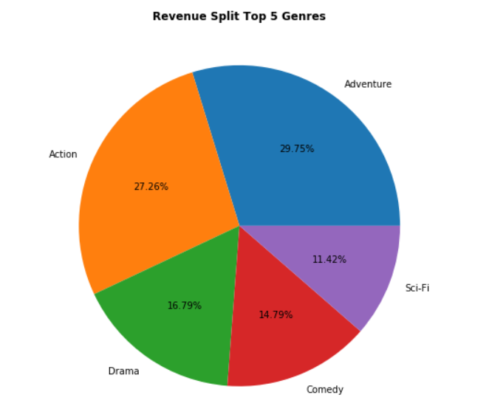
Top 5 genre based on movie count and revenue
It's pretty clear that Drama, Action, Comedy, Adventure and Thriller are the top 5 genre where most number of movies are made. We need to check other factors (revenue/popularity/rating etc.) behind the reason of their superiority.

Slide 4
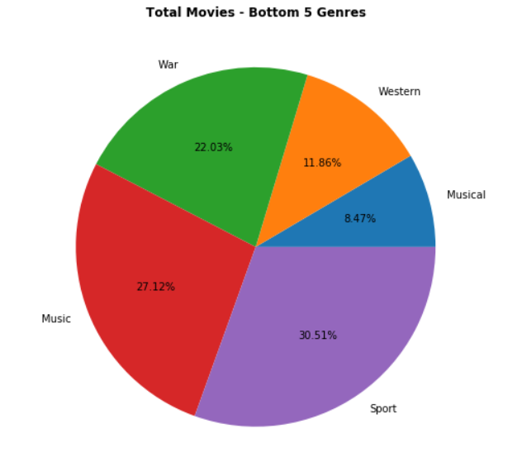
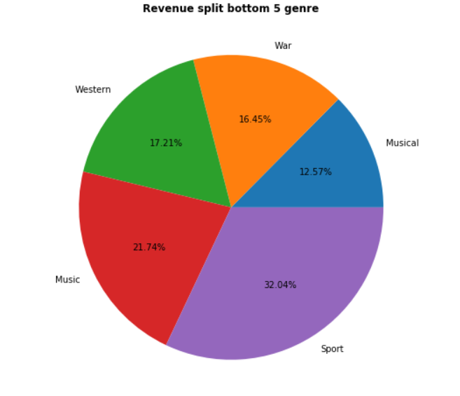
Bottom 5 genre based on movie count and revenue
Sports, Music, War, Western and Musical are bottom 5 genre.

Slide 5
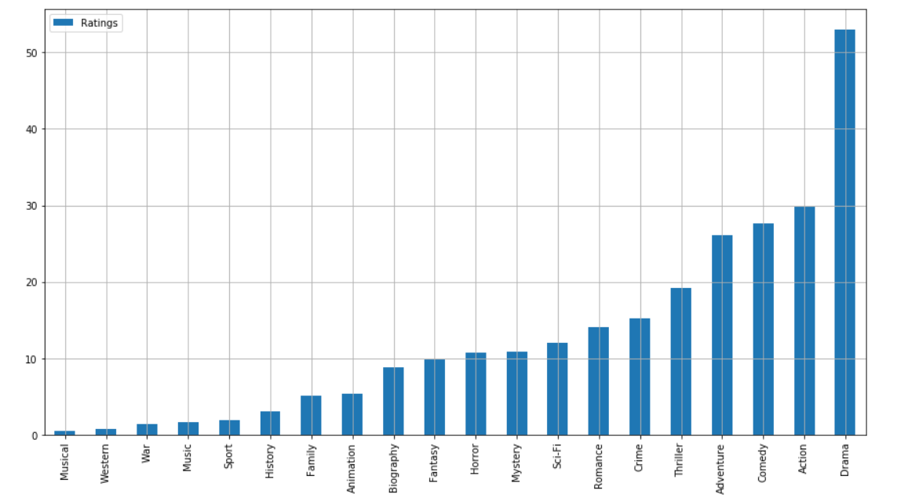
Movie rating distributed across genres
Drama tops the chart in terms of rating, followed by Action/Comedy/Adventure/Thriller.

Slide 6

Finding correlation amongst various category
Meta score and Rating has a highly positive correlation.
All the individual genres have high positive correlation between them
Surprisingly, revenue and rating does not have any correlation, which means a critically acclaimed movie might not generate high revenue and vice versa. Similarly revenue has a weak correlation with meta score and votes.
Rest of the categories seems to have weak correlation.

Slide 7
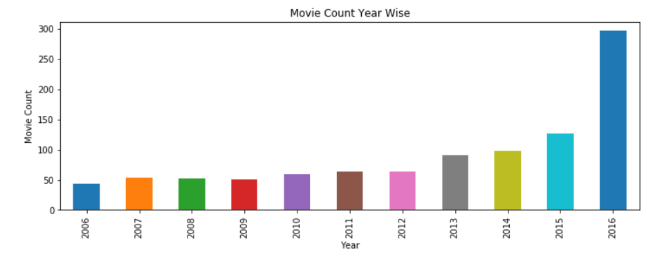
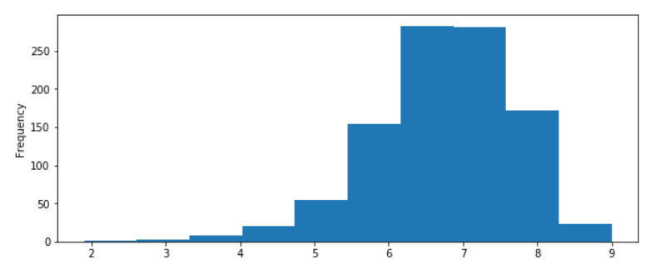
Movie produced per year and their rating distribution
Number of movie produced is getting increased every year. From 2006 till 2012 it was a steady number (50 and a bit above), 2013 onwards the numbers are increased drastically. But there is a sudden jump in movie numbers from 2015 to 2016 (almost double). Probably it indicates the website is getting popular and more movie data is getting recorded 2013 onwards.
Most of the movies fall between average rating 6 to 8, which can be termed as decent movies.
Movie rating distribution

Slide 8
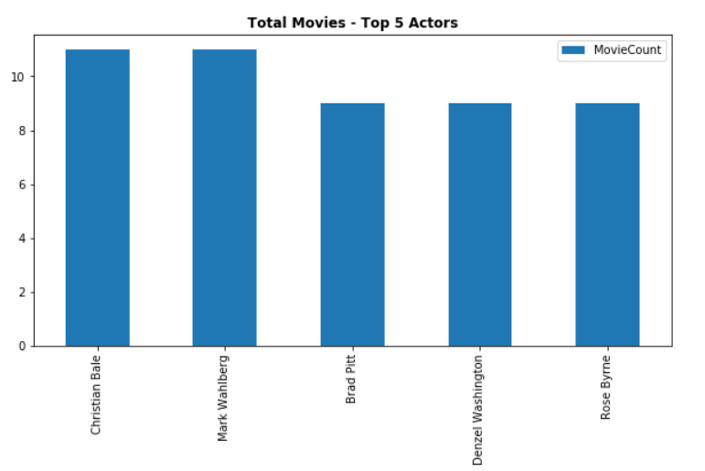
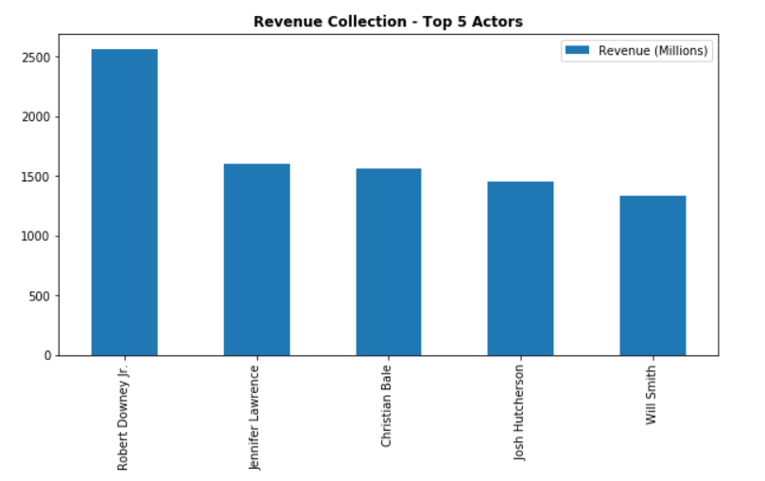
Top actors (w.r.to movies casted in and box office)
It seems movie count wise top actors does not necessarily top the box office.

Slide 9


Rating vs Year and Year vs Votes
2015 and 2016 has more number of rated movies
Number of votes are increased every year.
Rating vs Year
Year vs Votes

Slide 10
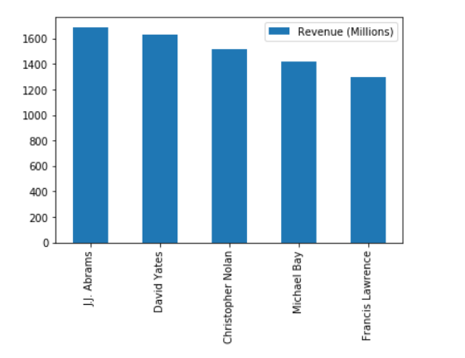
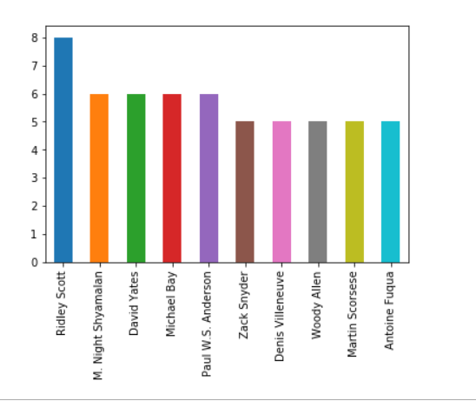
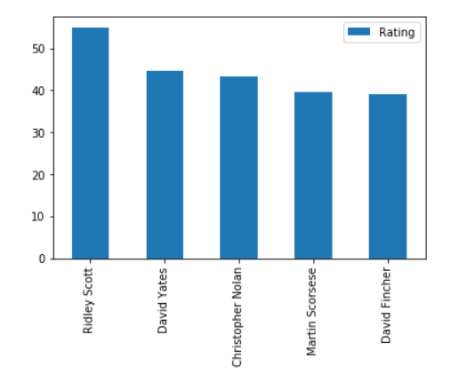
Top directors w.r.to number of movies, revenue and rating
Top directors w.r.to number of movies
Top directors w.r.to revenue
Top directors w.r.to rating

Slide 11
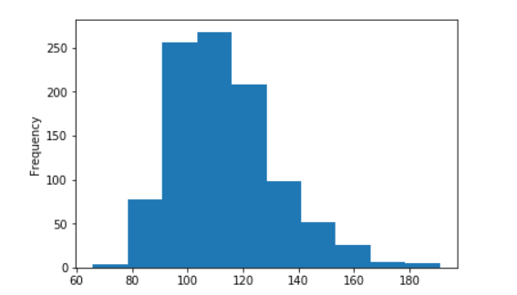
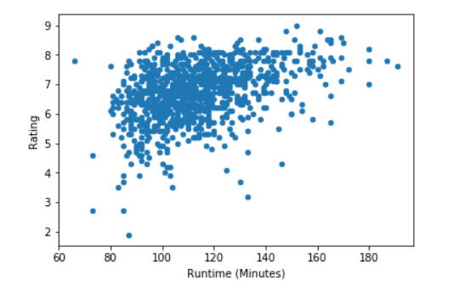
Runtime plot and runtime vs. rating
Most of the average rated movies (6 to 8) have a runtime between 90 to 120
Maximum movies fall between 90 to 120 minutes runtime
Runtime plot
Runtime vs. rating

Slide 12
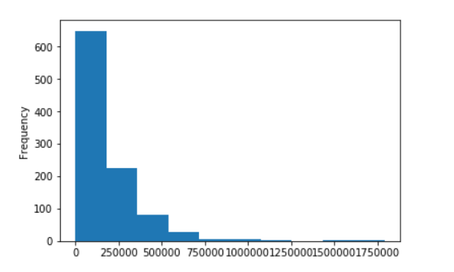
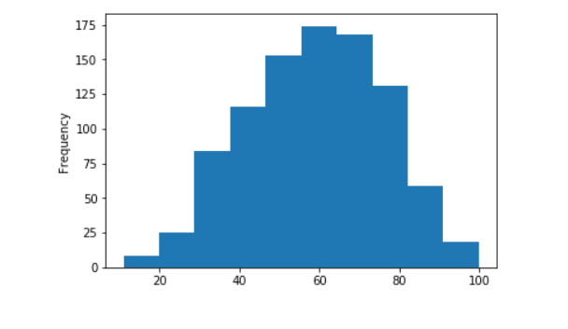
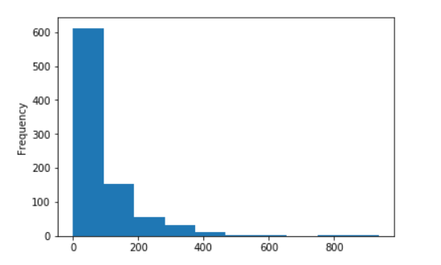
Votes, revenue and meta score plot
Votes plot
Meta score plot
Revenue plot

Slide 13
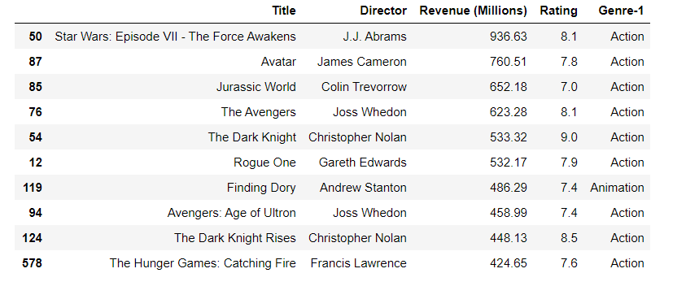
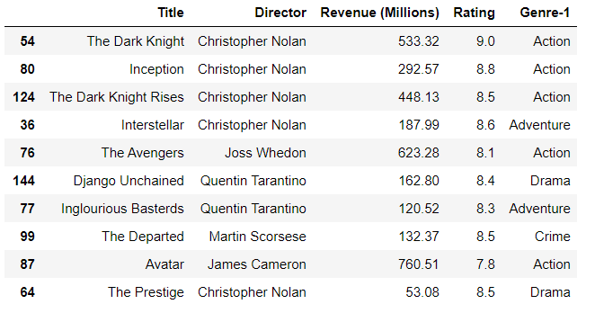
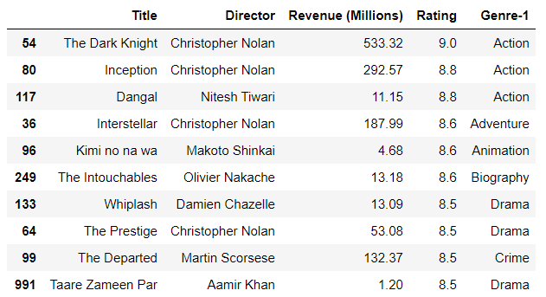
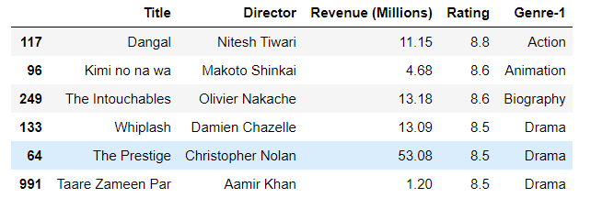
Top 10 movies w.r.to revenue, rating and votes cast
Top movies w.r.to revenue
Top movies w.r.to rating
Top movies w.r.to votes cast
Highly rated movies with less than expected revenue

Slide 14
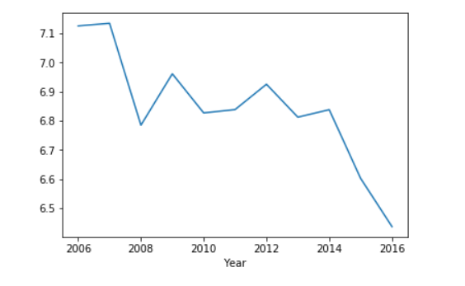
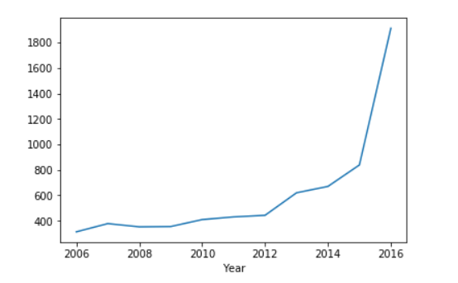
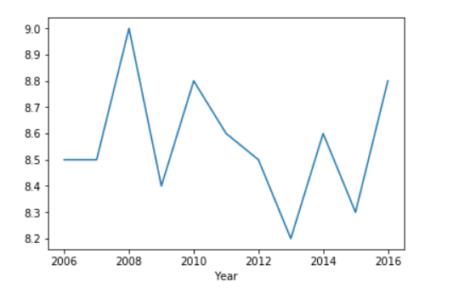
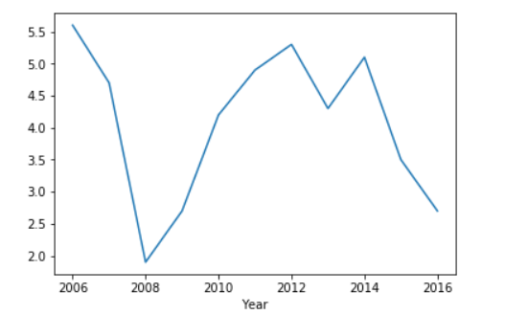
Rating trend
Average rating trend w.r.to year
Total rating trend w.r.to year
Max rating trend w.r.to year
Minimum rating trend w.r.to year

Slide 15
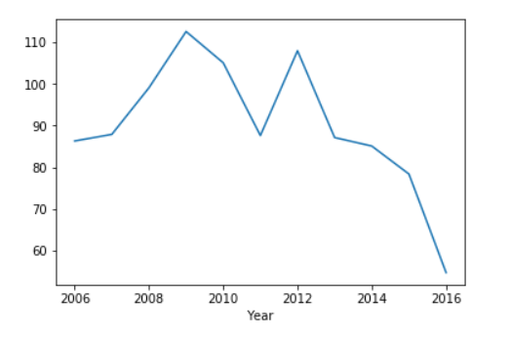


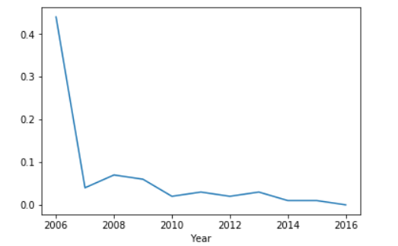
Revenue trend
Average revenue trend w.r.to year
Total revenue trend w.r.to year
Max revenue trend w.r.to year
Minimum revenue trend w.r.to year

Slide 16
Conclusion
This data set gives us information about 1000 movies released in between 2006 - 2016. -Most of the movies are rated between 6 to 8 on a scale of 10.
There are 20 genres available all total in the data. -Drama, Action, Comedy, Adventure and Thriller are the top 5 genre where most number of movies are made. Where as, Sports, Music, War, Western and Musical are the least popular genre w.r.to movies made.
Adventure, Action, Drama, Comedy, Thriller, Sci-fi type of movies generate more revenues and hence those movies are produced in a greater number each year. As usual Sports, Music, War, Western and Musical generate least revenue.
Drama tops the chart in terms of rating, followed by Action/Comedy/Adventure/Thriller. So these popular genre movies are produced more every year, liked by most number of people and generate more revenue. Action genre is successful in all the three categories - rating, votes and revenue. (Overall)
Metascore and Rating has a highly positive correlation.
Surprisingly, revenue and rating does not have any correlation, which means a critically acclaimed movie might not generate high revenue and vice versa.
Number of movie produced is getting increased every year. From 2006 till 2012 it was a steady number (50 and a bit above), 2013 onwards the numbers are increased drastically. But there is a sudden jump in movie numbers from 2015 to 2016 (almost double). Probably it indicates the website is getting popular and more movie data is getting recorded 2013 onwards.

Slide 17
Conclusion contd…
Chris Pratt, Noomi Rapace, James McAvoy,Adam G. Sevani,Shannon Woodward,Cheryl Hines are the top actors w.r.to number of movies acted in. This sequence changes if we try to figure out most successful actors w.r.to box office (revenue earned by movies) and they are Robert Downey Jr., Jennifer Lawrence, Christian Bale, Josh Hutcherson, Will Smith. Most probably these box office kings are more expensive than others, that’s the reason for a bit lesser appearance in films than other top actors (movie wise).
2015 and 2016 has more number of rated movies
Number of votes are increased every year, we can draw one inference from it that website is getting more popular every year.
Ridley Scott, Paul W.S. Anderson, M. Night Shyamalan, Michael Bay, David Yates are the top directors w.r.to number of movie directed. This list changes if we consider revenue wise top director count and the list is J.J. Abrams, David Yates, Christopher Nolan, Michael Bay, Francis Lawrence. Interestingly, only Michael Bay seems to be the man who reserve his spot in both top 5 category, so he is a balanced and perfect director.
Most of the average rated movies (6 to 8) have a runtime between 90 to 120

Slide 18
Conclusion contd…
It's a bit difficult to choose top 10 movies due to multiple deciding factor, so top movies can vary based on revenue, rating and votes.
-Star Wars: Episode VII - The Force Awakens, Avatar, Jurassic World, The Avengers, The Dark Knight
are the top movies w.r.to revenue.
-The Dark Knight, Inception, Dangal, Interstellar, Kimi no na wa are the top movies w.r.to rating.
- The Dark Knight, Inception, The Dark Knight Rises,Interstellar and The Avengers are the top movies w.r.to vote cast.
From this list one interesting fact comes out that director Christopher Nolan is the only director whose movie falls in top 5 in each of those 3 categories. Also, 4 of his movies are in top 5 w.r.to vote cast and 3 of his movies are in top 5 w.r.to rating. So he is definitely one of the most popular director who produce critically acclaimed successful movies. We also observe that several (Dangal, Kimi no na wa, The Intouchables, Whiplash, The Prestige, Taare Zameen Par) highly rated movies failed to earn good revenue in box office, but most of them are not Hollywood movies. Every box office hit movies have a rating greater than 6 atleast.
Average rating drops down w.r.to years, but the number of movies are increasing every year the total rating per year is increasing.
Average revenue also drops down w.r.to years, although sum of the revenue increasing every year due to higher movie count. 2016 is the year where revenue collected by a movie reaches highest number.
Average runtime drops down w.r.to years, which indicates that directors/viewers feel more connected to shorter movies.

