Slide 1
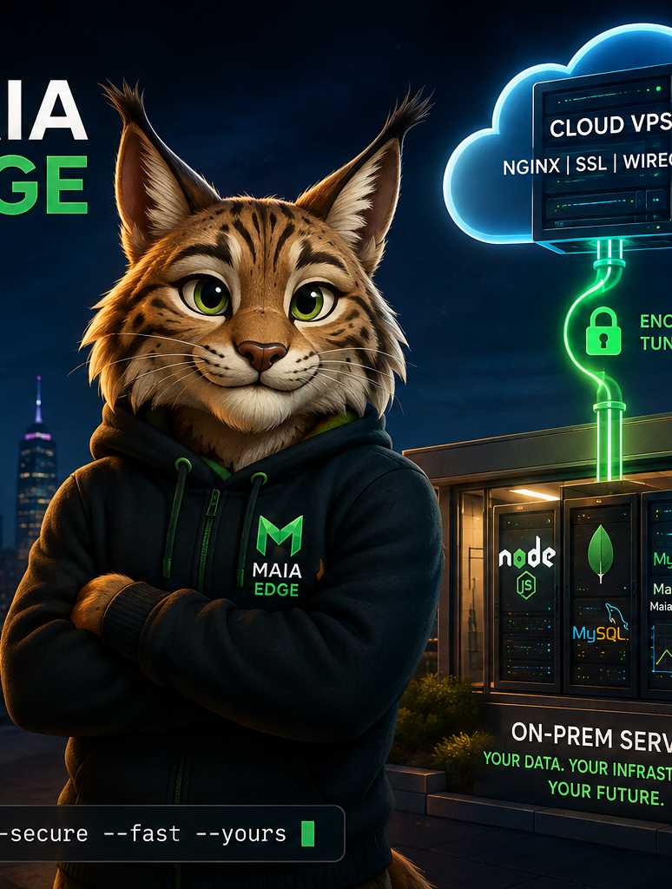
M
MAIA PLATFORM
Open intelligence,
close to your data
Investor brief
A working open-source ecosystem for local AI, knowledge retrieval and hybrid edge infrastructure.
Roberto Luiz Souza Monteiro • September 2026
Notes:
Open with the product status: Maia Chat and Maia RAG are online today. The purpose of the conversation is to show how those products sit on top of a broader technical platform and how investment can accelerate productization and commercial pilots.
Sources: https://www.maiaplatform.org/

Slide 2
OPPORTUNITY
The enterprise AI gap
Organizations want the value of generative AI while keeping control of sensitive knowledge, infrastructure and operating costs.
1
DATA CONTROL
Cloud-only workflows can move confidential documents outside the organization’s preferred boundary.
2
KNOWLEDGE ACCESS
General models do not know the institution’s documents, policies, research and operational history.
3
DEPLOYMENT FRICTION
Teams need a usable interface, retrieval, model serving and secure publication to work as one system.
02
Notes:
Frame the need in operational terms. Avoid abstract AI claims. The buyer needs a coherent route from private documents to useful answers, with deployment choices that fit institutional governance. Maia Platform already connects these layers.

Slide 3
SOLUTION
A complete path from documents to answers
Private knowledge
Maia RAG
Maia Chat
Users
PDFs, office files, code, research
Indexing, local embeddings, retrieval
Conversation, attachments, streaming
Teams, students, researchers
Maia Edge
Securely publishes services running on local hardware through a lightweight cloud gateway.
OPEN SOURCE
PRIVACY FIRST
EDGE READY
03
Notes:
This is the core architecture. Maia RAG converts institutional content into retrievable knowledge. Maia Chat turns that knowledge into a usable conversation. Maia Edge provides the deployment pattern for publishing services without giving up local compute and data ownership.
Sources: https://www.maiaplatform.org/ | https://github.com/souzamonteiro/maia-edge

Slide 4
PRODUCT 01
Maia Chat is ready for real use
A web chat and API for local language models, designed to make private AI practical for everyday users.
Streaming conversation
Responses appear as the model generates them.
LIVE PRODUCT
chat.maiaplatform.org
Document workflows
Attach files and organize reusable document collections.
Online today, with source code published openly.
Local model choice
The interface connects to independent models served locally.
EN
PT
ES
Portable history
Import and export conversations in Markdown and JSON.
04
Notes:
Demonstrate Maia Chat live if the connection is stable. Show the language selector, local model selection and a document collection. The important point is that this is a usable product, not a concept or static prototype.
Sources: https://chat.maiaplatform.org/ | https://github.com/souzamonteiro/maia-chat

Slide 5
PRODUCT 02
Maia RAG turns files into governed knowledge
A shared knowledge service for Maia Chat and other applications, built around local indexing and retrieval.
1
INGEST
2
INDEX
3
RETRIEVE
4
ANSWER
Documents enter a curated collection.
Text is segmented and encoded with local embeddings.
Relevant passages are selected for each question.
Maia Chat uses the retrieved context in its response.
Current status
Online curator access with repository available for inspection and deployment.
05
Notes:
Explain RAG without jargon: the system finds relevant material before the model answers. This makes institutional documents usable and reduces dependence on what the base model happened to learn during training. Curator access is protected, which is appropriate for administration.
Sources: https://www.maiaplatform.org/ | https://rag.maiaplatform.org/ | https://github.com/souzamonteiro/maia-rag

Slide 6
DEFENSIBILITY
The products sit on a broader technical foundation
Maia Platform combines infrastructure, language tooling, data components and applied research developed over more than two decades.
DEPLOYMENT
Maia Edge
Hybrid cloud and secure self-hosting
LANGUAGES
MaiaScript + MaiaCC
Programming language, compiler and parser infrastructure
DATA
MaiaSQL
Portable and browser-friendly database workflows
AI + SCIENCE
MaiaNNE + MaiaStatistics
Machine learning, forecasting and scientific computing
Why it matters
The roadmap can reuse owned components instead of assembling every layer from third-party products.
06
Notes:
The defensibility comes from integration and accumulated engineering. Maia Chat and Maia RAG are the most visible products, but they benefit from compiler, data, scientific computing and deployment work already present in the ecosystem.
Sources: https://www.maiaplatform.org/ | https://www.robertomonteiro.net/

Slide 7
BUSINESS MODEL
Commercial paths around an open core
Proposed routes to revenue
These are commercialization hypotheses for validation with early customers.
Managed deployment
Institutional AI
Installation, monitoring, updates and support for Maia Chat, RAG and Edge.
Private knowledge assistants for education, research and professional organizations.
Vertical solutions
Engineering services
Specialized collections, workflows and integrations for selected domains.
Customization, model integration, data preparation and secure infrastructure.
Near-term validation
Paid pilots with clear user groups, document collections and measurable service requirements.
07
Notes:
Present these as hypotheses, not as established revenue lines. A sensible first step is a small number of paid pilots in organizations where data control and local deployment matter. Use pilot feedback to select the strongest segment and pricing model.

Slide 8
NEXT STAGE
Working technology. Repeatable product.
Capital and strategic support would concentrate on four execution priorities.
1
PRODUCT
Simplify onboarding, administration and multi-user operation.
2
TRUST
Harden security, observability, backup and deployment automation.
3
PILOTS
Deploy with selected institutions and document measurable outcomes.
4
GO TO MARKET
Define target segment, packaging, pricing and support model.
Maia Chat and Maia RAG are online. The next milestone is commercial evidence.
08
Notes:
Close with a concrete invitation: discuss the investor’s strategic fit, identify one or two pilot environments and agree on the diligence information needed for a second meeting. If asked about the investment amount, explain that the funding plan should follow the chosen pilot scope and commercial milestones.
Sources: https://chat.maiaplatform.org/ | https://rag.maiaplatform.org/ | https://www.maiaplatform.org/

