Slide 1
Thermodynamics tutorial
Souzan Hammadi
souzan.hammadi@kemi.uu.se
Notes:
I work as a PhD stundent at structural chemistry where I investigate thermodynamical properties of battery materials. Why? Becasue we can have different phases, and its important to know how they behave.
Because this will affect the performance of the materials and so the battery.

Slide 2
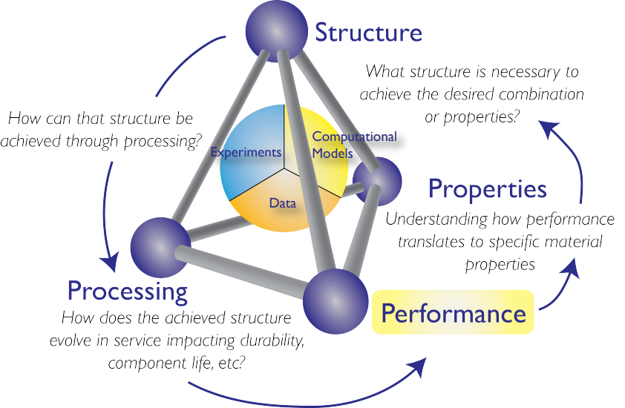
https://gems.matse.illinois.edu/educators/

Slide 3
What we’ll be learing today
At the end of this tutorial you will have learned:
• how to extract simple elemental properties from databases
• how to visualize structures
• how to read a thermodynamic database for CALPHAD
• how to predict phases
• (how to draw Pourbaix diagrams)

Slide 4
What we’ll be doing today
Installation ~ 5 min
Intro ~ 10 min
Part 1 30 min
Part 1 discussion 10 min
9:10
Pause 10 min
Part 1 30 min
Part 2 discussion 10 min

Slide 5
Installation procedure
Download the folder on studium - unzip
Download miniconda for windows
Using the conda prompt go to folder
Type: call install.bat

Slide 6

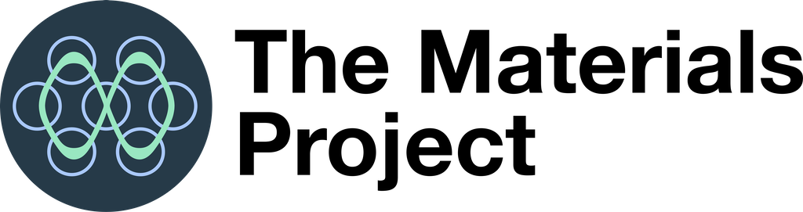

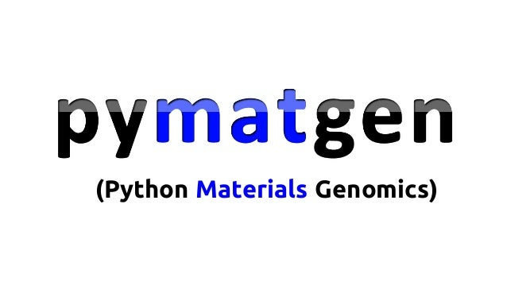
Python modules and interfaces

Slide 7
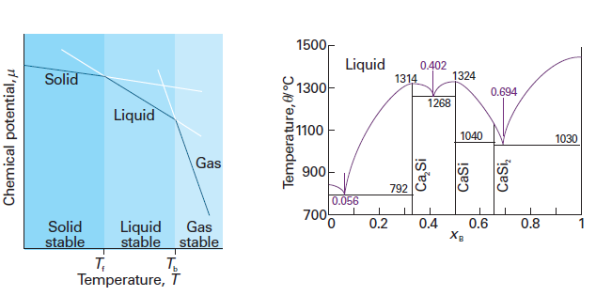
What are phases?

Slide 8
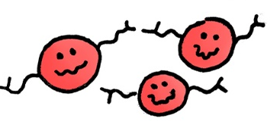


What are phases?
Veronica Berns http://www.veronicaberns.com/

Slide 9
What are the most stable phases at given composition, temperature, pressure?
What determines in which phase the component will be?
Notes:
Those with minimum Gibbs energy!!!
G(p, T)

Slide 10
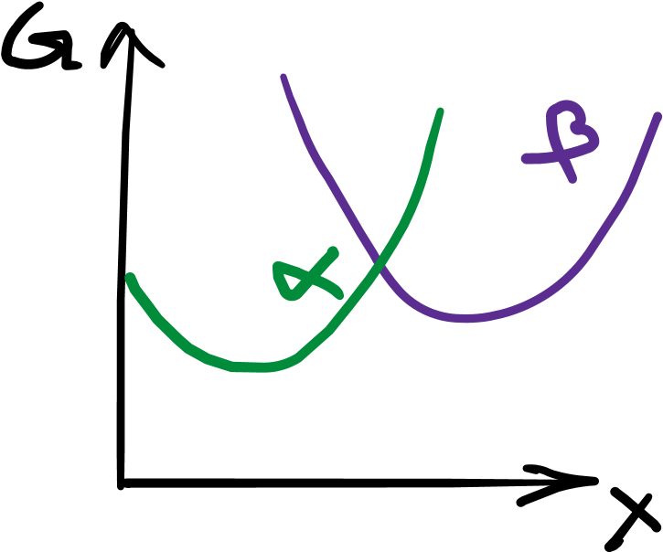
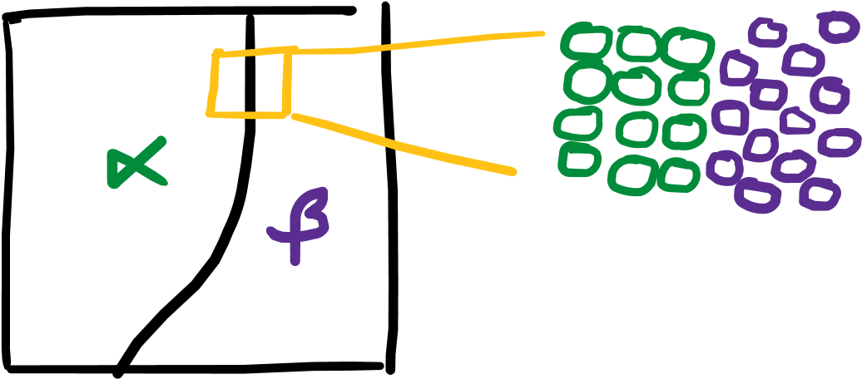

Slide 11
Phase predicitions using atomistic models
Phase predicitions using semi-empirical models

Slide 12
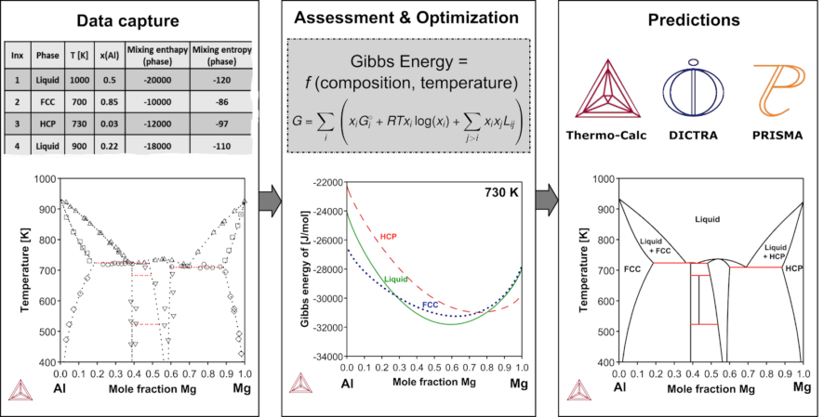
The CALPHAD methodology
Notes:
Multicomponent alloys
Temperature important property

Slide 13
Part 1 – atomistic models
Strengths?
Limitations?
Why is it interesting to include unsable phases?
Notes:
Temperature?
Why is it interesting to include higher energy unstable phases?
Limitations? – how big systems can be use?
Strengths? – new systems, where we don’t have any or much data

Slide 14
Part 2 - CALPHAD
Strengths?
Limitations?
Assumptions?
Compare the predictions of the CALPHAD phase diagram with the previous results from the atomistic calculations. What are the main differences?
Notes:
Temperature as a variable
Phase stabilities
What are the assumptions?
Equilibrium

Slide 15
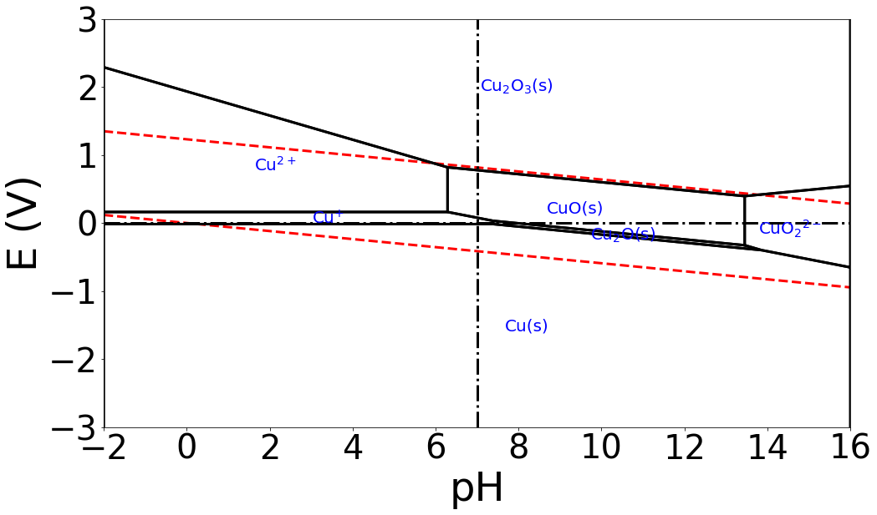
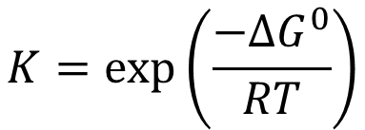
Pourbaix diagrams
$$K=\exp\left(\frac{−ΔG^{0}}{RT}\right)$$

