Slide 1
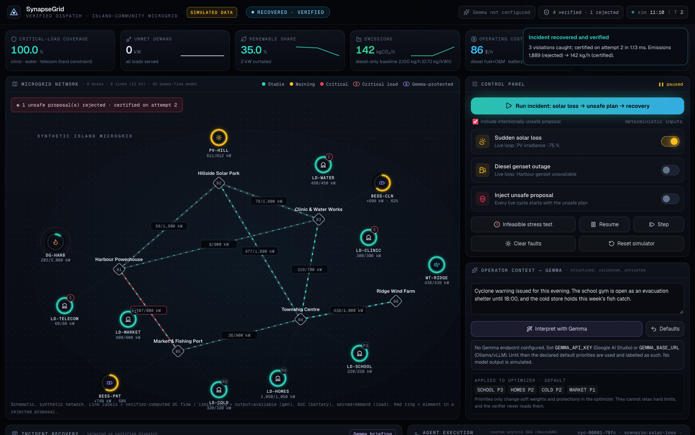
SynapseGrid
Verified renewable-energy dispatch for critical community loads
Prototype dashboard (simulated data)
Google Cloud AI Builder Cup · Category: Sustainability
Gemma reads the context · Google OR-Tools plans · an independent verifier decides
Notes:
SynapseGrid helps small island and remote microgrids recover from sudden solar loss without ever dispatching an unsafe plan. Everything shown is a simulation on synthetic data.

Slide 2




Solar can vanish in minutes
Island and remote communities are replacing expensive, polluting diesel with solar and batteries. That makes their small grids cleaner — and more volatile.
Sudden solar loss
Unsafe recovery plans
Critical loads at risk
No safety check
A cloud front can remove most of a solar farm's output within minutes.
A rushed plan can overload a power line, exceed a generator's rating, or drain a battery too far.
The clinic, water pumps and emergency radio must stay powered, whatever else is cut.
Small operators rarely have a tool that checks a plan against physical limits before acting on it.
Notes:
The plan might come from a buggy script, a tired operator, or an AI model that sounds confident. The risk is the same: acting on a plan nobody checked against the physics.

Slide 3



Three roles that cannot overrule each other
Planners — including AI — may propose. Nothing is dispatched unless an independent check of every modeled physical limit passes.
Understand
Plan
Decide
Gemma
Google OR-Tools
Independent verifier
Reads the operator's free-text incident note and returns load priorities as JSON. Output is schema-validated and treated as untrusted.
Finds the lowest-cost, lowest-carbon dispatch that balances power at every bus and respects line, battery and generator limits. Critical loads always served.
Recomputes the physics from scratch and approves or rejects every proposal. Rejections go back to the planner with exact violations (max 4 tries).
Notes:
The key design choice: the AI and the optimizer can only propose. A separate, deterministic checker that shares no code with the planner has the final say.

Slide 4
How one recovery works
Simulated telemetry
(solar, wind, demand, batteries)
✓ Certified → dispatch
+ carbon & cost
OR-Tools planner
Operator note
→ Gemma priorities
Independent verifier
recomputes power flow
✗ No safe plan → report FAILED
violations → re-plan (≤ 4 tries)
Untrusted proposal
(human, script, AI)
Hashed audit record
(replayable)
Why the verifier is independent: no shared code with the planner, Python standard library only, ignores the planner's claimed line flows, rejects unexpected fields, and recalculates every flow itself.
Notes:
Every proposal, from the optimizer or from outside, goes through the same verifier. Rejections become cuts for the planner. If no safe plan exists, the system reports failure instead of dispatching something unsafe.

Slide 5
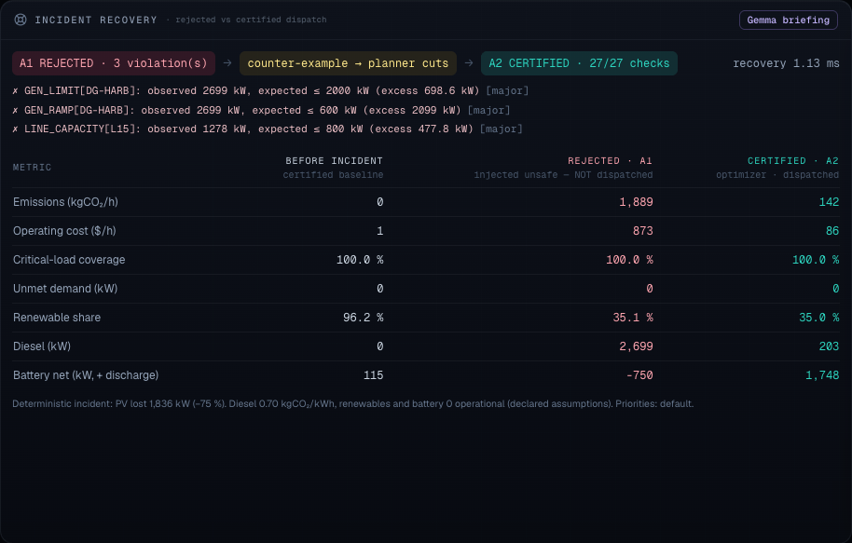
Demo: unsafe plan rejected, safe plan certified
1
Cloud front removes 1,836 kW of solar (−75 %)
2
Proposal: restart diesel at 2,699 kW and charge the port battery
3
Rejected — 3 exact violations: generator rating, ramp limit, line L15 at 1,278 of 800 kW
4
OR-Tools re-plans with the violations as cuts
5
Certified — 27 / 27 checks pass; audit record replays to the same verdict
Notes:
This is a deterministic scenario: the same inputs give the same record hashes every time. The verifier computed the 1,278 kW line flow itself.

Slide 6
Cleaner, cheaper, critical loads kept on
−1,747
kg CO₂/h
certified vs rejected plan
$86/h
vs $873/h
operating cost, certified vs rejected
100 %
critical loads
clinic, water and radio stay powered
Simulated data. Assumptions: diesel 0.70 kg CO₂/kWh and $320/MWh; solar, wind and batteries 0 operational emissions. Comparison is against the rejected plan, not a real-world baseline.
Notes:
Numbers come from the prototype's deterministic incident. Before the cloud front the grid ran at about 96 % renewable share; after it, the certified plan uses both batteries and 203 kW of diesel.

Slide 7
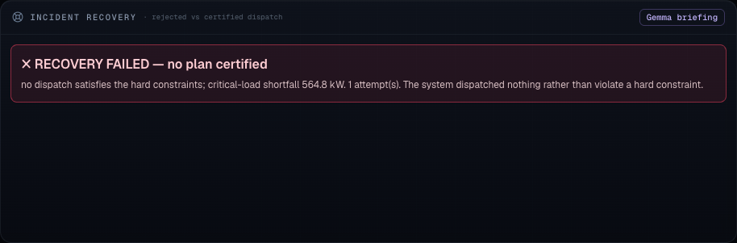

When no safe plan exists, it says so
Stress test
Night, no wind, batteries at 11 %, diesel genset tripped.
564.8 kW
critical-load shortfall reported — nothing dispatched
Why this matters
Critical loads are a hard constraint. The optimizer cannot trade them for cost or carbon, so when they can't be met the problem is infeasible and the system reports failure instead of shedding the clinic or pretending.
Notes:
An honest failure state is part of the safety story: the operator is told exactly how much critical load is at risk.

Slide 8
Evidence: 300 randomized fault scenarios
273 / 273
27 / 27
0
recoverable scenarios reached a certified plan after an unsafe proposal was injected
impossible scenarios reported as FAILED — never certified
certified plans found unsafe by a second, separately written checker
2,400 / 2,400
1.1 ms
22 / 22
adversarial and malformed proposals classified the same by both checkers
median recovery time (95th percentile 1.2 ms)
re-runs produced identical results
Reproduce: python app/evaluation.py --n 300 --seed 7. Both checkers share the same constraint definitions, so agreement shows the code is consistent — not that the physics model is complete.
Notes:
Scenarios mix solar loss, wind, demand swings, battery levels, line outages and diesel trips; 10 % are deliberately extreme.

Slide 9
Gemma turns human context into validated priorities
Operator note
"Cyclone warning — the school gym is the evacuation shelter until 18:00."
Gemma
Returns JSON: summary, protected loads, priority 1–5 per load, rationale
Schema validation
Only known non-critical loads, valid ranges, no extra keys — otherwise rejected
Optimizer weights
Priorities change who is shed first — never a hard limit
Every call is labelled with its real outcome — no model output is ever simulated
inference
real model response, validated
rejected
model answered, output failed validation
unavailable
timeout or HTTP error after 1 retry
not configured
no endpoint set
If Gemma is missing, slow or wrong, the system falls back to declared default priorities. The verifier never reads Gemma's output, so safety never depends on the model.
Notes:
Gemma does the part machines are traditionally bad at: reading messy human context. The structured, validated output keeps it from becoming a safety risk. Tested so far against mocked responses; a live run needs an API key.

Slide 10

Feasible today on a small, open Google stack
Gemma
Operator-context understanding (Google AI Studio or self-hosted)
≈ 0.2 ms
≈ 0.1 ms
optimizer solve
verifier run
Google OR-Tools
DC optimal power flow — the dispatch plan (GLOP linear solver)
35
1 vCPU
Cloud Run + Secret Manager
Hosting the FastAPI app; Gemma key kept out of the code
automated tests passing
enough to run the prototype
Not used and not claimed: Google Cloud Pub/Sub (the event stream is in-process) and the NeuroSAN runtime (the agent pipeline is a custom asyncio DAG inspired by it).
Notes:
Small, pinned, open-source dependencies: FastAPI, Pydantic, httpx, Jinja2, OR-Tools. Tests cover overloads, battery limits, recovery, honest failure, malformed input, Gemma timeouts and reproducibility.

Slide 11

From one simulated island to real community grids
1
Real telemetry
Pub/Sub or IoT ingestion instead of the simulator
Built to scale
2
Look-ahead planning
multi-hour dispatch so batteries aren't drained too eagerly
The network is plain data — a new microgrid is a new data file, not new code
Planning and checking grow polynomially with network size; community grids are small
One isolated Cloud Run service per community
3
Fuller physics
voltage and reactive-power checks
4
Persistent audit trail
e.g. Firestore instead of in-memory records
5
Field validation
with a utility partner and a power-systems engineer
Notes:
Roadmap items are not built yet. Today SynapseGrid is a simulator; the path to real use runs through real telemetry, better physics and validation with a utility partner.

Slide 12

What this prototype is — and isn't
It is
It isn't (yet)
A working simulator with a real optimizer, an independent verifier and replayable audit records
Deterministic: the same inputs give the same verdicts and hashes
Tested: 35 automated tests plus a 300-scenario randomized evaluation
Connected to real equipment — all data is synthetic
Full physics — lossless DC power flow, one 15-minute interval, no voltage or stability
A formal proof — "certified" means every modeled constraint holds
Tested against a live Gemma endpoint — only mocked responses so far
Notes:
Being explicit about scope is deliberate: the whole project is about not overclaiming safety.

Slide 13


Who benefits
Island & remote communities
Microgrid operators
Anyone adding AI to infrastructure
Fewer outages of clinics, water and emergency radio during sudden renewable drops — and less diesel burned.
A second check that explains exactly why a plan is unsafe before anything is switched.
A working pattern: AI handles messy human context, a deterministic check has the final say.
Gemma reads the context · OR-Tools plans · an independent verifier decides
github.com/souzataniya/SynapseGrid
Notes:
Close on the core idea: AI can help with messy context, but safety comes from an independent, deterministic check.

