Slide 1
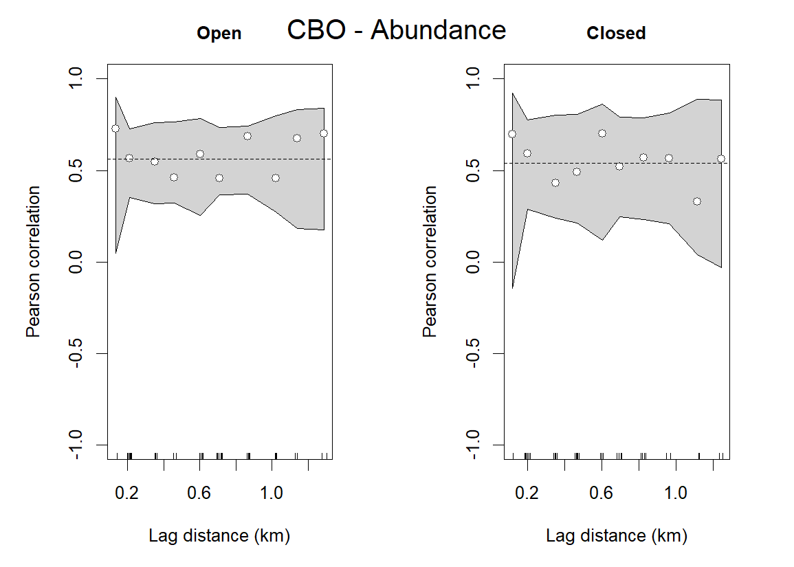
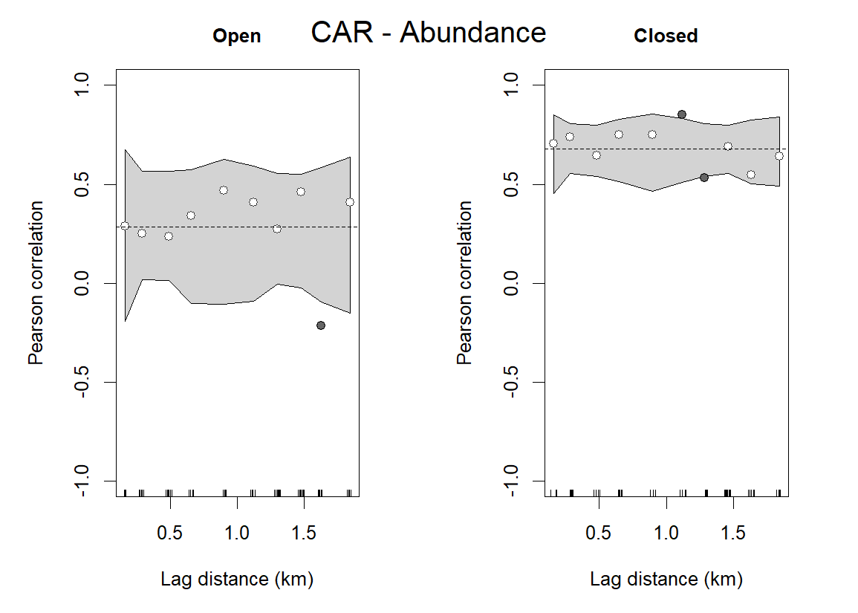
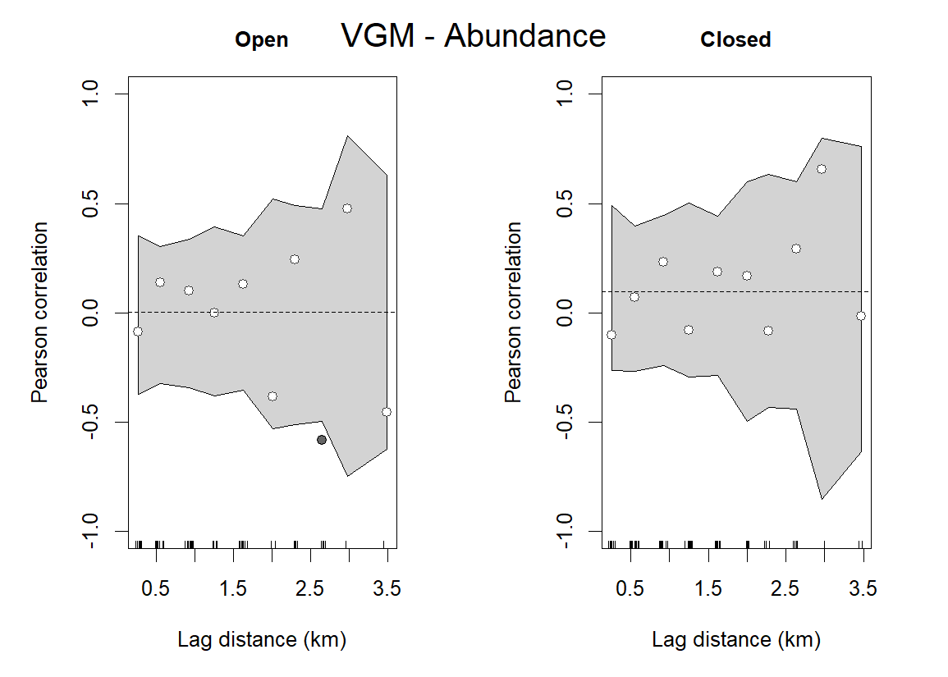
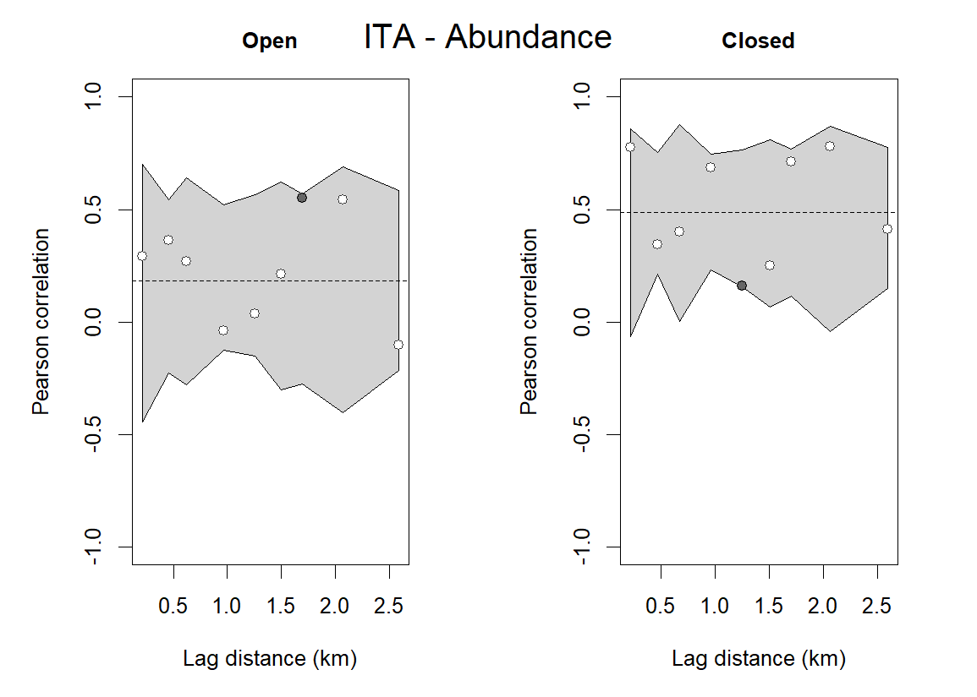
RMSE: 0.09967
AIC: -42.12
RMSE: 0.09883
AIC: -42.29
RMSE: 0.1867
AIC: -29.57
RMSE: 0.08373
AIC: -45.6
RMSE: 0.3082
AIC: -19.54
RMSE: 0.2034
AIC: -27.85
RMSE: 0.2205
AIC: -23.21
RMSE: 0.2243
AIC: -22.9

