Slide 1
Underfitting. Overfitting. Regularization.

Slide 2
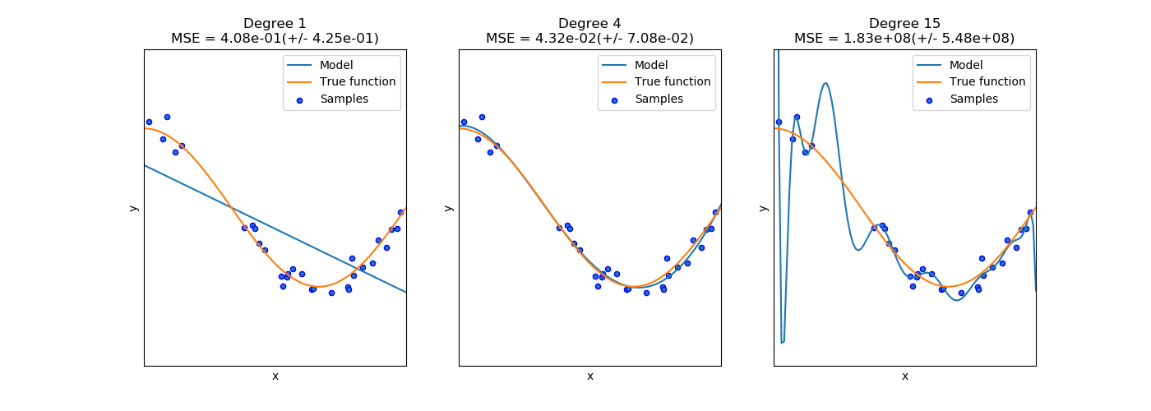
Underfitting. Overfitting
From scikit-learn
Underfitting.
High bias
Overfitting.
High variance
Just right!

Slide 3
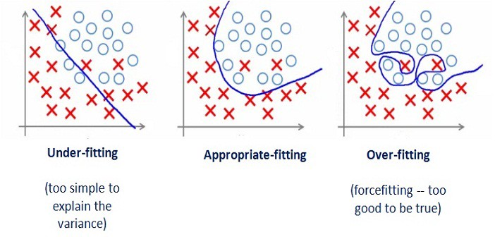
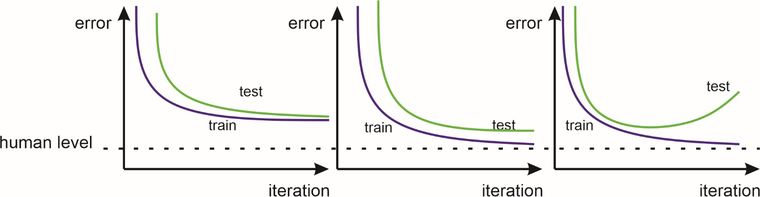
Data
Learning curves
High train/test error,
high bias, test error is close to train error
Low train/test error,
test error is a little bit higher
then train error
Low train error, high test error, divergence is increasing, high variance
Symptoms
More complex model, more features, longer training
More data, regularization
Prescription
Just right

Slide 4
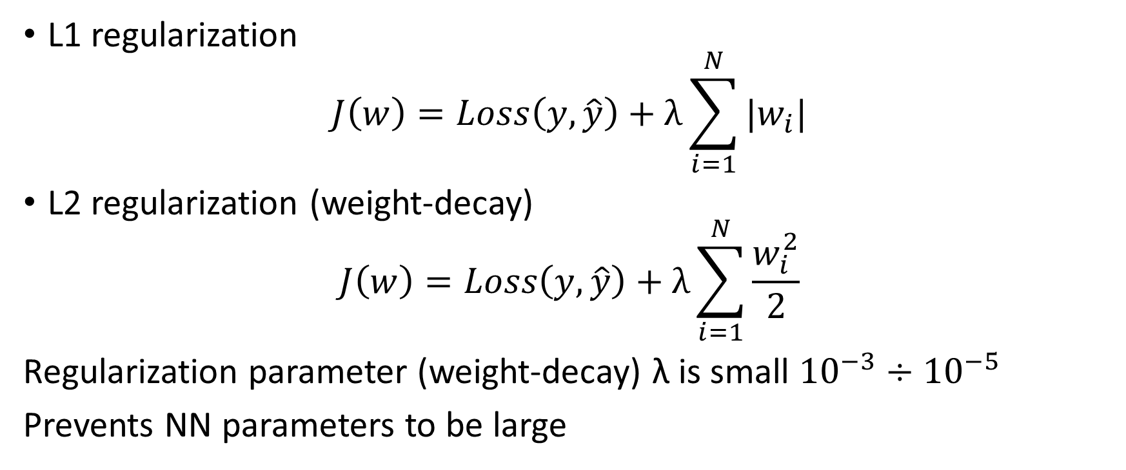
Regularization
L1 regularization
$$J\left(w\right)=Loss\left(y,\hat{y}\right)+λ\sum_{i=1}^{N}{|w_{i}|}$$
L2 regularization (weight-decay)
$$J\left(w\right)=Loss\left(y,\hat{y}\right)+λ\sum_{i=1}^{N}{\frac{w_{i}^{2}}{2}}$$
Regularization parameter (weight-decay) λ is small ${10}^{−3}÷{10}^{−5}$
Prevents NN parameters to be large

Slide 5
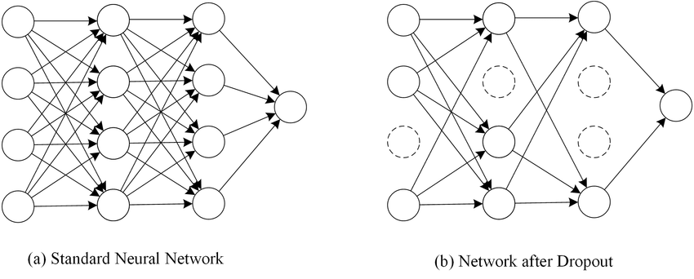
Regularization
Dropout

Slide 6
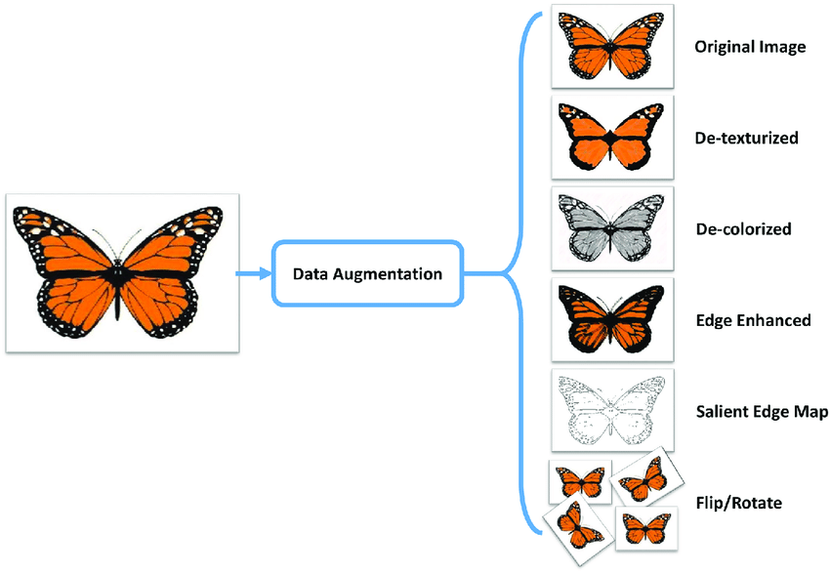
Data augmentation

