Slide 1
System Architecture and Technology Strategy

Slide 2
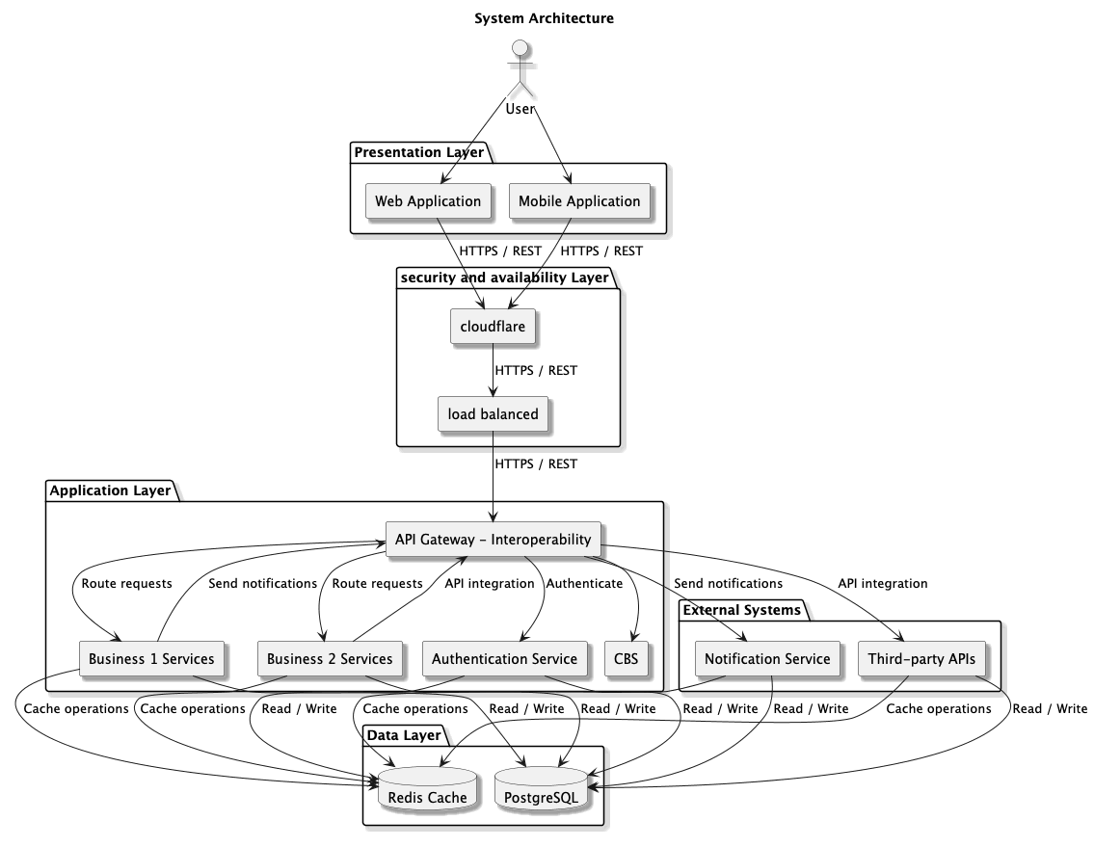
System architecture

Slide 3
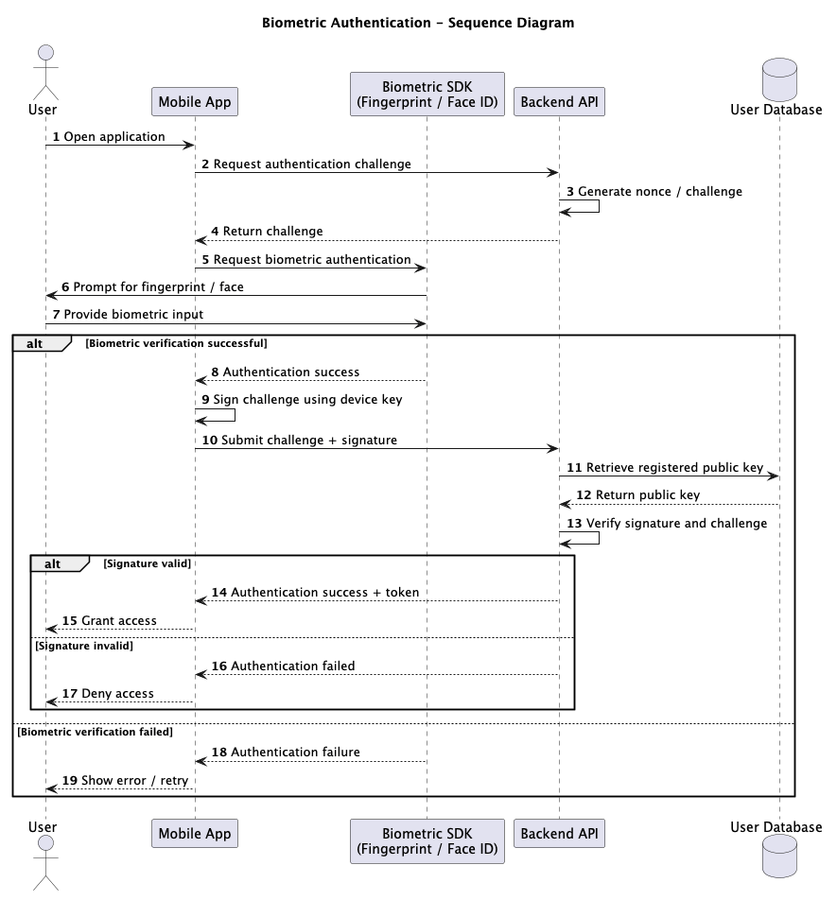
Bio-auth Sequence

