Slide 1
Team Design, Workflow and Collaboration

Slide 2
Q1 Team structure
To avoid destabilizing project, Team’s member is need culture structured base on agile, not fix domain base. if any unplanned works is need, we will have team (kanban) to handle separably because kanban’s Delivery Cycle is Continuous delivery as items are finished and planned works will handle by scrum teams.
3 scrum team consist of 2 backend, 2 frontend total 12 headcount
1 kanban team for fix bau, pen-test, security, complaint consist of 4 backend, 2 frontend total 6 headcount
QA team 1 lead, tester 4 for each dev team total 5 headcount
Product Owner Or PMO 1 for each dev team (Input 1) total 4 headcount
Operation Support (Input 2) total 3 headcount

Slide 3
Q2 Intake Request
PO or PMO get request
Assessment request (Dev, PO Or PMO)
Priority by risk heatmap-matrix (Probability/Likelihood and Severity/Impact)
Assessment Backlog and Dev Input (availability human resource and Technical debt) get SLA
consensus/compliant/approval
entry as Jira ticket

Slide 4
Q2 Intake Hotfix
IT Support fund defect
Assessment defect (Dev, PO Or PMO)
Priority by risk heatmap-matrix (Probability/Likelihood and Severity/Impact)
Assessment Backlog and Dev Input (availability human resource and Technical debt) get SLA
consensus/compliant/approval
trigger urgent fix or backlog fix
entry as Jira ticket

Slide 5
Q3 Tool
PO or POM (Jira/Confluence/google docs)
Dev (git pull request, Jira/Confluence/google docs/Bruno/SwaggerUI/Docker Jenkins, Sonarqube, Trivy)
QA (Jira/Confluence/google docs/Bruno/SwaggerUI)
IT Support (Jira/Confluence/google docs)

Slide 6
Q4 process and workflow
Intake / Intake Hotfix ( input problem/request > process identify > outcome ticket )
Implement (input ticket > implement > marge stage )
QA Test (marge stage > Assessment quality > qualify releases )
Release (qualify releases > Assessment quality > production)

Slide 7
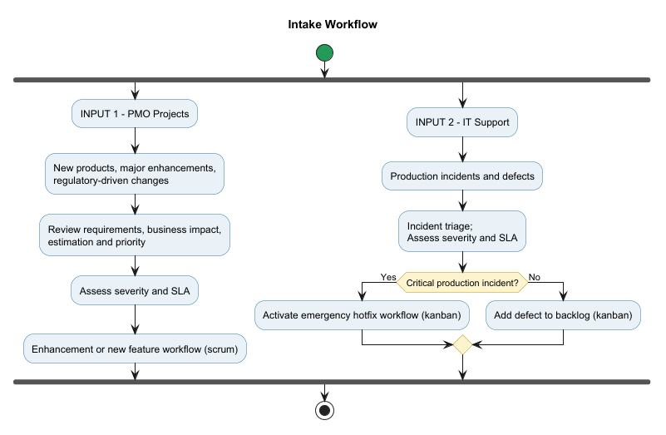
Intake

Slide 8
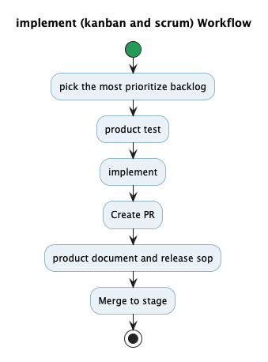
Implement

Slide 9
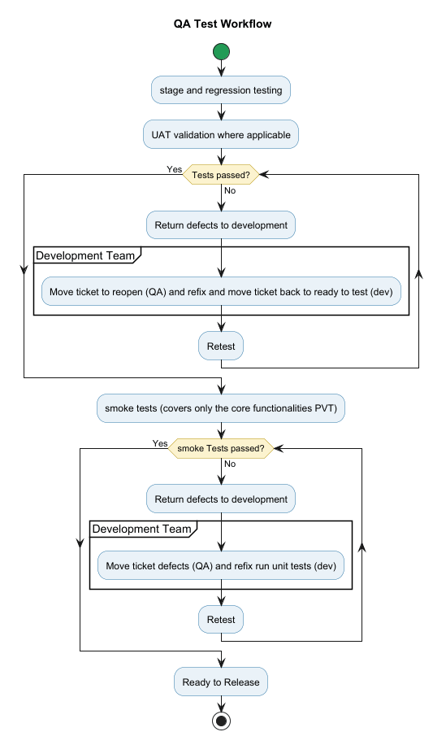
QA

Slide 10
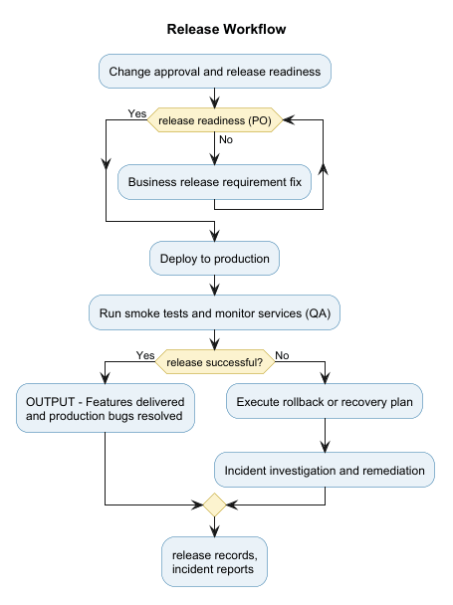
Release

Slide 11
Collaborate
We have some tool for collaborate between team.
Jira ticket (scrum, kanban board), Confluence for PO, Operation Support, Dev, QA
Google doc for QA to test case collaborate with Dev , PO to stakeholder
Bruno, swagger UI for backend to QA, frontend and external integrator
Pull request is Git collaborate process to code reviews

