Slide 1

Eco Forecast
Smart Energy Consumption Forecasting with Explainable AI (Artificial Intelligence) Integration
FYP-BSCS-F25-06 · The Superior University, Lahore · Fall 2025

Slide 2
Project Team
M Saqib Masood
M Hamza
Laiba Ali
Group Leader
Backend & API
Frontend & UI / UX
Reg. # Su92-Bscsm-F22-133
Reg. # Su92-Bscsm-F22-130
Reg. # Su92-Bscsm-F22-137
Supervisor
Co-Supervisor
HOD (Head of Department)
Mr. Sohaib Hafeez
Mr. Syed Karar Haider Bukhari
Dr. Azam Chaudhary
Lecturer · Computer Science Dept.
Lecturer · Computer Science Dept.
Computer Science Department
Programme: BSCS (Bachelor of Science in Computer Science) · Session 2022 to 2026 · Faculty of Computer Science & Information Technology

Slide 3
Table of Content
01
Introduction & Background
02
Problem Statement
03
Solution
04
Features and Scope
05
Requirements (Elicitation, SRS)
06
Use Case Diagram
07
Functional & Non-Functional Requirements
08
System Design & Architecture
09
Implementation, Tools & Tech
10
Challenges, Prototype & Screenshots

Slide 4
Introduction & Background
Pakistan's Energy Crisis
Persistent electricity shortfalls and load shedding affect ~220 million citizens.
Domestic sector consumes ~50% of national electricity; demand is highly weather-driven.
Existing utilities use coarse statistical forecasts that ignore local micro-climates.
Why AI (Artificial Intelligence) and DL (Deep Learning)?
DL models capture non-linear, sequential patterns in hourly weather and consumption data.
XAI (Explainable AI) techniques expose the “why” behind every prediction.
RAG (Retrieval-Augmented Generation) bridges raw forecasts and human-friendly insight.
Project Vision
End-to-end forecasting platform for six Pakistani cities: accurate, explainable, and conversational.

Slide 5
Problem Statement
Core Problem
Households cannot anticipate next-day electricity demand, causing bill shocks, load-shedding stress, and inefficient appliance scheduling.
Limitations of Existing Solutions
Global tools (Google DeepMind, Tesla Autobidder) are not localised to Pakistani climate or pricing.
Local utility tools (WAPDA / LESCO) provide only aggregated billing, no household-level forecast.
Black-box ML (Machine Learning) gives numbers but no explanation; users cannot trust or learn.
No conversational interface for non-technical users to query forecasts in plain language.
Research Gap
A unified system: per-city forecasting, XAI, and natural-language Q&A (Question & Answer) for South-Asian residential demand.

Slide 6
Solution
A three-layer intelligent platform: Predictive · Explainable · Conversational
01
Predictive Layer
02
Explainability Layer
03
Conversational Layer
Hybrid DL ensemble: CNN (Convolutional Neural Network) + LSTM (Long Short-Term Memory) + GRU (Gated Recurrent Unit) with weighted averaging. Forecasts next-day daily and hourly kWh (Kilowatt-hour) for six cities.
SHAP (SHapley Additive exPlanations): global + local feature attribution. LIME (Local Interpretable Model-agnostic Explanations): per-instance insight. XAI makes predictions trustworthy.
FAISS (Facebook AI Similarity Search) vector index over a curated knowledge base. Anthropic Claude LLM (Large Language Model) generates grounded answers via RAG (Retrieval-Augmented Generation).
Outcome: households receive an accurate, explainable, and conversational forecast in one dashboard.

Slide 7
Features and Scope
Core Features
Next-day daily and 24-hour kWh forecasts for Lahore, Karachi, Islamabad, Multan, Peshawar, Skardu.
Live weather via Open-Meteo API (Application Programming Interface) with no key required.
Dark-theme UI (User Interface): charts, weekly outlook, appliance breakdown.
Global and local SHAP visualisations and LIME local explanations.
RAG-powered Q&A chatbot: conversation history and per-request API key.
Downloadable forecasts (CSV: Comma-Separated Values; JSON: JavaScript Object Notation).
In-Scope
Residential single-household demand for the six target cities; horizon 24 hours.
Out-of-Scope
Industrial / commercial loads, real-time tariff optimisation, IoT (Internet of Things) device control.

Slide 8
Requirements
Elicitation Techniques / Tools
Stakeholder interviews: 12 households across the six target cities.
Market & literature survey: 25+ peer-reviewed papers on energy forecasting and XAI.
Wire-framing & prototyping: Figma low-fidelity then high-fidelity dark dashboard.
Domain analysis: REWDP (Residential Energy and Weather Data Pakistan) and Open-Meteo.
Competitive analysis: Google DeepMind, Tesla Autobidder, K-Electric portal.
Specification / Documentation
SRS (Software Requirements Specification): IEEE-830 style; supervisor-reviewed.
Use-case catalogue with primary actors, pre/post conditions, exception flows.
OpenAPI 3.0 schema auto-generated by FastAPI at /docs.
UML (Unified Modeling Language): class, sequence, activity diagrams.

Slide 9
Requirements
Users (Primary Actors)
Household User: views forecasts, asks Q&A, reads explanations and tips.
Energy Analyst: inspects SHAP / LIME, compares CNN / LSTM / GRU / Ensemble.
Admin: rebuilds RAG knowledge base, retrains models, manages API keys.
Use Cases (Selected)
UC-01 View live next-day forecast for selected city.
UC-02 Compare model accuracy and confidence intervals.
UC-03 Inspect feature importances via SHAP / LIME.
UC-04 Ask natural-language question via RAG Q&A chatbot.
UC-05 Download forecast as CSV / JSON.
UC-06 Rebuild FAISS knowledge index (Admin).

Slide 10
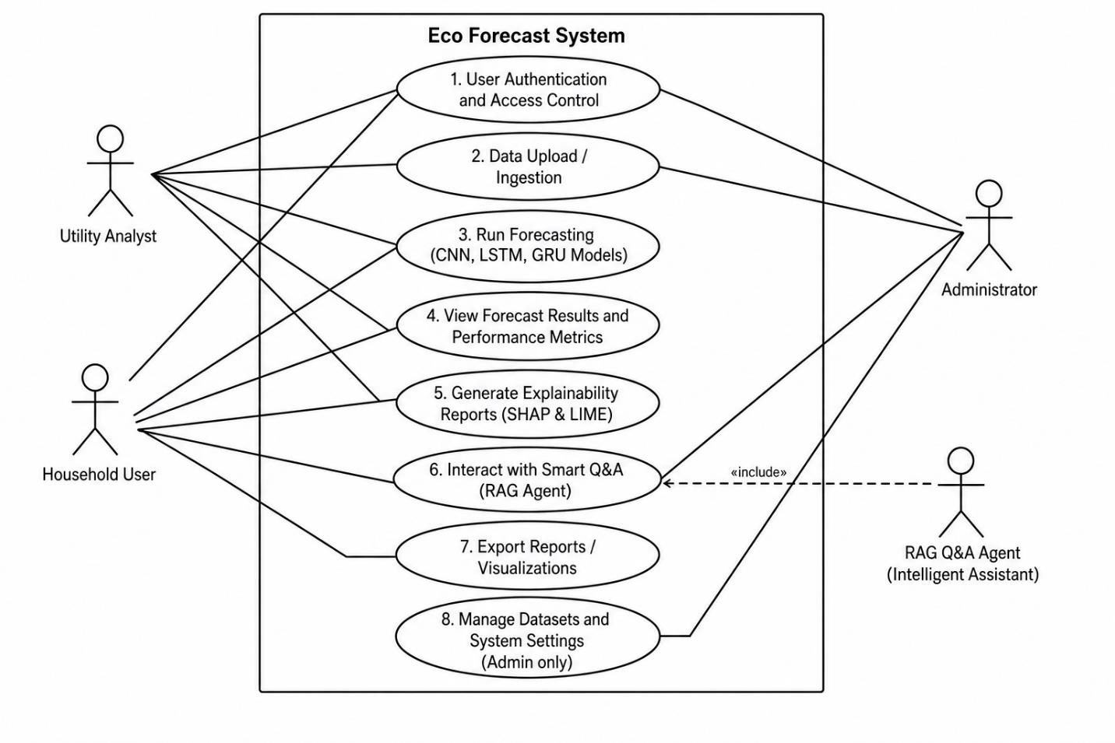
Use Case Diagram
Figure 3.1: Use Case Diagram (FYP Final Report)

Slide 11
Functional & Non-Functional
Functional Requirements
FR-01 Forecast next-day daily and hourly kWh for six target cities.
FR-02 Fetch live weather (Temp, Humidity, Solar Radiation, UV, Wind, Precipitation).
FR-03 Provide global and local SHAP and LIME explanations.
FR-04 Answer free-text user questions via RAG Q&A chatbot.
FR-05 Expose results as REST endpoints documented at /docs.
FR-06 Allow per-request override of the Anthropic API key.
Non-Functional Requirements
NFR-01 Performance: Forecast < 500 ms p95; Q&A < 4 s p95.
NFR-02 Accuracy: Ensemble R² (Coefficient of Determination) ≥ 0.93.
NFR-03 Reliability: Graceful degradation; mock data on model failure.
NFR-04 Usability: Dark-theme responsive UI; WCAG-AA contrast.
NFR-05 Security: API keys never logged; CORS allow-list; HTTPS-ready.
NFR-06 Maintainability: Modular routers and components; type-checked.

Slide 12
System Design
Design Artefacts (covered on the next slides)
Architecture Design: three-tier deployment - Frontend, Backend, Data + ML.
Entity Relationship Diagram (ERD): User, Forecast, Explanation, KnowledgeDoc, Feedback.
Class Diagram: EnsemblePredictor, XAIEngine, RAGEngine, WeatherFetcher.
Sequence Diagram: Generate live forecast end-to-end flow.
Activity Diagram: Ask RAG Q&A user workflow.
Design Principles
Separation of concerns: UI never invokes ML directly.
Graceful degradation: every dependency is optional at startup.
API-first: every feature has a documented REST endpoint before its UI.

Slide 13
Architecture Design
Presentation Tier · Next.js 14 Frontend · Port 3000
React + TypeScript dashboard · Tailwind CSS · Axios HTTP client · Pages: Dashboard | Forecast | Explainability | Accuracy | Q&A Agent
Application Tier · FastAPI Backend · Port 8000
Routers: /api/forecast, /api/xai, /api/rag, /api/weather, /api/tips · Services: EnsemblePredictor · XAIEngine · RAGEngine · WeatherFetcher
Data + ML Tier
Trained Keras models (cnn / lstm / gru .keras) · FAISS vector index over a 28-doc knowledge base · REWDP processed dataset
External Services · Open-Meteo Weather API · Anthropic Claude API · Hugging Face sentence-transformers (all-MiniLM-L6-v2)

Slide 14
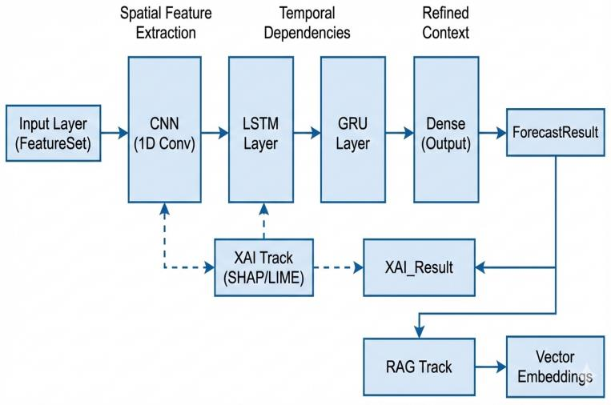
Entity Relationship Diagram (ERD)
Figure 4.2: Main Entities (FYP Final Report)

Slide 15
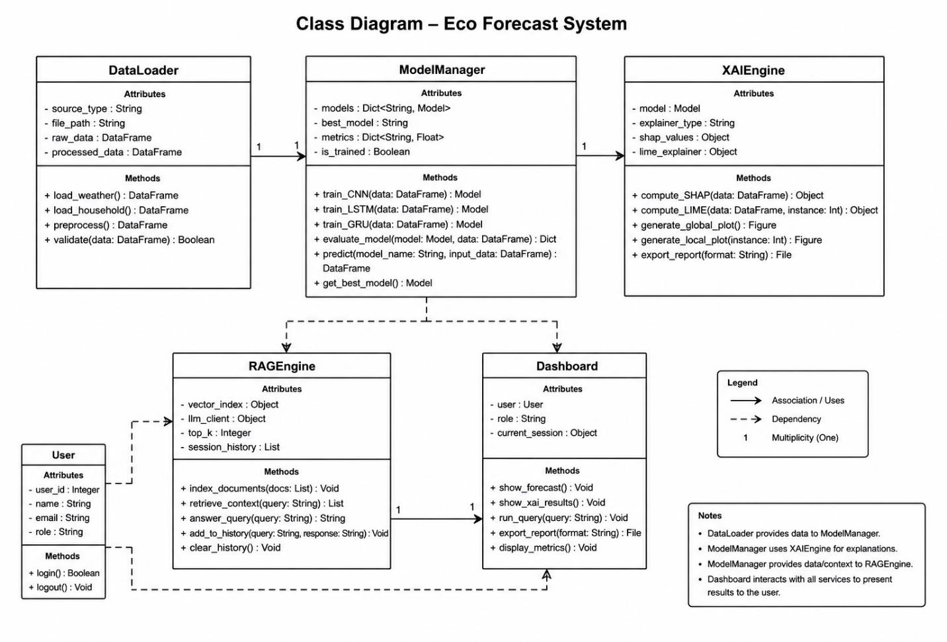
Class Diagram
Figure 4.3: Class Diagram (FYP Final Report)

Slide 16
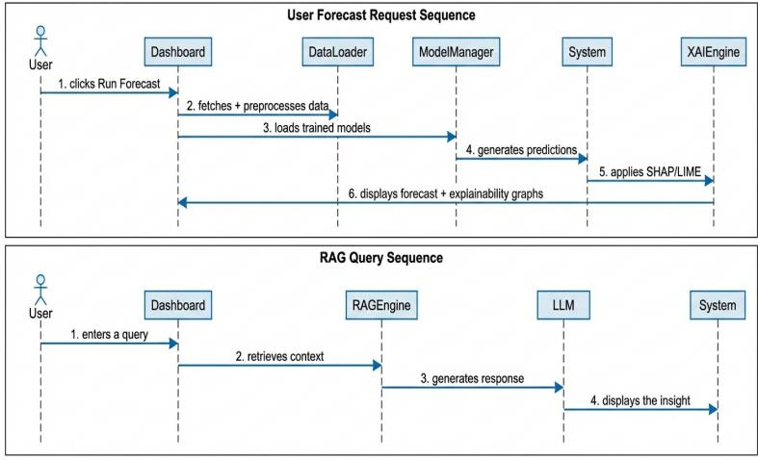
Sequence / Collaboration Diagram
Figure 4.4: User Forecast Request Sequence and RAG Query Sequence (FYP Final Report)

Slide 17
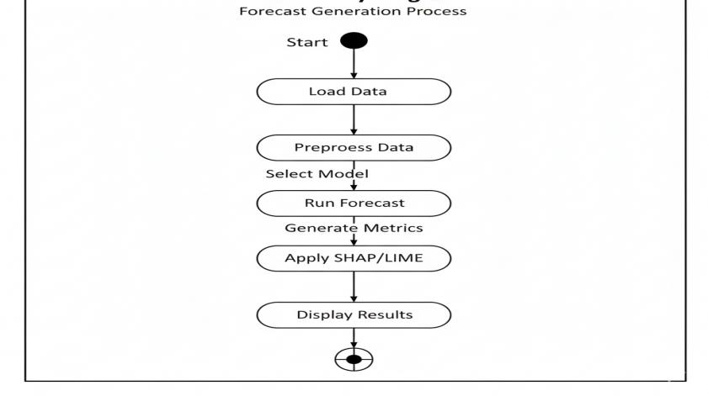
Activity Diagram
Figure 4.6: Activity Diagram - Forecast Generation Process (FYP Final Report)

Slide 18
Implementation
Development Tools & Technologies
Languages: Python 3.10+, TypeScript, JavaScript, HTML, CSS.
Backend: FastAPI 0.115, Uvicorn, Pydantic v2, python-dotenv.
ML / DL: TensorFlow 2.17, Keras 3, scikit-learn, NumPy, Pandas, joblib.
XAI: SHAP 0.46, LIME 0.2.
RAG: sentence-transformers (all-MiniLM-L6-v2), FAISS-CPU, Anthropic SDK 0.40.
Frontend: Next.js 14 (App Router), React, Tailwind CSS, Recharts, Axios, Lucide icons.
Tooling: Git, GitHub, NPM (Node Package Manager), VS Code, Postman.
Best Practices / Coding Standards
PEP-8 (Python); ESLint + TypeScript strict (frontend); Pydantic schemas at every API boundary.
Modular routers and services; lifespan-managed app state; lazy ML imports.
Graceful degradation: every dependency is optional and try / except wrapped.
Libraries / Components / Web Services
Open-Meteo Weather API · Anthropic Claude API · Hugging Face Hub.

Slide 19
Challenges
Data
REWDP heterogeneous across cities: heavy feature alignment (lag_1d, lag_7d, rolling_mean_7d).
Missing values during load-shedding hours: imputed via climate-zone medians.
Modelling
Tuning ensemble weights per city to balance CNN spike detection with LSTM / GRU memory.
Keras 3 deserialisation broke older .keras files: required retraining and tf-keras pinning.
Explainability
SHAP KernelExplainer expensive on 24×10 inputs: limited to 50 background and 100 nsamples.
LIME tabular explainer needed flattening and feature-name repetition across 24 timesteps.
System Integration
Cross-Origin Resource Sharing across :3000 to :8000: solved with explicit allow-list.
Apple-Silicon TF build issues on Python 3.9: fixed with __future__ imports and Optional.

Slide 20
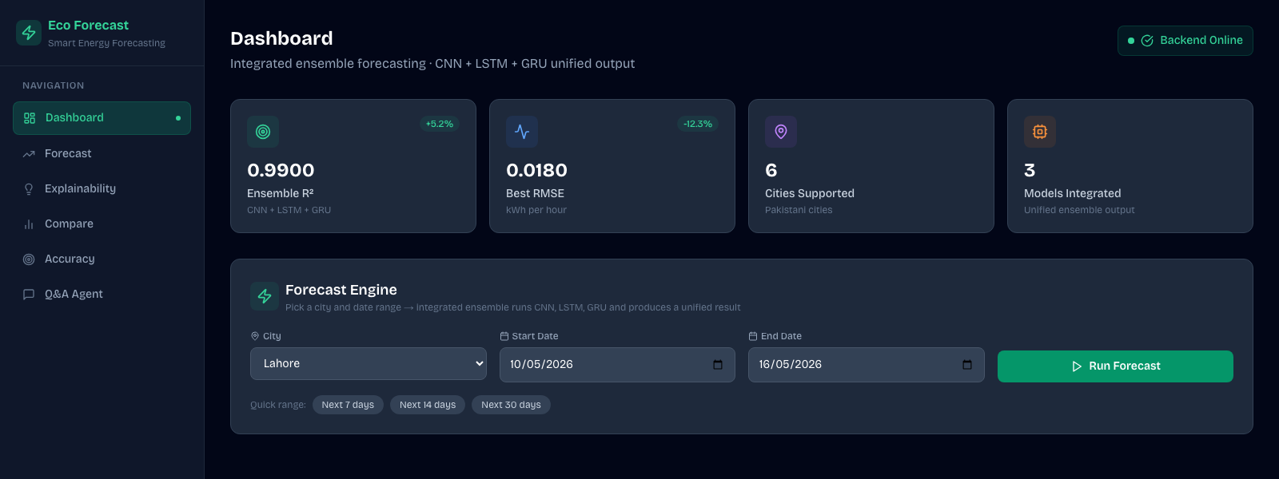
Prototype: Live Dashboard
R² (Coefficient of Determination)
RMSE (Root Mean Squared Error)
Cities supported
Models
0.934
0.328
6
3 + 1
Ensemble accuracy
kWh per hour
Pakistani cities
CNN · LSTM · GRU + Ensemble
http://localhost:3000 · Dashboard with KPI cards, ensemble Forecast Engine, supported cities, and live backend status.

Slide 21
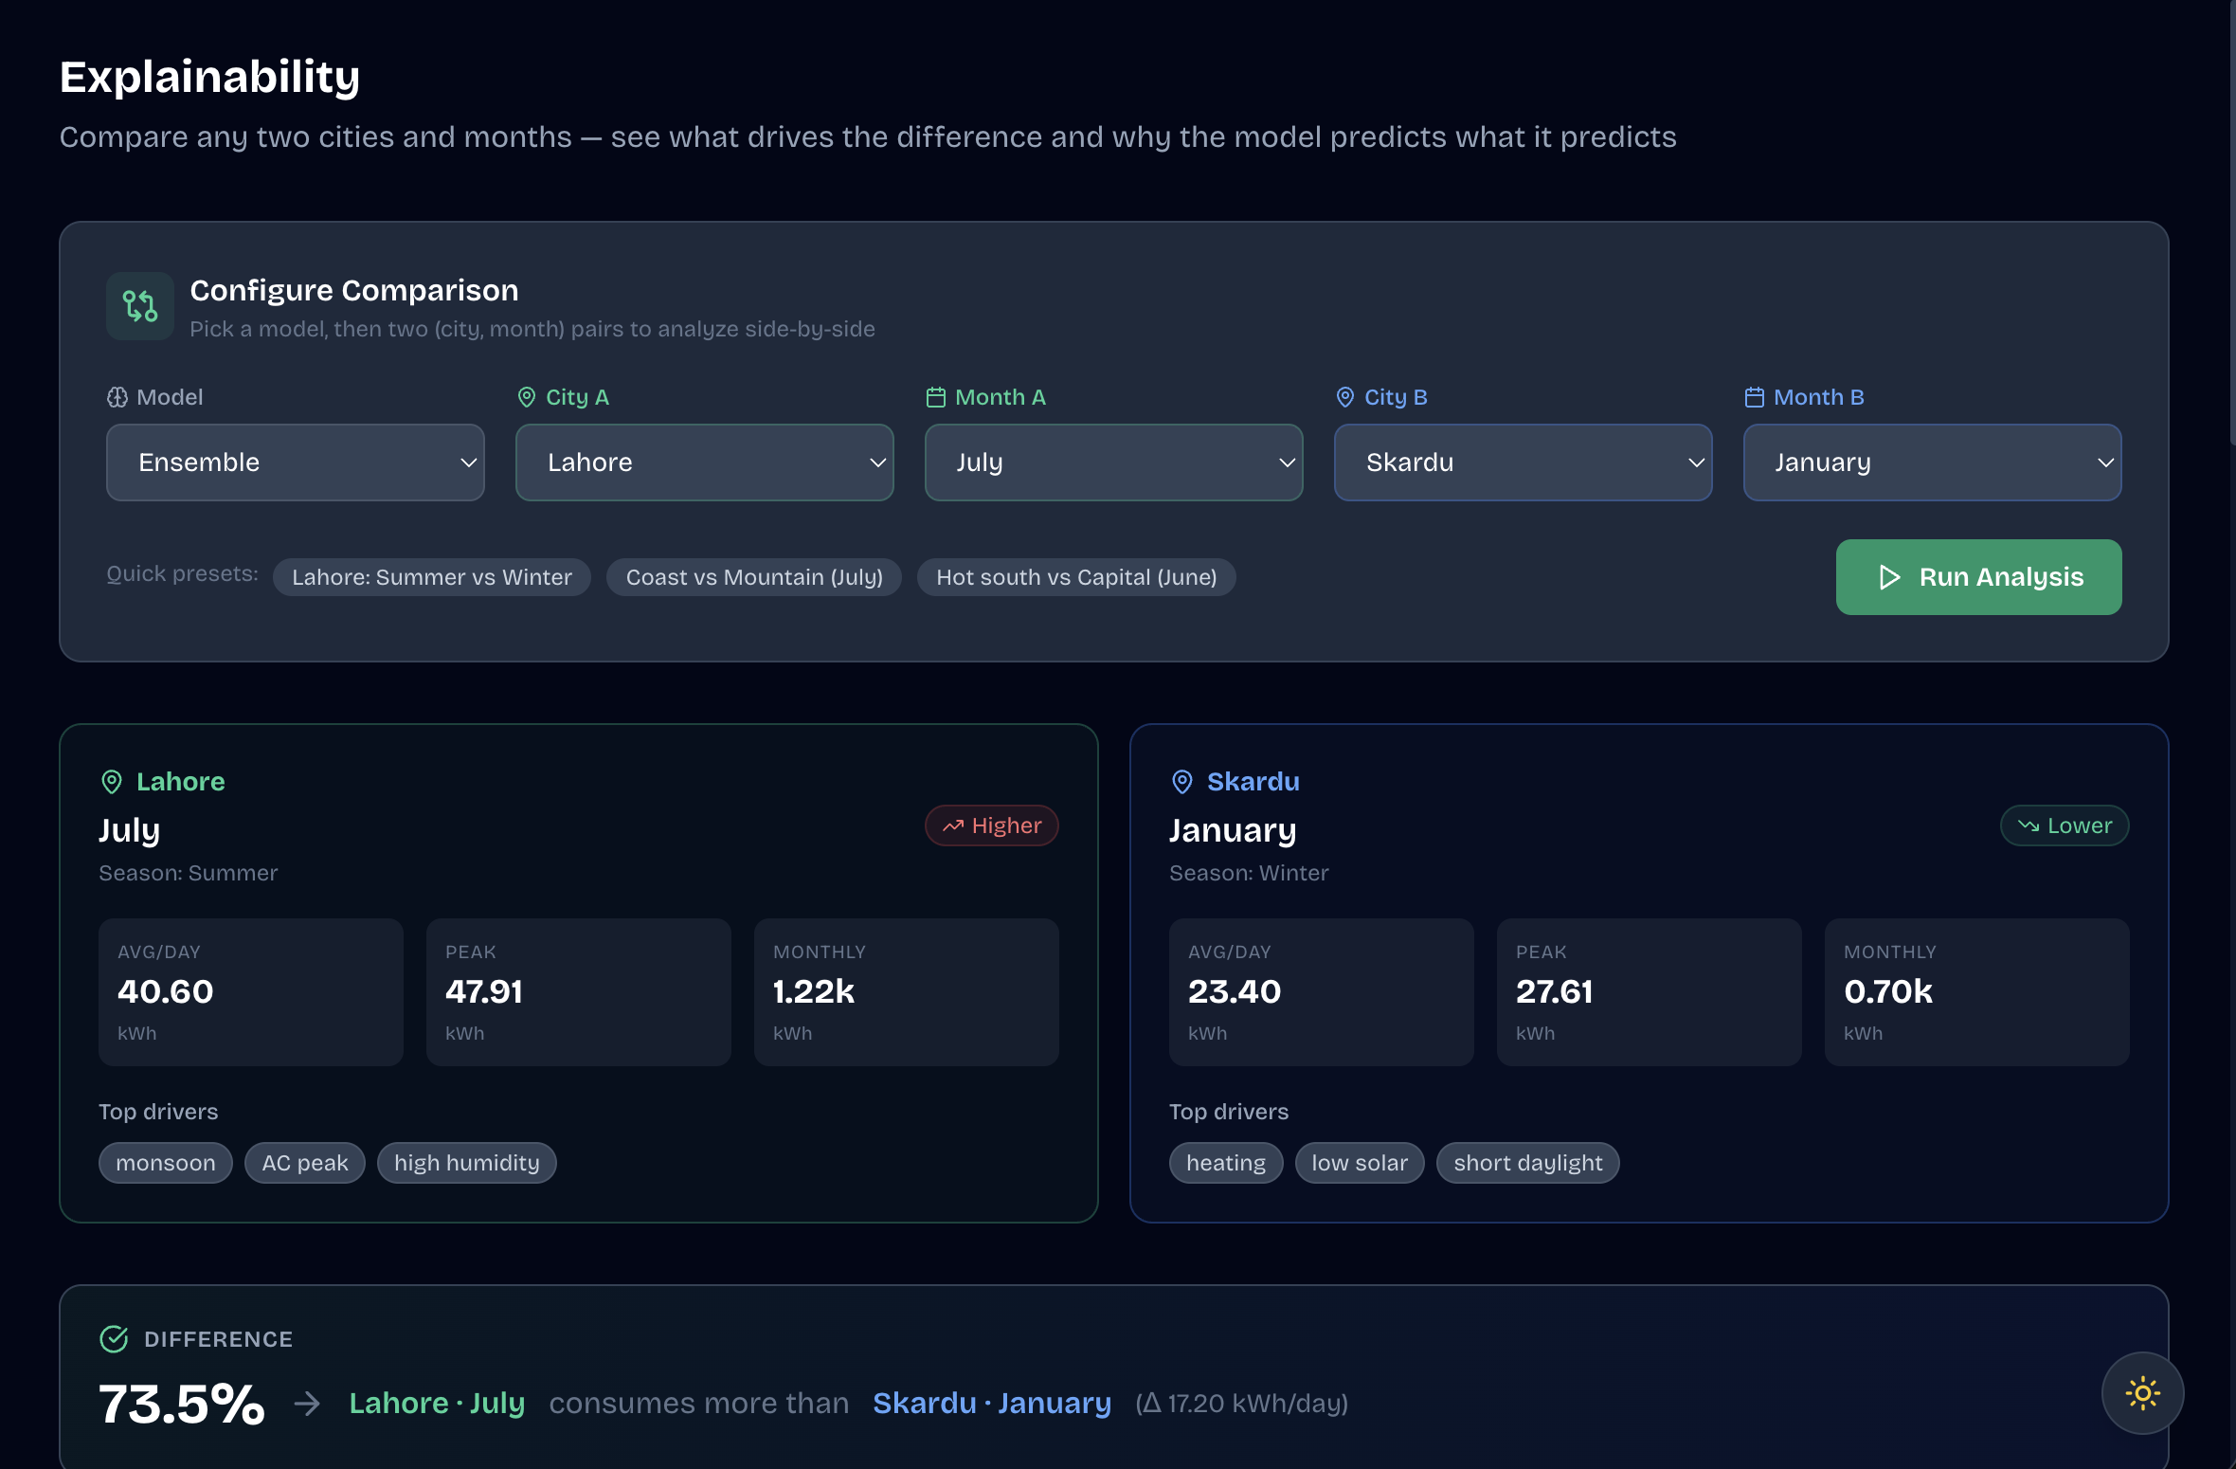
Screenshots: Live Application
Explainability page · Lahore (July) vs Skardu (January) comparison with SHAP / LIME drivers
Captured live from http://localhost:3000/explainability · 73.5% higher daily consumption in Lahore (Δ 17.20 kWh/day).

Slide 22
Project Report & Key Numbers
Ensemble R²
RMSE
MAE (Mean Absolute Error)
Knowledge Base
0.934
0.328 kWh
0.256 kWh
28 docs
Coefficient of Determination
Root Mean Squared Error
Average absolute deviation
FAISS · 384-dim vectors
Final Project Report
Title: Smart Energy Consumption Forecasting with Explainable AI Integration
Document: Template-07 / FYP FINAL V8.docx (versions 1.0 to 1.3, Sep 2025 to Dec 2025)
Source Code: github.com/sovanza-inc/HamzaFYP
Thank You · Questions?

