Slide 1
Project Logo

Slide 2
Name : Sovath Koeun
ID : 2020031
Class : WEP_2020B
Logo and meaning of it.
I have learnt from this project.

Slide 3
I have learnt from this project.
The first: Design on paper
The Second: Take a logo to the customer to customize
The third: Take on design illustrator

Slide 4
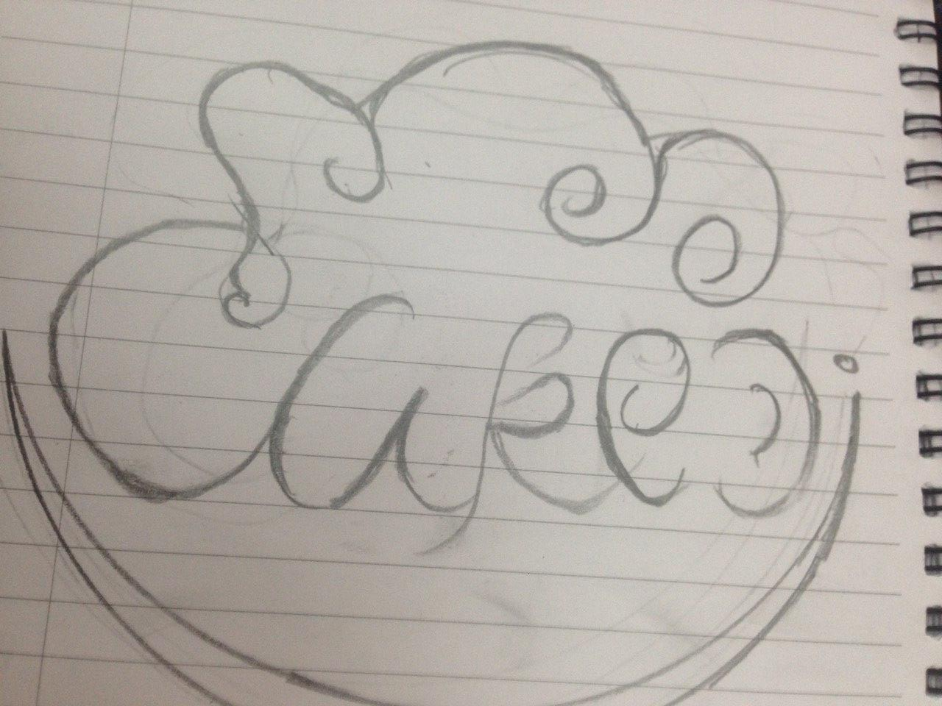
The first: Design on paper

Slide 5
The Second: Take a logo to the customer to customize
The customer don't accept and I do design again
And Do new logo

Slide 6

The third: Take on design illustrator
The customer accept Logo and I do design

Slide 7
Logo and meaning of it
Cake Di serves our families, employees, community and God by preparing baked goods of exceptional quality that bring a special joy to life.
Pink​ around: represents an alliance of love, kindness and happiness. Light blue : This color indicates the ideals, responsibilities and commitment to education and family. It is the most suitable color for home use, especially for children as it is a cool color

Slide 8

Question and Answer

