Slide 1


Code Review // Clean Code
Episode 4 – COMMENTS

Slide 2
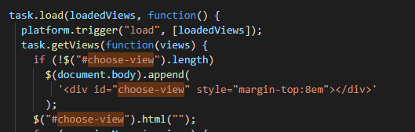
How many language in this code
A
B
C
D
E
1
2
3
4
5

Slide 3
How many language in this code
It s too much !
A
B
C
D
E
1
2
3
4
5

Slide 4

What have we cleaned so far ?
DRY : Do not repeat yourself
Avoid magic numbers
Fail fast
One Purpose For Each Variable
Meaning full names
Function Say what they do
+ Snake/camel conventions
Avoid multiple returns
Use comments
Use objects to protect your data

Slide 5


Warning
Today homework will be marked
Note : Copying another student code will result in a zero score
DRY
MEANING FULL NAME
COMMENT
Next session : quiz on

Slide 6
Hungarian notation
Naming convention in which the name of a variable indicates its intention, its type, its kind..

Slide 7
Hungarian notation
Boolean b_isValid;
B for boolean
Function (p_name, p_age) { }
P for parameter
var _name
_ for private
Do you know other examples ?
In the language you have learnt

Slide 8
Hungarian notation
WHY
THIS IS
BAD

Slide 9
Hungarian notation
WHY
What is the type
Of the variable changes?
We need to remember
If the variable
Is public or private !
THIS IS
BAD

Slide 10

CODE REVIEW
ACTIVITIES S3-ACTIVITY-1
On Google classroom

Slide 11
EXERCICE
ACTIVITIES S3-ACTIVITY-2
On Google classroom

Slide 12
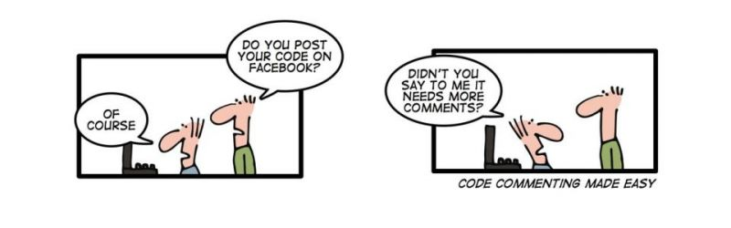
Code commenting

Slide 13
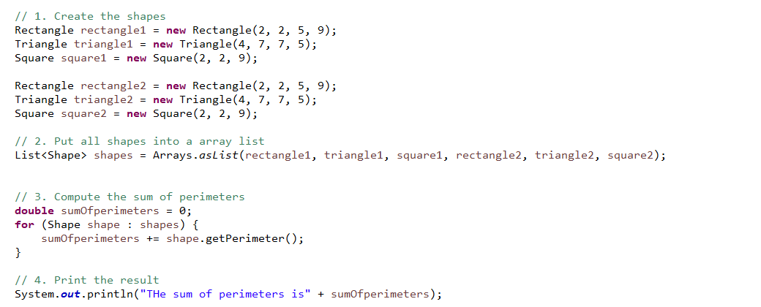
Why are those comments for ?

Slide 14
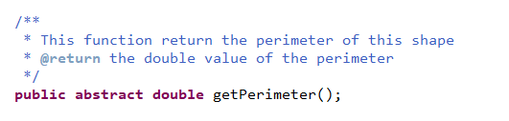
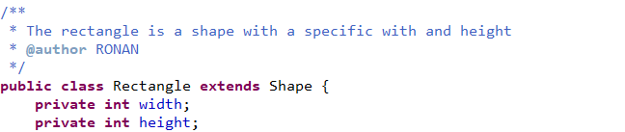
Why are those comments for ?

Slide 15
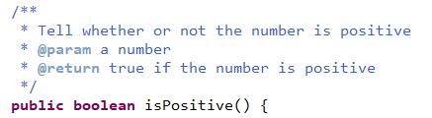
When to comment…
To
Explain some line of code
To
Specify the meaning of a class/function
// 1. Get all list students scores
// 2. Compute the sum of students scores
// 3. Return true if sum is greater than 50

Slide 16
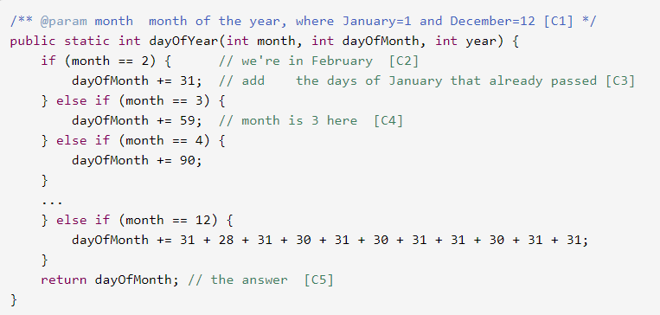
Which comments are useful addition to the code ?
A
B
C
D
E
C1
C2
C3
C4
C5

Slide 17
Which comments are useful addition to the code ?
A
B
C
D
E
C1
C2
C3
C4
C5

Slide 18
EXERCICE
ACTIVITIES S4-ACTIVITY-1
On Google classroom

