Slide 1

Group :10
How to be
A smart learner

Slide 2

Agenda
Reasons to learn
Factor of smart learner
Effective of studying
Strategies to learn
Q &*& A

Slide 3




Reasons to learn
Why we need to learn?
Vet Khamyoeung

Slide 4
Factor of smart learner
Factor of
Factor of
Ownself
School
Family
Heng Sreypich

Slide 5
Ownself
Clear Objective
Pay attention
Don’t be lazy
Heng Sreypich

Slide 6
Family
Good advice
Happiness
Motivation
Lonh Chainy

Slide 7
School
Good curriculum
Have good teacher
Enough documents
Yen Yon

Slide 8

Effective of studying at School
After
At School
Before
During
Yen Yon
Before

Slide 9
Effective of studying at
Home
Before
During
After
Sreang Chanty

Slide 10





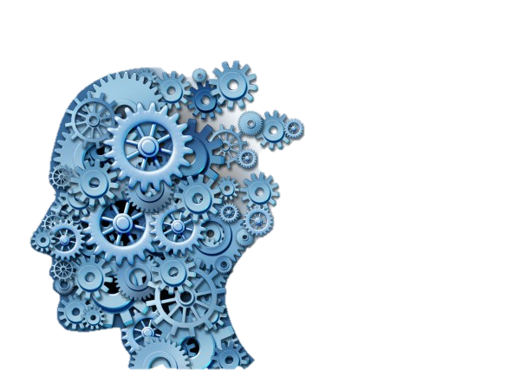
Strategies to learn
Han Sreyhorn

Slide 11

To summary
To be a smart learner we should try to study
Hard and take our health.
Han Sreyhorn

Slide 12


Slide 13

Team members
Yen Yon
Han Sreyhorn
Sreang Chanty
Vet Khamyoeung
Heng Sreypich
Lonh Chainy

