Slide 1
COMP 472 Mini Project 2
By Mateen, Sovra, and Gursimranjot

Slide 2
Instructions
Prepare an 8-minute presentation to analyse the results of your analysis (see Section 2.6. In particular, discuss the effect of the depth, the use of alpha-beta and the two heuristic(s) functions. Back-up your claims with actual data from your experiments. Prepare a few slides explaining your heuristics and presenting and analysing the above data. You will present these slides at the demo (see Section 4.2). The intended audience of your presentation is your TAs. Hence there is no need to explain the theory. Your presentation should focus on your work and analysis. Any material used for the presentation (slides, . . . ) must be uploaded on EAS before the due date

Slide 3
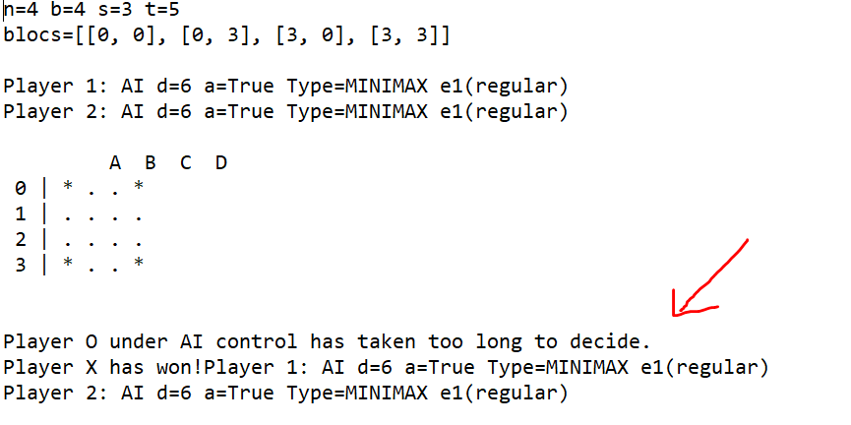
Effect of depth
As we increase in depth, for either of the players, the average evaluation time increases as well as the total heuristics evaluation since there are more states to be visited the deeper, we move into the tree.
When we have minimax with a depth of 6 for both players, there is not enough time to evaluate and we time out right away. (gameTrace-4435)

Slide 4
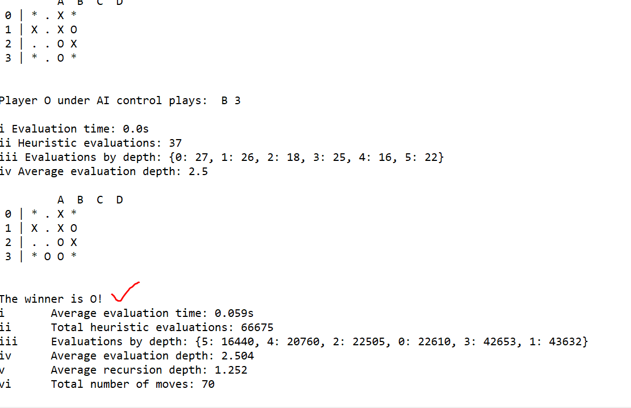
We also see the effect of depth as we increase the board size. When the board size is 4 or 5, and the depth is not too deep, we see that the game usually finishes before either player starts taking too long and timing out. Here in 4431 we were able to complete the game and get a winner
For gameTrace 4435, the game finishes early due to
timeout but this does not happen in 4431 since
we are using alphabeta instead of minimax

Slide 5
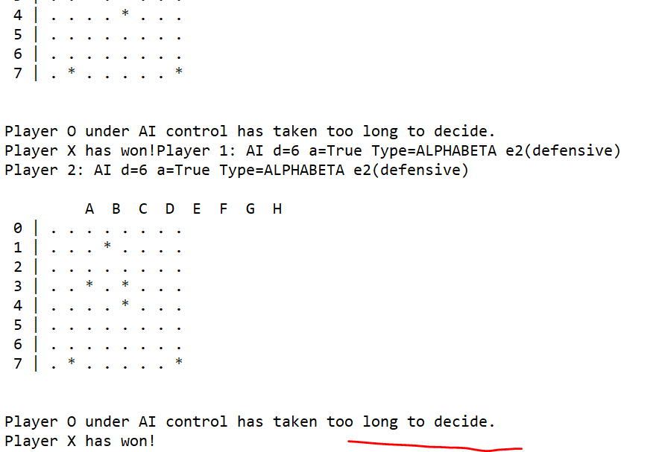
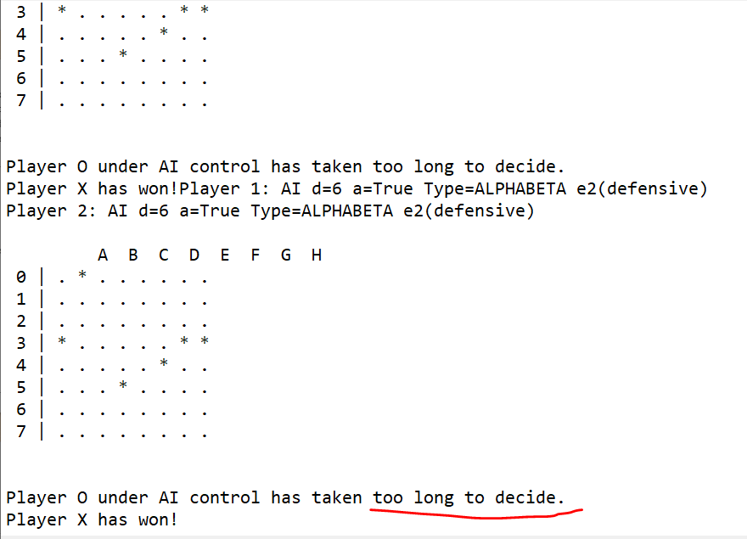
In trace 8551, when the depth for player 1 is 2 and depth for player 2 is 6, we see that even though the board eventually times out, player 1 with the depth of 2 wins since the gap is so wide and depth of 2 is much less than depth of 6. When we have a board size of 8, we see that it is just too deep for the search to conclude therefore for any value of time t either 1 or 5, we still end up running out of time
gameTrace8655 gameTrace8651

Slide 6
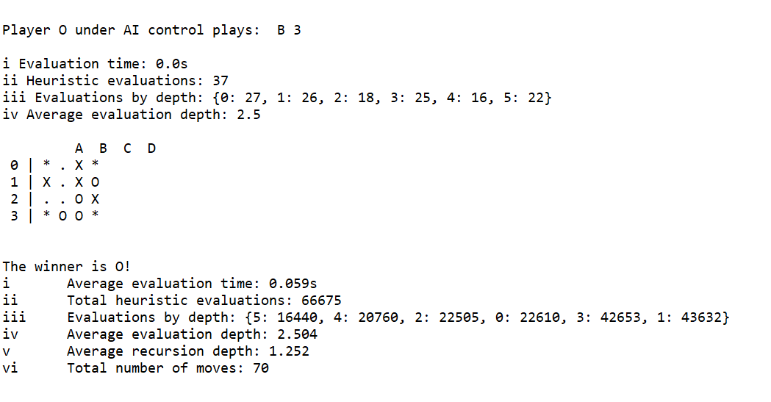
Alpha beta
Using alpha beta lowers the evaluation time and makes it possible for us to have results at a board size of 4 with time t=1 (as we see here in gameTrace4431 with average evaluation time of 0.059s

Slide 7
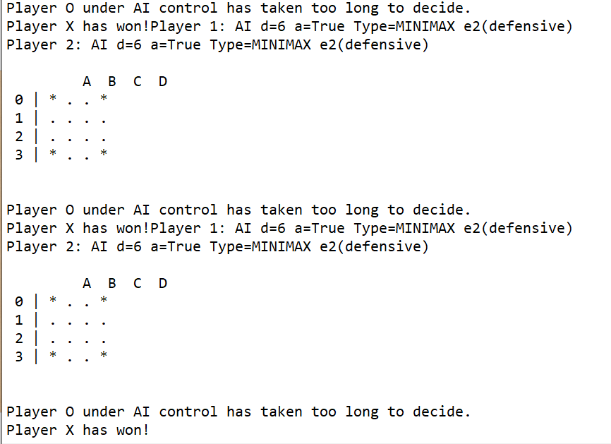
However, for the minimax algorithm with the same board size of 4, the evaluation time is so long that it times out even given a time of t=5 which is higher than t=1 that we saw before. See here the results of gameTrace4435
In Alpha beta we take advantage of pruning(getting rid of branches that are “dead ends”) certain branches so it is more efficient. This is shown by the comparison we made above.

Slide 8
Heuristic e1 – very simple but fast
For e1, we check the boxes adjacent to the current_state[x][y]
Since we maximize for O, we add to the score every time the adjacent symbol is the same.
Since we minimize for X, we subtract from the score every time the adjacent symbol is X
Due to the board size and depth issues that were discussed before, we did not get any analysis for some of the games.

Slide 9
Heuristic e2 – more sophisticated and complex to compute
For e2 we have a more complex heuristic and we check vertical. Horizontal and diagonal. In vertical, we check vertically (with respect to the current_state) and if the total of all O is greater than the total of all X (since we are maximising for O), we increment the value of score. However, if they are equal and not zero, we also increment the value of score. The only time we decrement is when we have total number of x greater than total number of O, in which case we want to minimise for X there fore we decrement the value of score.

Slide 10
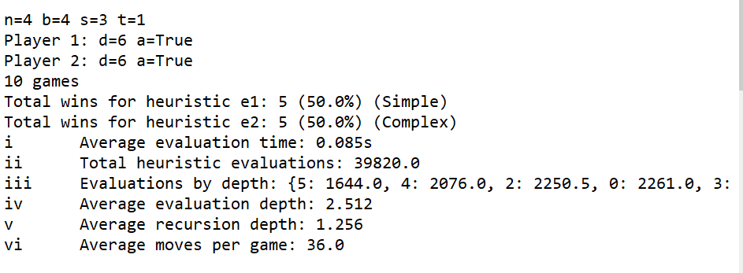
Comparison e1 vs e2
Due to the board size and depth issues that were discussed before, we did not get any analysis for some of the games.
However, from the scoreboard file with all 8 games, for gameTrace 4431, we got a 50/50 for e1 and e2. This shows that at least for this dataset, though e1 was simpler and e2 was more sophisticated, they performed the same.
However, it is worth noting that the average evaluation time here is 0.085seconds

Slide 11
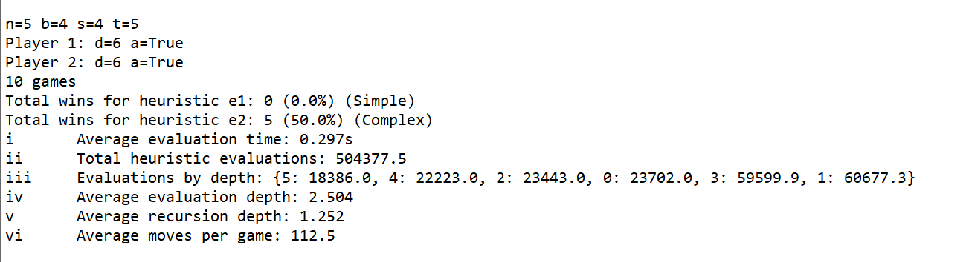
However, here where the complex heuristic e2 was responsible for the wins, the average evaluation time was much longer 0.297.
Overall, e2 gave a higher likelihood of wins compared to the simple heuristic e1. Though e1 was faster.

Slide 12
End

