Slide 1



Evolution of agents in a virtual environment using neural networks and genetic algorithm
2nd International Student Conference «Digital Generation-2025»
Paper ID-30
Section name: Computer Science & Harnessing AI & Medtech
Student Authors’ names: Sanzhar
Supervisor: Nurakhov Edil Sergazievich, Aitolkyn Kulmuratovna Nurkenovna
University/company: Astana IT University
City, Country: Astana, Kazakhstan
8-10 April 2025, Astana, 2nd AITUSC- 2025

Slide 2
Table of contents
Introduction
Related work
Methodology
  Environment
  Agents
  Genetic Algorithm
Experimental setup
Results
Conclusion

Slide 3
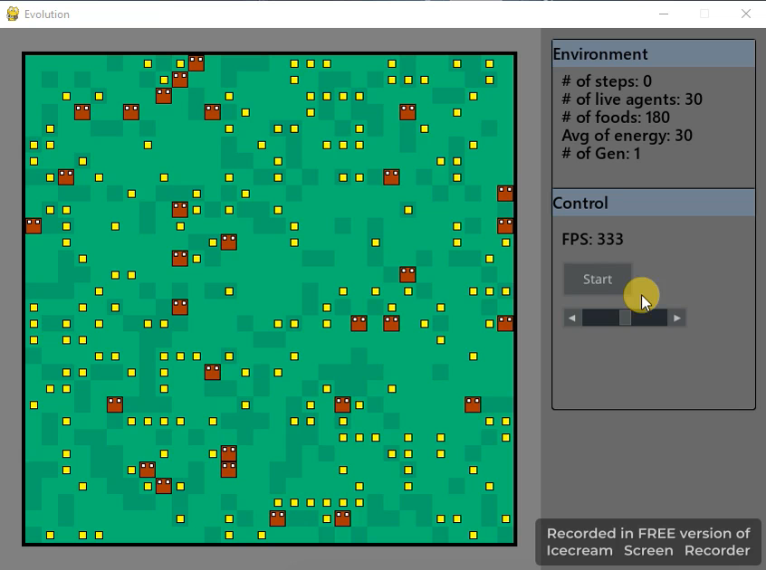
Introduction
Research goal:
To investigate the potential of genetic algorithms in optimizing agent behavior in a decentralized, multi-agent, discrete, and competitive environment.
Research question:
How do changes in environmental parameters or genetic algorithm settings influence the evolution of agents in a virtual environment?
Novelty:
Research combines neural network, genetic algorithms in a discrete decentralized multi-agent competitive environment.

Slide 4
Related work
Authors and year | Title of research | Goal | Methods | Environment
Manasa Josyula(2022) | Using Genetic Algorithms to Simulate Evolution | The goal of this article is to simulate and analyze evolutionary processes using genetic algorithms in a virtual environment. | GA | Continuous action space multi-agent competitive environment
Nam Le(2019) | Evolving self-taught neural networks: the baldwin effect and the emergence of intelligence | Presents a technique called evolving self-taught neural networks – neural networks that can teach themselves without external supervision or reward. | Self-taught NN, GA | Continuous action space decentralized multi-agent competitive environment
Yuji Kanagawa, Kenji Doya(2024) | Evolution of Rewards for Food and Motor Action by Simulating Birth and Death | The study aims to investigate how biologically plausible reward functions evolve in agents and how different environmental conditions influence the shape of these evolved rewards. Specifically, it seeks to understand the emergence of positive rewards for food acquisition and the divergence in rewards associated with motor actions. | PPO, TD3 algorithm | Continuous action space decentralized multi-agent competitive environment

Slide 5
Related work
Authors and year | Title of research | Goal | Methods | Environment
João P. Abrantes, Arnaldo J. Abrantes, Frans A. Oliehoek (2020) | Mimicking Evolution with Reinforcement Learning | Develop a reinforcement learning framework that mimics biological evolution by aligning agent rewards with evolutionary fitness — enabling agents to survive, adapt, and reproduce. | Evolutionary Reward, NN, E-VDN | Competitive centralized multi-agent discrete environment. There are asexual and sexual implementation
Tony Abou-Assaleh(2001) | Evolution of Recurrent Neural Networks to Control Autonomous Life Agents | Development of a learning system capable of evolving the parameters and topology of recurrent neural networks (RNNs) to control Autonomous Life Agents (ALA) that adapt and survive in artificial environments | RNN, GA | Single-agent discrete environment
Malrey Lee, Suchong Joo, HeeSook Kim (2004) | Realization of emergent behavior in collective autonomous mobile agents using an artificial neural network and a genetic algorithm | Proposes a so-called “stalking system” using the concept of artificial life and implement group behavior of animals and insects. In this case, the group hunting behavior of Predators on Prey is simulated. | NN, GA with different Selection | Centralized cooperative multi-agent discrete environment with two type of agent (Prey and Predator)

Slide 6
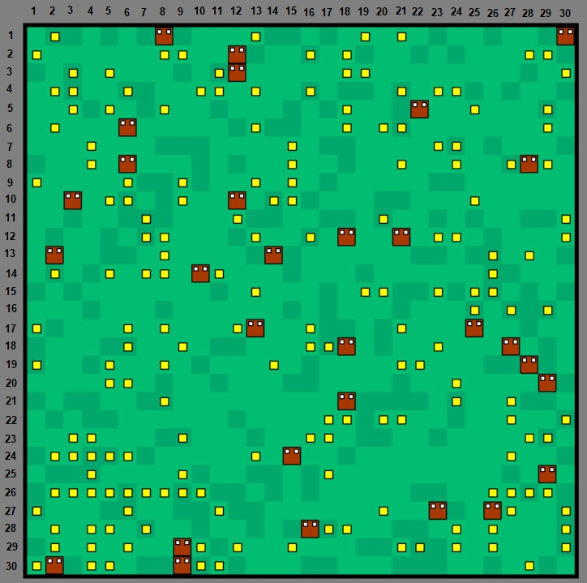


Methodology - Environment
The virtual environment is a 2D grid composed of discrete cells. It is stored as a two-dimensional matrix filled with various objects
Discrete decentralized multi-agent competitive environment.
- Food
- Agent
- Grass(empty)

Slide 7
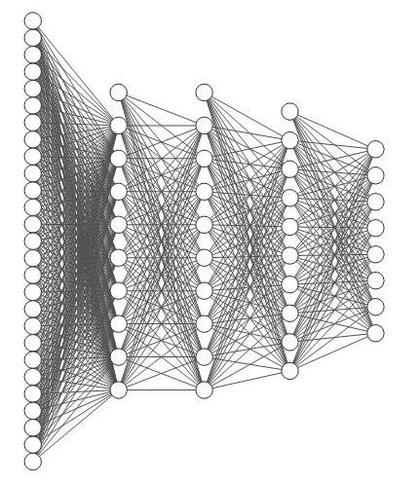
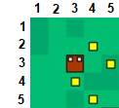
Methodology - Agents
Each agent has two internal variables: age and energy and a brain that is represented by a neural network. The hidden layers use the ReLU activation function, while the output layer uses Softmax.
One of 8 directions
+
two internal
variables
8 neurons
10 neurons each
27 neurons

Slide 8
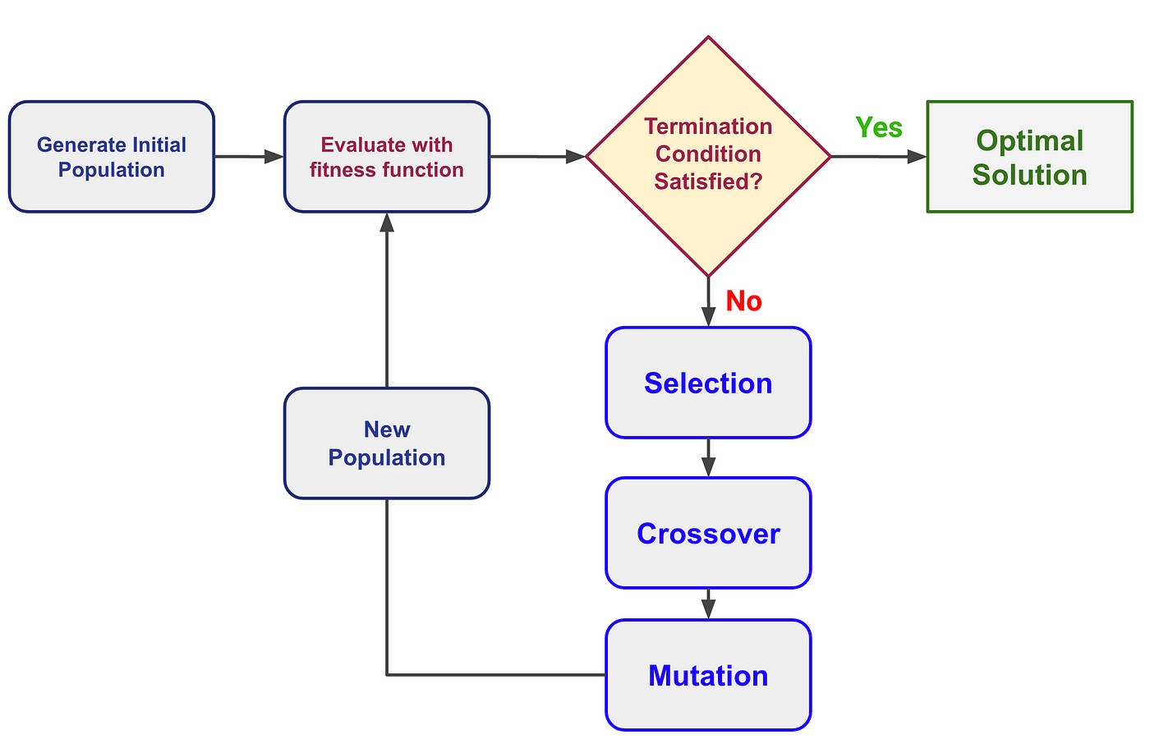
Methodology - Genetic Algorithm
Fitness function is the value of age
The proportional-fitness selection method is used
Uniform Crossover method is used

Slide 9
Experimental setup
Control run parameters
Hypothesis 1:
Increasing the number of agents leads to stronger natural selection pressures and promotes the development of more aggressive behavior.
Hypothesis 2:
Increasing the number of agents leads to stronger natural selection pressures and favors faster adaptation of agents.
Runs: control, low competition(10 agents), high competition(80 agents)
Parameter | Value
Population size | 40 agents
Grid size | 30 × 30 cells
Maximum food on the map | 180 units
Maximum new food per iteration | 10 units
Food energy value | 30 energy points
Initial agent energy | 30 energy points
Mutation probability | 1%

Slide 10
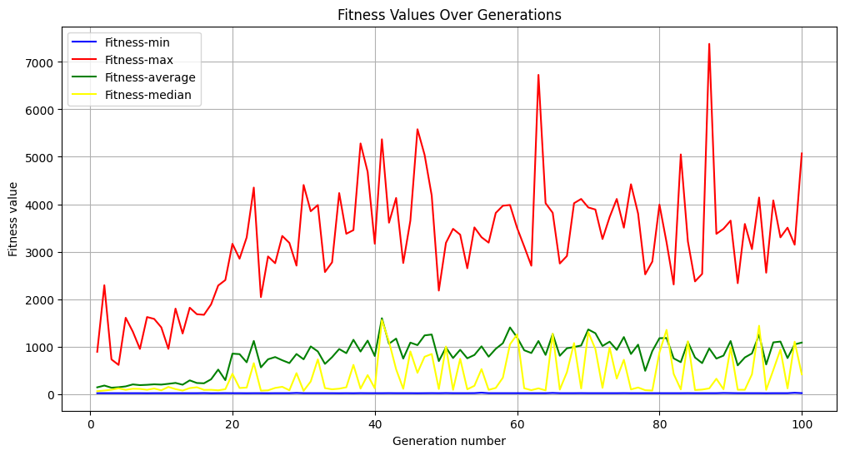
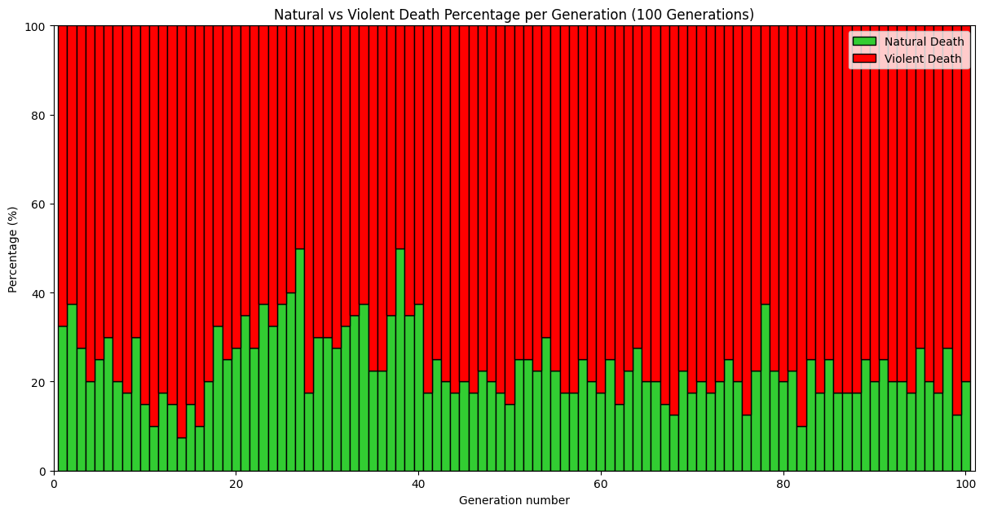
Results – Control run
The average fitness value among all generations is 803.
The maximum value is 7381.
The percentage of violent deaths among all generations is 77%.

Slide 11
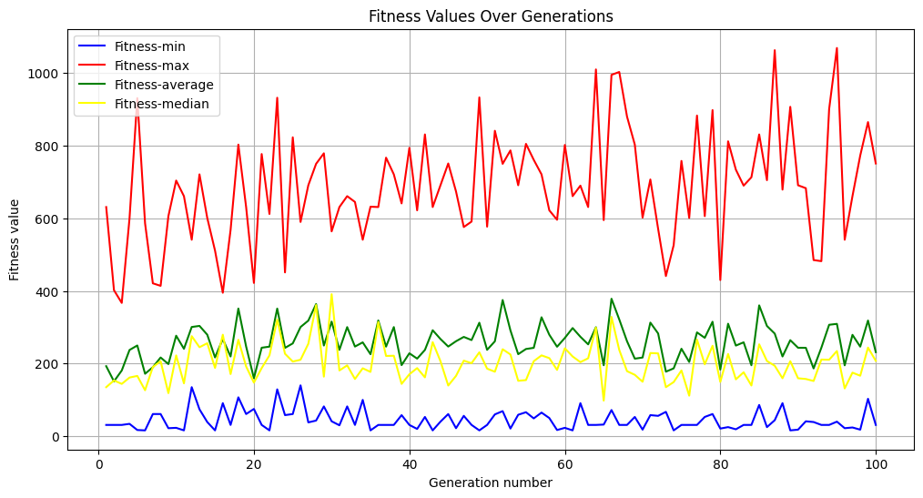
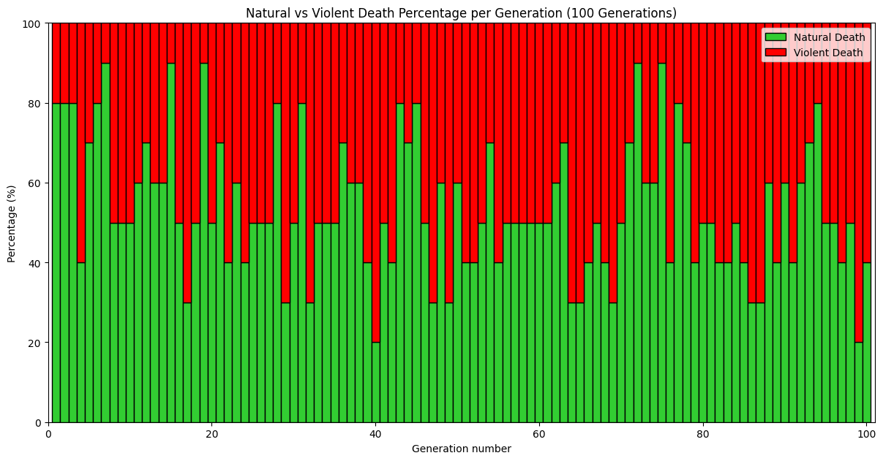
Results – Low competition
The average fitness value among all generations is 259.
The maximum value is 1069.
The percentage of violent deaths is 46%

Slide 12
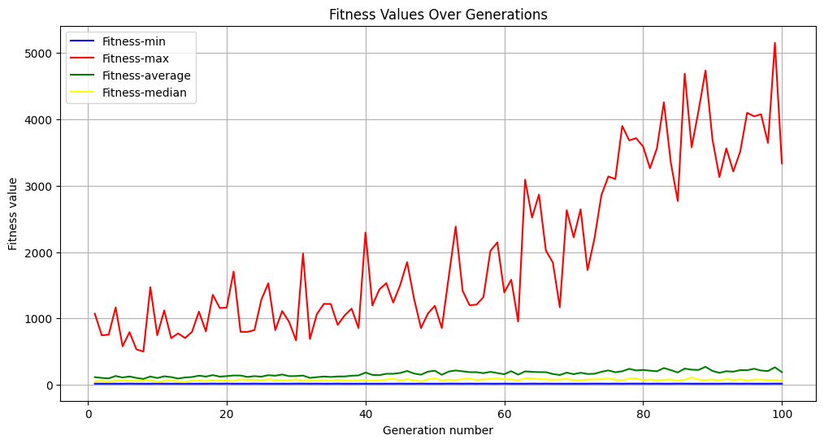
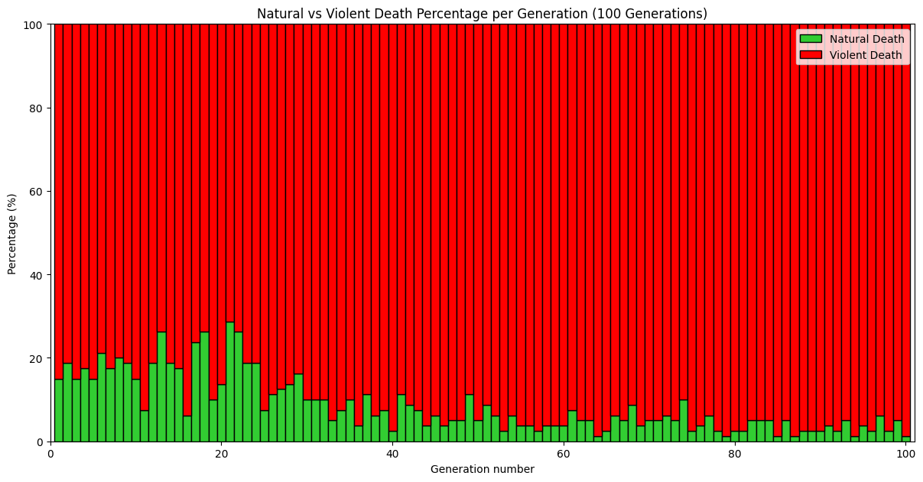
Results – High competition
The average fitness value among all generations is 167.
The maximum value is 5155.
The percentage of violent deaths is 91%

Slide 13
Results – Interpretation
There is a clear correlation between the size of the initial populations and the number of violent deaths, which supports hypothesis 1.
No significant link was found between population size and adaptability. The control group (medium population) showed the highest mean and maximum fitness. Both low- and high-competition environments led to sharp fitness declines. Thus, Hypothesis 2 was not supported.

Slide 14
Conclusion
New environment is implemented
Neural network is implemented
Genetic algorithm is implemented
A graphical user interface at the basic level is realized
Prepared literature review
Basic hypothesis is tested, and research question is answered

Slide 15
Thanks for your attention

