Slide 1

Evolution of Price of Commodities (Crude Oil) and related Financial Markets (Energy Equities)
An ANALYSIS at hanlon financial lab, Hoboken, New Jersey
- sovik kumar nath

Slide 2
contents
Project Objectives
Project Phases
Methods and Data
Phase I - U.S. Crude Oil System and Economics
Phase II - Impact of Shale Exploration on WTI Cushing Crude Oil price returns and variance
Phase III - Analysis of Energy Equities related to Shale Exploration
Conclusions

Slide 3
Project Objectives
To understand U.S. crude oil economics – production, supply, storage since the new century.
To understand market perceptions of crude oil price based on WTI NYMEX crude oil futures.
To understand the impact of shale gas exploration on WTI crude oil price returns and variance
To analyze equity returns and volatility among energy companies involved in shale exploration.

Slide 4
Project phases
PHASE I
Study of Petroleum production, storage and supply system.
PHASE II
Investigation of changes in oil market dynamics based on shale gas exploration in U.S.
PHASE III
Analysis of some equities of oil exploration and production (E&P) companies mostly working related to shale gas in U.S. Appalachian basin
Reconstruction of U.S. oil value chain
Analysis of shale exploration on oil price returns and realized variation.
Analysis of future price curves of WTI Crude Oil.
Multivariate Regression Modelling

Slide 5
Methods and Data
Application of data analysis, analytics, data visualization and multivariate regression analysis.
Three primary sources of data: U.S. Energy Information Administration (EIA) database, Bloomberg and Compustat database from Wharton Research Data Services (WRDS).
R was used as the primary programming language (data processing, regression modelling, correlation analysis).

Slide 6
U.S. Crude oil System and economics
Phase i

Slide 7
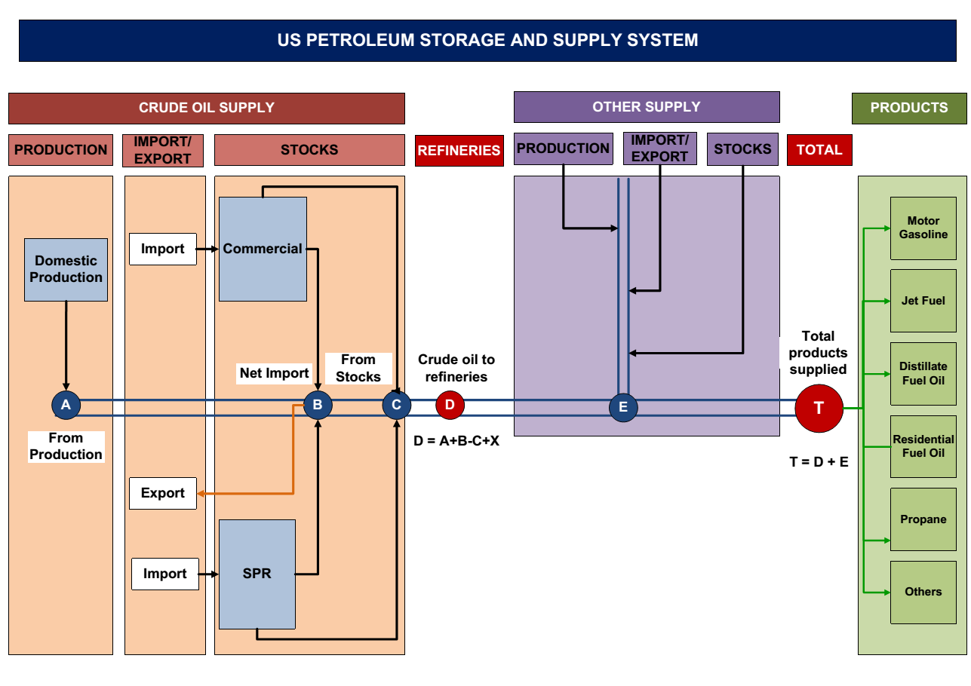
U.S. Crude Oil Value Chain

Slide 8
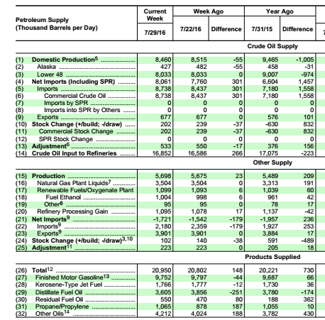
U.S. Petroleum Balance Sheet based on U.S. Energy Information Administration (EIA)

Slide 9
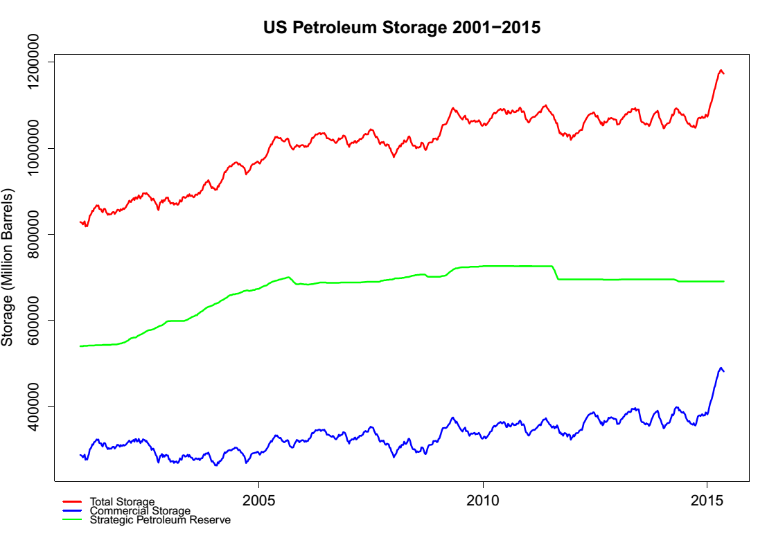
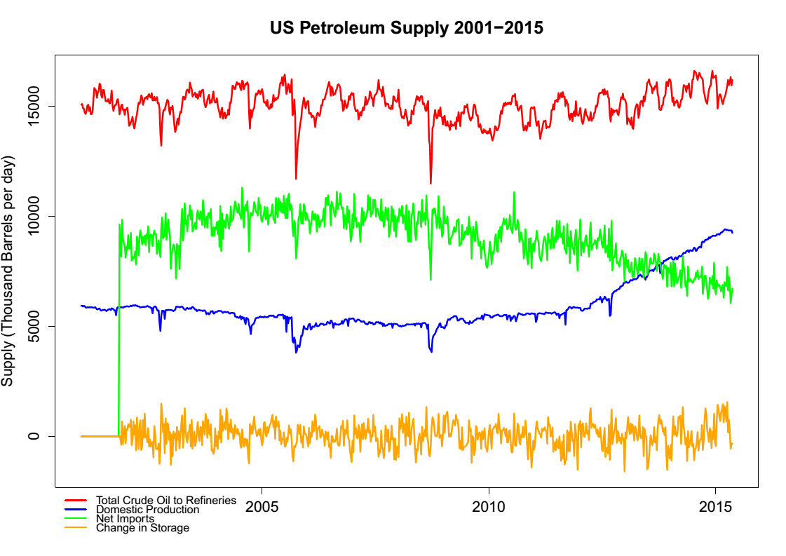
U.S. Crude Oil Production, Supply and Storage
For period 2000 - 2015, substantial increase in U.S. crude oil production since 2010 with reduction in imports.

Slide 10
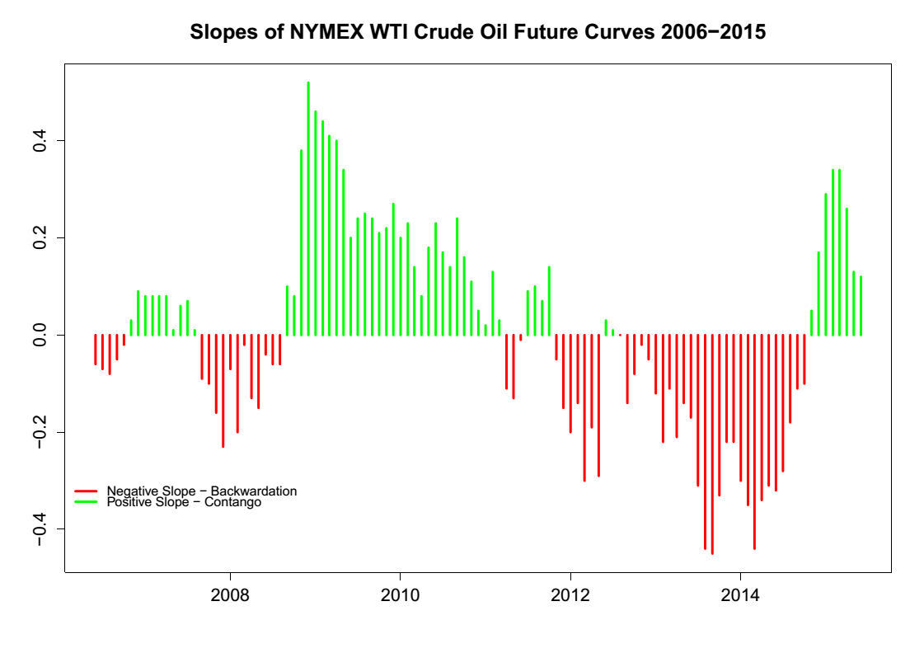
Market Perceptions of WTI NYMEX Crude Oil Futures
Contango : Future prices increase → Positively Sloped
Backwardation : future prices
decrease → Negatively Sloped.
WTI NYMEX crude oil future prices swayed back and forth from contango to backwardation and back.
Between 2013-2014, the slopes were negative indicating that the market had perceived drop in crude oil prices.

Slide 11
Impact of Shale Exploration on WTI Cushing Crude Oil price returns and realized variance
Phase 11

Slide 12
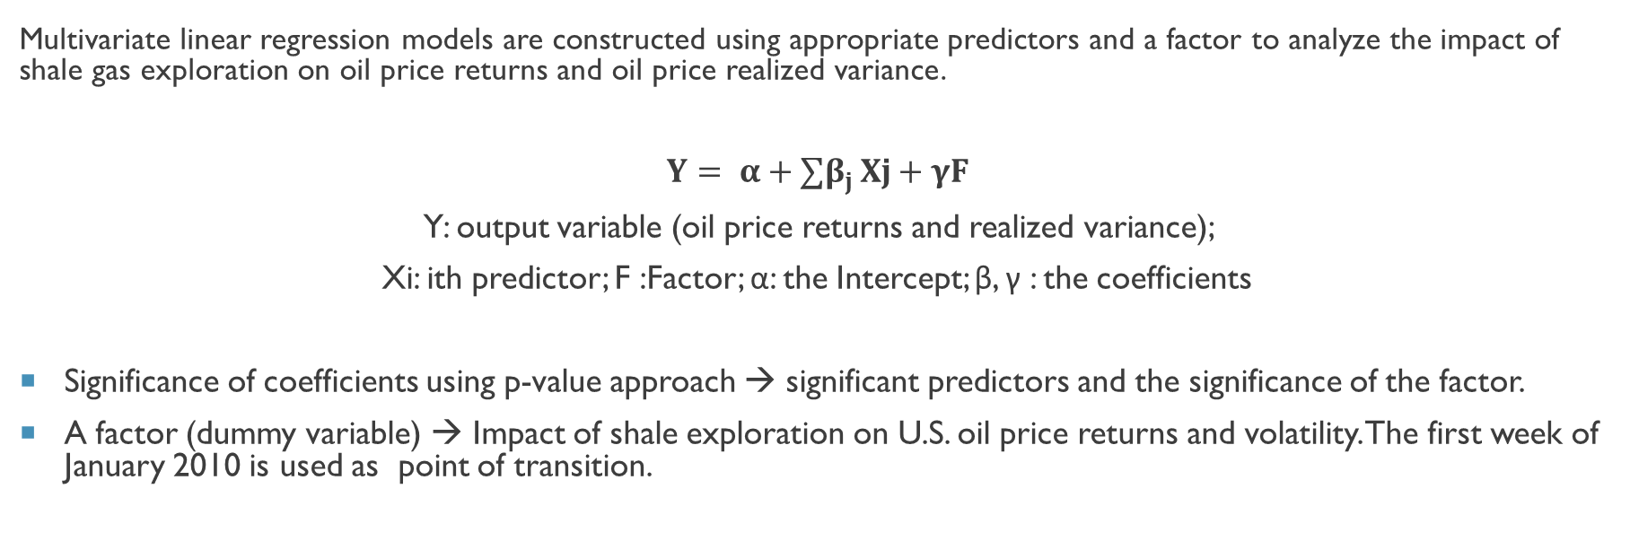
Regression Modelling
Multivariate linear regression models are constructed using appropriate predictors and a factor to analyze the impact of shale gas exploration on oil price returns and oil price realized variance.
$$Y= α+{∑β}_{j }Xj+γF$$
Y: output variable (oil price returns and realized variance);
Xi: ith predictor; F :Factor; α: the Intercept; β, γ : the coefficients
Significance of coefficients using p-value approach → significant predictors and the significance of the factor.
A factor (dummy variable) → Impact of shale exploration on U.S. oil price returns and volatility. The first week of January 2010 is used as point of transition.

Slide 13
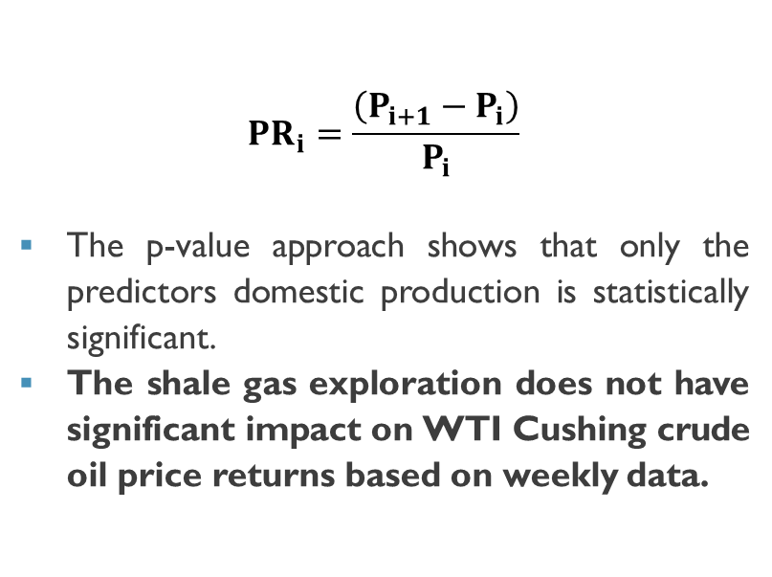
WTI Cushing Crude Oil Price Returns
$${PR}_{i}=\frac{\left(P_{i+1}−P_{i}\right)}{P_{i}}$$
The p-value approach shows that only the predictors domestic production is statistically significant.
The shale gas exploration does not have significant impact on WTI Cushing crude oil price returns based on weekly data.
 | Estimate | Std. Error | t value | Pr(>|t|)
Intercept | 0.0087 | 0.0053 | 1.631 | 0.1033
Total Storage | -0.0880 | 0.5411 | -0.163 | 0.8709
Domestic Production | -0.1804 | 0.0779 | -2.317 | 0.0209
Net Imports | 0.0055 | 0.0293 | 0.186 | 0.8523
Total to Refineries | 0.1680 | 0.0882 | 1.905 | 0.0572
Factor | -0.0048 | 0.0034 | -1.408 | 0.1596

Slide 14
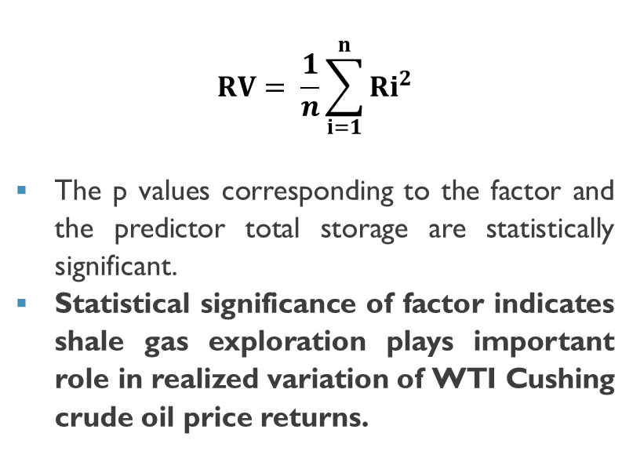
WTI Crude Oil Price Returns Realized Variance
$$RV= \frac{1}{n}\sum_{i=1}^{n}{{Ri}^{2}}$$
The p values corresponding to the factor and the predictor total storage are statistically significant.
Statistical significance of factor indicates shale gas exploration plays important role in realized variation of WTI Cushing crude oil price returns.
 | Estimate | Std. Error | t value | Pr(>|t|)
Intercept | 0.0011 | 0.0001 | 9.044 | < 2e-16
Total Storage | 0.0393 | 0.0121 | 3.255 | 0.0012
Domestic Production | -0.0017 | 0.0017 | -0.98 | 0.3277
Net Imports | -0.0009 | 0.0007 | -1.304 | 0.1926
Total to Refineries | 0.0030 | 0.0020 | 1.543 | 0.1234
Factor | -0.0003 | 0.0001 | -4.601 | 5.13E-06

Slide 15
Analysis of Energy Equities related to Shale EXPLORATION
Phase 111

Slide 16
 | Mean Daily Returns (%) | Annualized Return (%) | Variance (Daily) | Daily Volatility (%) | Annualized Volatility (%)
EQT | 0.027 | 6.774 | 3.633 | 1.906 | 476.54
RRC | -0.026 | -6.578 | 5.195 | 2.279 | 569.83
PDCE | 0.021 | 5.133 | 11.996 | 3.463 | 865.87
SWN | -0.075 | -18.639 | 4.406 | 2.099 | 524.74
COG | -0.096 | -24.112 | 20.649 | 4.544 | 1136.04
GPOR | 0.040 | 10.070 | 10.401 | 3.225 | 806.25
CHK | -0.093 | -23.324 | 6.531 | 2.556 | 638.90
CRZO | -0.001 | -0.373 | 9.801 | 3.131 | 782.68
Analysis of daily price returns of equities for E&P companies related to shale exploration for Jan 2000 to Jun 2015.
These equities have low daily returns of range (-0.001% to 0.040%), annualized returns are more than 5% for three equities.
They have very high annualized volatility (daily volatility measured by standard deviation of daily realized variance), seven are > 500%.

Slide 17
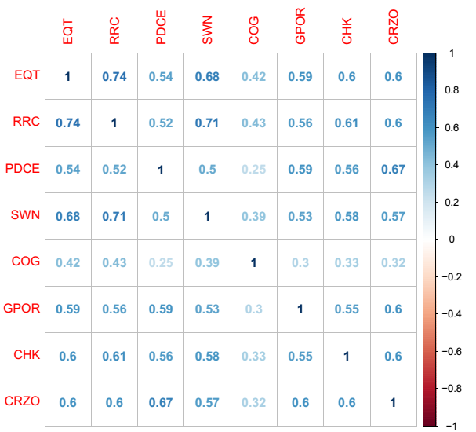
Correlation matrix of equities shows 21 out of 28 pairs have correlation of more than 0.5.

Slide 18
conclusions
In the period 2000-2015, substantial increase in U.S. Crude Oil production since 2010 along with reduction in imports.
Strong growth of production in U.S. after financial crisis can be attributed to commencement of shale gas exploration around 2010 in Utica and Marcellus shale regions in Appalachian basins.
WTI NYMEX crude oil future prices swayed back and forth from contango to backwardation and back with time.
In 2013-2014, the slopes were negative indicating that the market had been perceiving drop in crude oil prices.

Slide 19
conclusions
Shale gas exploration does not have significant impact on WTI Cushing crude oil price returns based on weekly data.
Shale gas exploration plays important role in realized variation of WTI Cushing crude oil price returns.
Analysis of eight companies related to shale gas exploration show that three equities have annualized returns of > 5%, seven have very high annualized volatility (>500%) and most pairs are highly correlated (>0.5).

Slide 20
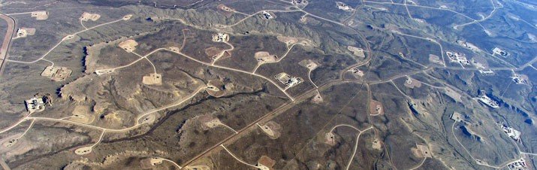
Thank you

